Slide 1
UNCONVENTIONAL RESERVOIR ENGINEERING PROJECT
Colorado School of Mines
U R E P
CSM
Unconventional Enhanced Oil Recovery (EOR)
H. Kazemi, Professor
Colorado School of Mines
UNCONVENTIONAL RESERVOIR ENGINEERING PROJECT
1
Advisory Board Meeting, November 8, 2019, Golden, Colorado

Slide 2
Wet Gas Injection is the EOR King in Unconventional Reservoirs (1)
Wet gas injection penetrate micro and macro fractures. Then, interface and interphase molecular mixing (diffusion) enhances production.
Low salinity water if forced to enter micro and macro fractures, then, osmotic interface mass transport pushes the oil out of the matrix. The oil and water in the micro and macro fractures are immiscible; thus, causing very low mobility, immiscible two-phase or three-phase environment. If we break the IFT, the oil in the fractures can be potentially produced effectively. This is the current area of our research in the PE department.
UNCONVENTIONAL RESERVOIR ENGINEERING PROJECT
Advisory Board Meeting, November 8, 2019, Golden, Colorado

Slide 3
Basic Premise of Non-Gas EOR in Unconventional Reservoirs (2)
Displace oil out of the nanopores to micro ad macro fractures. The key word is displacement.
Displacement requires pressure gradient—leading to advective flow. Simple calculation shows that this is very impractical (Next Slide)! Just imagine a pore throat of 100 nanometer diameter. Its permeability is less than 10 micro Darcy. Such a pore channel requires a very large pressure gradient to generate realistic displacement velocities.
UNCONVENTIONAL RESERVOIR ENGINEERING PROJECT
Advisory Board Meeting, November 8, 2019, Golden, Colorado

Slide 4
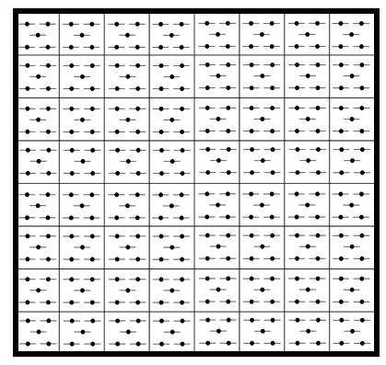
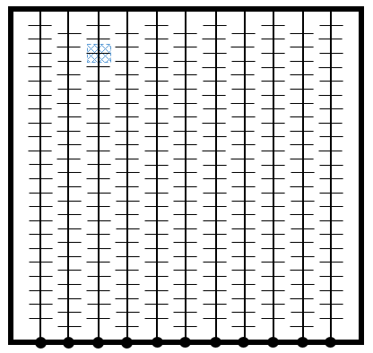
Hydraulic Fractures Placed in One Square Mile Compared with Equivalent Vertical Wells
320 fraced vertical wells in
one square mile
11 zipper fraced horizontal
wells in one square mile
UNCONVENTIONAL RESERVOIR ENGINEERING PROJECT
Advisory Board Meeting, November 8, 2019, Golden, Colorado

Slide 5
Centrifuge Measurements in A Bakken Core, Indicating a Very Narrow Mobile Saturation Range (Somayeh Karimi, CSM, 2015)
Mobile saturation window to WF ~ 10 %
Mobile saturation window to GF ~ 30 %
Residual oil saturation to water ~ 29.7%
Irreducible water saturation
~ 62%
UNCONVENTIONAL RESERVOIR ENGINEERING PROJECT
Advisory Board Meeting, November 8, 2019, Golden, Colorado

Slide 6
Basic Premise of Non-Gas EOR in Unconventional Reservoirs (3)
As an alternative, let us examine the micro and macro fracture channels surrounding the matrix pore assemblage. Displacement in these fractures is more realistic because tortuosity is much smaller.
In this scenario, an appropriate EOR fluid (such as low-salinity brine) can enter the matrix by chemical osmosis forcing the oil to be displaced into the micro and macro fractures. Thus, the fractures will be in two- or three-phase flow condition. If we can break the IFT in these fractures, we can produce the displaced oil.
UNCONVENTIONAL RESERVOIR ENGINEERING PROJECT
Advisory Board Meeting, November 8, 2019, Golden, Colorado

Slide 7
Basic Premise of Non-Gas EOR in Unconventional Reservoirs (4)
To reduce IFT, one can use a low concentration of an appropriate non-ionic surfactants in carbonate shale reservoirs.
Other possibilities include the use of nanoparticle colloidal dispersions.
UNCONVENTIONAL RESERVOIR ENGINEERING PROJECT
Advisory Board Meeting, November 8, 2019, Golden, Colorado

Slide 8
Acidic crudes potentially render carbonates oleophilic
Carbonate rock surface is believed to be positively charged (+) either because of calcium atom residing near the surface of calcite crystal, or presence of Ca++ precipitate on the calcite surface resulting from calcite dissolution in water. Because of this positive charge, crude’s carboxylate ions (-) become attracted to the carbonate pore surface, rendering it oleophilic:
UNCONVENTIONAL RESERVOIR ENGINEERING PROJECT
Advisory Board Meeting, November 8, 2019, Golden, Colorado

Slide 9
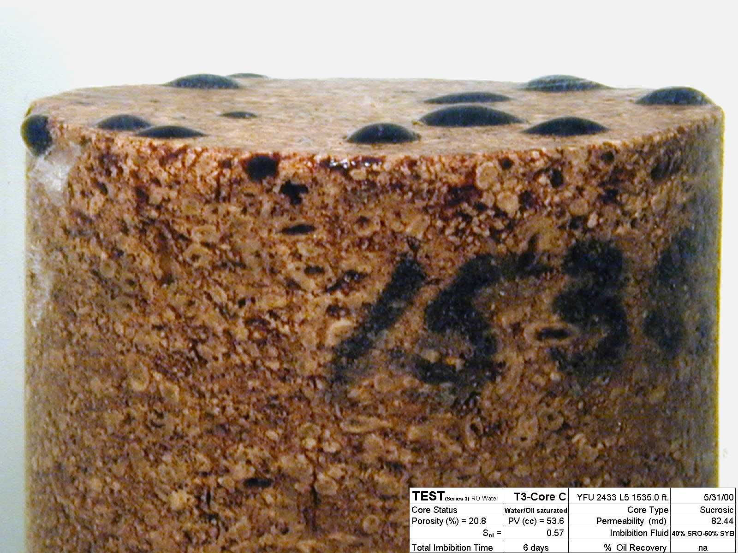
Oil expulsion by brine imbibition and gravity segregation in an 82-mD, sucrosic carbonate core after 6 days of exposure (Yates Field, USA)
UNCONVENTIONAL RESERVOIR ENGINEERING PROJECT
Advisory Board Meeting, November 8, 2019, Golden, Colorado

Slide 10
Carbonate dissolution in low-salinity water
may promote EOR
Altahir and Hussain (2017) experimental results indicate that a pH of about 9.5 is generated because of calcite dissolution in low salinity water. This alkaline environment could be the driving mechanism for low-salinity EOR probably by OH⁻ bonding illustrated below and on the following slide.
UNCONVENTIONAL RESERVOIR ENGINEERING PROJECT
Advisory Board Meeting, November 8, 2019, Golden, Colorado

Slide 11
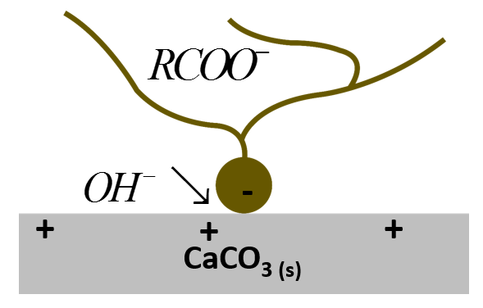
Acidic crude possible interaction with calcite (Adopted from: Austad et al., 2010)
UNCONVENTIONAL RESERVOIR ENGINEERING PROJECT
Advisory Board Meeting, November 8, 2019, Golden, Colorado

Slide 12
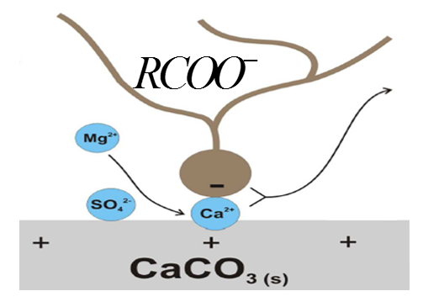
Sea water potentially alters carbonates from oleophylic to hydrophilic (Adopted from: Austad et al., 2010)
UNCONVENTIONAL RESERVOIR ENGINEERING PROJECT
Advisory Board Meeting, November 8, 2019, Golden, Colorado

Slide 13
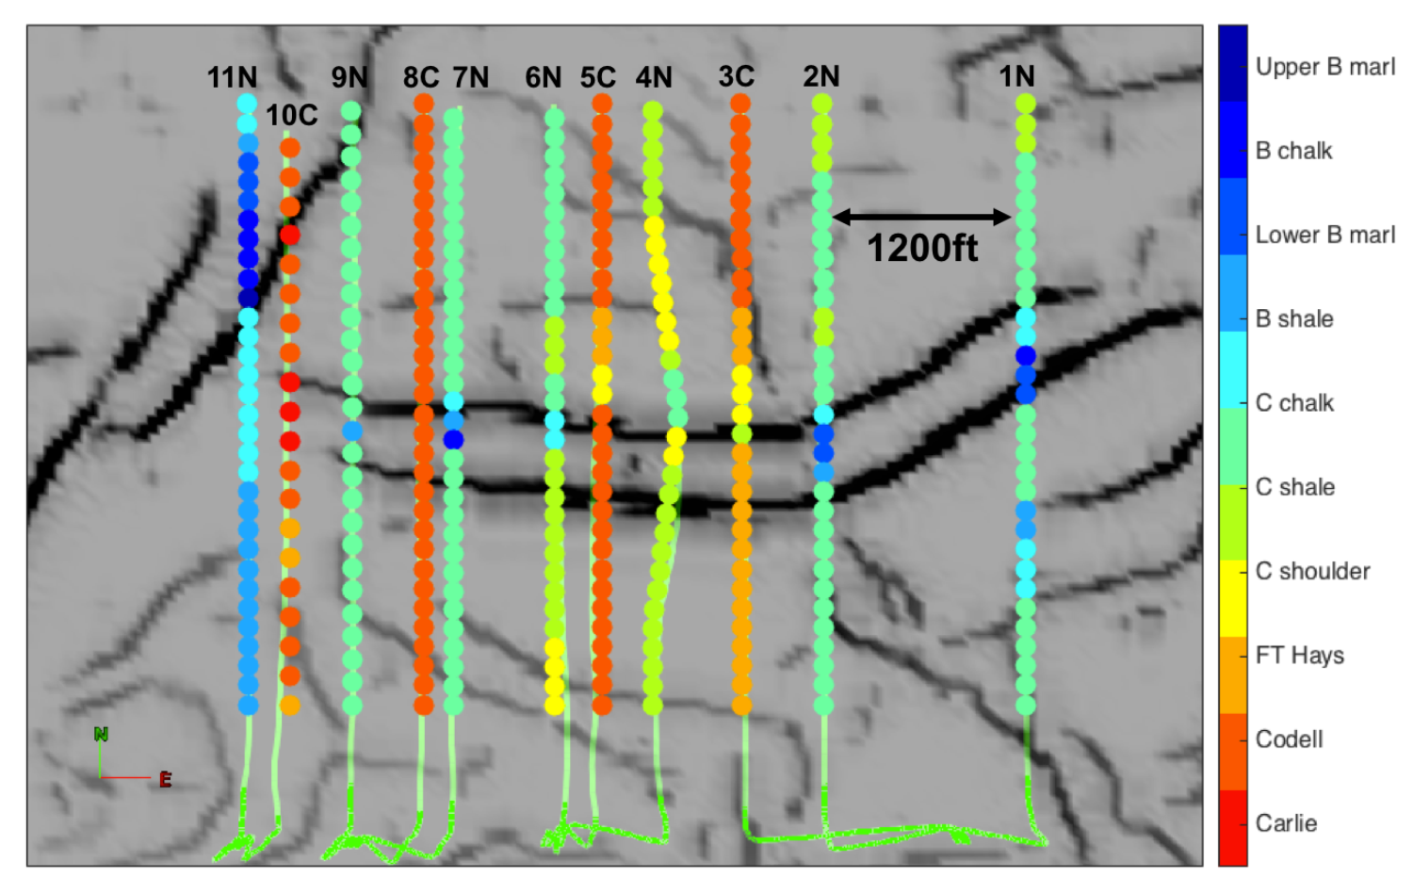
Eleven Wells in the One Square Mile Study Area And a Well Path (Yanrui Ning, CSM, 2017)
Pitcher, 2015
UNCONVENTIONAL RESERVOIR ENGINEERING PROJECT
Advisory Board Meeting, November 8, 2019, Golden, Colorado

Slide 14
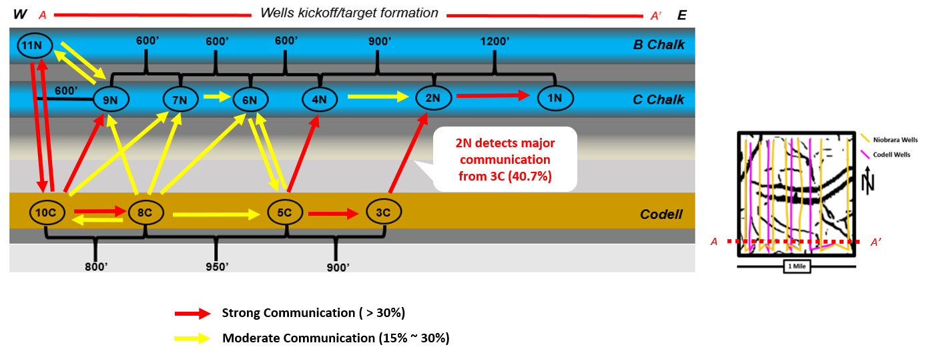
Significant Interwell & Interlayer Communication
(Yanrui Ning, CSM, 2017)
UNCONVENTIONAL RESERVOIR ENGINEERING PROJECT
Advisory Board Meeting, November 8, 2019, Golden, Colorado

Slide 15
Conclusions
Displacement-based EOR is impractical in unconventional reservoirs.
Micro and macro fractures are the key flow paths for getting the primary and EOR oil out.
While gas injection EOR is the king of oil recovery in unconventional shale reservoirs, low-salinity osmosis, plus an IFT reducer, can lead to additional oil production. This is the current state of our research at CSM.
UNCONVENTIONAL RESERVOIR ENGINEERING PROJECT
Advisory Board Meeting, November 8, 2019, Golden, Colorado

Slide 16
Questions?
Thank you
UNCONVENTIONAL RESERVOIR ENGINEERING PROJECT
Advisory Board Meeting, November 8, 2019, Golden, Colorado

