Slide 1
UNCONVENTIONAL RESERVOIR ENGINEERING PROJECT
Colorado School of Mines
U R E P
CSM
Measuring In-Site Matrix Permeability Using DFIT
Omar Khaleel, PhD
Colorado School of Mines
UNCONVENTIONAL RESERVOIR ENGINEERING PROJECT
1
Advisory Board Meeting, November 8, 2019, Golden, Colorado

Slide 2
Objectives
The main thesis objective was to assess geological and reservoir engineering aspects of the UAE Upper Jurassic Diyab gas condensate and Middle Cretaceous light oil unconventional shale.
However, in this presentation, we focus on the use minifrac pressure fall-off data (known as Diagnostic Flow Injection Test, DFIT) as the major source of in-situ matrix permeability measurement for use in reservoir evaluation and modeling of stimulated shale reservoirs in UAE.
Minifrac/DFIT has followed the evolution of classical Drill Stem Test (DST) and Mini DST as a major tool to determine in-situ permeability.
DST was used in vertical well, thus flow was radial. Mini DST uses a single perforation and a small fluid receiving chamber, thus flow is spherical. DFIT is conducted in a small hydraulic fracture, thus flow is linear perpendicular to the fracture surface.
UNCONVENTIONAL RESERVOIR ENGINEERING PROJECT
Advisory Board Meeting, November 8, 2019, Golden, Colorado

Slide 3
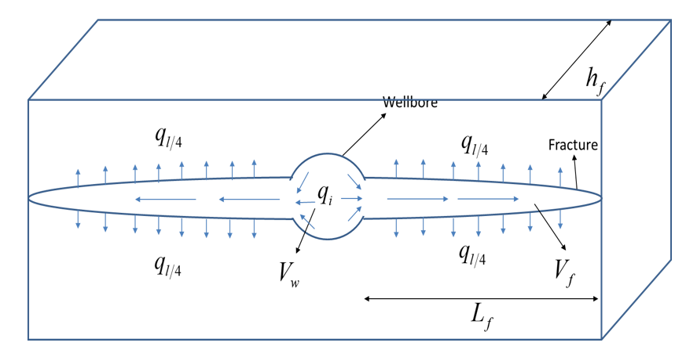
L. Frash (2014) Hydraulic Fracture
UNCONVENTIONAL RESERVOIR ENGINEERING PROJECT
Advisory Board Meeting, November 8, 2019, Golden, Colorado

Slide 4
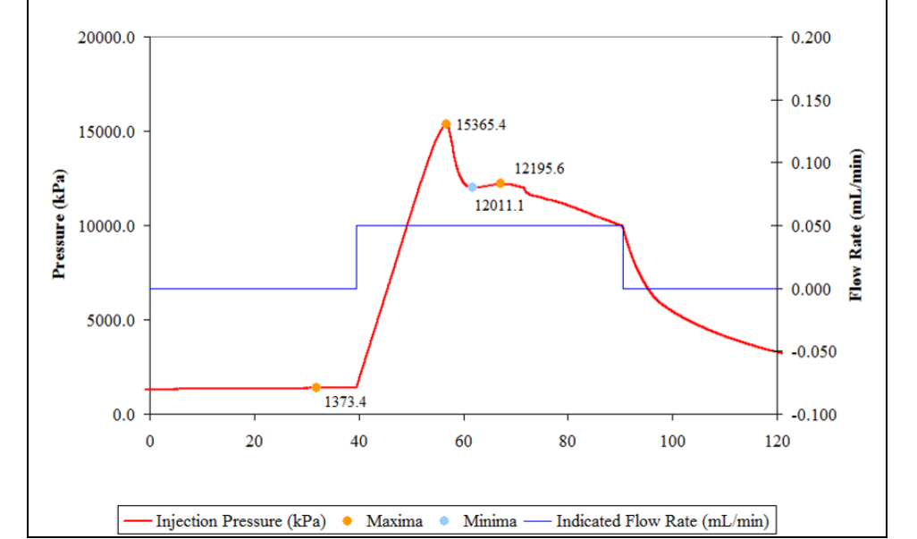
L. Frash (2014) Hydraulic Fracture Experiment
Breakdown pressure
Injection Stopped
Perceived ISIP
Fracture closure pressure
UNCONVENTIONAL RESERVOIR ENGINEERING PROJECT
Advisory Board Meeting, November 8, 2019, Golden, Colorado

Slide 5
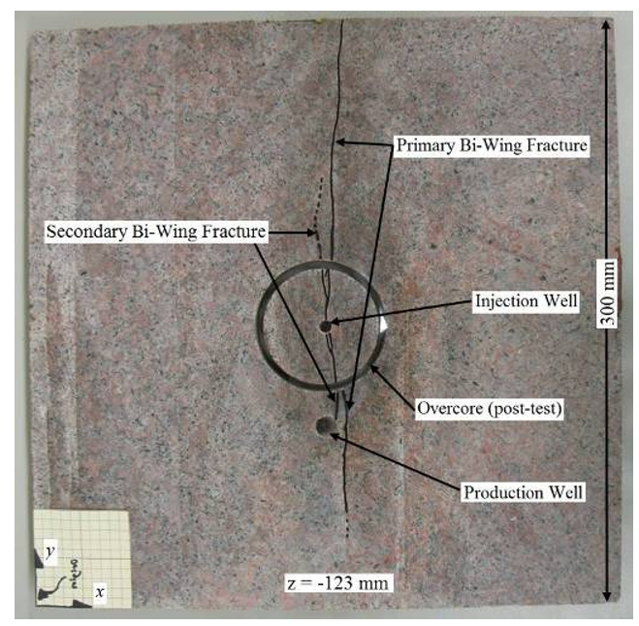
L. Frash (2014) Hydraulic Fracture Experiment
UNCONVENTIONAL RESERVOIR ENGINEERING PROJECT
Advisory Board Meeting, November 8, 2019, Golden, Colorado

Slide 6
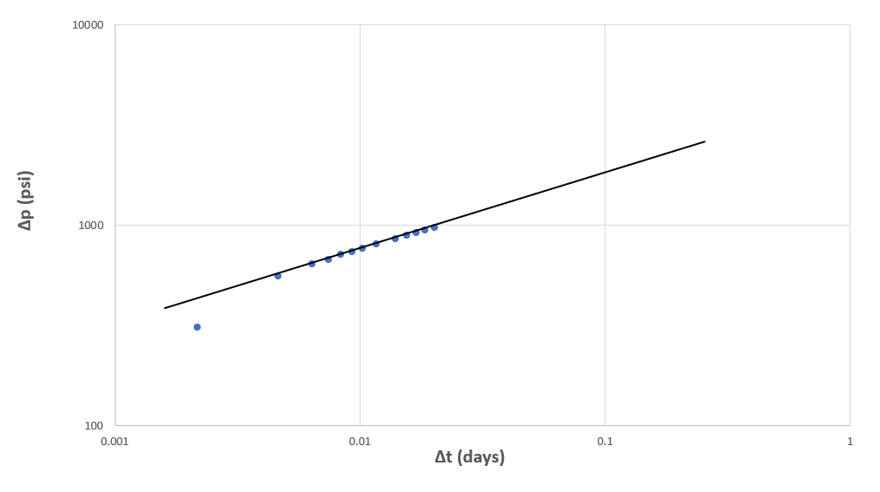
L. Frash (2014) Hydraulic Fracture
Diagnostic Plot
UNCONVENTIONAL RESERVOIR ENGINEERING PROJECT
Advisory Board Meeting, November 8, 2019, Golden, Colorado

Slide 7
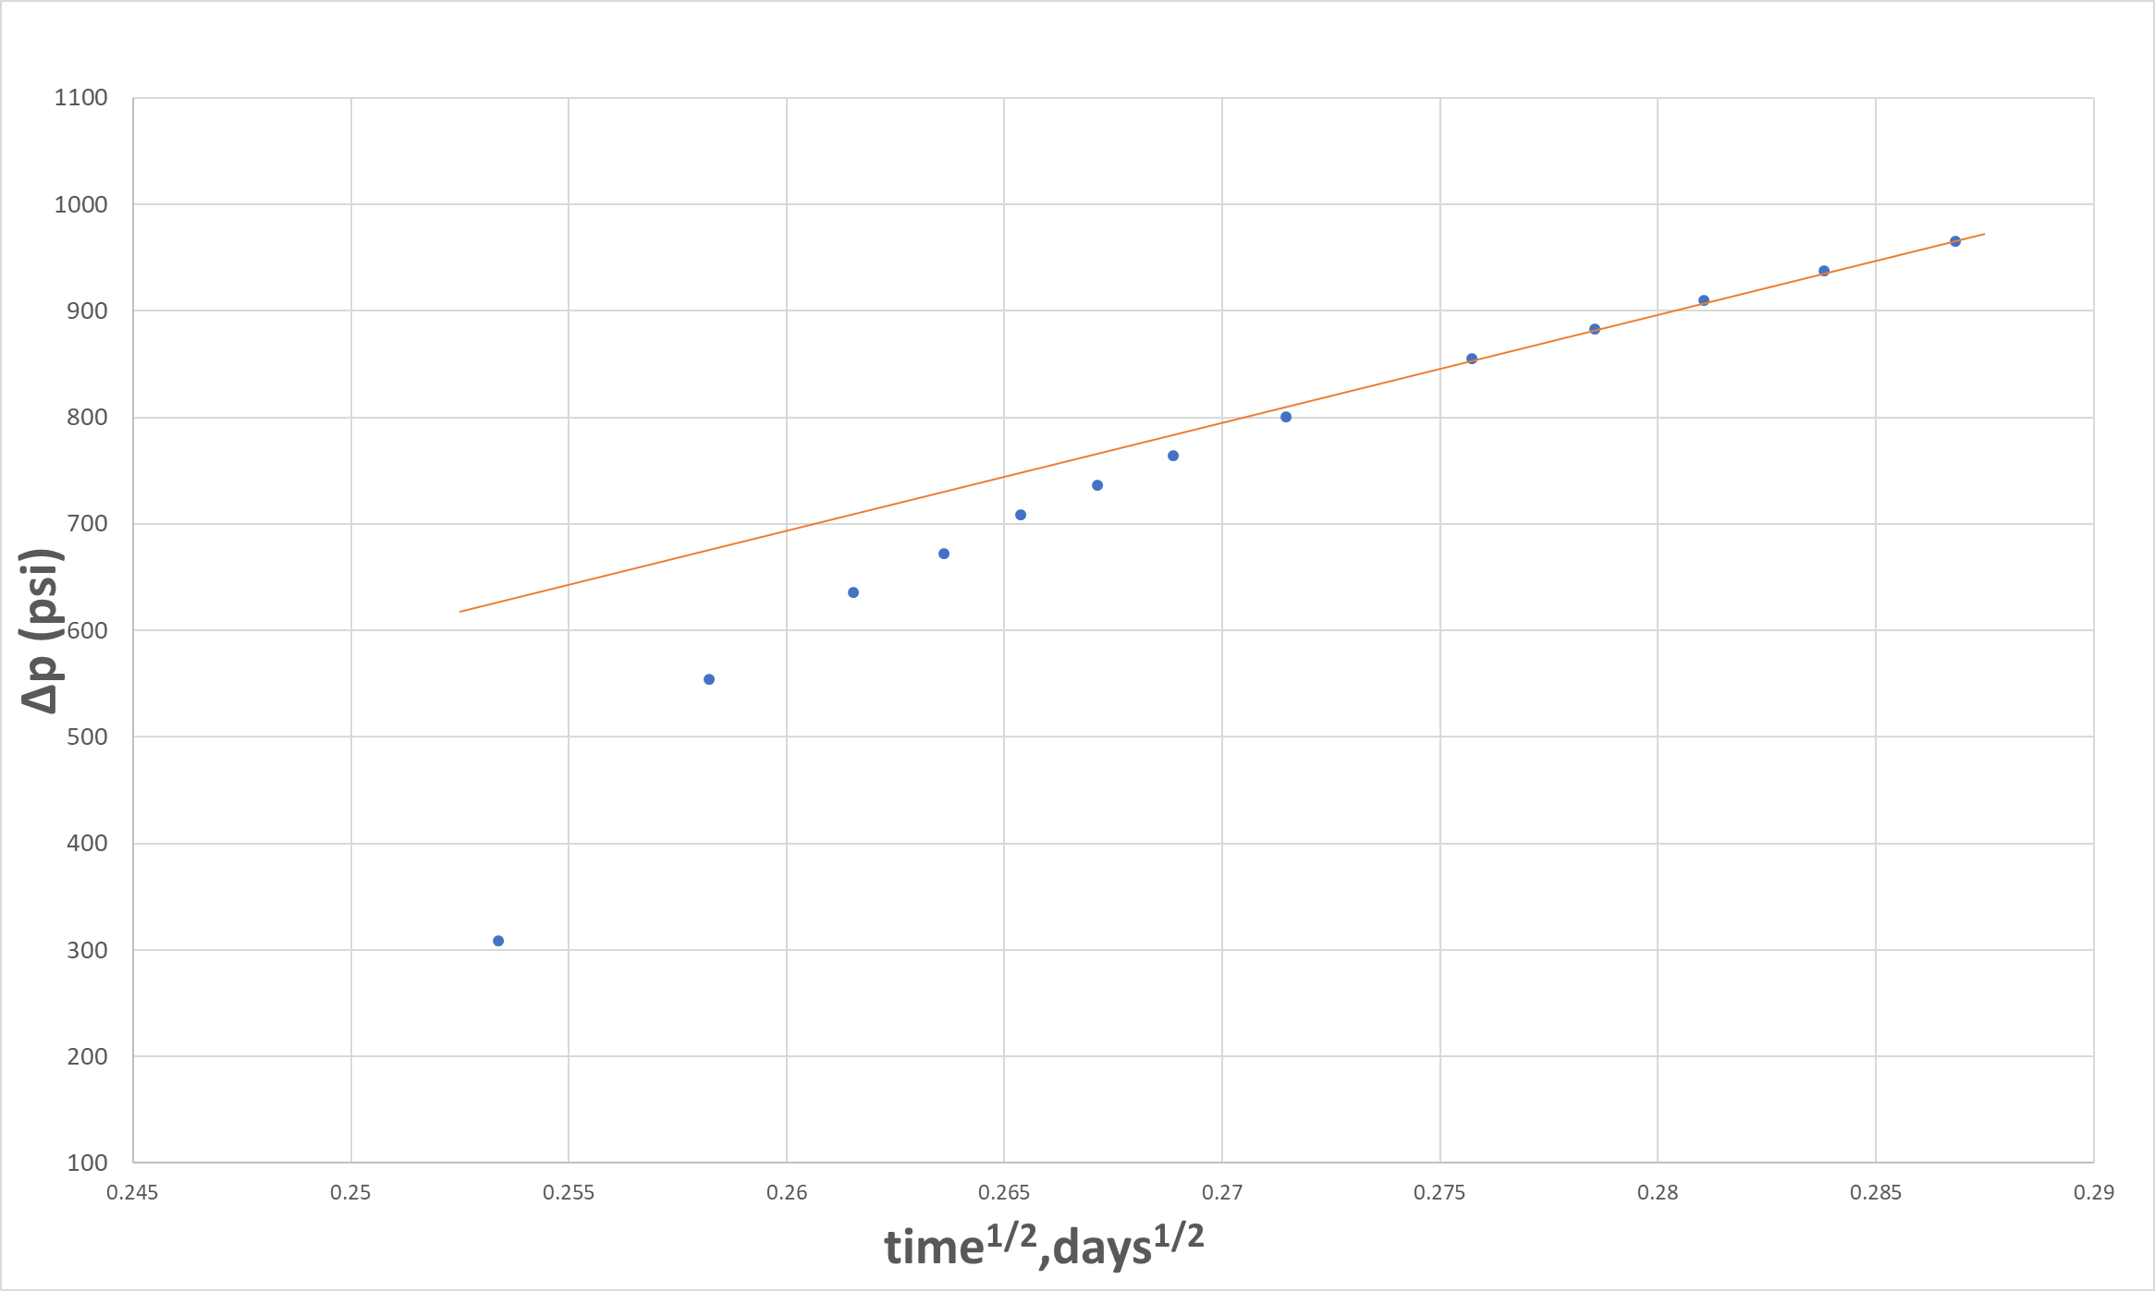
L. Frash (2014) Hydraulic Fracture
Linear Flow Analysis
Fracture storage response
UNCONVENTIONAL RESERVOIR ENGINEERING PROJECT
Advisory Board Meeting, November 8, 2019, Golden, Colorado

Slide 8
L. Frash (2014) Hydraulic Fracture
1D linear flow pressure transient analysis (PTA) method; calculate raw formation permeability (short term Performance)
UNCONVENTIONAL RESERVOIR ENGINEERING PROJECT
Advisory Board Meeting, November 8, 2019, Golden, Colorado

Slide 9
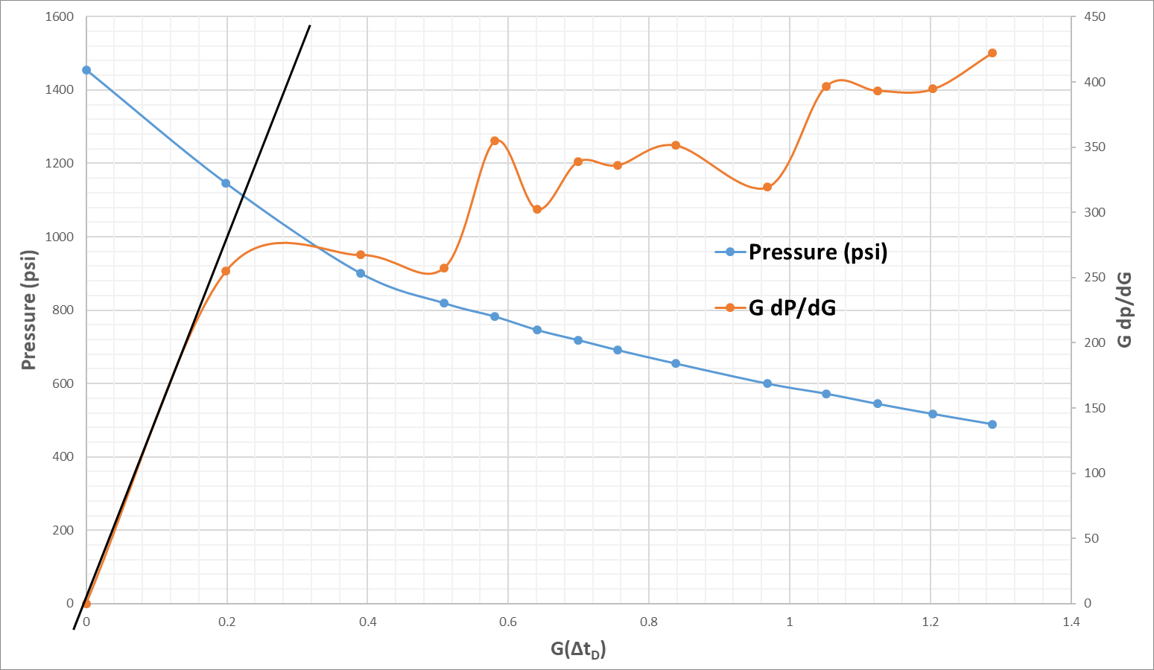
L. Frash (2014) Hydraulic Fracture
G-function Plot
UNCONVENTIONAL RESERVOIR ENGINEERING PROJECT
Advisory Board Meeting, November 8, 2019, Golden, Colorado

Slide 10
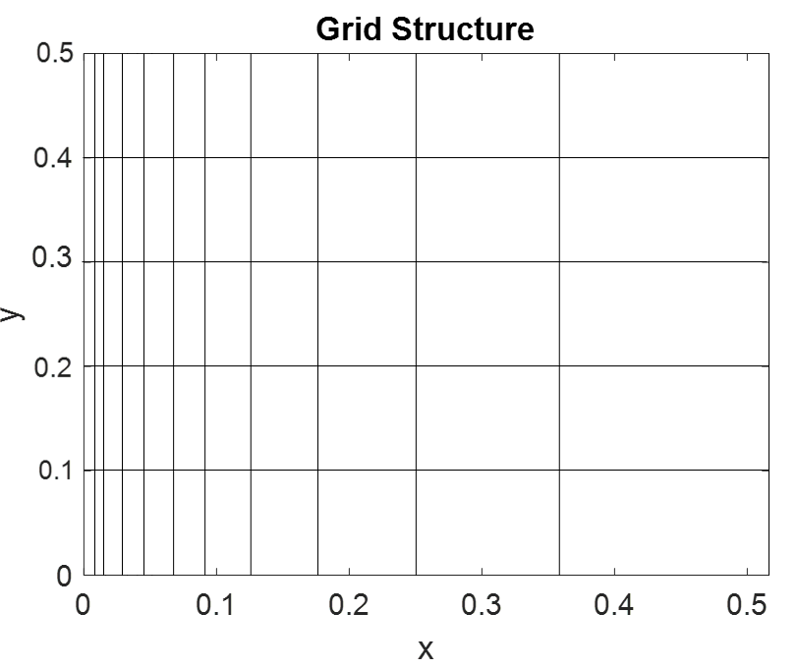
L. Frash (2014) Hydraulic Fracture Numerical Model
UNCONVENTIONAL RESERVOIR ENGINEERING PROJECT
Advisory Board Meeting, November 8, 2019, Golden, Colorado

Slide 11
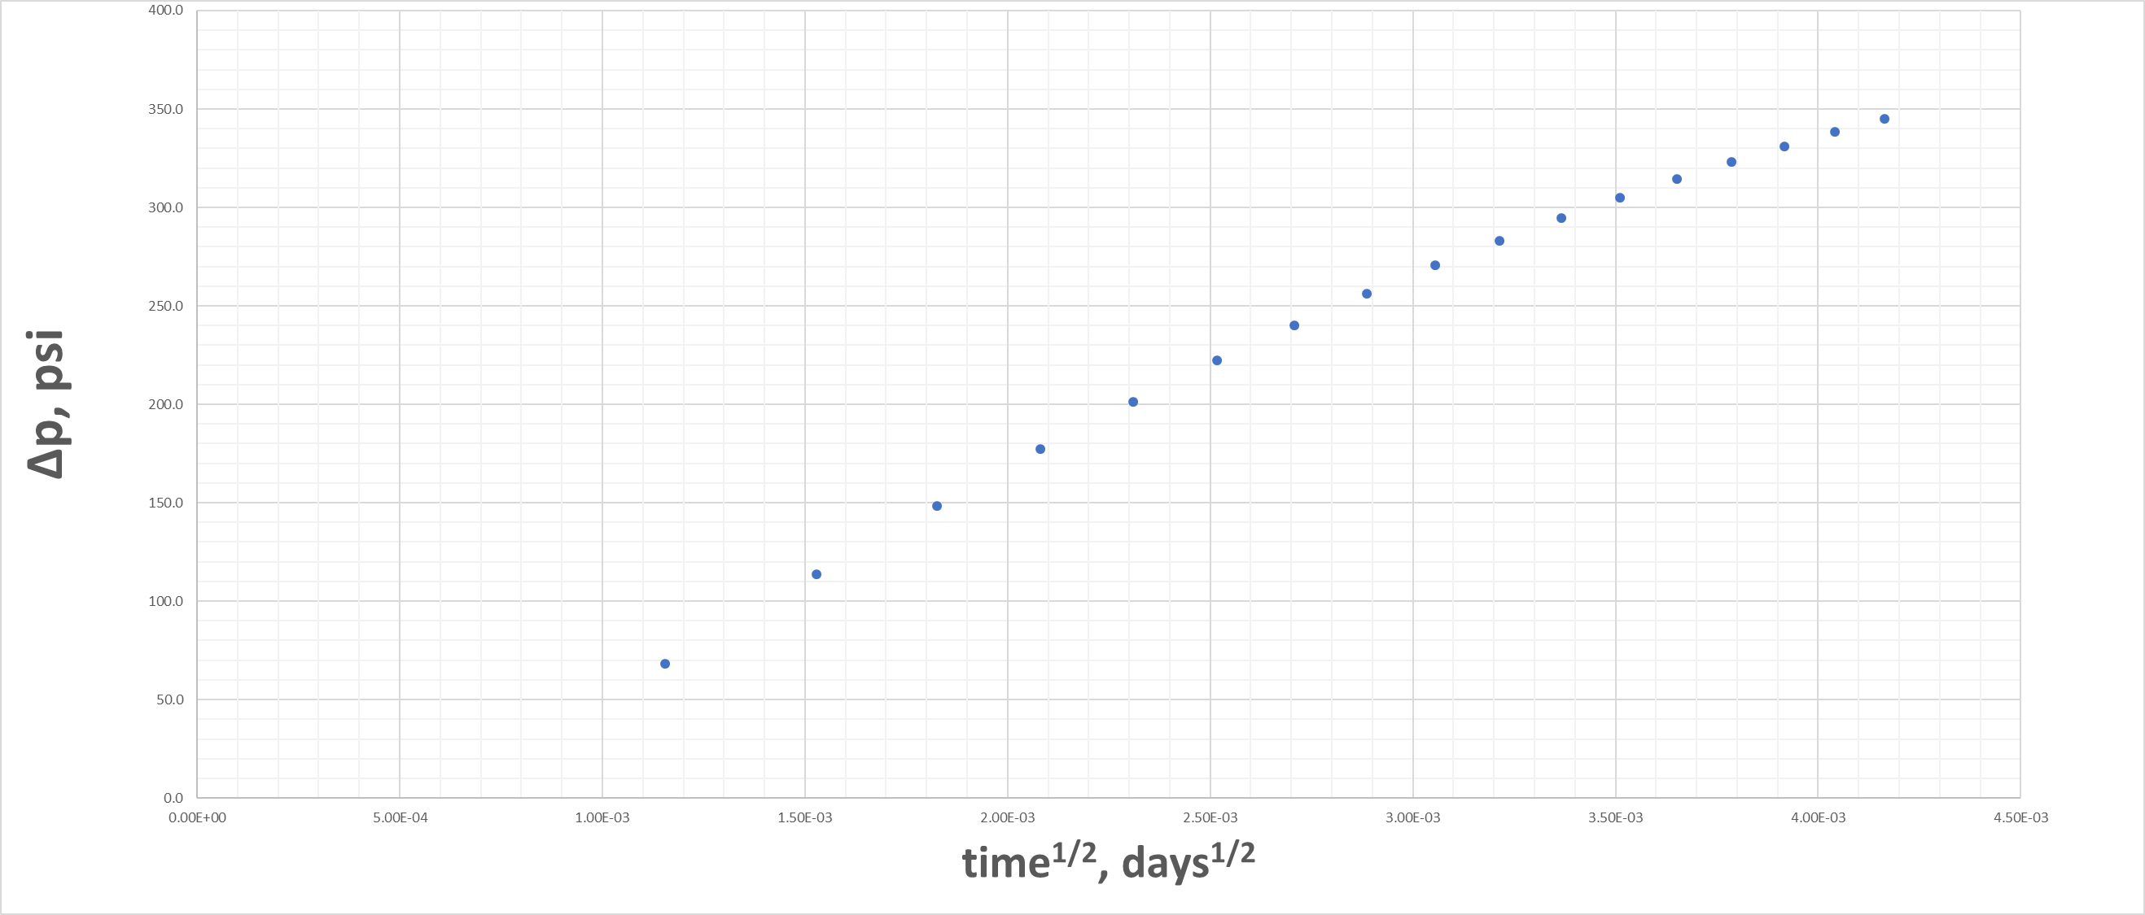
L. Frash (2014) Hydraulic Fracture Numerical Model
Linear Flow Analysis
Linear Flow
UNCONVENTIONAL RESERVOIR ENGINEERING PROJECT
Advisory Board Meeting, November 8, 2019, Golden, Colorado

Slide 12
L. Frash (2014) Hydraulic Fracture Numerical Model
1D linear flow pressure transient analysis (PTA) method
UNCONVENTIONAL RESERVOIR ENGINEERING PROJECT
Advisory Board Meeting, November 8, 2019, Golden, Colorado

Slide 13
Conclusion
Using conventional pressure transient analysis (PTA), rate transient analysis (RTA), and Nolte G-function technique to analyze several field and experimental data proves that the pressure transient analysis and rate transient analysis, both are reliable and easier to use compared with Nolte’s G-function. Nonetheless, the calculated permeability from three methods yield similar results. However, PTA and RTA do not require the use of geomechanical properties while the G-function requires Young modulus and Poison ratio.
Applying PTA and G-function to the experimental data obtained by L. Frash (PhD Thesis, CSM, 2014) to calculate permeability, and comparing with core measured permeability, we obtained excellent agreement.
UNCONVENTIONAL RESERVOIR ENGINEERING PROJECT
Advisory Board Meeting, November 8, 2019, Golden, Colorado

Slide 14
Questions?
Thank you
UNCONVENTIONAL RESERVOIR ENGINEERING PROJECT
Advisory Board Meeting, November 8, 2019, Golden, Colorado

Slide 15
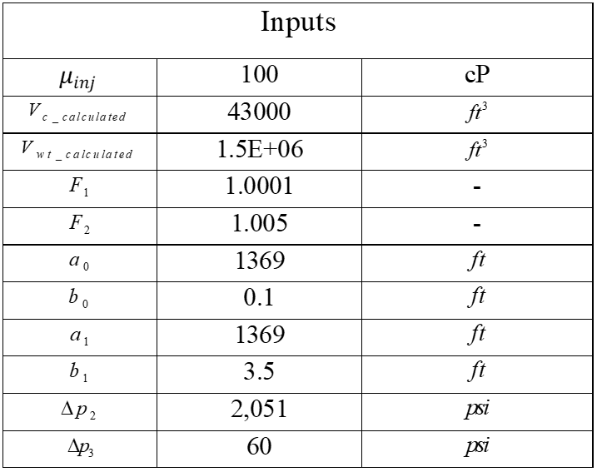
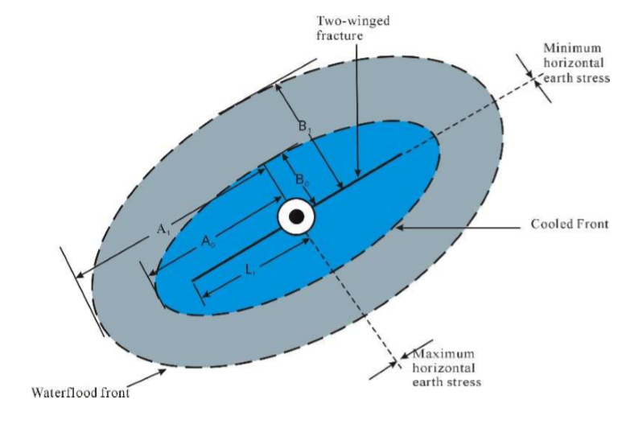
Stress Shadow Model (Full Hydraulic Fracture Job)
UNCONVENTIONAL RESERVOIR ENGINEERING PROJECT
Advisory Board Meeting, November 8, 2019, Golden, Colorado

