Slide 1
UNCONVENTIONAL RESERVOIR ENGINEERING PROJECT
Colorado School of Mines
U R E P
CSM
MODELING OF TRANSIENT FLOW OF DIAGNOSTIC FRACTURE INJECTION TESTS IN POROUS MEDIA
Mohamed Ibrahim Mohamed
UNCONVENTIONAL RESERVOIR ENGINEERING PROJECT
Advisory Board Meeting, November 8, 2019, Golden, Colorado

Slide 2
Motivation
Only a few analytical studies focus on the effect of randomly distributed natural fractures on the pressure transient during falloff.
However, most of the studies have focused on the geomechanics approach of the minifrac analysis and the pressure transient solutions have been overlooked.
Understand the complete picture of the pressure transient responses in the natural fractures as well as the main fracture.
Unfortunately, many field tests that are done provide misleading results because of either incorrect analysis of the acquired data or problematic data acquisition.
UNCONVENTIONAL RESERVOIR ENGINEERING PROJECT
Advisory Board Meeting, November 8, 2019, Golden, Colorado

Slide 3
Objectives of Study
First develop a geomechanics coupled reservoir flow simulation for Minifrac tests.
Allow modeling of pressure response of minifrac before and after fracture closure.
Second develop semi-analytical model that simulates transient flow in a porous media, which contains finite conductivity, randomly connected and disconnected, fractures.
Investigate the properties of main fracture as well as natural fractures, such as length, azimuth, conductivity and fracture distribution on the pressure during falloff.
Third discuss specific issues that result in poor estimation of reservoir properties.
Apply machine learning methods to predict the fracture closure pressure
Minimize shortcomings in determining $p_{c} \& t_{c}$for non-ideal or subjective conditions.
UNCONVENTIONAL RESERVOIR ENGINEERING PROJECT
Advisory Board Meeting, November 8, 2019, Golden, Colorado

Slide 4
UNCONVENTIONAL RESERVOIR ENGINEERING PROJECT
Colorado School of Mines
U R E P
CSM
Geomechanics Coupled Reservoir Flow Simulation
Numerical Simulation (SPE-199728-MS)
UNCONVENTIONAL RESERVOIR ENGINEERING PROJECT
Advisory Board Meeting, November 8, 2019, Golden, Colorado

Slide 5
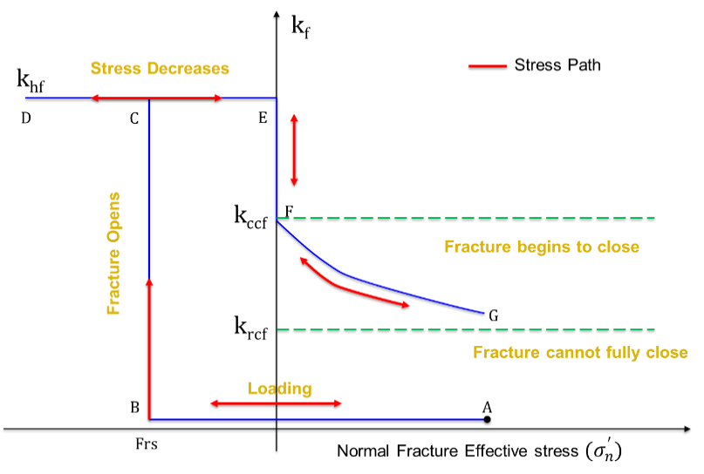
Geomechanics Coupled Reservoir Flow Simulation
GEM is used in the study
Describes relationship between the permeability of the fracture system and fracture opening.
As pressure increases in regular grid, the normal effective stresses on the fractures decrease.
Stress breaks past the failure envelope of the rock → fracture propagates and allow fluid to flow through the fracture system in addition to the underlying matrix system.
Barton-Bandis stress permeability relationship model
UNCONVENTIONAL RESERVOIR ENGINEERING PROJECT
Advisory Board Meeting, November 8, 2019, Golden, Colorado

Slide 6
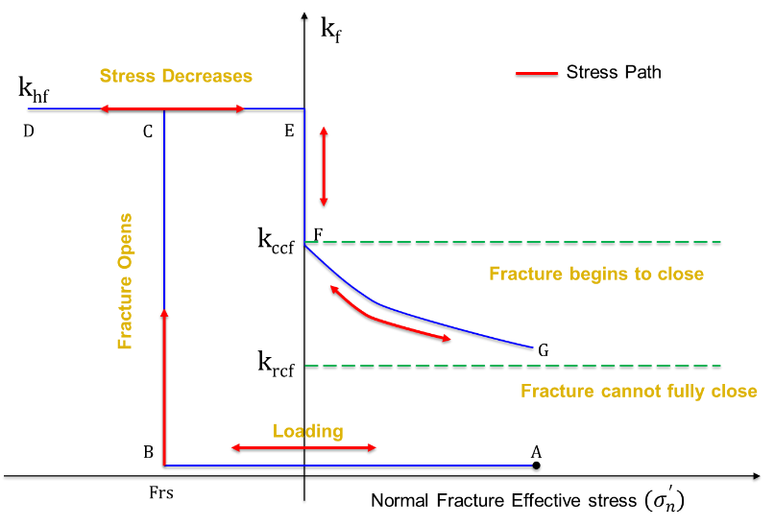
Geomechanics Coupled Reservoir Flow Simulation
Barton-Bandis parameters used in this test case were obtained by history matching a field case.
The history matching was done by using
Actual field injection schedule
Bottom hole pressure recorded using a downhole gauge
Initial Fracture Aperture (ft) | 1.4E-05
Fracture Stiffness (psi/ft) | 536000
Fracture Opening Stress (psi) | 6750.4
Hydraulic Fracture Permeability (mD) | 134.4
Fracture Closure Permeability (mD) | 63.6
Fracture Residual Permeability (mD) | 9.6
Barton-Bandis parameters for test case.
UNCONVENTIONAL RESERVOIR ENGINEERING PROJECT
Advisory Board Meeting, November 8, 2019, Golden, Colorado

Slide 7
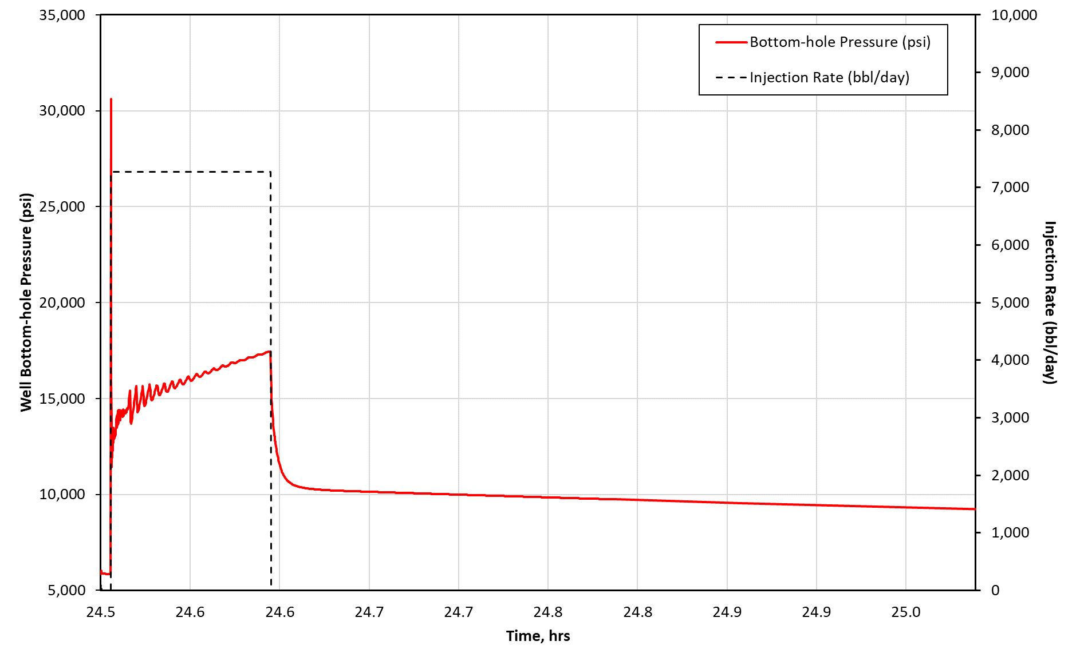
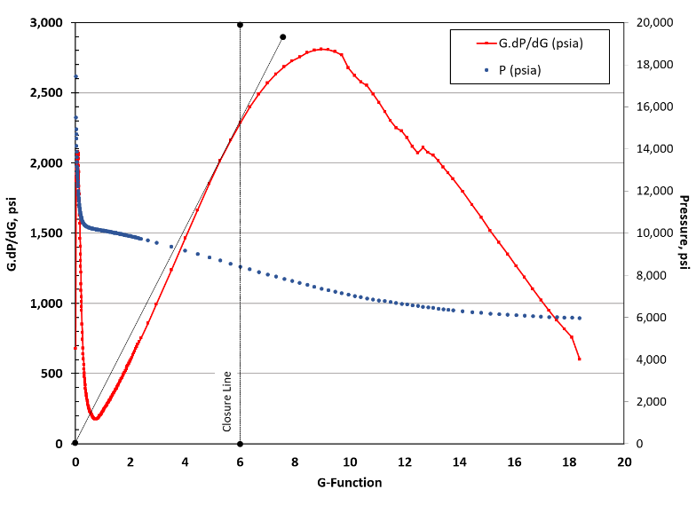
Geomechanics Coupled Reservoir Flow Simulation
Pressure Response Interpretation:
Breakdown pressure
Relatively higher than the breakdown pressure observed from the field data.
G-Function Plot:
A pressure drop during the first hours of shut-in caused by tip extension or near-wellbore tortuosity.
Shows the behavior of fracture height recession leakoff.
Rate and pressure from the Minifrac simulation for test case.
Nolte G-function plot for test case
UNCONVENTIONAL RESERVOIR ENGINEERING PROJECT
Advisory Board Meeting, November 8, 2019, Golden, Colorado

Slide 8
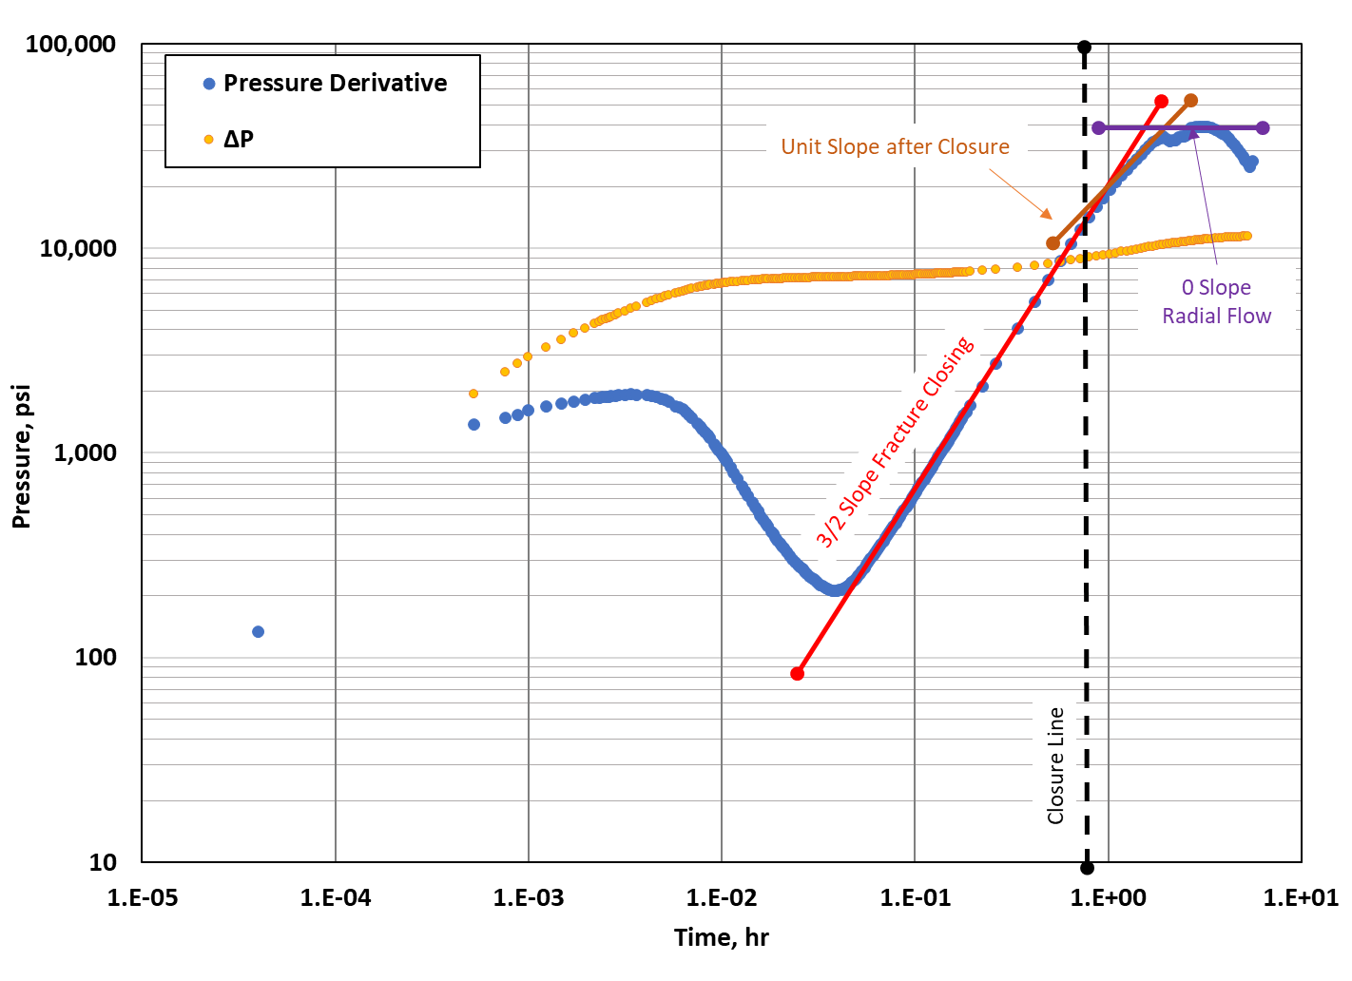
Geomechanics Coupled Reservoir Flow Simulation
Pressure Response Interpretation:
Bourdet Log-Log of pressure and derivative
1/4 slope defining the before closure early time bi-linear flow.
There is a 3/2 slope period before closure. Fracture closure is picked at the deviation from the 3/2 slope.
A unit slope is shown after closure
The zero slope is defined as a pseudo-radial flow regime.
Log-Log Diagnostic plot for pressure response for test case
UNCONVENTIONAL RESERVOIR ENGINEERING PROJECT
Advisory Board Meeting, November 8, 2019, Golden, Colorado

Slide 9
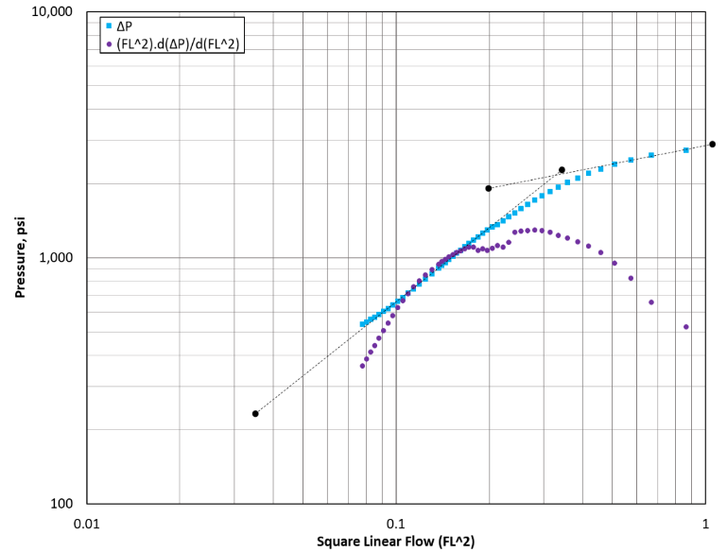
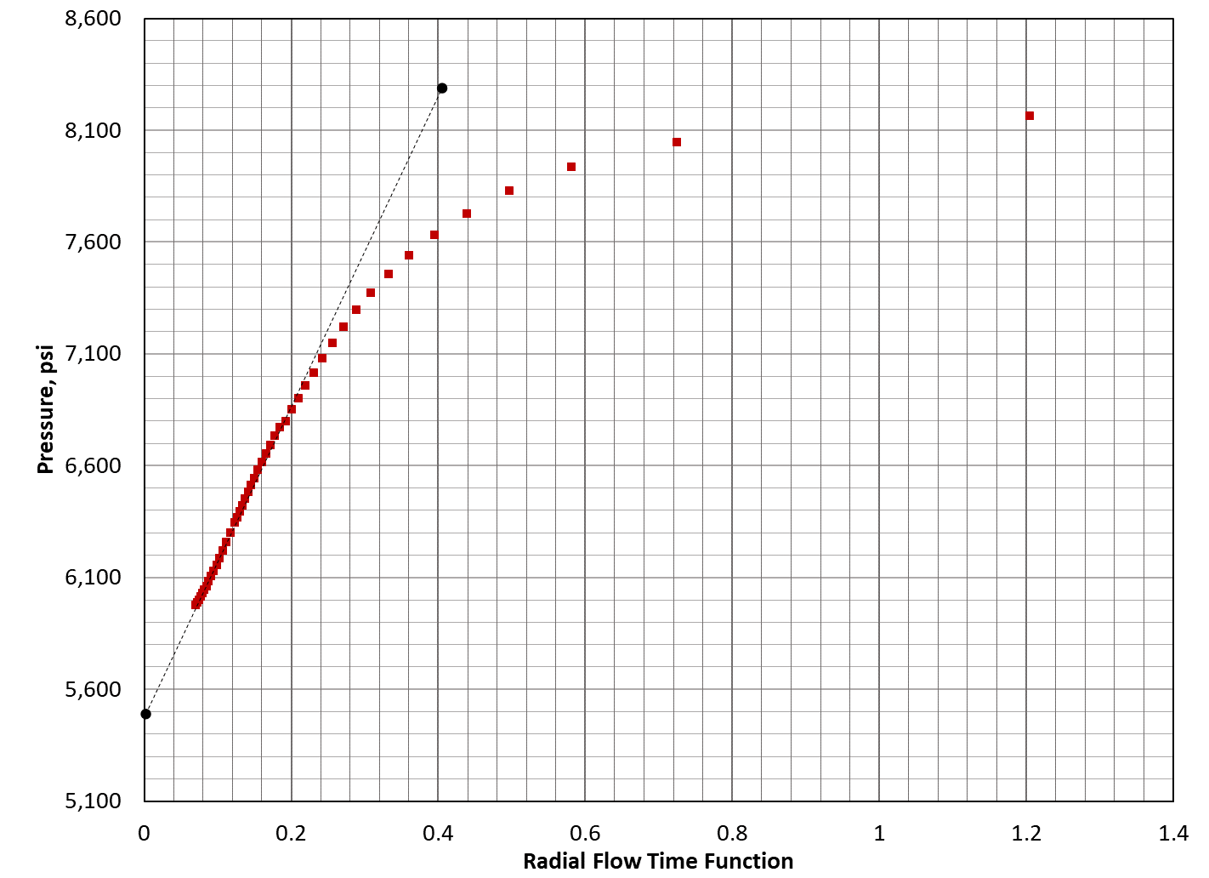
Geomechanics Coupled Reservoir Flow Simulation
Pressure Response Interpretation:
After-Closure Analysis
Radial flow regime can be observed,
Identified by a unit slope of the pressure derivative.
The slope is used to calculate the transmissibility.
Knowing frac height and fluid viscosity, permeability can be determined
After Closure Analysis- Square Linear Flow Time Function
 | Geomechanics Coupled Flow Simulation | Minifrac Field
Initial Reservoir Pressure (psi.) | 5,503.0 | 5,644.6
Closure pressure (psi.) | 8,182.9 | 6,677.6
ISIP (psi.) | 10,673.0 | 7,801.7
kh (md.ft) | 4.14 | 1.65
Permeability, $k$ (μd) | 0.08 | 0.011
$$\frac{kh}{μ}=251,000[\frac{V_{i}}{m_{R}t_{c}} ]$$
After Closure Analysis Radial Flow Time Function Plot
UNCONVENTIONAL RESERVOIR ENGINEERING PROJECT
Advisory Board Meeting, November 8, 2019, Golden, Colorado

Slide 10
Geomechanics Coupled Reservoir Flow Simulation
Conclusion and Next steps
The model, can possibly couple the fluid flow and matrix deformation in the presence of natural fractures.
The model, can possibly capture different flow regimes during falloffs.
Further investigation should be done to verify the model.
Effect of natural fracture density on pressure response
Effect of stress variations
Range of permeabilities on time needed to reach closure and late time flow regimes.
Effect of injected volume on time needed to reach late time flow regimes.
UNCONVENTIONAL RESERVOIR ENGINEERING PROJECT
Advisory Board Meeting, November 8, 2019, Golden, Colorado

Slide 11
UNCONVENTIONAL RESERVOIR ENGINEERING PROJECT
Colorado School of Mines
U R E P
CSM
Geomechanics Coupled Reservoir Flow Simulation
Semi-Analytical Modeling
UNCONVENTIONAL RESERVOIR ENGINEERING PROJECT
Advisory Board Meeting, November 8, 2019, Golden, Colorado

Slide 12
Semi-Analytical Model
Challenges with complex fractures and NF Distribution
Secondary Fracture
Secondary Fracture
Hydraulic Fracture
Hydraulic Fracture
Wellbore
Wellbore
UNCONVENTIONAL RESERVOIR ENGINEERING PROJECT
Advisory Board Meeting, November 8, 2019, Golden, Colorado

Slide 13
Semi-Analytical Model
Couples three models using continuity of mass and pressure at the fracture matrix interfaces.
Reservoir-flow model (Izadi et al. 2007)
Fracture-flow model
Fracture Leakoff/propagation geomechanical model
Secondary Fracture
Hydraulic Fracture
Wellbore
UNCONVENTIONAL RESERVOIR ENGINEERING PROJECT
Advisory Board Meeting, November 8, 2019, Golden, Colorado

Slide 14
Semi-Analytical Model: Reservoir-flow Model
2D diffusivity equation governs transient flow
$S_{w}$: source function for vertical well
$S_{f}$: source function for hydraulic and naturally fractures
$$k_{x}\frac{∂^{2}∆p}{∂x^{2}}+k_{y}\frac{∂^{2}∆p}{∂y^{2}}+ S_{w}\left(t\right)+S_{f}\left(t\right)= β\frac{∂∆p}{∂t}$$
$$S_{w}\left(t\right)= γ\sum_{m=1}^{M}{q_{wm}}(t)(x−x_{wm})δ(y−y_{m})$$
$$S_{f}\left(t\right)= γ\sum_{n=1}^{N_{tf}}{\int_{0}^{L_{fn}}{q_{fn}\left(u_{n},t\right)δ\left(x−x_{fn}−u_{n}cosθ_{fn}\right)δ\left(y−y_{fn}−u_{n}sinθ_{fn}\right)du_{n}}}$$
UNCONVENTIONAL RESERVOIR ENGINEERING PROJECT
Advisory Board Meeting, November 8, 2019, Golden, Colorado

Slide 15
Semi-Analytical Model: Fracture-Flow Model
Pressure at center of j^{th} segment of the k^{th} fracture
For Hydraulic fracture:
For Natural Fractures:
$$\sum_{i=1}^{N_{sn}}{q_{sfi}\left(t\right)=q_{whfn}}$$
$$∆{\tilde{p}}_{fn}\left(z_{skj},s\right)=∆{\tilde{p}}_{fk} |_{z_{k}=0}−\frac{1}{s}\frac{γ_{fk}}{k_{fk}}q_{whfk}\left(z_{skj}−z_{wfk}\right)+ \frac{γ_{fk}}{k_{fk}}\left\{\sum_{i=1}^{j−1}{{\tilde{q}}_{fki}\left(s\right)\left(z_{skj}−z_{ski}\right)+}\frac{{\tilde{q}}_{fkj}\left(s\right)}{∆L_{fk}}\frac{1}{2}(z_{skj}−{\left(z_{skj}−∆{L_{fk}}/2\right)}^{2} \right\}$$
= 0
$$\sum_{i=1}^{N_{sn}}{q_{sfi}\left(t\right)=0}$$
Flux Distribution
q_{whfn}
Z_{n} = 0
Z_{n} = L_{fn}
Z_{n} = 0
Z_{n} = L_{fn}
Z_{n} = Z_{whfn}
Flow inside and around hydraulic fractures
Flow inside and around Natural fractures
UNCONVENTIONAL RESERVOIR ENGINEERING PROJECT
Advisory Board Meeting, November 8, 2019, Golden, Colorado

Slide 16
Semi-Analytical Model: Geomechanical model
Fracture initiation and fluid leakoff rate
Linear fracture propagation and rectangular cross-section
Both are updated at each time step
Fluid is partially stored in the fracture. Residual leaves fracture face into reservoir
At each time step the adjusted fracture dimension is used to calculate the pressure along the fracture.
$$t_{i+2}$$
$$w_{ave, i+2}$$
$$w_{ave, i+2}$$
$$t_{i+1}$$
$$w_{ave, i+1}$$
$$t_{i}$$
$$w_{ave, i}$$
$$w_{ave, i}$$
$$x_{f,i}$$
$$x_{f,i+1}$$
$$x_{f,i+2}$$
UNCONVENTIONAL RESERVOIR ENGINEERING PROJECT
Advisory Board Meeting, November 8, 2019, Golden, Colorado

Slide 17
Ongoing Projects
1. Cross-discipline leveraging of machine learning, and data analytics
Limit the subjectivity in the determination of minifrac parameters
By applying machine learning and artificial neural network methods
To predict (p_{c}, t_{c}, kh, … ). Other parameters ?
Minimize the shortcoming in determining the closure pressure for non-ideal or subjective conditions.
UNCONVENTIONAL RESERVOIR ENGINEERING PROJECT
Advisory Board Meeting, November 8, 2019, Golden, Colorado

Slide 18
Ongoing Projects
2. Characterization of Frac Stage Geometry and Conductivity
Data Acquisition
Pressure data are recorded at surface by service company conducting Frac at little or no cost.
Makes this process Cost-effective
Data processing
Picking the LOF period at the end of stage pumping
cleaning, smoothing and reducing points.
Log-Log Diagnostic Plot
Investigation of flow regimes
Stage Properties
Fracture dimensions & conductivity.
SRV Calculations
Tie LOF analysis with Tracers
and Production logs (if available)
Tie LOF analysis with Build up
Mohamed, M., Ibrahim, M., Ozkan E., State of The Art In Characterization of Frac Stage Geometry and Conductivity Using Pressure Leakoff. Paper SPE-200018-MS Unconventional Resources Conference to be held 18 – 19 March 2020 in Calgary, Alberta, Canada.
UNCONVENTIONAL RESERVOIR ENGINEERING PROJECT
Advisory Board Meeting, November 8, 2019, Golden, Colorado

Slide 19
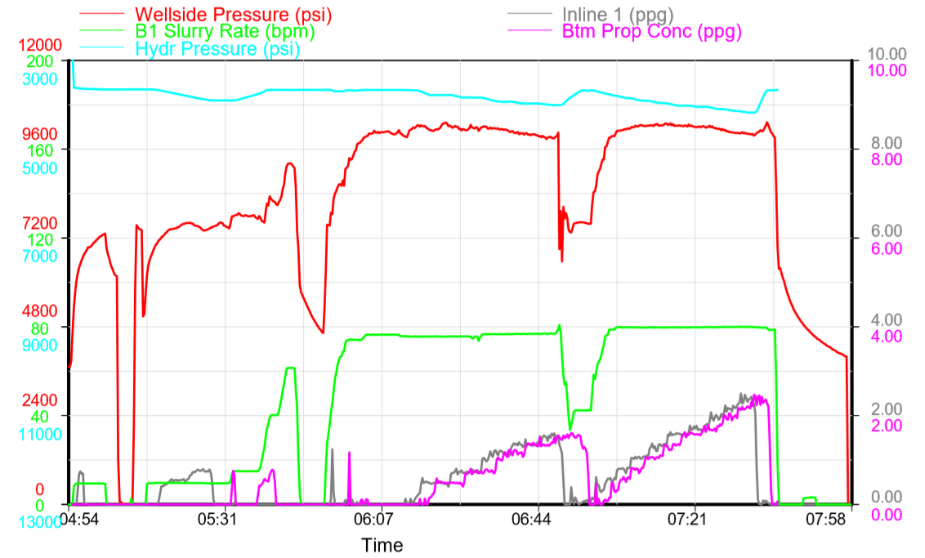
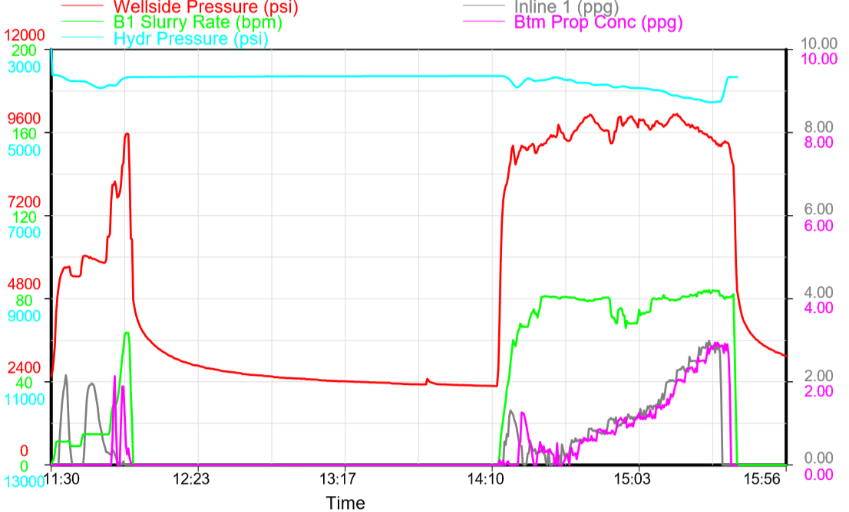
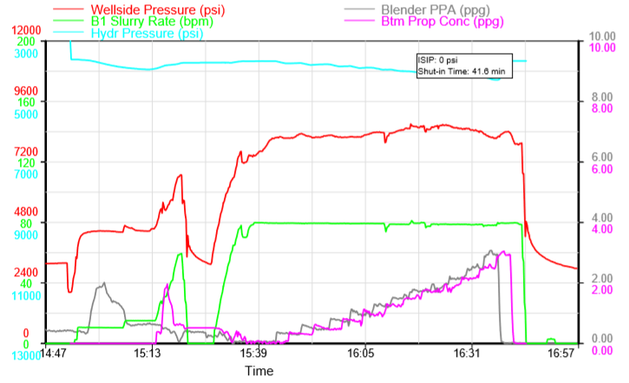
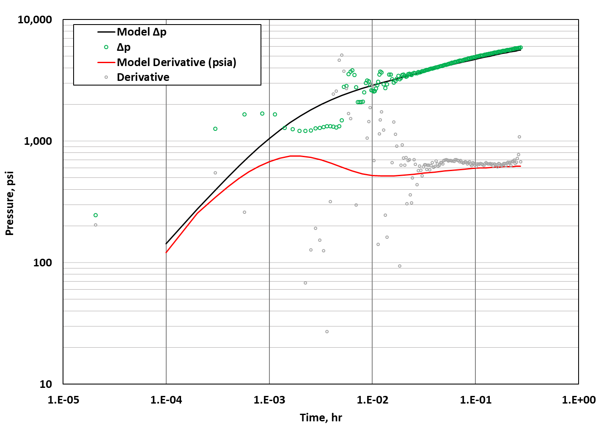
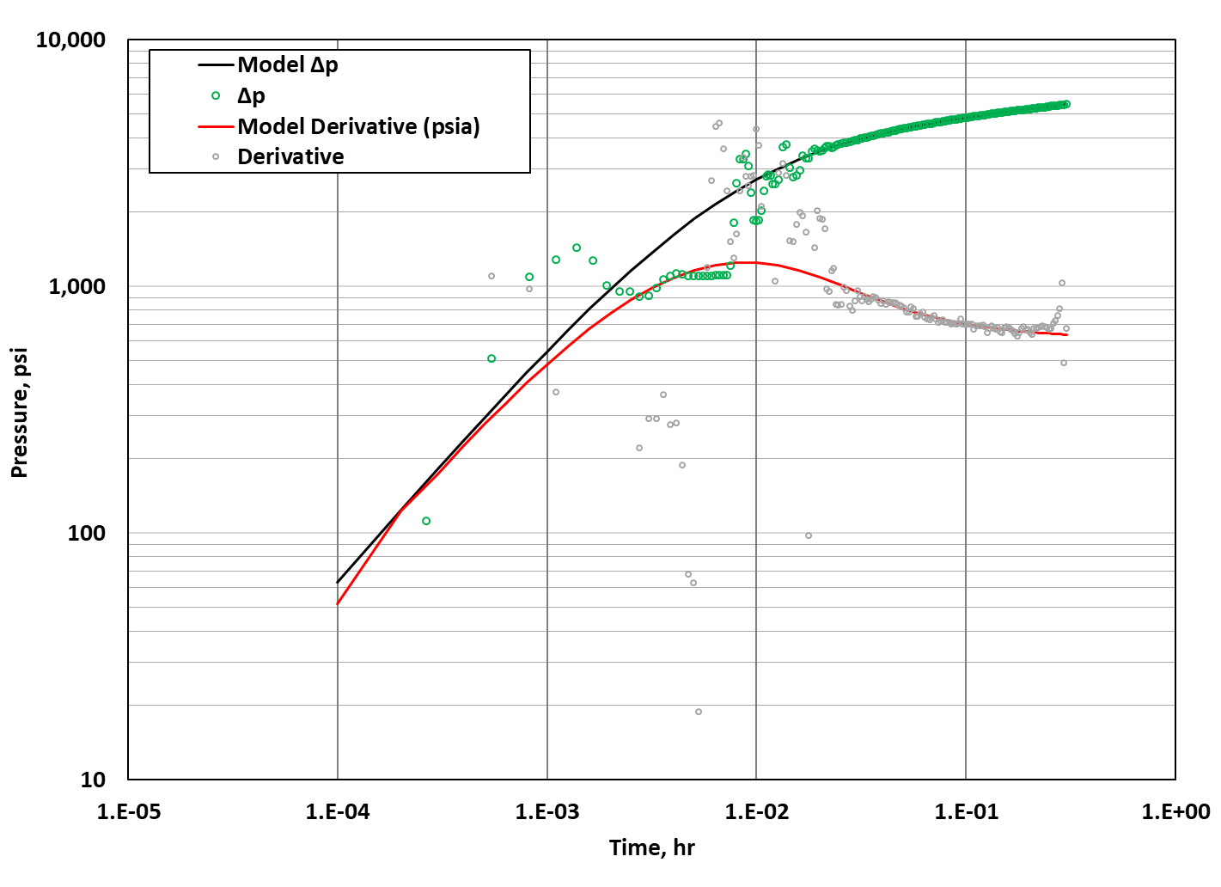
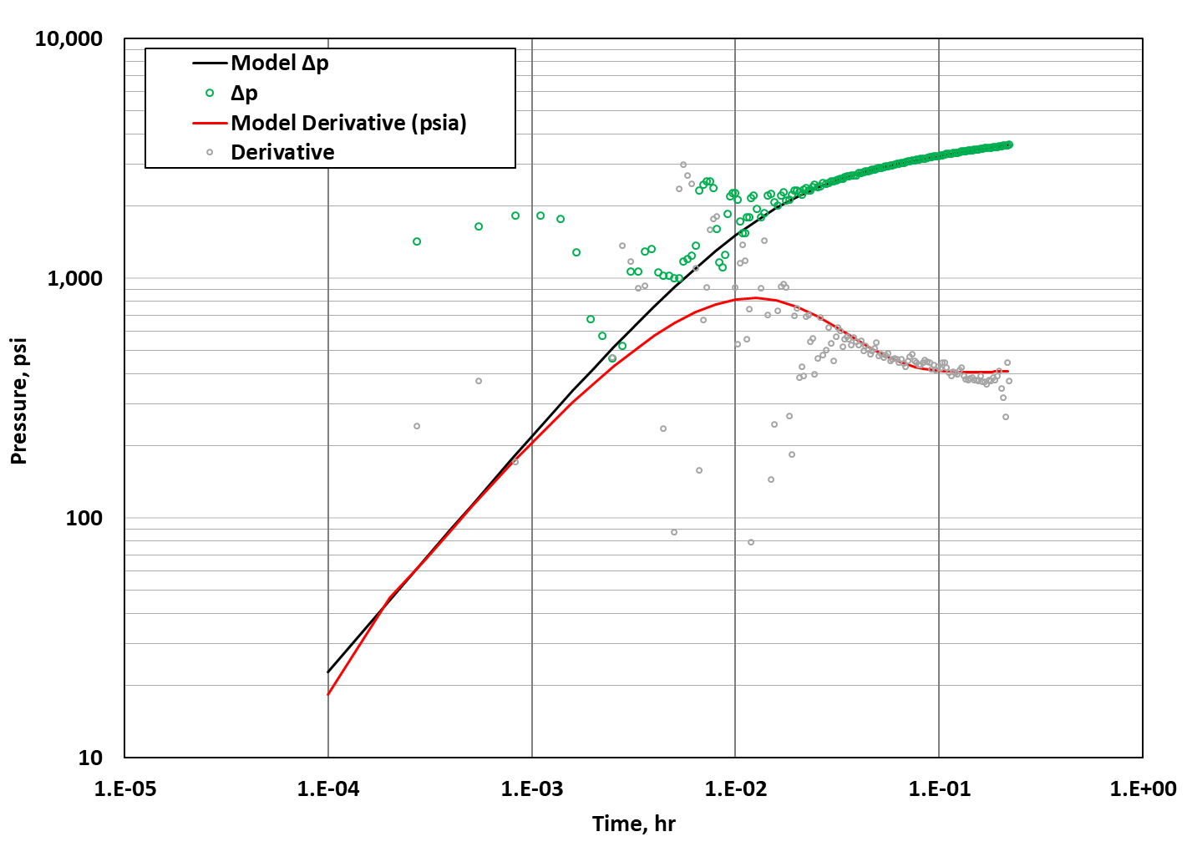
Ongoing Projects
2. Characterization of Frac Stage Geometry and Conductivity
Injection History
Pressure log-log Plot and Model Match
UNCONVENTIONAL RESERVOIR ENGINEERING PROJECT
Advisory Board Meeting, November 8, 2019, Golden, Colorado

Slide 20
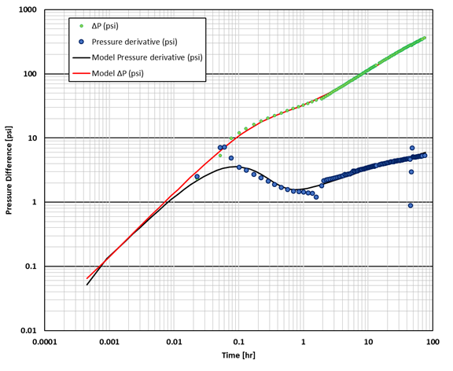
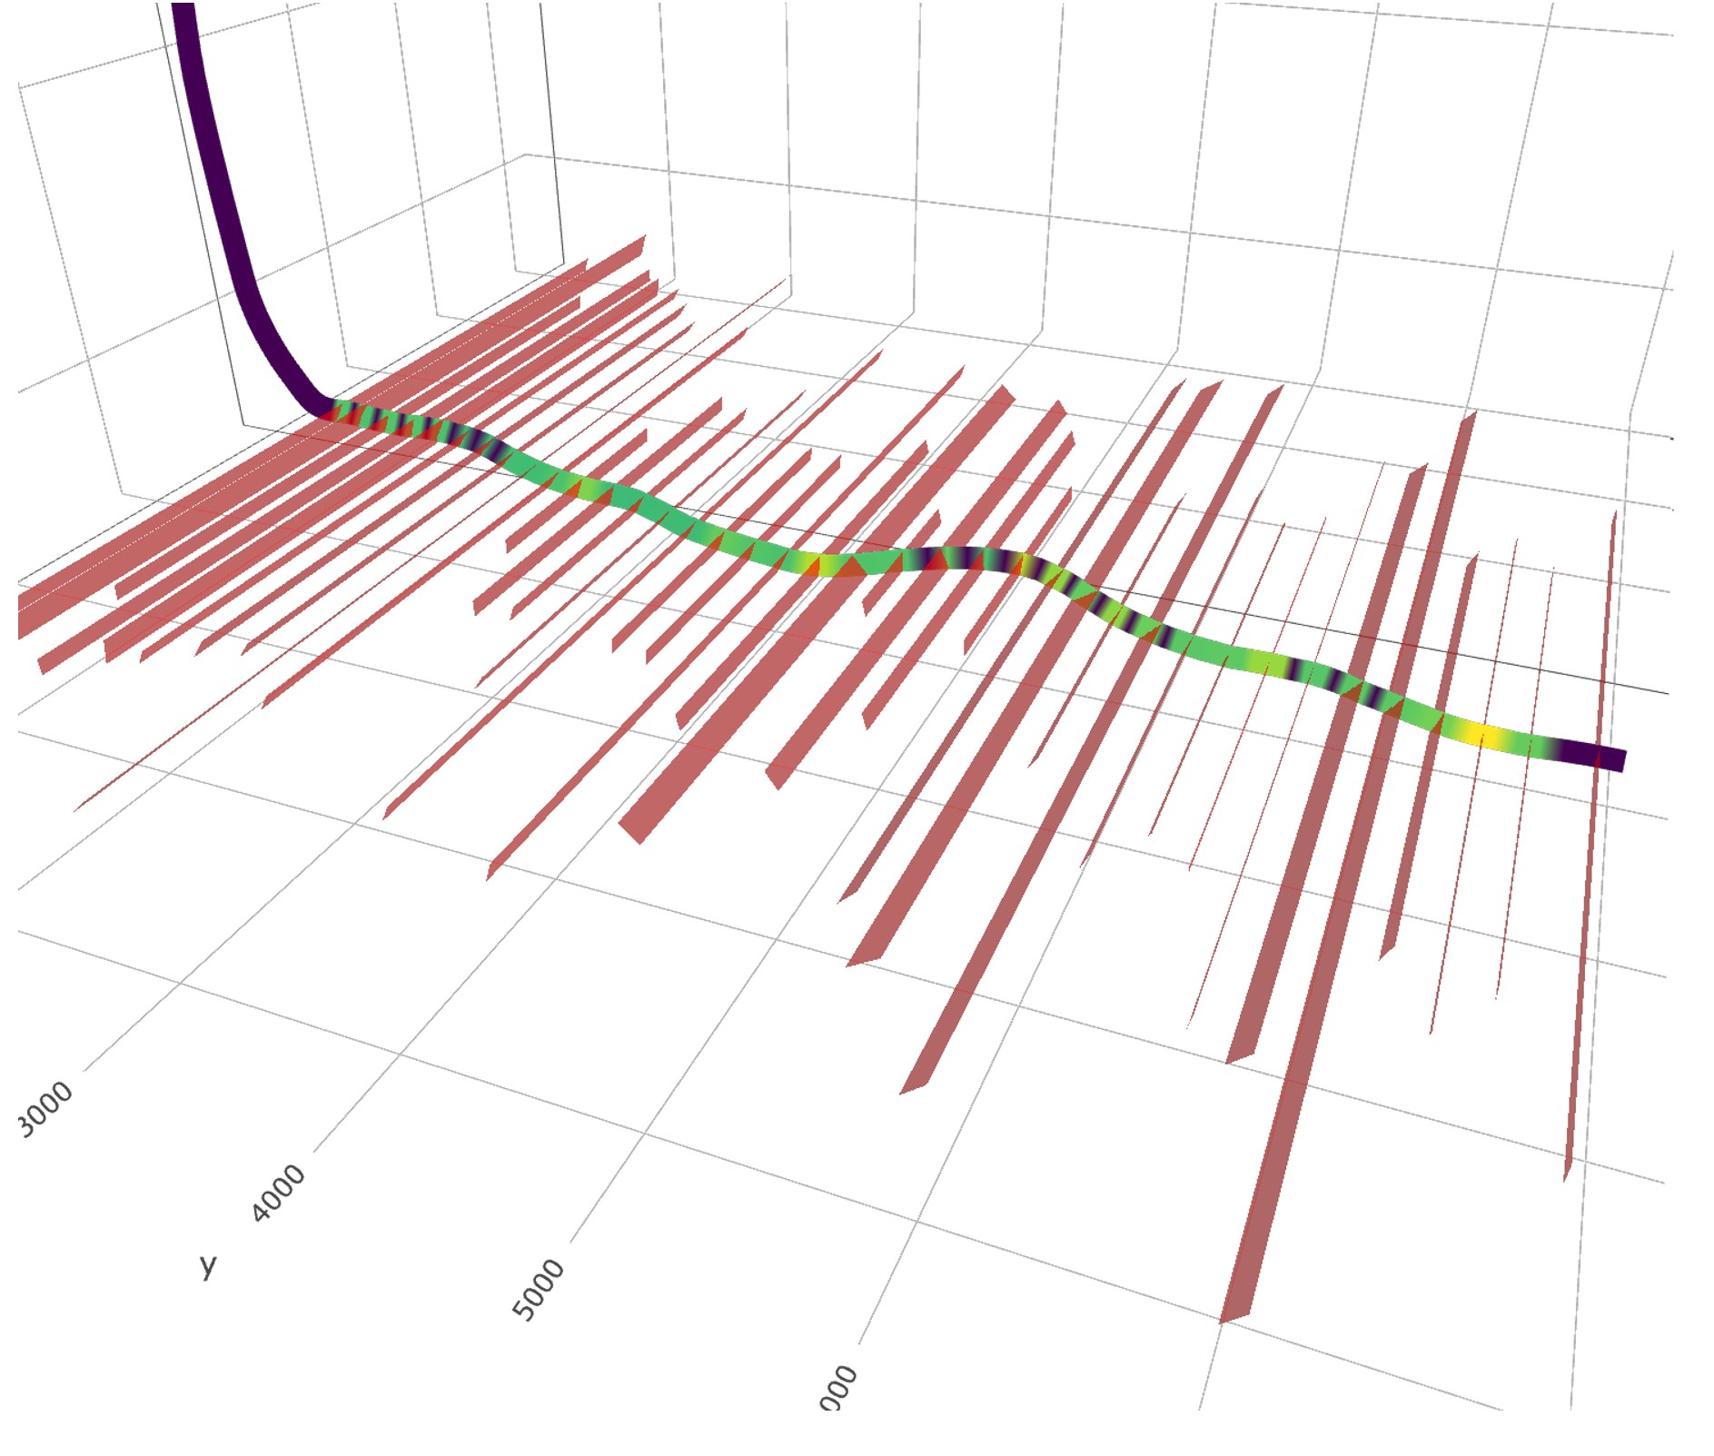
Ongoing Projects
2. Characterization of Frac Stage Geometry and Conductivity
SRV_{(Buildup)} = 81 acres
SRV_{(Buildup)} = 61 acres
SRV_{(StagexStage)} > SRV_{(Buildup)}
UNCONVENTIONAL RESERVOIR ENGINEERING PROJECT
Advisory Board Meeting, November 8, 2019, Golden, Colorado

Slide 21
Thank you
Questions?
UNCONVENTIONAL RESERVOIR ENGINEERING PROJECT
Advisory Board Meeting, November 8, 2019, Golden, Colorado

