Slide 1
Coupled Geomechanics and Flow Simulation
Philip H. Winterfeld
Research Associate Professor
Colorado School of Mines

Slide 2
Introduction
Geomechanics should be considered, as well as flow, when simulating processes such as CO₂ sequestration, geothermal energy production, and enhanced oil and gas recovery
TOUGH2-CSM: fully coupled simulator for modeling thermal-hydrological-mechanical effects in fractured and porous media
Based on TOUGH2-MP multiphase, multiple porosity fluid and heat flow formulation
Geomechanical effects added to TOUGH2-MP: simplified Mean Stress formulation; full stress tensor formulation

Slide 3
Geomechanical Equations
Hooke’s law for thermo-multi-poroelastic medium:
Strain tensor definition:
Static equilibrium equation: $∇∙\overset{̿}{τ}+{\overline{F}}_{b}=0$
Combine into thermo-multi-poroelastic (TMP) Navier equation ($h\left(\overline{P},\overline{T}\right)$ is above summation term):
$\overset{̿}{τ}−\sum_{j}{\left(α_{j}P_{j}+3βKω_{j}\left(T_{j}−T_{ref}\right)\right)}=λε_{v}+2G\overset{̿}{ε}$
$\overset{̿}{ε}=\frac{1}{2}\left(∇\overline{u}+{∇\overline{u}}^{t}\right)$
$$\left(λ+G\right)∇ε_{v}+G∇^{2}\overline{u}+∇h\left(\overline{P},\overline{T}\right)+{\overline{F}}_{b}=0$$

Slide 4
Mean Stress Equation
Divergence of TMP Navier equation is Mean Stress Equation:
Trace of Hooke’s law: volumetric strain equation
Simplified geomechanical formulation: fully coupled solution for mean stress and volumetric strain along with fluid and heat flow; k and ϕ depend on effective stress ($τ_{m}−h\left(\overline{P},\overline{T}\right)$)
$$∇∙\left[\frac{3\left(1−υ\right)}{1+υ}∇τ_{m}+{\overline{F}}_{b}−\frac{2\left(1−2υ\right)}{1+υ}∇h\left(\overline{P},\overline{T}\right)\right]=0$$
$${Kε}_{v}=τ_{m}−h\left(\overline{P},\overline{T}\right)$$

Slide 5
Normal and Shear Stresses
TMP Navier equation is a vector equation, so each component and its derivatives are zero; normal and shear stresses obtained from the derivatives
Normal stress (xx-component):
Shear stress (xy-component):
$$∇∙\left[\left[\frac{2υ−1}{1+υ}\frac{∂h\left(\overline{P},\overline{T}\right)}{∂x}+\frac{3}{1+υ}\frac{∂τ_{m}}{∂x}+2F_{b,x}\right]\hat{i}+∇\left[τ_{xx}−{\frac{3}{1+υ}τ}_{m}+\frac{2υ−1}{1+υ}h\left(\overline{P},\overline{T}\right)\right]\right]=0$$
$$∇∙\left[\begin{aligned}\left[\frac{∂h\left(\overline{P},\overline{T}\right)}{∂y}+\frac{3}{2\left(1+υ\right)}\frac{∂\left(τ_{m}−h\left(\overline{P},\overline{T}\right)\right)}{∂y}+F_{b,y}\right]\hat{i}+ \\ \left[\frac{∂h\left(\overline{P},\overline{T}\right)}{∂x}+\frac{3}{2\left(1+υ\right)}\frac{∂\left(τ_{m}−h\left(\overline{P},\overline{T}\right)\right)}{∂x}+F_{b,x}\right]\hat{j}+∇τ_{xy}\end{aligned}\right]=0$$

Slide 6
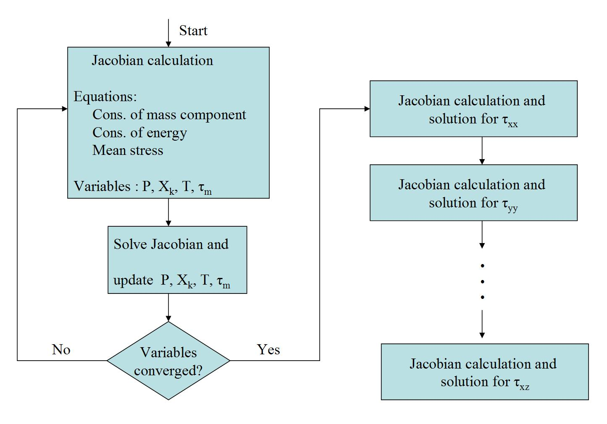
Finite-Difference Solution

Slide 7
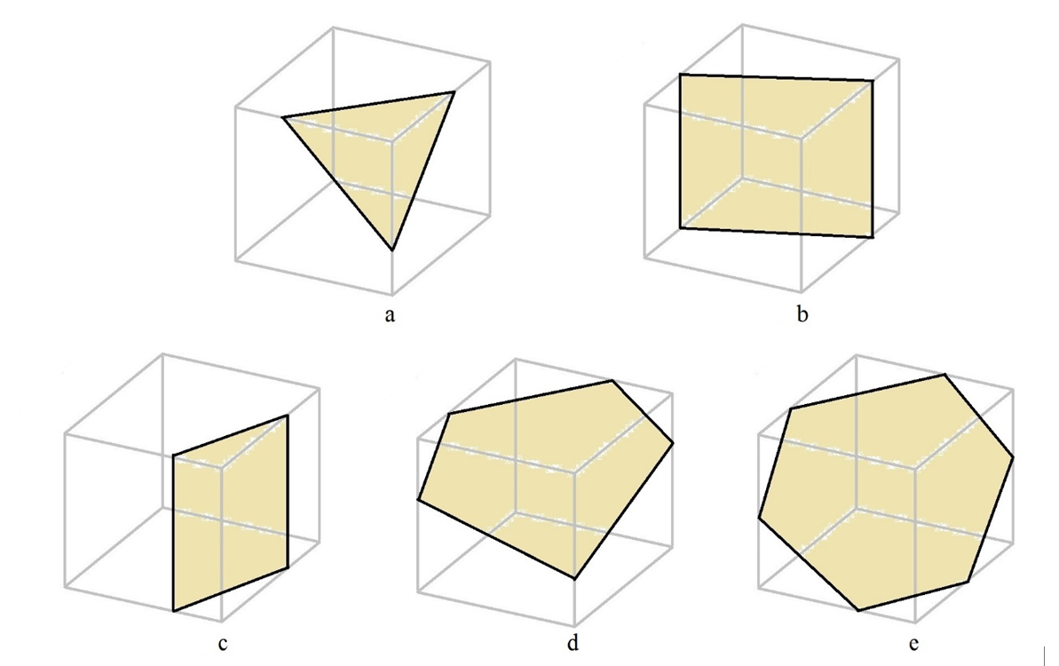
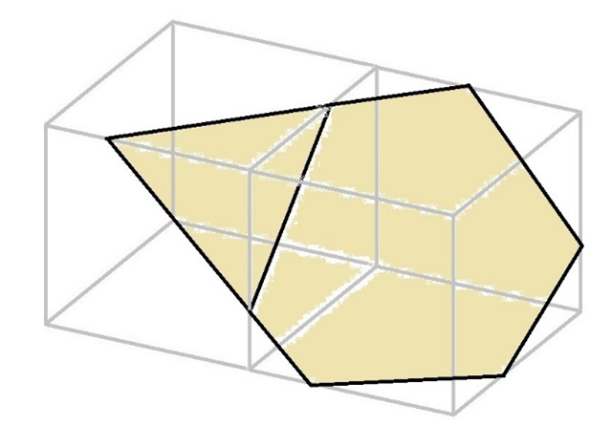
Discrete Fractures, I
EDFM method - Lee et al. (2001), Li and Lee (2008), Moinfar et
al. (2014)
Primary grid is Cartesian
Fracture – planar rectangular region
with associated aperture
Fracture plane that intersects a grid block
contributes fracture volume to it
Fracture communication: Cartesian neighbors,
volumes in both have contributions from the same fracture

Slide 8
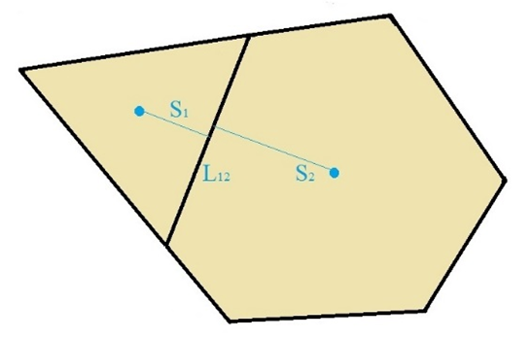
Discrete Fractures, II
Mass and energy conservation, and geomechanics
Grid block fracture volume - sum over fractures
Fracture flow between grid blocks and
matrix-fracture flow within grid blocks
Matrix and fracture volumes each have TOUGH2-CSM
primary variables associated with them
Mixture of single porosity (matrix) and double porosity (matrix
and fracture) grid blocks

Slide 9
In Salah Gas Project
Krechba gas field at In Salah - first industrial scale on-shore CO₂ storage demonstration project
Satellite-based ground-deformation monitoring measures surface uplift caused by CO₂ injection
Rutqvist et al. (2010): TOUGH2-FLAC simulation
4 geological layers
Horizontal injection well in center of Injection Zone, injection for
three years
TOUGH2-CSM simulation using simplified Mean Stress model
9

Slide 10
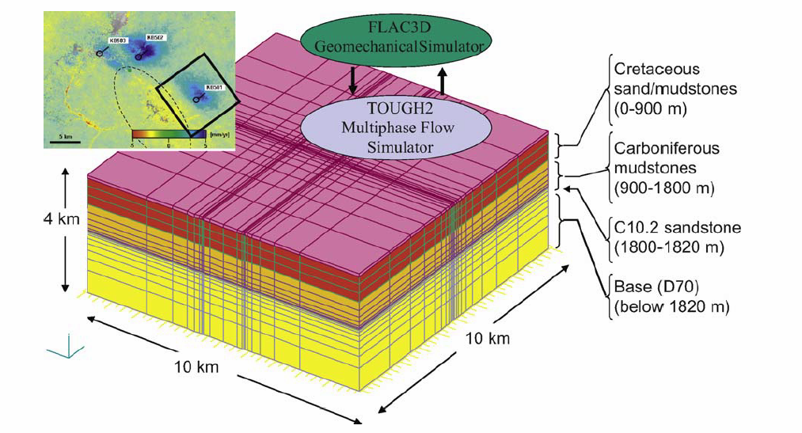
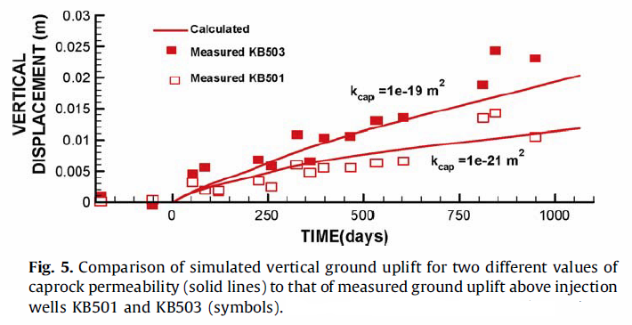
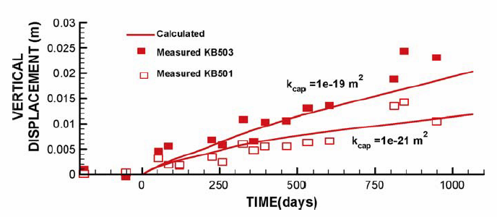
Rutqvist et al. (2010) Simulation
10

Slide 11
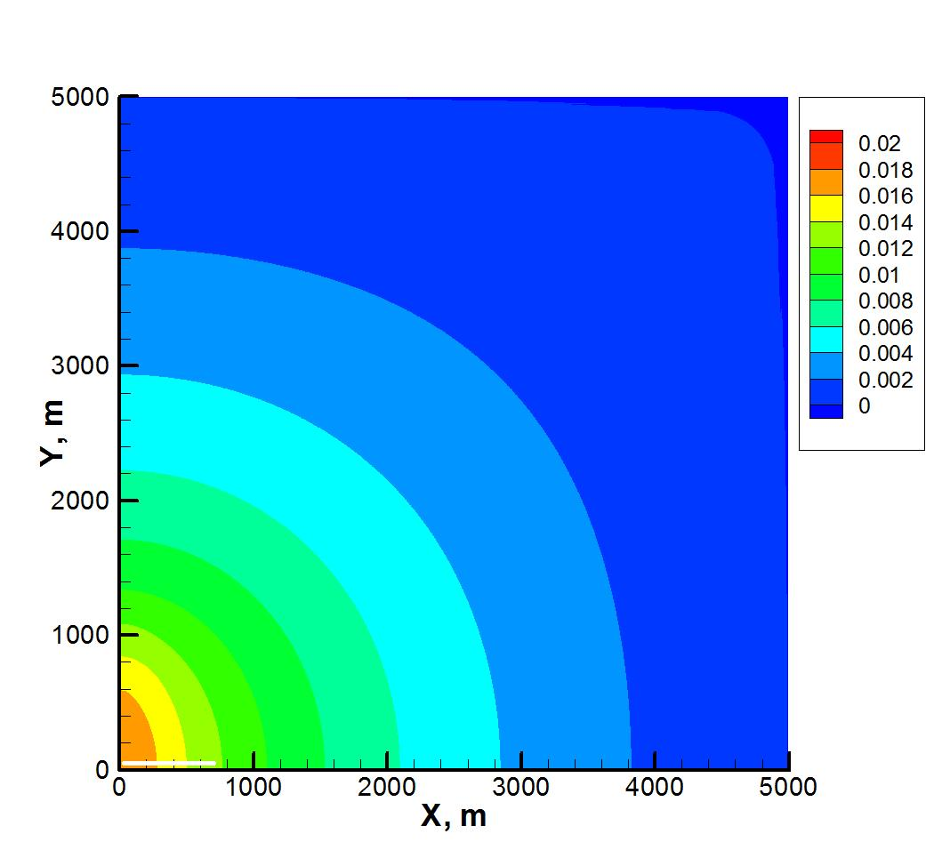
TOUGH2-CSM Simulation
Figure 6.2. Surface uplift, m, for TOUGH2-CSM In Salah CO₂ injection simulation; injection well shown by thick horizontal line at origin.

Slide 12
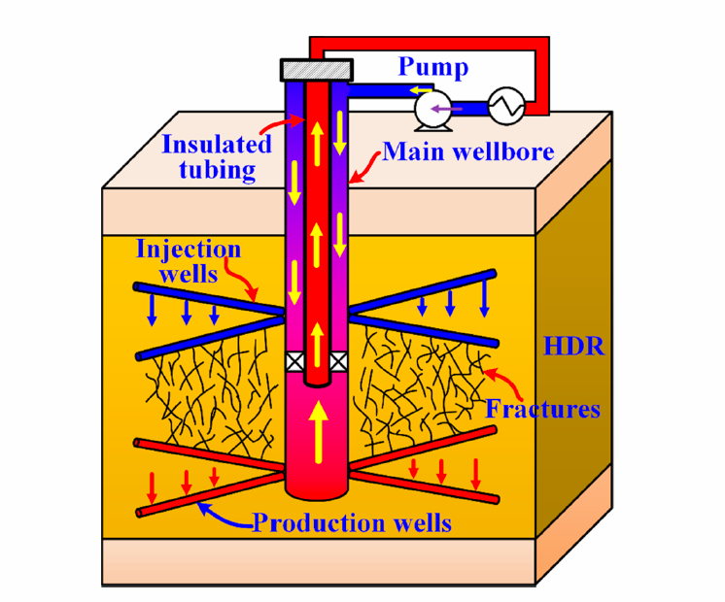
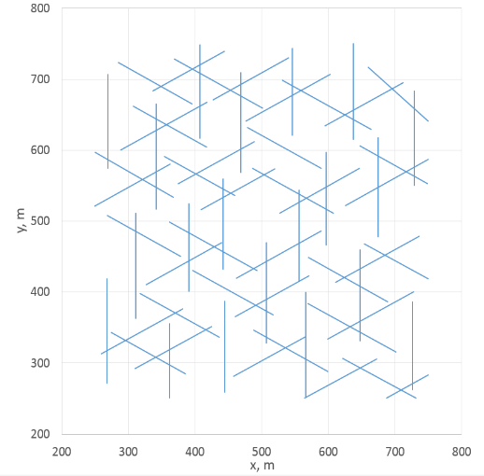
EGS Simulation
Shi (2019) - one main wellbore with injection and production simultaneously, multilateral wells (6 arms)
1000 m cube, 500 m fractured central
cube long surrounded by rock
60 vertical fractures, 20 each 30°, 90°,
and 150° in xy-plane, from injector to
producer
200 °C at the top, scCO₂ at 60 °C,
50 kg/s injected for thirty years
Stress dependent fracture permeability;
fluid and heat flow, and geomechanics

Slide 13
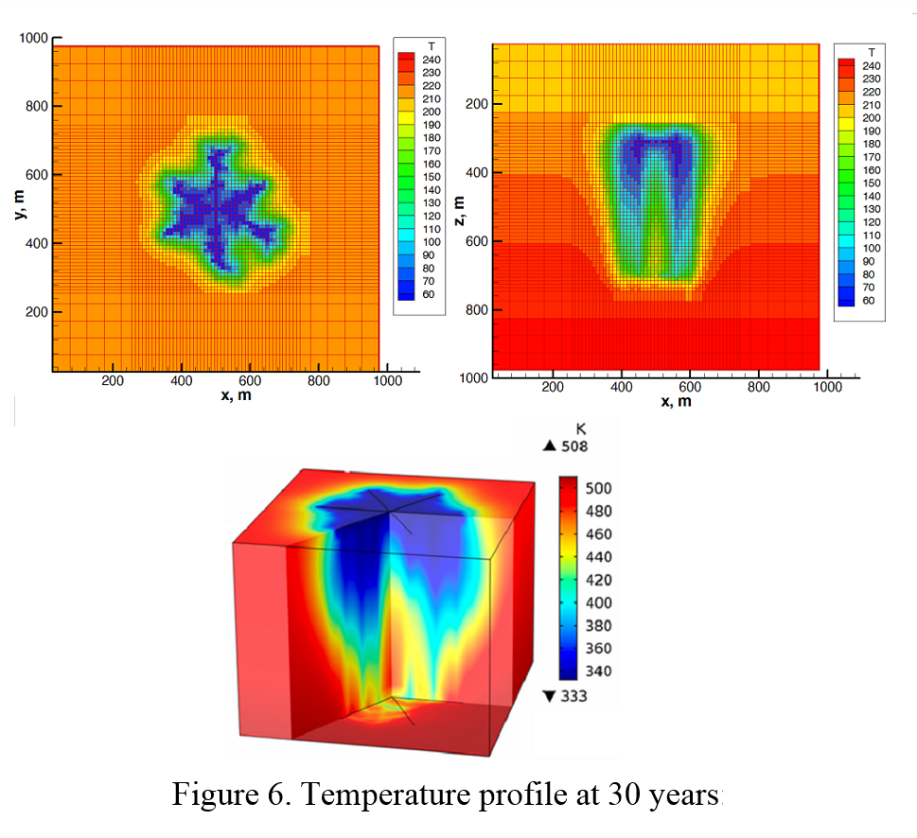
Simulation Comparison

Slide 14
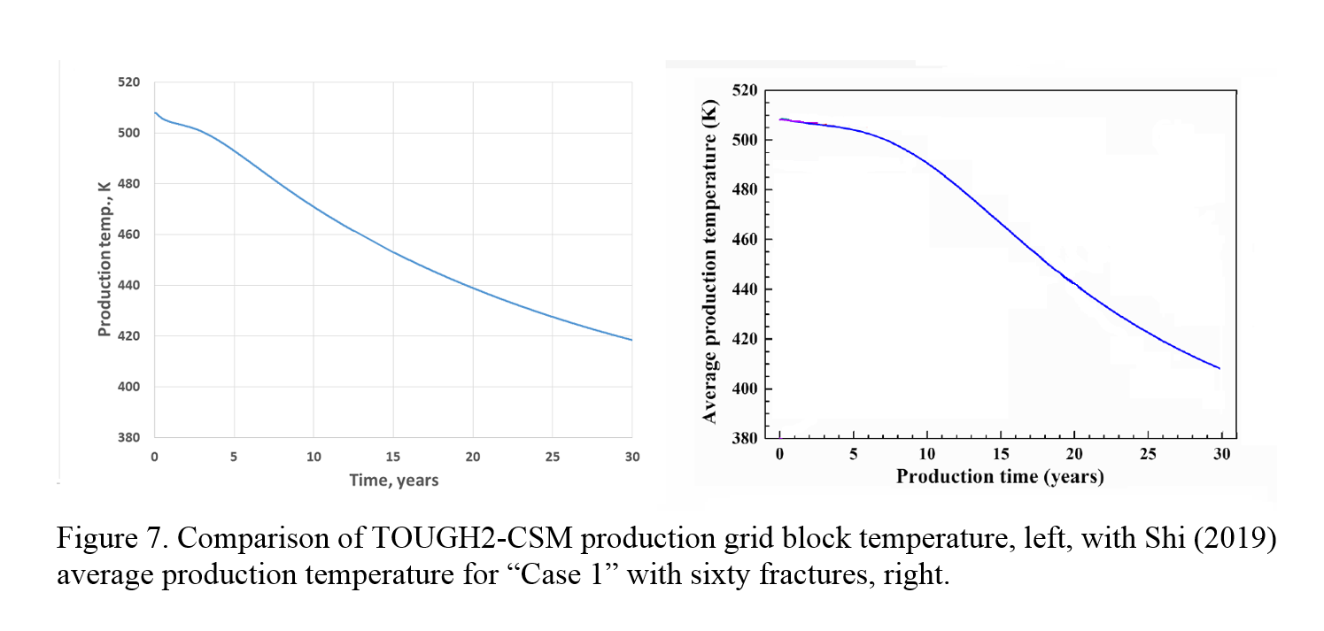
Simulation Comparison, II

Slide 15
Thank You
Any Questions?

