Slide 1
UNCONVENTIONAL RESERVOIR ENGINEERING PROJECT
Colorado School of Mines
U R E P
CSM
Permian Basin Oil and Gas Wells Production Trend and Analysis
Ozan Uzun, PhD Student
Colorado School of Mines
UNCONVENTIONAL RESERVOIR ENGINEERING PROJECT
1
Advisory Board Meeting, November 8, 2019, Golden, Colorado

Slide 2
Permian Basin and Project Objective
The Permian Basin is a most prolific oil and gas producing geologic basins in the United Sates, spanning West Texas and Southeastern New Mexico. It has produced more than 33.4 Bbbl of oil and 118 Tcf of natural gas during a 100-year period (EIA 2018).
The ever increasing water production and usage in the Permian Basin requires water management—a major issue.
The objective is to evaluate production trends of Permian wells, and improve future oil and gas recovery.
UNCONVENTIONAL RESERVOIR ENGINEERING PROJECT
Advisory Board Meeting, November 8, 2019, Golden, Colorado

Slide 3
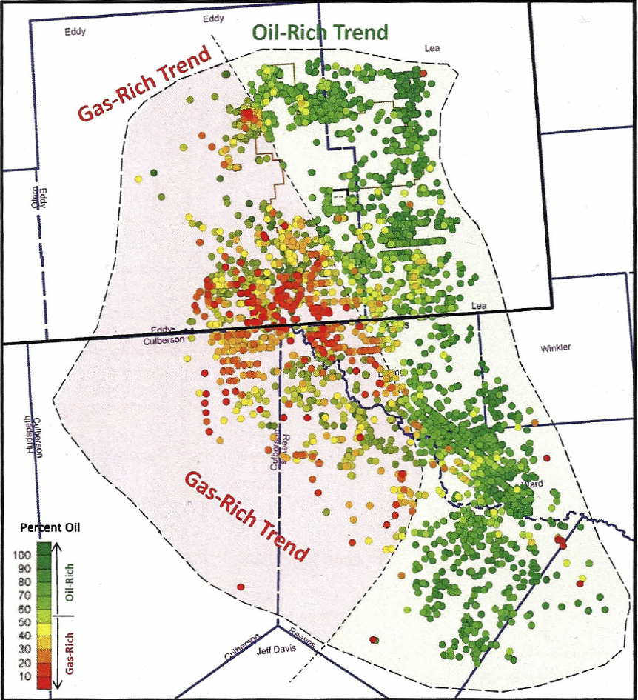
Oil (Green) and Gas (Red) Production Map
The ultimate hydrocarbon recovery potential is a function of:
Thermal maturity
Lithology
Mineralogy
Pore Type
Fluid Properties
(Dilli 2019)
UNCONVENTIONAL RESERVOIR ENGINEERING PROJECT
Advisory Board Meeting, November 8, 2019, Golden, Colorado

Slide 4
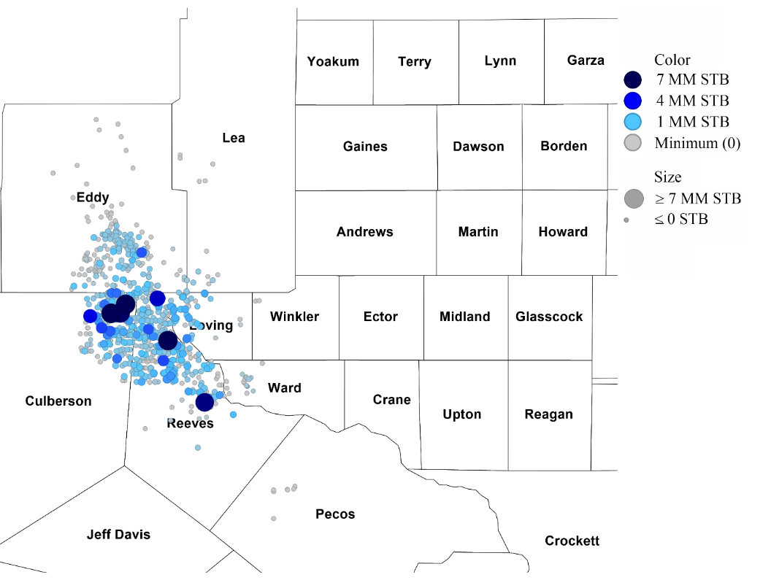
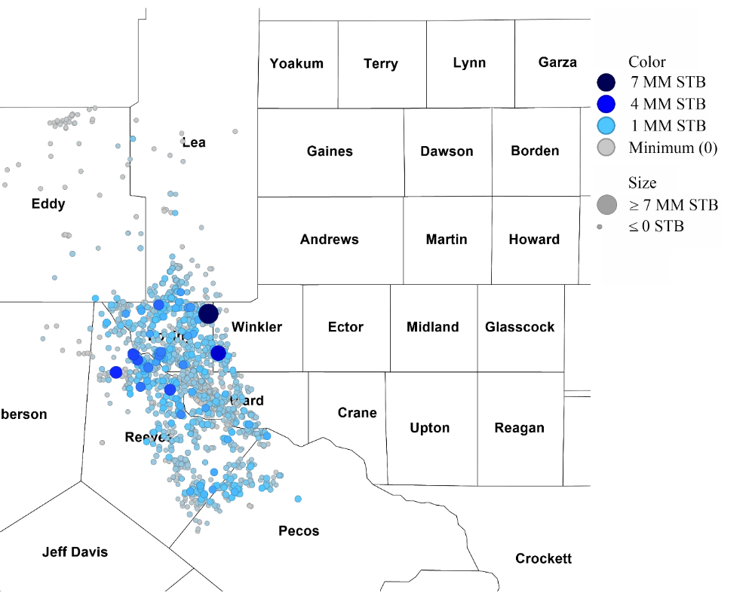
Water Production Map
Water Production from Gas Wells
Water Production from Oil Wells
(Source: DrillingInfo 2019)
UNCONVENTIONAL RESERVOIR ENGINEERING PROJECT
Advisory Board Meeting, November 8, 2019, Golden, Colorado

Slide 5
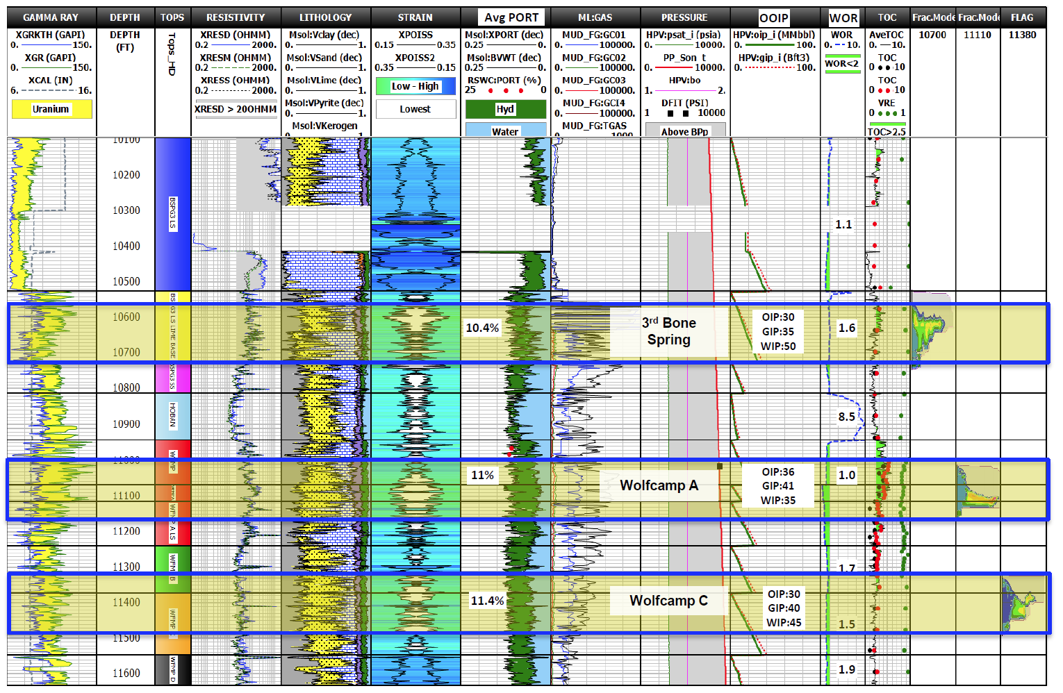
Water Bearing Layers in Wolfcamp Formation
(Polasek 2017)
UNCONVENTIONAL RESERVOIR ENGINEERING PROJECT
Advisory Board Meeting, November 8, 2019, Golden, Colorado

Slide 6
Current Accomplishments
Conducted experiments on selected cores to determine permeability, porosity, and pore compressibility.
Compared static and dynamic elastic properties E, K, ν for four wells from existing reports.
Conducted Rate Transient Analysis (RTA) on six wells to determine the stimulated formation permeability to assess stimulation effectiveness.
UNCONVENTIONAL RESERVOIR ENGINEERING PROJECT
Advisory Board Meeting, November 8, 2019, Golden, Colorado

Slide 7
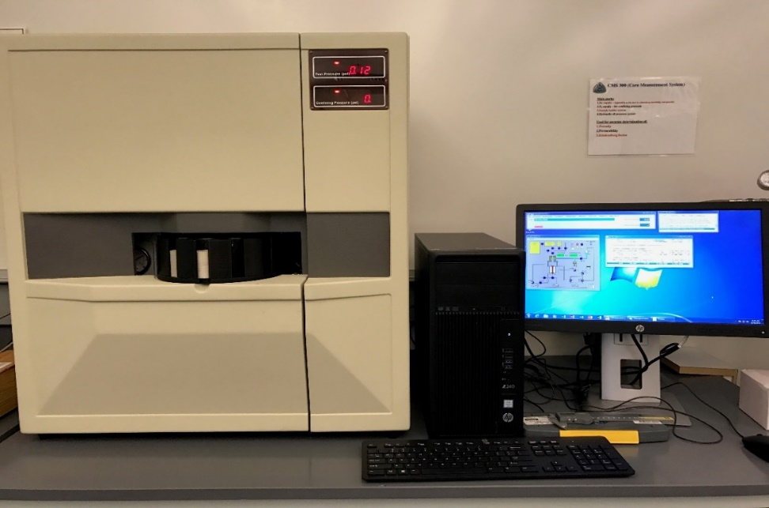
Porosity and Permeability Measurements
UNCONVENTIONAL RESERVOIR ENGINEERING PROJECT
Advisory Board Meeting, November 8, 2019, Golden, Colorado

Slide 8
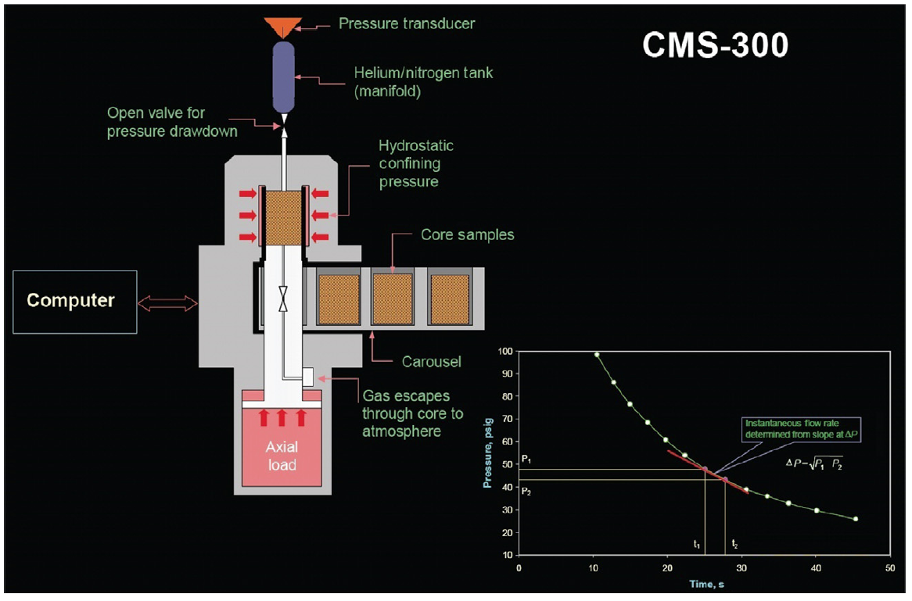
Porosity and Permeability Measurements
(Cubitt and Wales, 2015)
UNCONVENTIONAL RESERVOIR ENGINEERING PROJECT
Advisory Board Meeting, November 8, 2019, Golden, Colorado

Slide 9
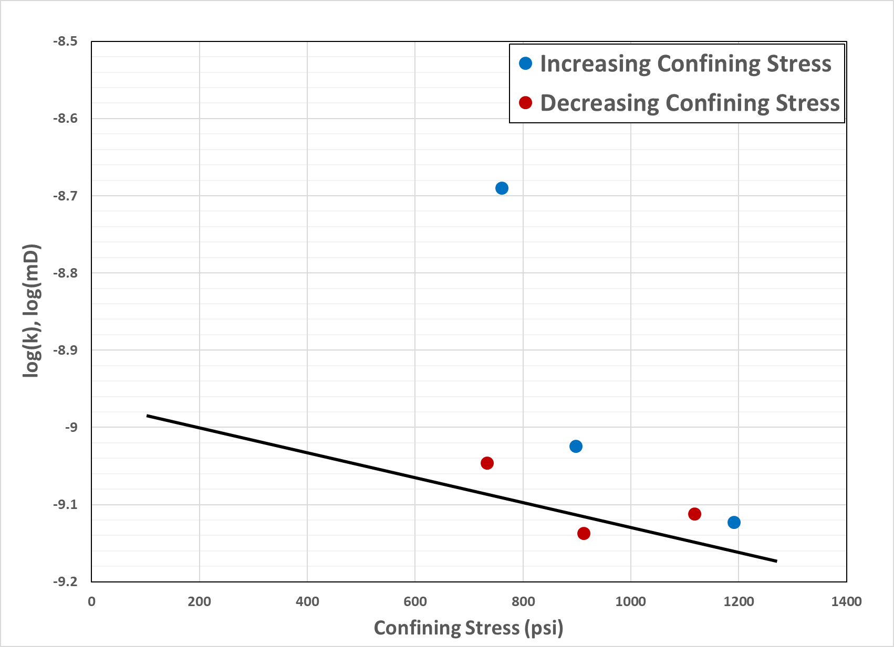
Porosity-permeability-compressibility Relationship
UNCONVENTIONAL RESERVOIR ENGINEERING PROJECT
Advisory Board Meeting, November 8, 2019, Golden, Colorado

Slide 10
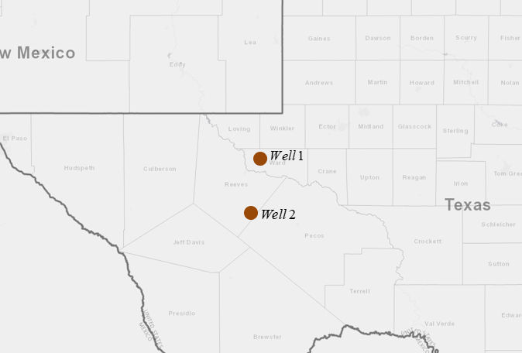
Correlating Well 1 and 2 Porosity and Permeability Data
(Source: DrillingInfo 2019)
UNCONVENTIONAL RESERVOIR ENGINEERING PROJECT
Advisory Board Meeting, November 8, 2019, Golden, Colorado

Slide 11
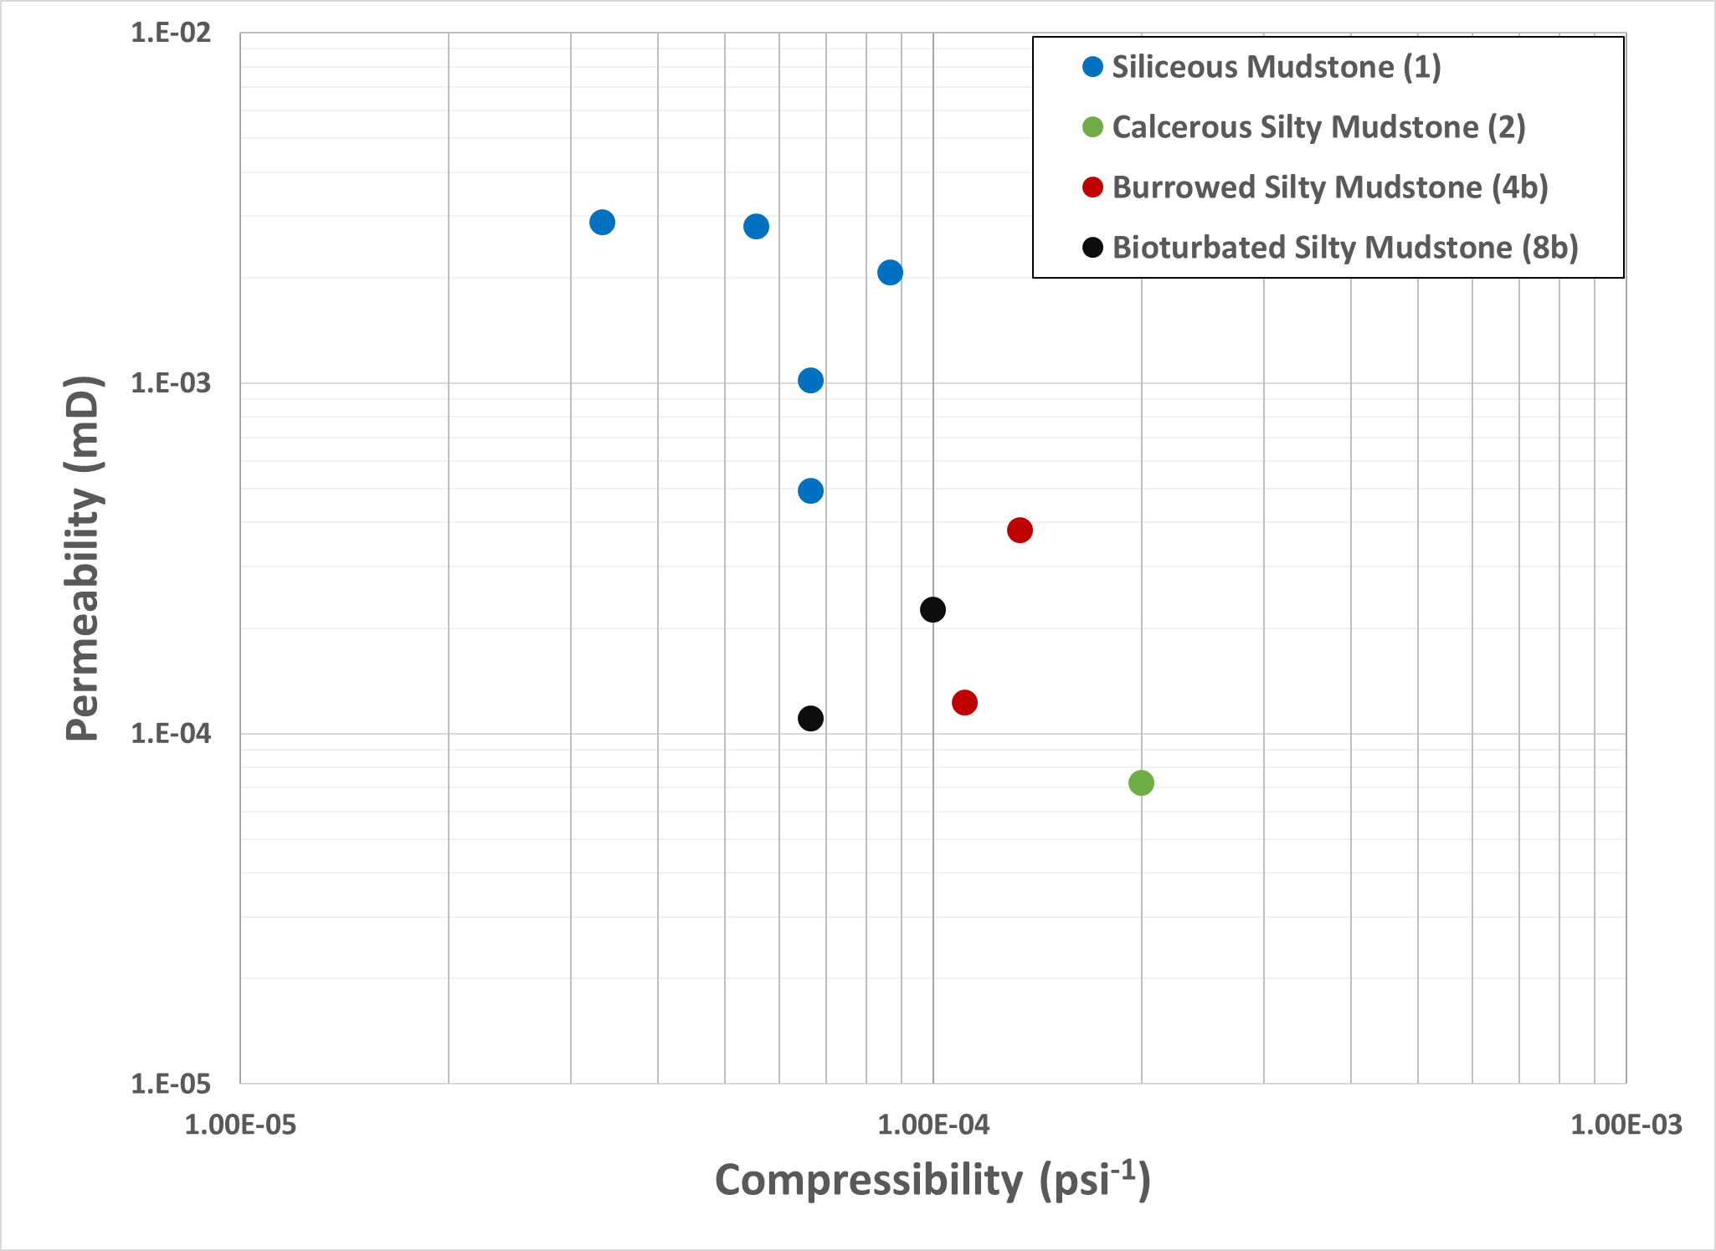
Compressibility vs Permeability Trend
UNCONVENTIONAL RESERVOIR ENGINEERING PROJECT
Advisory Board Meeting, November 8, 2019, Golden, Colorado

Slide 12
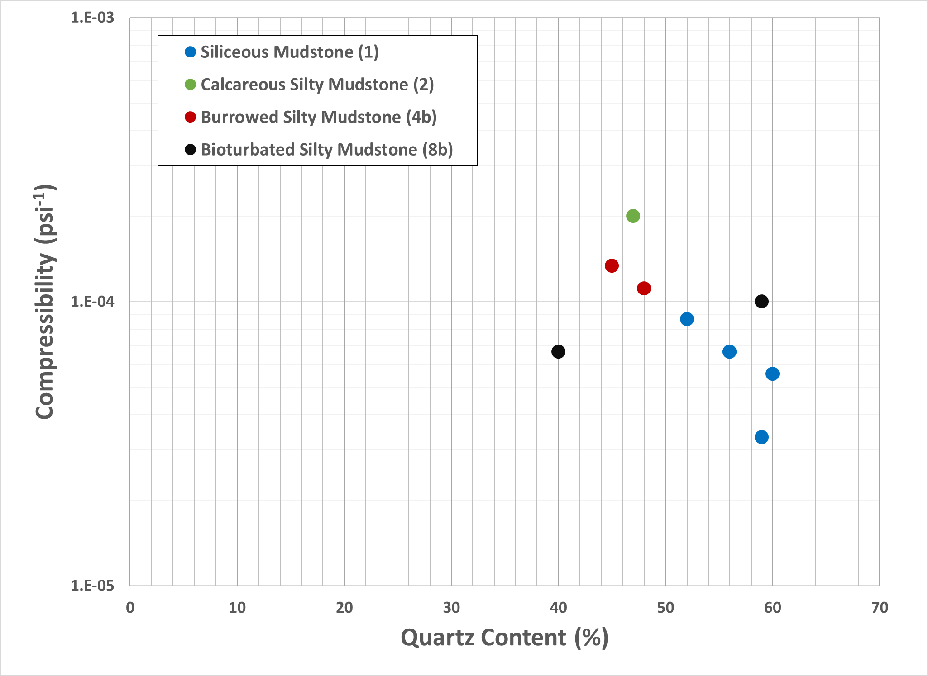
Compressibility vs Quartz Content Trend
Decreasing compressibility with increasing Quartz content
Effect on Brittleness
(Rickman et al. 2008)
(Jarvie et al. 2007)
UNCONVENTIONAL RESERVOIR ENGINEERING PROJECT
Advisory Board Meeting, November 8, 2019, Golden, Colorado

Slide 13
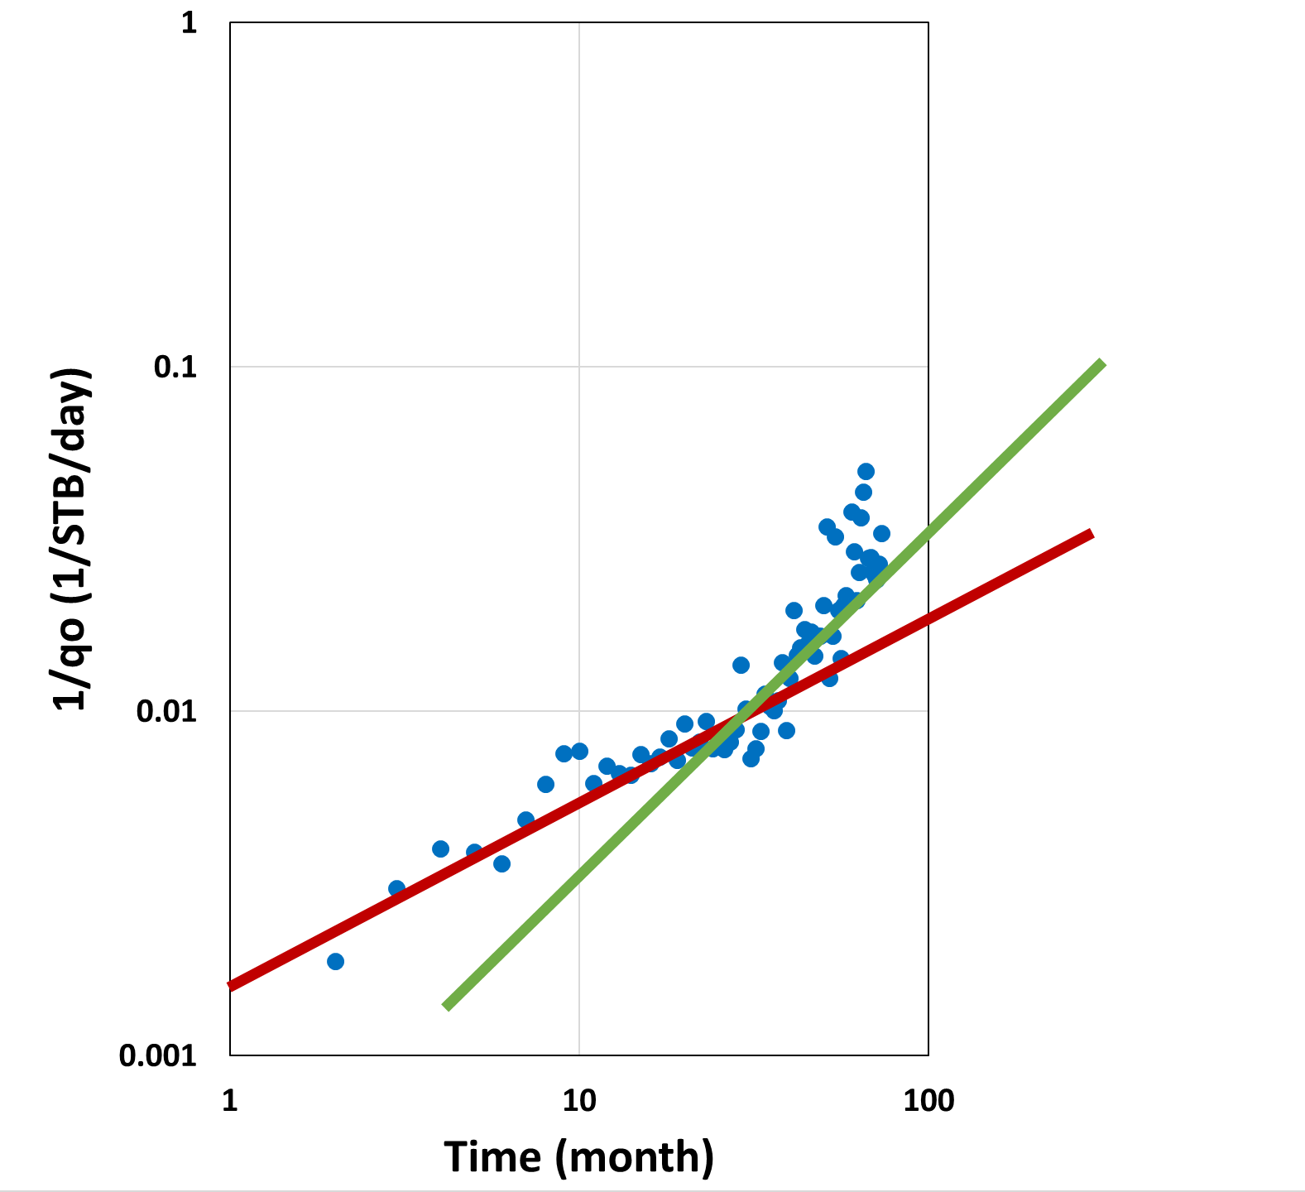
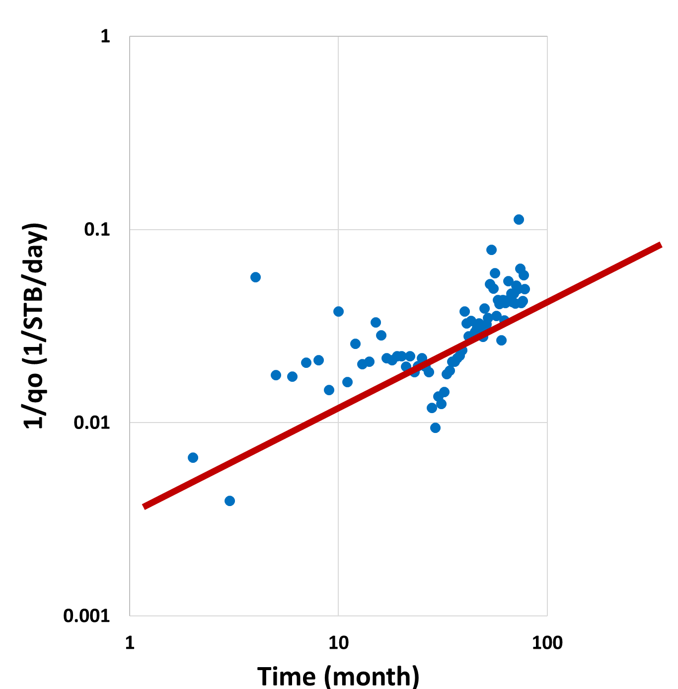
Rate Transient Analysis for Well 1 and Well 2
Diagnostic Plot for Well 1
Diagnostic Plot for Well 2
(Source: DrillingInfo 2019)
UNCONVENTIONAL RESERVOIR ENGINEERING PROJECT
Advisory Board Meeting, November 8, 2019, Golden, Colorado

Slide 14
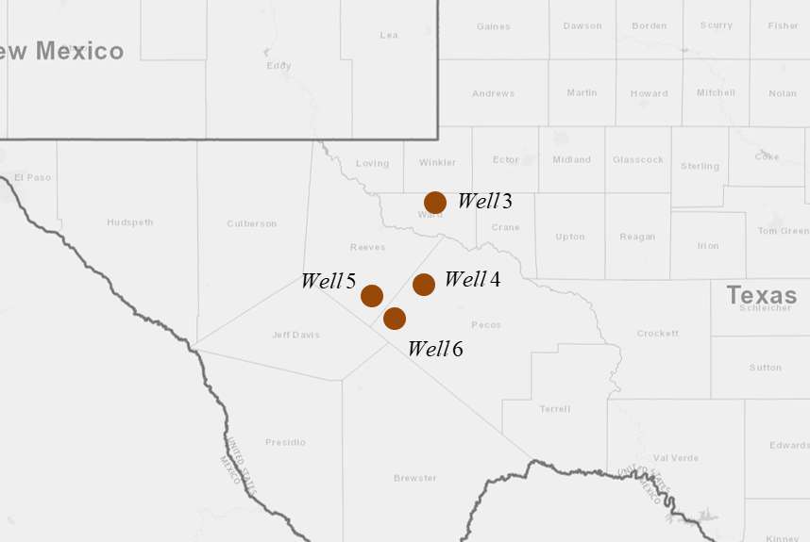
Correlating Well 3, 4, 5, and 6 Elastic Properties
(Source: DrillingInfo 2019)
UNCONVENTIONAL RESERVOIR ENGINEERING PROJECT
Advisory Board Meeting, November 8, 2019, Golden, Colorado

Slide 15
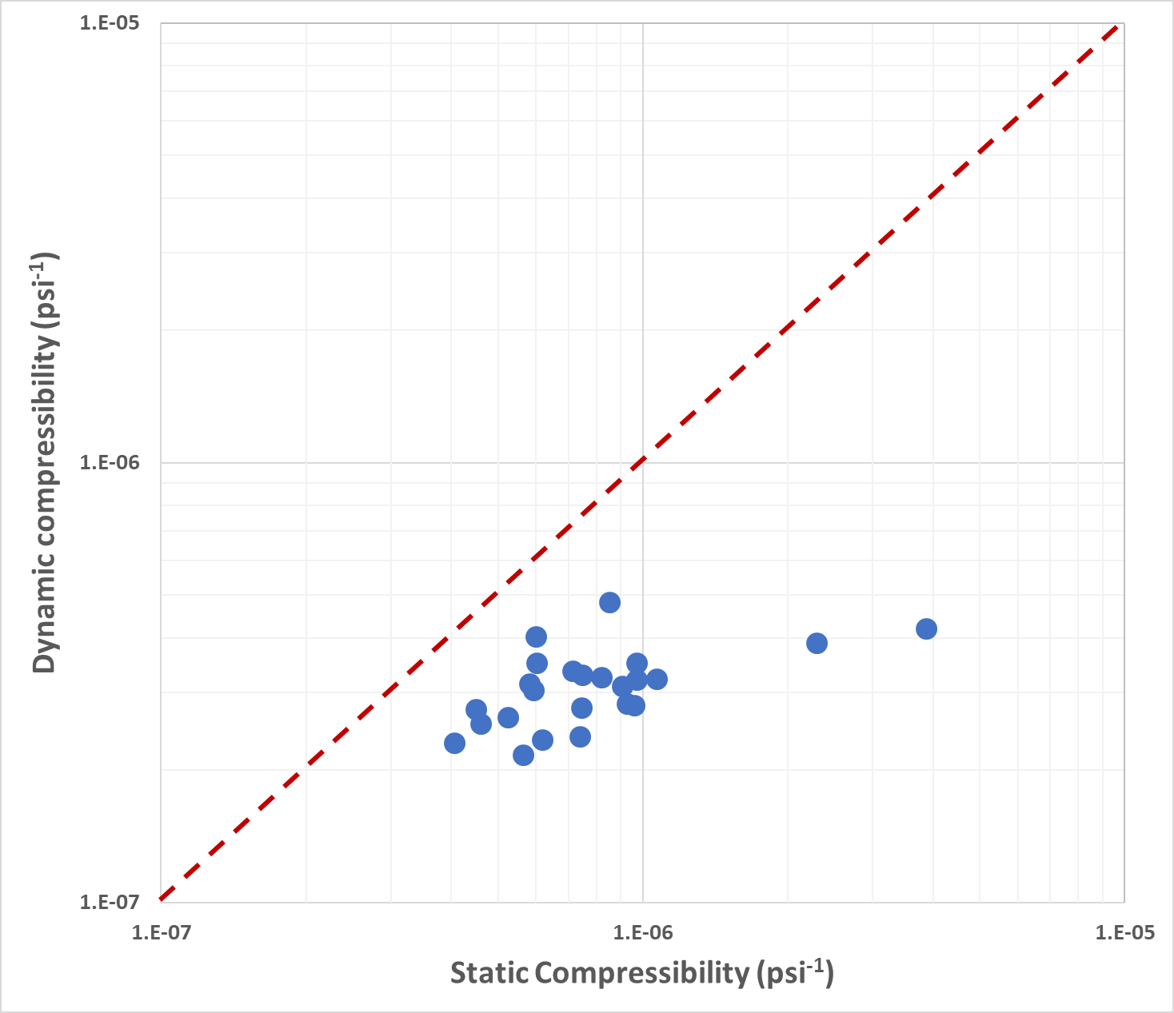
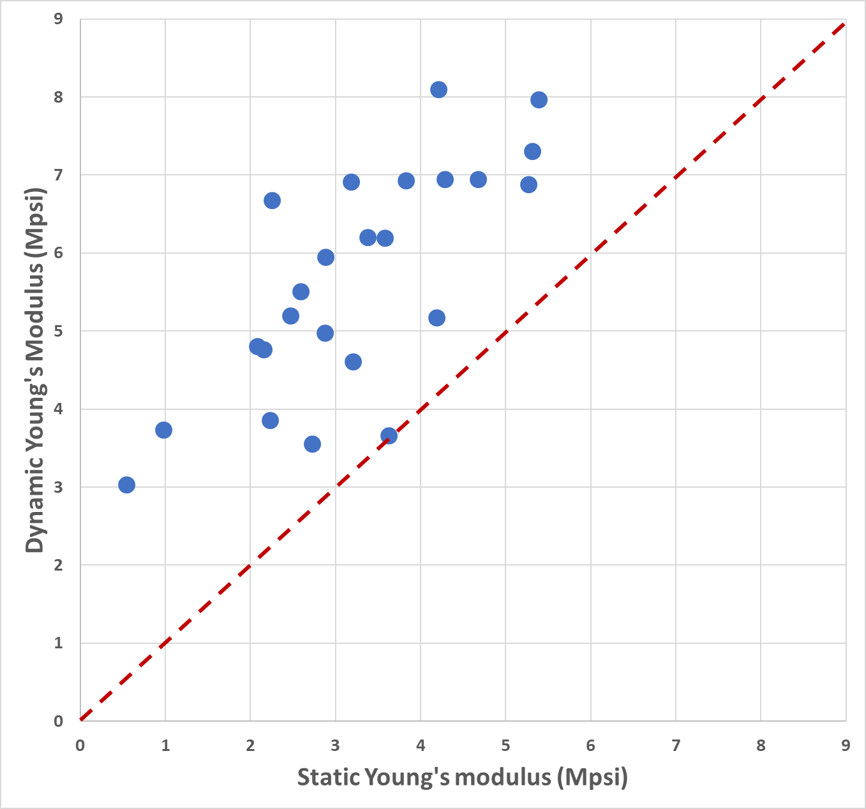
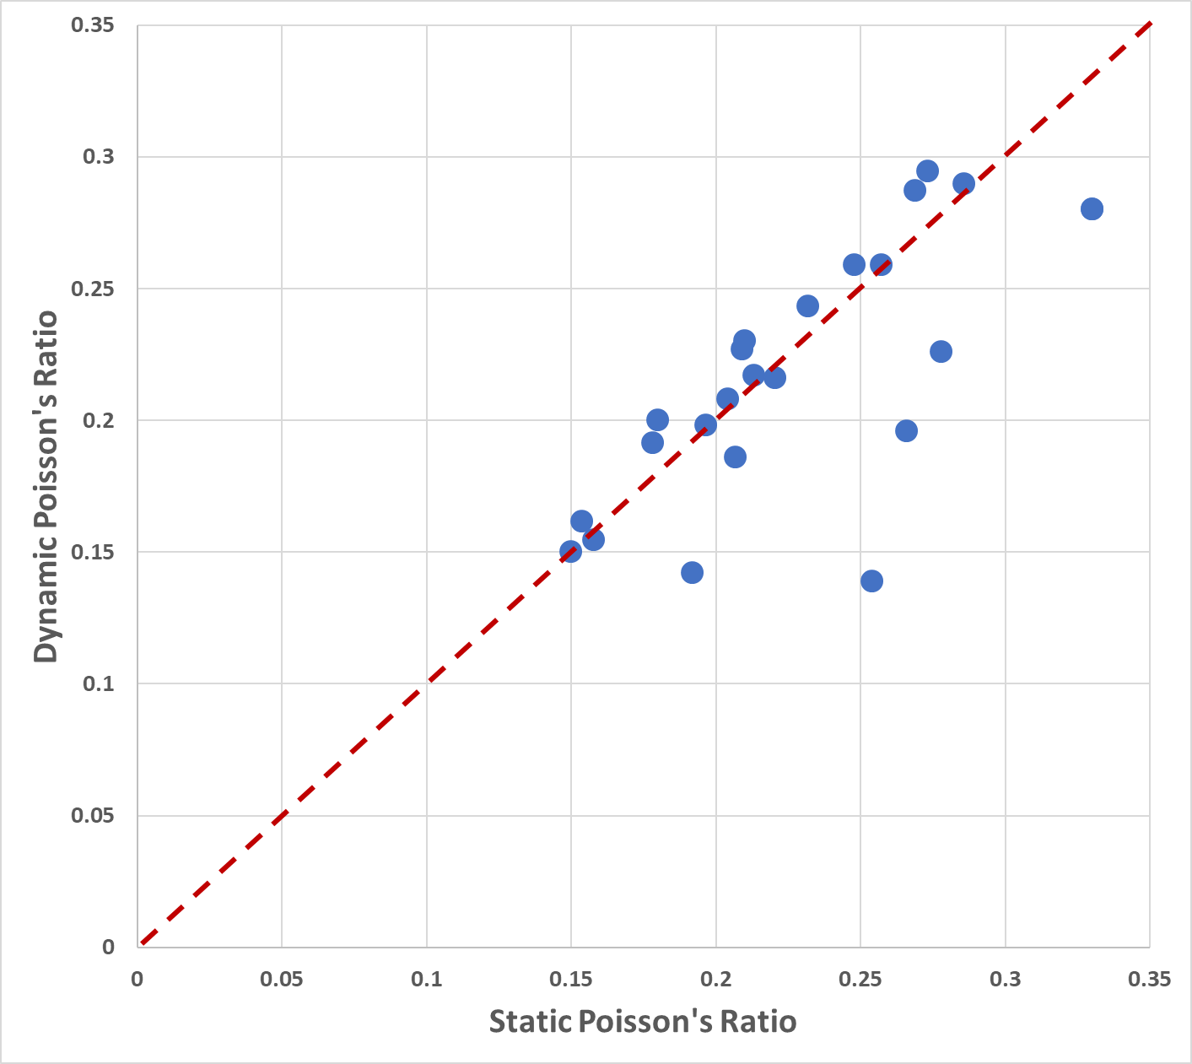
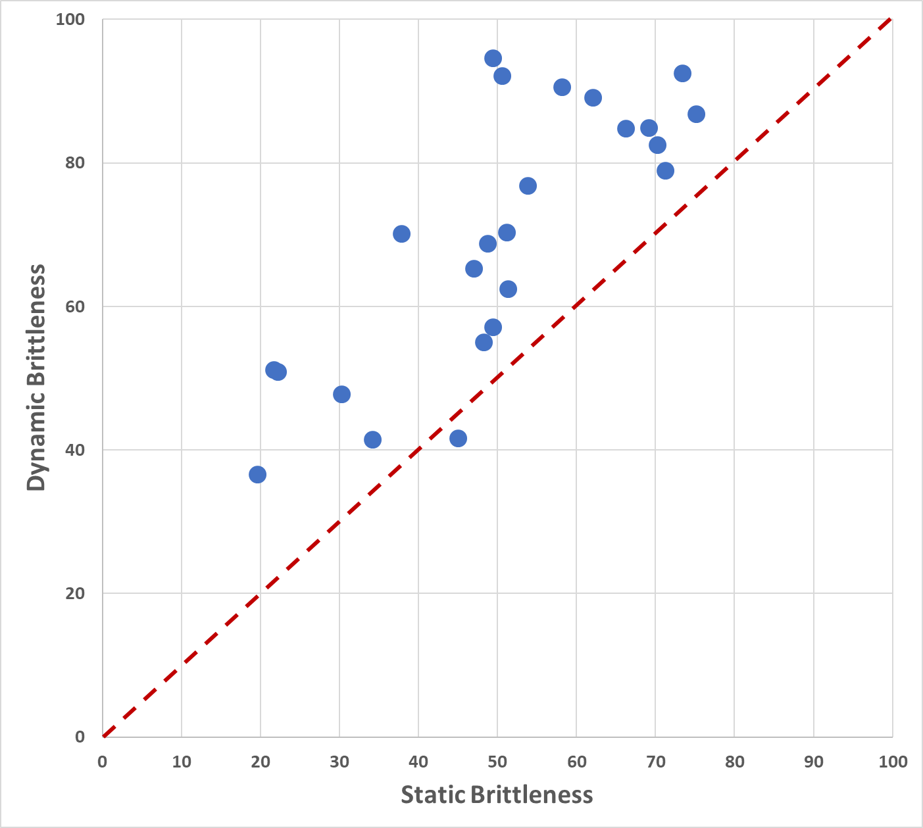
Static vs Dynamic Elastic Rock Properties
UNCONVENTIONAL RESERVOIR ENGINEERING PROJECT
Advisory Board Meeting, November 8, 2019, Golden, Colorado

Slide 16
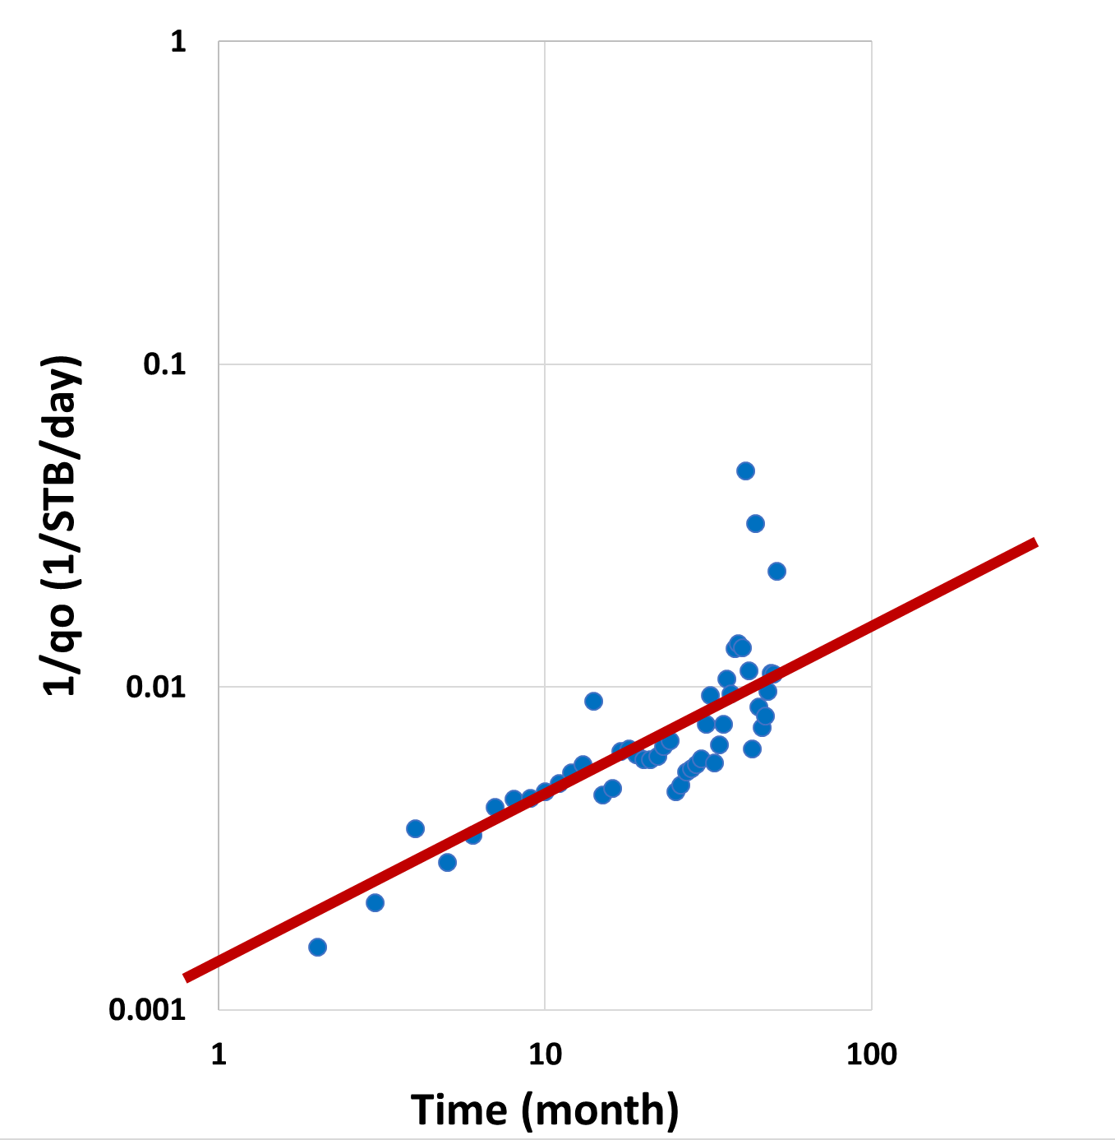
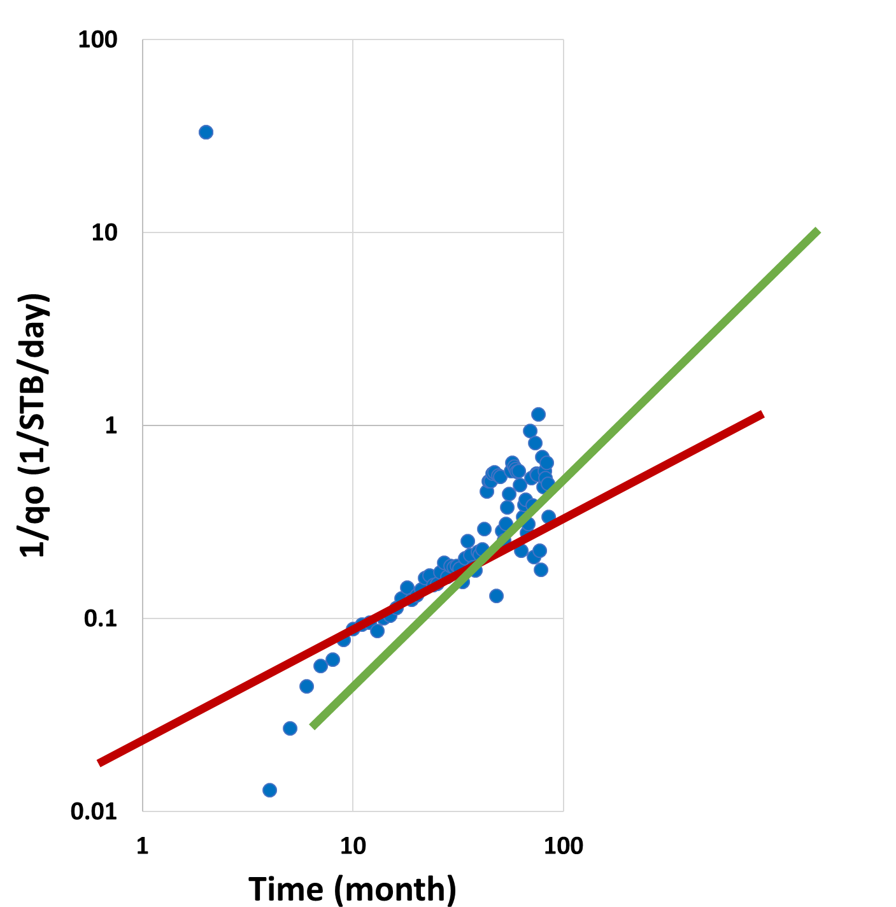
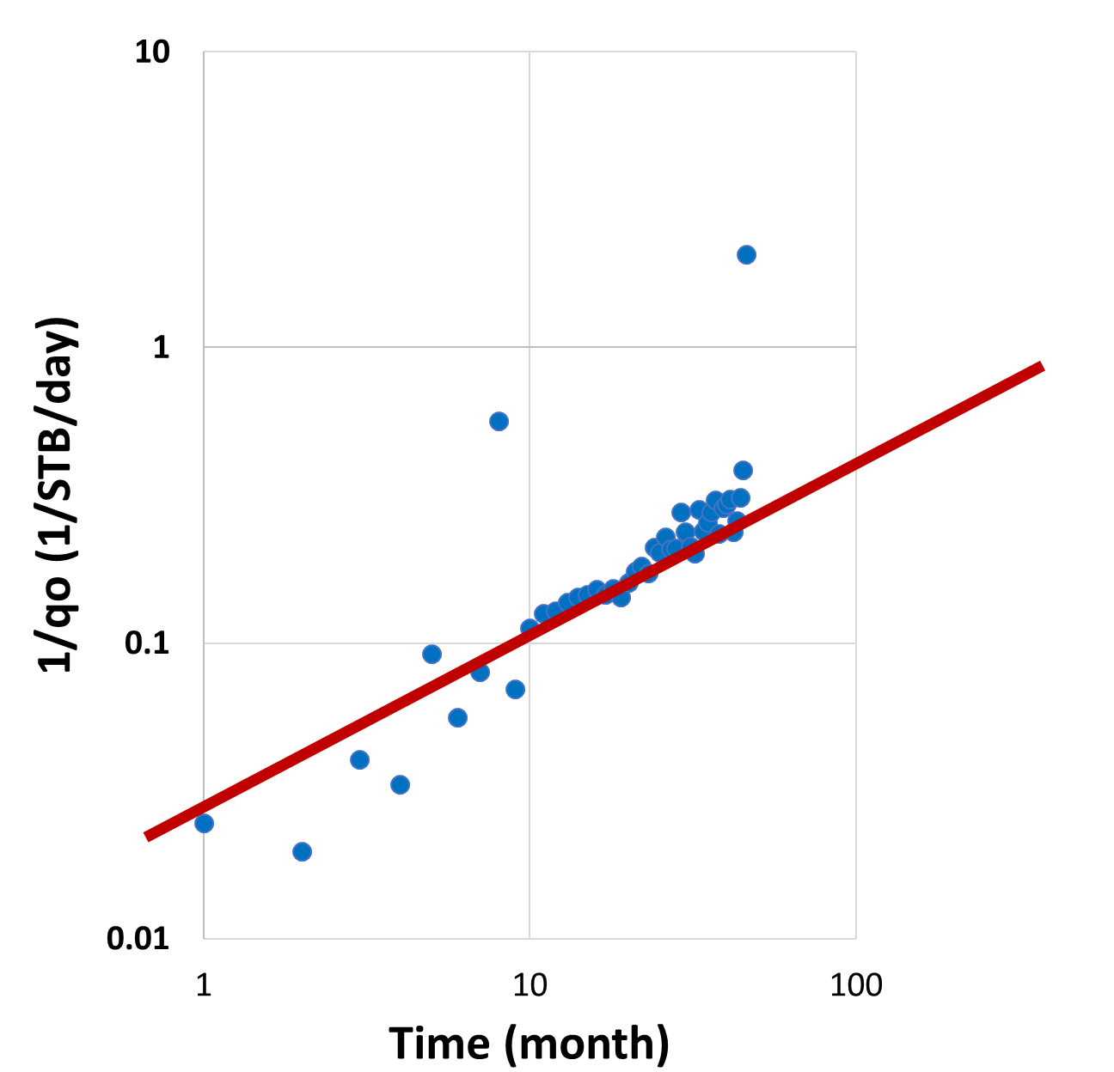
Rate Transient Analysis for Well 4, 5, and 6
Diagnostic Plot for Well 4
Diagnostic Plot for Well 5
Diagnostic Plot for Well 6
UNCONVENTIONAL RESERVOIR ENGINEERING PROJECT
(Source: DrillingInfo 2019)
Advisory Board Meeting, November 8, 2019, Golden, Colorado

Slide 17
Geomechanical Model Types
(Massaro et al. 2017)
UNCONVENTIONAL RESERVOIR ENGINEERING PROJECT
Advisory Board Meeting, November 8, 2019, Golden, Colorado

Slide 18
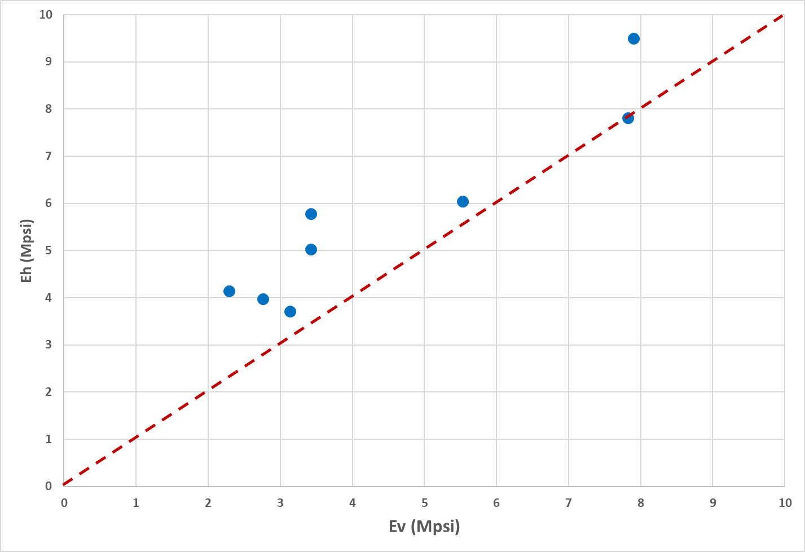
Static Young’s Modulus Comparison
VTI system behavior
UNCONVENTIONAL RESERVOIR ENGINEERING PROJECT
Advisory Board Meeting, November 8, 2019, Golden, Colorado

Slide 19
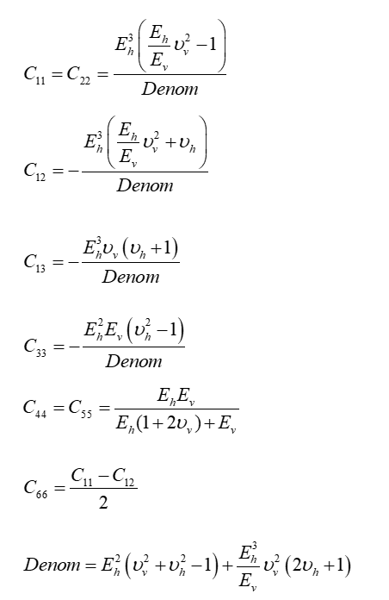
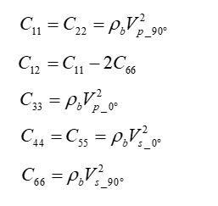
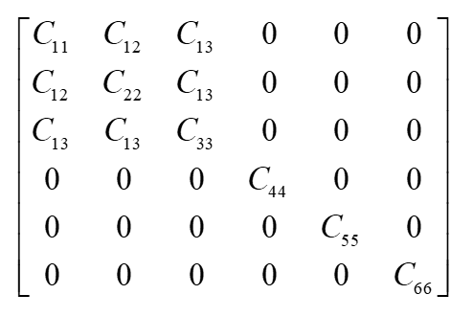
Stiffness Coefficient
Static Coefficients
Dynamic Coefficients
VTI C_{ij} Matrix
UNCONVENTIONAL RESERVOIR ENGINEERING PROJECT
Advisory Board Meeting, November 8, 2019, Golden, Colorado

Slide 20
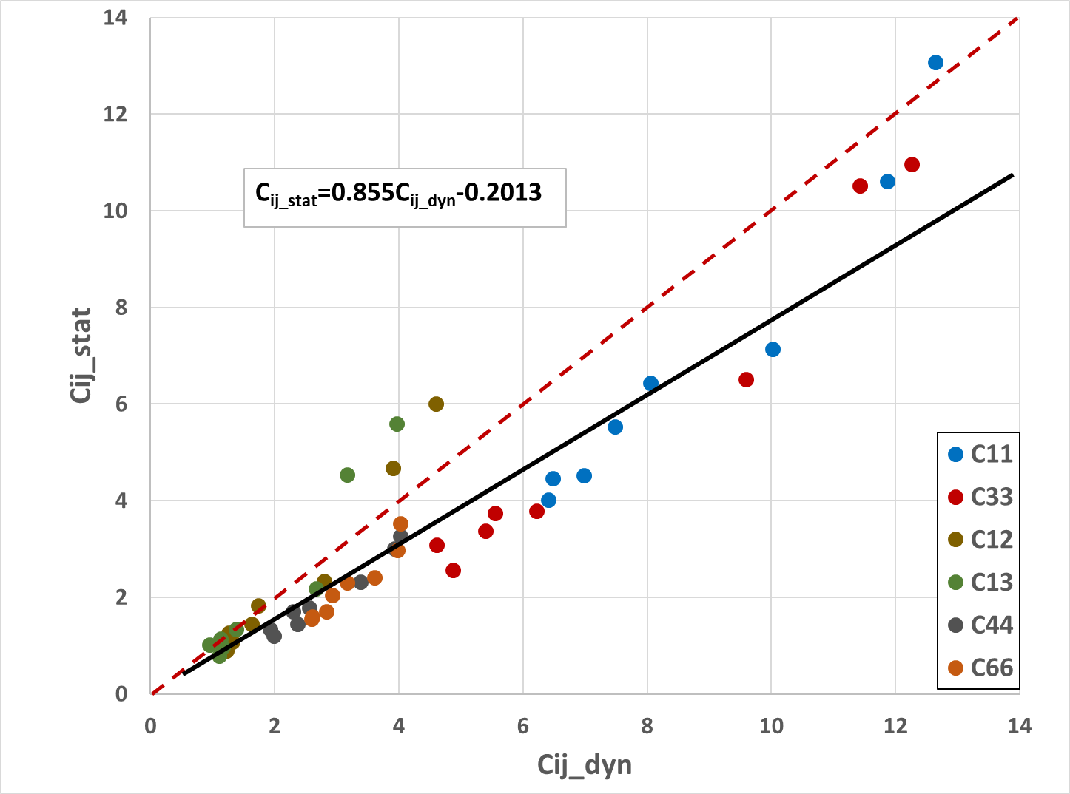
Static-Dynamic Relationship
UNCONVENTIONAL RESERVOIR ENGINEERING PROJECT
Advisory Board Meeting, November 8, 2019, Golden, Colorado

Slide 21
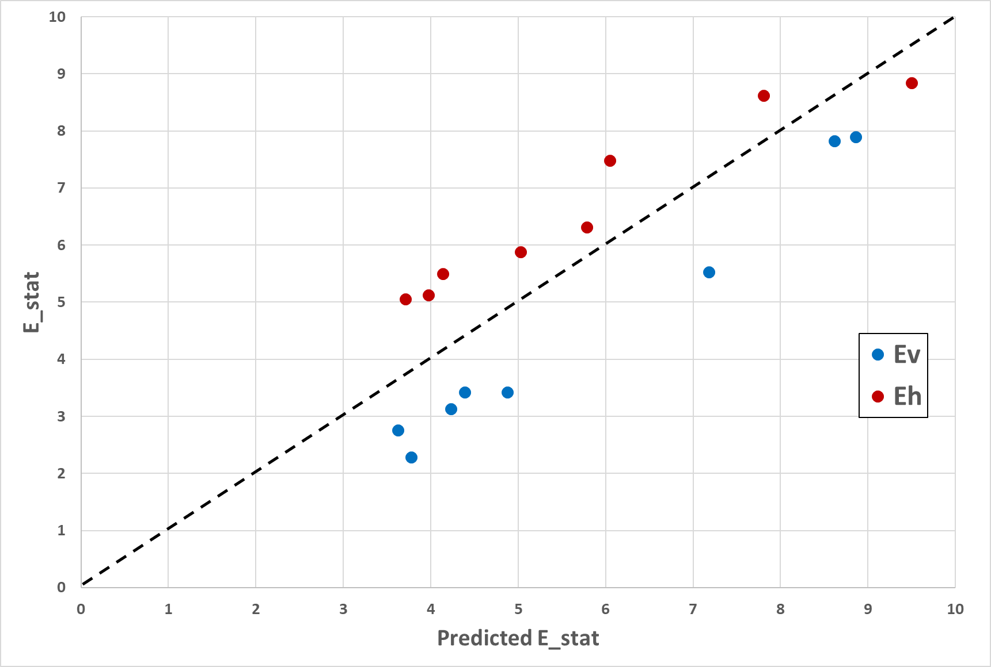
Static-Dynamic Relationship
Validation for the back-calculated static moduli = 86%
UNCONVENTIONAL RESERVOIR ENGINEERING PROJECT
Advisory Board Meeting, November 8, 2019, Golden, Colorado

Slide 22
FUTURE WORK
Well Logs
Rock and Fluid Properties
Production Data
Core Data
Reservoir Characterization
Lab Experiments
Reservoir Modelling to Evaluate Production Performance and Forecast
UNCONVENTIONAL RESERVOIR ENGINEERING PROJECT
Advisory Board Meeting, November 8, 2019, Golden, Colorado

Slide 23
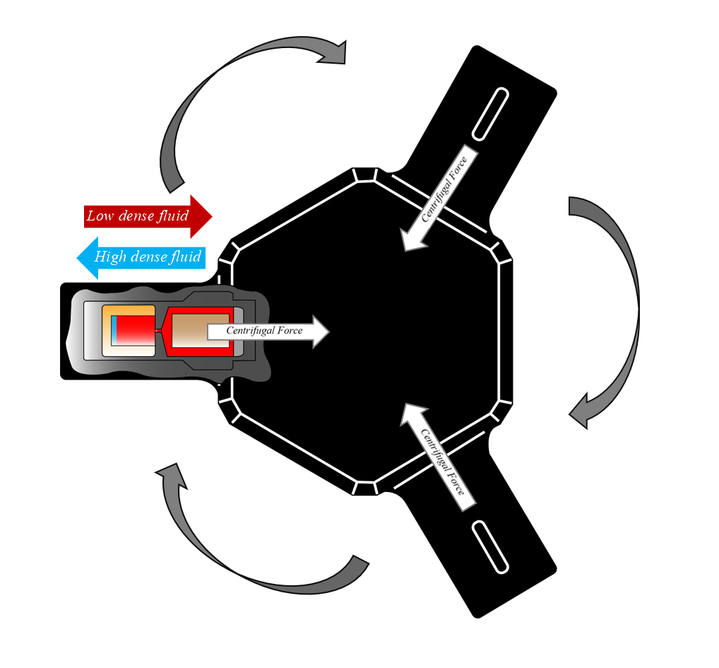
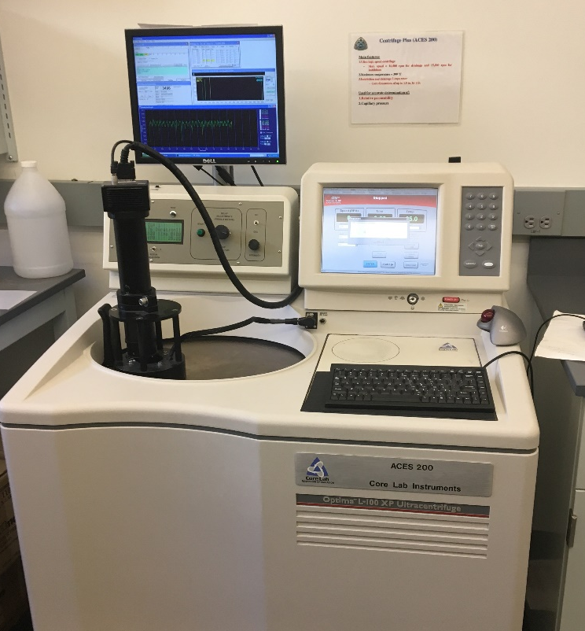
High-Speed Centrifuge For Capillary Pressure Measurement
UNCONVENTIONAL RESERVOIR ENGINEERING PROJECT
Advisory Board Meeting, November 8, 2019, Golden, Colorado

Slide 24
FRT-6100 for Gas Injection Measurement
UNCONVENTIONAL RESERVOIR ENGINEERING PROJECT
Advisory Board Meeting, November 8, 2019, Golden, Colorado

Slide 25
Ackowledgement
Dr. Hossein Kazemi (Co-Advisor)
Dr. Steve Sonnenberg (Co-Advisor)
Jacquie Colborne (PhD Candidate – Geology)
UNCONVENTIONAL RESERVOIR ENGINEERING PROJECT
Advisory Board Meeting, November 8, 2019, Golden, Colorado

Slide 26
Questions?
Thank you
UNCONVENTIONAL RESERVOIR ENGINEERING PROJECT
Advisory Board Meeting, November 8, 2019, Golden, Colorado

