Slide 1
UNCONVENTIONAL RESERVOIR ENGINEERING PROJECT
Colorado School of Mines
U R E P
CSM
Modeling Studies of Gas Injection in Tight Oil Reservoirs
Ye Tian
(SPE 193818; SPE197101)
UNCONVENTIONAL RESERVOIR ENGINEERING PROJECT
Advisory Board Meeting, Nov 8, 2019, Golden, Colorado

Slide 2
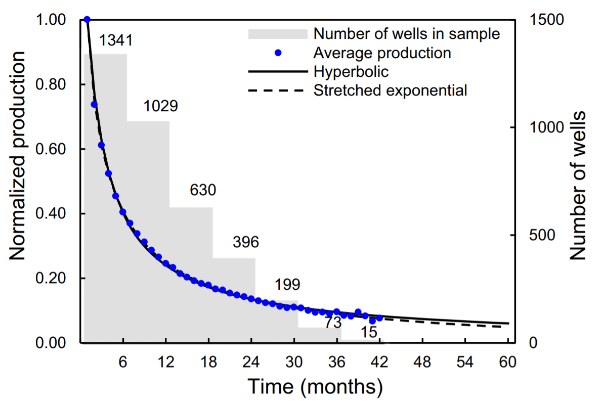
Background—Status quo of tight oil production
High initial rates (~800 b/d) due to long horizontal lateral and massive fracturing
Fast decline (50%-75% production loss after 12 months)
Recovery factor low (<10%) for depletion, needs for improved/enhanced oil recovery
Gas injection is preferred over water, becoming 1st choice due to:
High injectivity & compressibility
Less formation damage v.s. water
Gas cost affordable (e.g. produced gas)
Reduce gas flaring
(Wachtmeister et al., 2017)

Slide 3
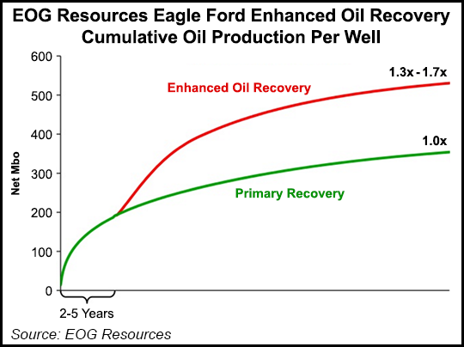
Successful Pilots
1
Lightstream Resources in Bakken, Canada
CH₄ flooding between horizontal laterals @ 9 wells
130 bbl/d to a of 295 bbl/d
Increased yield of NGL due to vaporizing
EOG Resources in Eagle Ford
produced gas re-injection @15 wells
Huff-n-puff and flooding
Response in 2 to 3 months
Cost: $6 per barrel
1. Matrix K: Bakken >> Eagle Ford
2. Bakken has more fractures
3. More pilots ongoing e.g. Permian (SPE197101)
(Wang et. al, 2017)

Slide 4
Background—Black oil model v.s. compositional model
3 pseudo-components: water, oil, gas
Primary eqs—conservation of mass
Darcy’s law:
Constitutive eqs.
nc+1 true/pseudo-components
Mass conservation of each component
Darcy’s law for advective flux
Fick’s law for diffusive flux
Phase equilibrium equations
Good for Non-volatile oil or dry gas
Reservoirs.
Compositional model works better for gas injection because,
Phase equilibrium under nanopore confinement
Transport is composition-dependent, e.g. diffusion
Fluid transport coupled with dynamic stress field

Slide 5
A general compositional model
Hydrocarbon component is negligible in the aqueous phase
Water component is negligible in the oil or gas phase
Diffusion only in oil and gas phase
Conservation of mass
i=1…nc

Slide 6
A general compositional model
Geomechanical equation
Assuming isothermal reservoir
Assuming poroelasticity (Biot’s equation)
Solved simultaneously with mass balance equations as primary equations.
(Winterfeld and Wu, 2018)

Slide 7
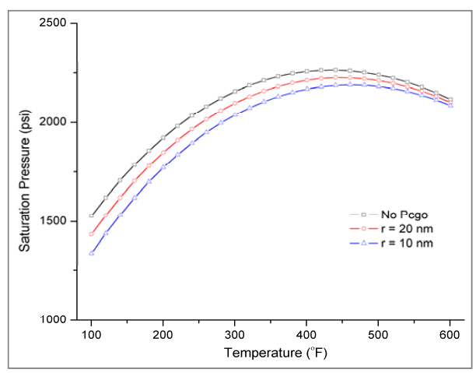
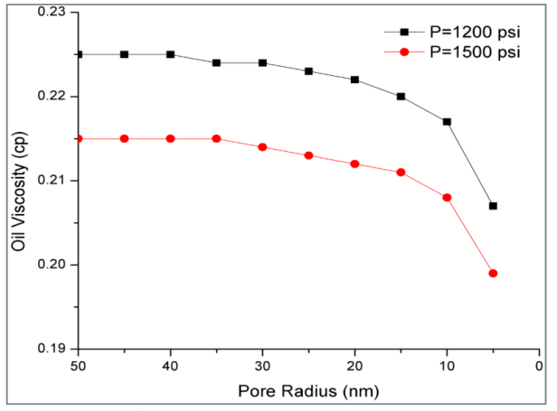
A general compositional model
Nanopore confinement effect
Pc is large in nm pores, affecting saturation pressure, viscosity, MMP, etc.
Pore size is dynamically changing due to cyclic stress.
at equilibrium due to Pc
Where,
(Xiong, 2015)

Slide 8
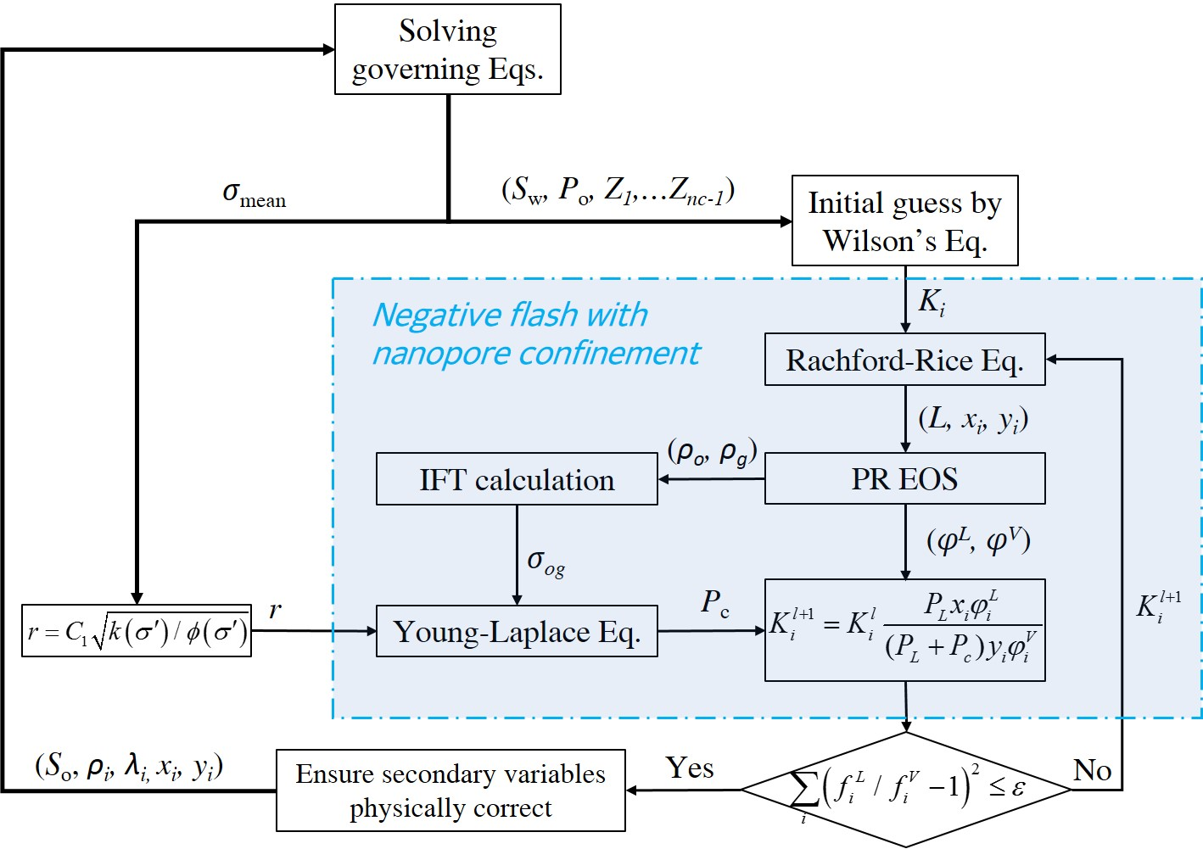
A general compositional model
Nanopore confinement effect coupled with stress
Mean stress solved from governing eqs.
Stress-dependent pore size r
VLE with Pc by Successive Substitution
(Tian et al., 2019)

Slide 9
A general compositional model
Mass conservation for Nc component and water+stress equation (nc+2)
Integral finite-difference method (Finite Volume)
P_{o}, S_{w}, Z₁…Z_{nc-1},σ_{mean} (nc+2 primary variables) with Newton Iteration
Fractured media handled with MINC (Multiple INteracting Continua)
Phase equilibrium equations with nanopore confinement (SS+Newton Iteration)
Multicomponent diffusion considering cross-effect and non-ideality
Capillary pressure, diffusion coefficient, rock properties all coupled with stress.
i=1…nc

Slide 10
An in-house compositional simulator MSFLOW_COM
Newton iteration
Data input &
Initialization
Calculation of
secondary variables
(VLE, S_{β}, ρ_{β}, μ_{β}, k, k_{rβ}, φ, J_{diff} ,etc.)
Initial state
Primary
variables
Secondary
variables
Simulation control
(e.g., time stepping)
Primary variables @t
Assemble system of
linear equations
(R and J)
Converged results @t+1
Simulation results
Solution
Linear system
Output
Iterative sparse
matrix solver
(GMRES)
(Wu, 2005; Xiong, 2015, Tian et al., 2019)
Notes:
generalized minimal residual method

Slide 11
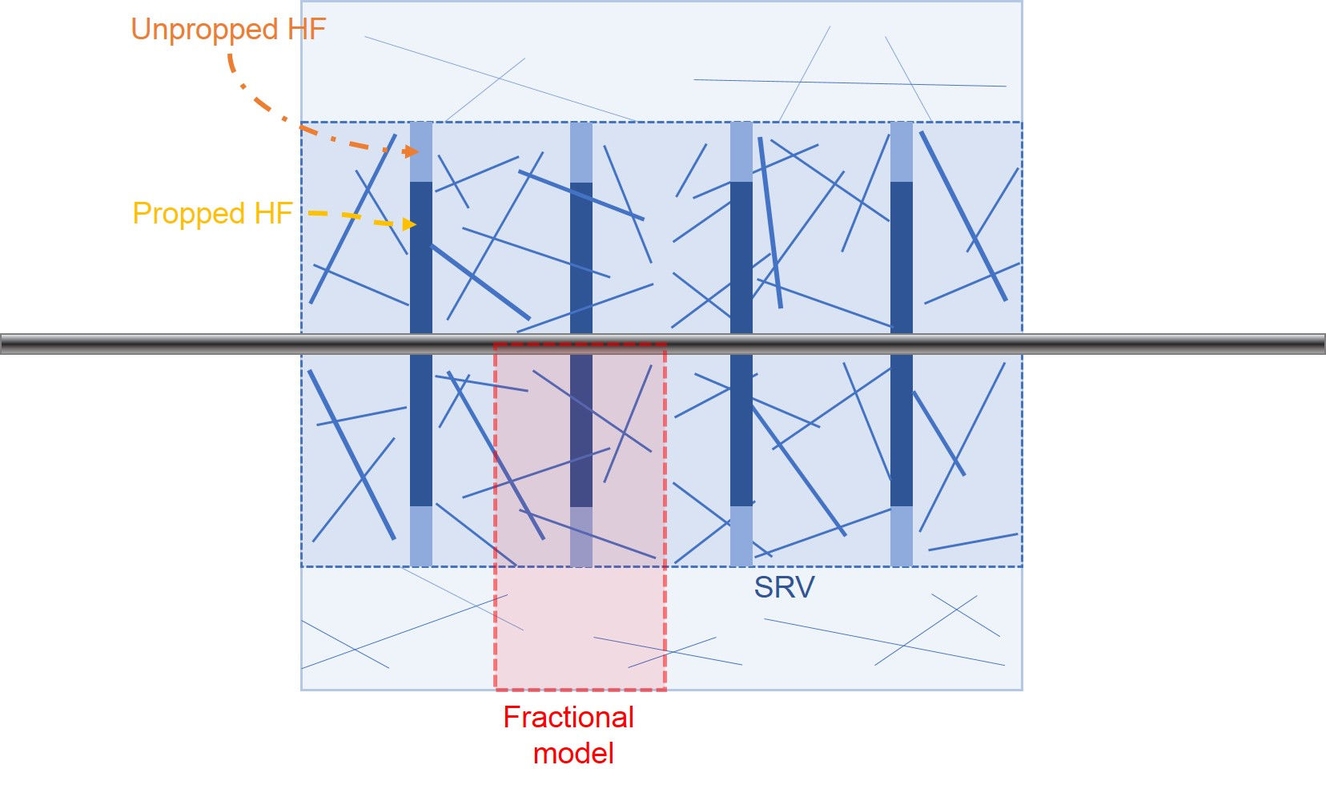
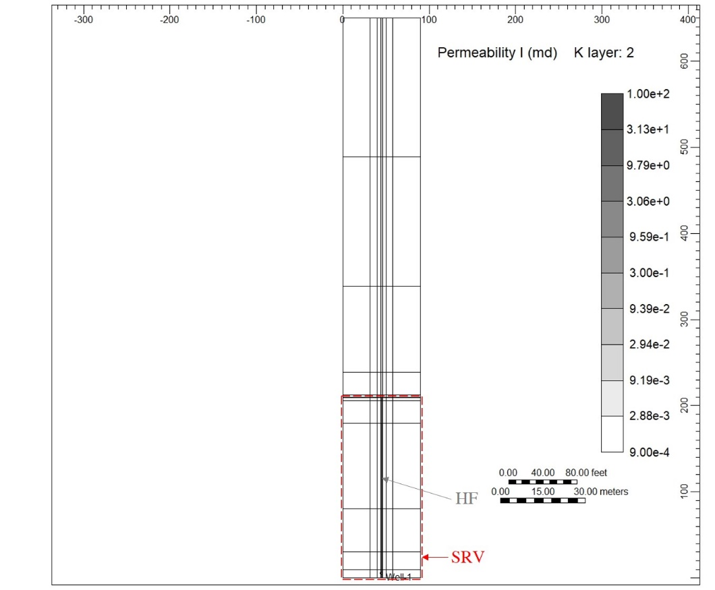
Conceptual model
A typical well in Eagle Ford Shale
Only a fraction of well is modelled
Grids is logarithmically refined near HF.
5 regions: propped HF, unpropped HF, NF in SRV, NF outside SRV, Matrix
Well geometry |  | Fractional model
Perforated lateral length, ft | 6840 | X, ft | 90
Stage number | 19 | Y, ft | 650
Clusters per stage | 4 | Z, ft | 100
Cluster spacing, ft | 90 | HF half-length, ft | 210
Formation thickness, ft | 100 | HF height, ft | 36
Notes:
This slide show a base case based on a typical well in eagle ford shale. The well geometry is summarized in the table. A fraction of the well is modelling by assuming symmetry. The hydraulic fracture is modelled explicitly by logarithmic refinement while nature fractures are modelling by MINC.

Slide 12
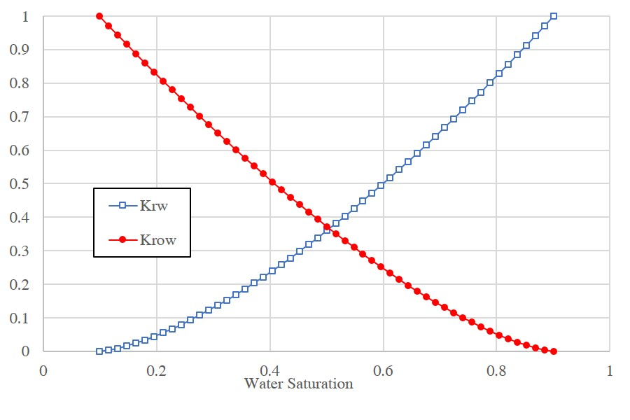
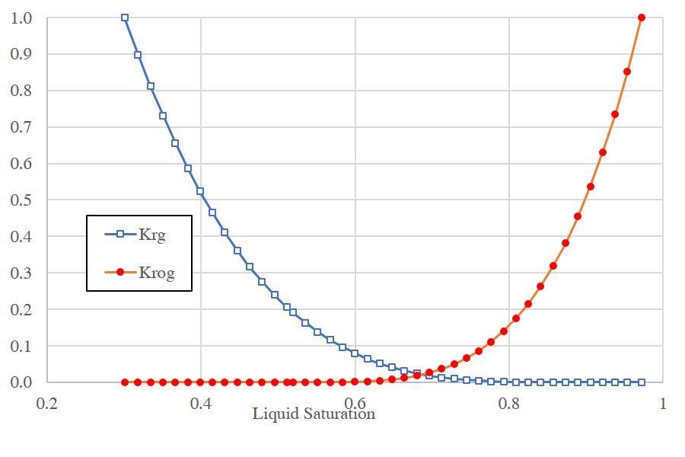
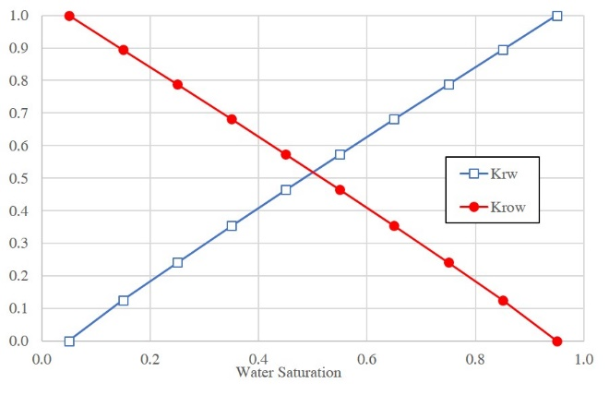
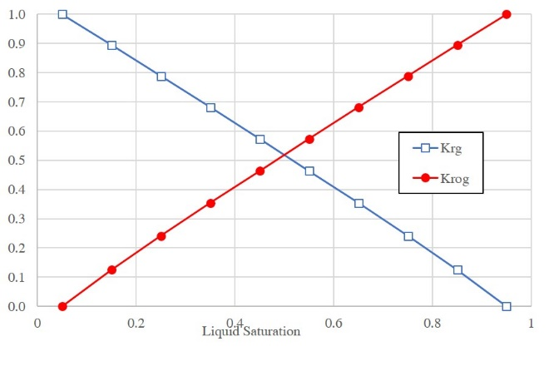
Conceptual model
Different Kr for fracture and matrix, kr in fractures has less residual saturation.
Kr for matrix
Kr for fractures
Six pseudo components are used, initial reservoir pressure 8125 psi >> Pb 1585 psi
GOR 944 scf/stb (WinProp) v.s. 948 scf/stb (MSLOW_COM) above Pb
Notes:
Five different rock regions were defined, and different rock properties were used for different regions. Different relative curves were also used in fracture and matrix media. With very small residual saturation in fractures.

Slide 13
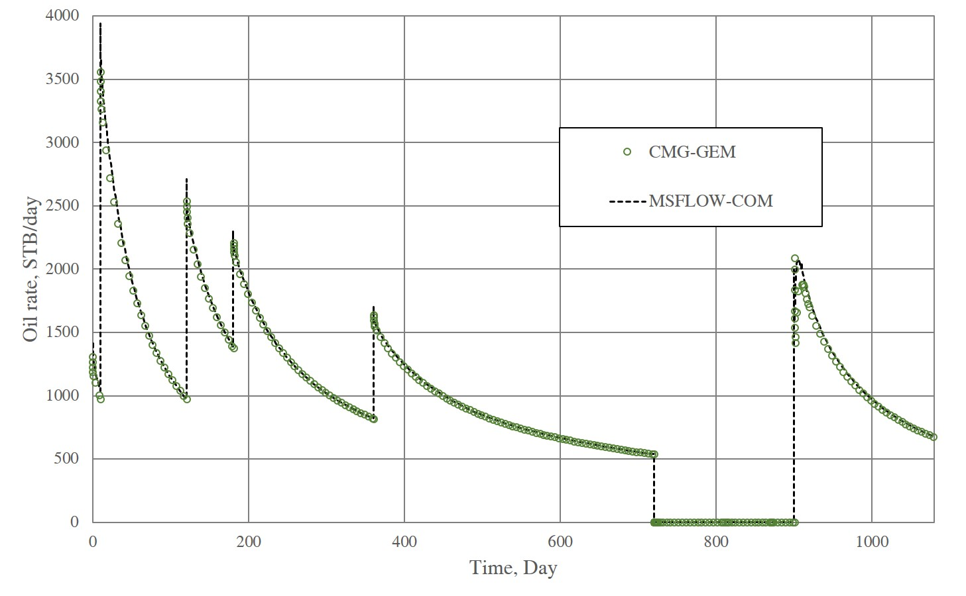
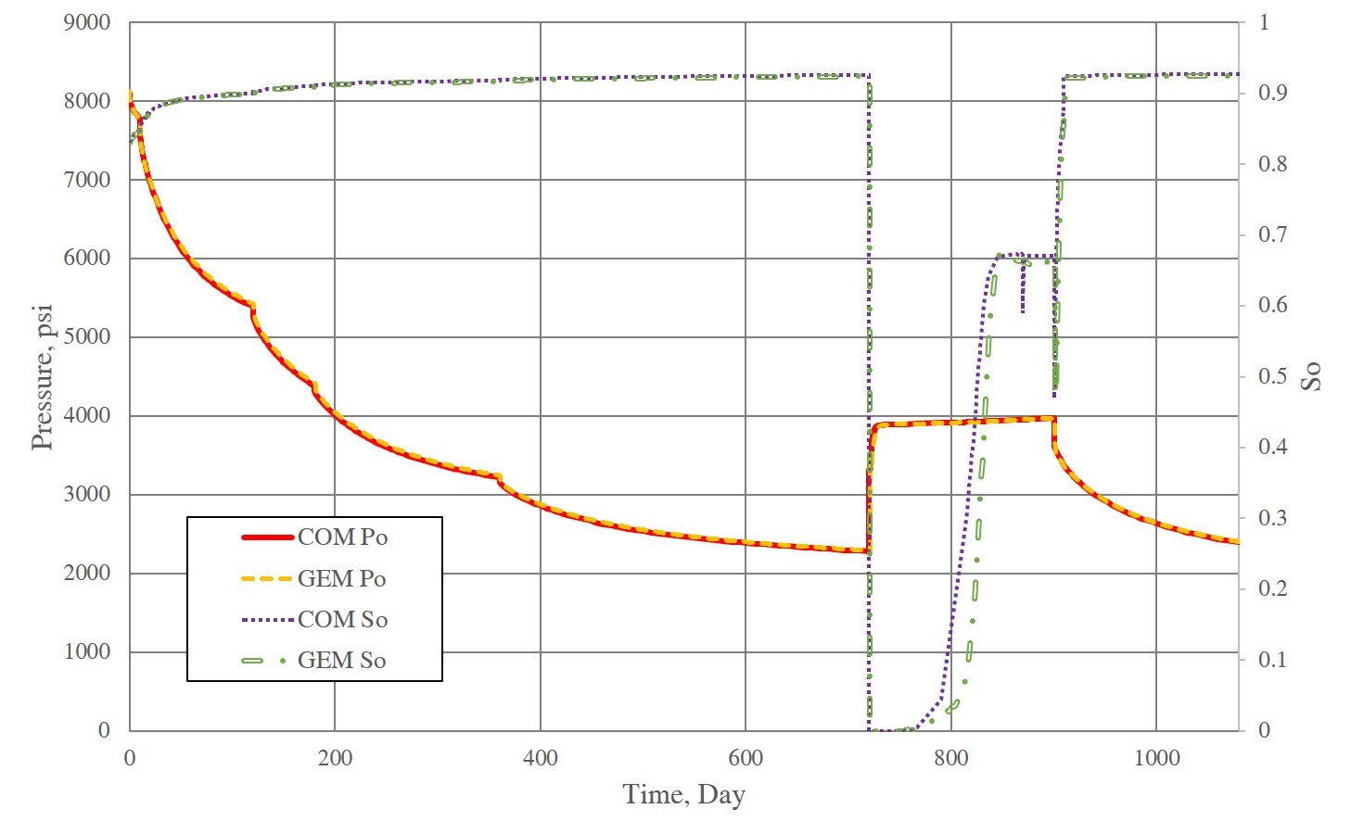
Model validation v.s. CMG-GEM without Pc and geomechanics
Depletion for 720 days, the accumulated CH₄, CO₂ stored for injection
Huff-n-puff with 91% CH₄ &9% CO₂: inj (150d)+soaking(30d)+prd(180d)
Oil rate
Po & Sw at well grid
Notes:
The base case is then under depletion for two years and is put on cyclic gas injection with produced gas. The gas was injected for 5 months, and then soaked for 1 month and finally produced for 6 months.
Our model is then validated against GEM without Pc effect and geomechanics. We can see that both oil rate and pressure and oil saturation at the well grid matched well.

Slide 14
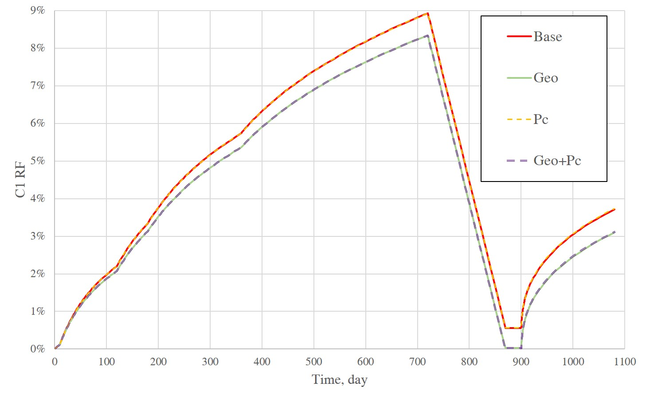
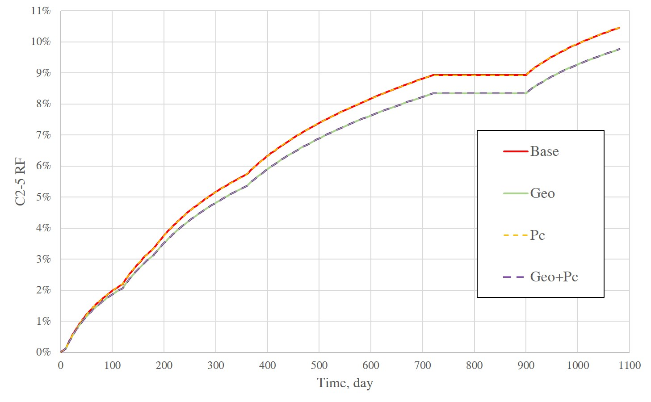
Simulation results
Case 1: Base case validated v.s. GEM; Case 2: Geomechanics effects (Geo);
Case 3: nanopore confinement (Pc); Case 4: Pc coupled with geomechanics (Geo+Pc)
Appreciable difference due to Geo but not Pc at early huff-n-puff.
Notes:
Then more cases are run with our simulator. Case 2 is with geomechanics effect and Case 3 is with nanopore confinement effect only. Case 4 coupled PC and geomechanics effects.
The left figure shows the RF of methane and right figure shows the RF of C2-5 which represents the NGL. We can see the appreciable RF reduction caused by the geomechanically effect. While nanopore confinement effect has very limited impact on RF for the early huff-n-puff.

Slide 15
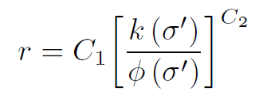
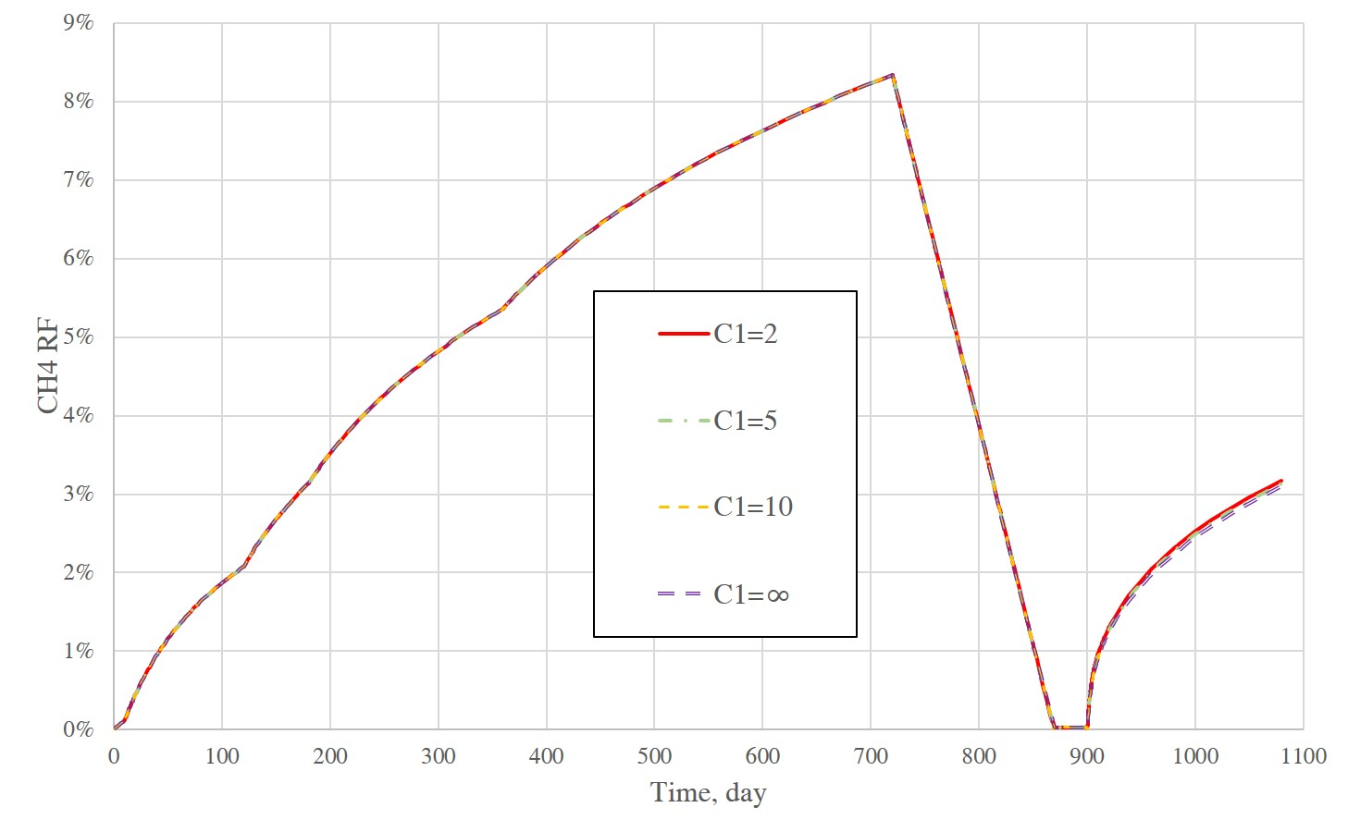
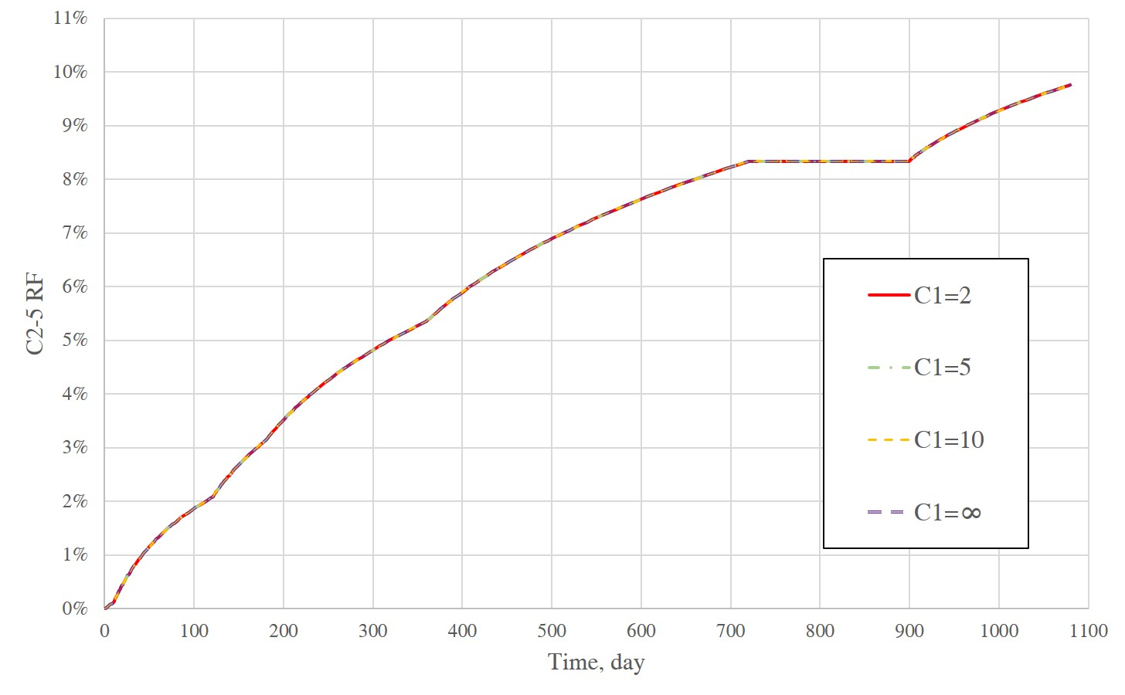
Simulation results
A smaller C1 means a higher contribution from Pc effect.
C₁=2, 5, 10; correspond with r=5.4, 13.5, 27 nm; r=∞ means no Pc effect.
Small difference by changing Pc at early huff-n-puff as P>Pb in matrix.
15
Notes:
We then investigate the effect of nanopore confinement effect by changing the effective pore size. Still the impact of Pc effect on RF is small for early huff-n-puff and P is much larger than Pb.

Slide 16
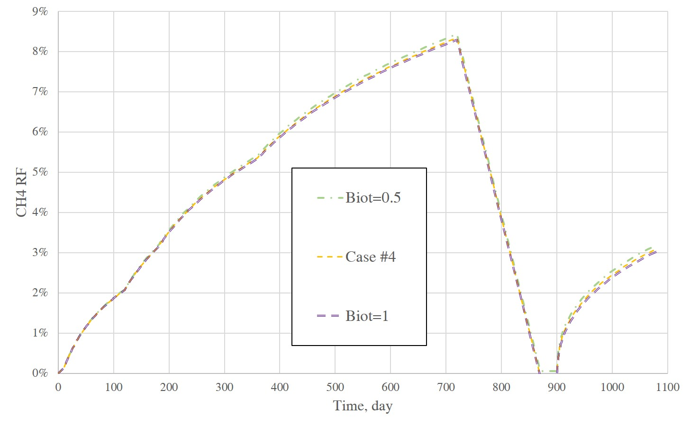
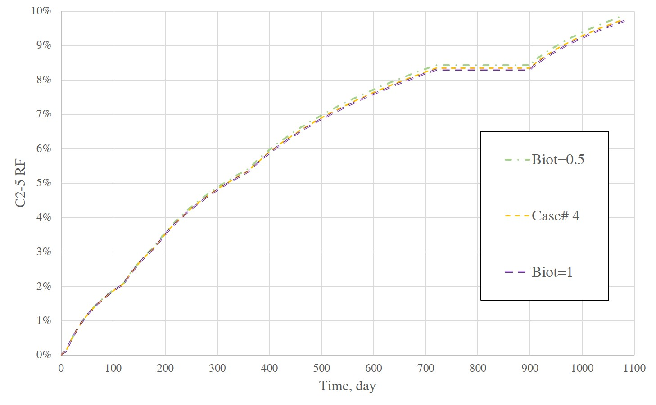
Simulation results
A higher α means a higher contribution from stress effect.
α =0.5, 0.7, 1 in fracture with same α in matrix.
The higher the α in fracture, the lower the RF, due to k reduction in fractures.
16
Notes:
Here we investigated the effect of Biot’s coefficient on RF. The fracture Biot coefficient alpha was set as 0.7 in previous cases. A higher alpha in fracture means a higher contribution from stress effect. And our simulation shows a higher alpha would lead to a smaller RF due to fracture permeability reduction.

Slide 17
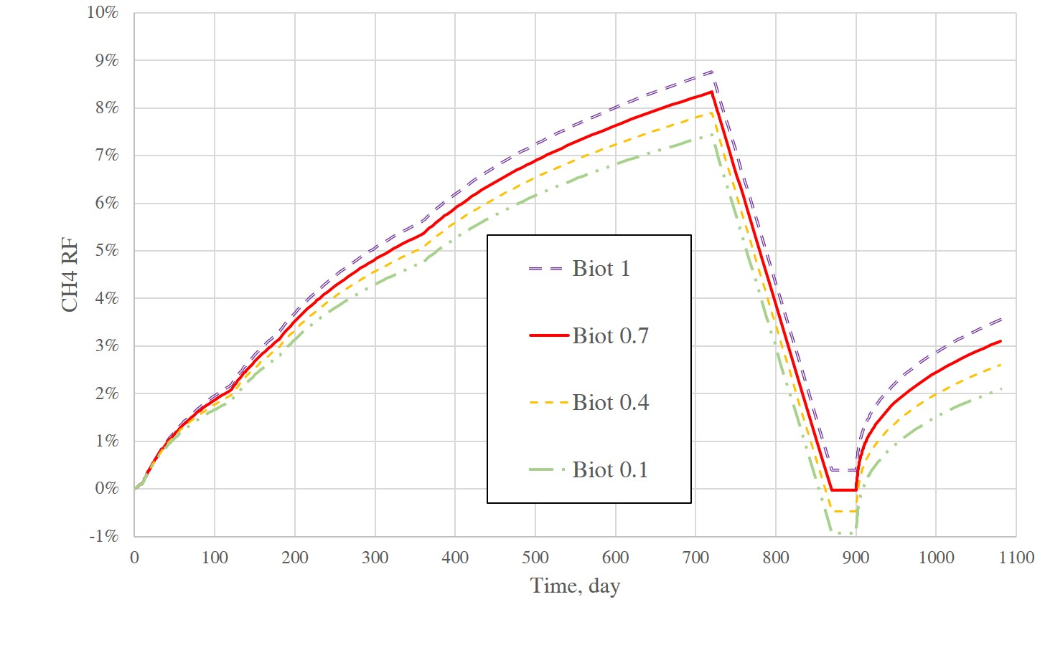
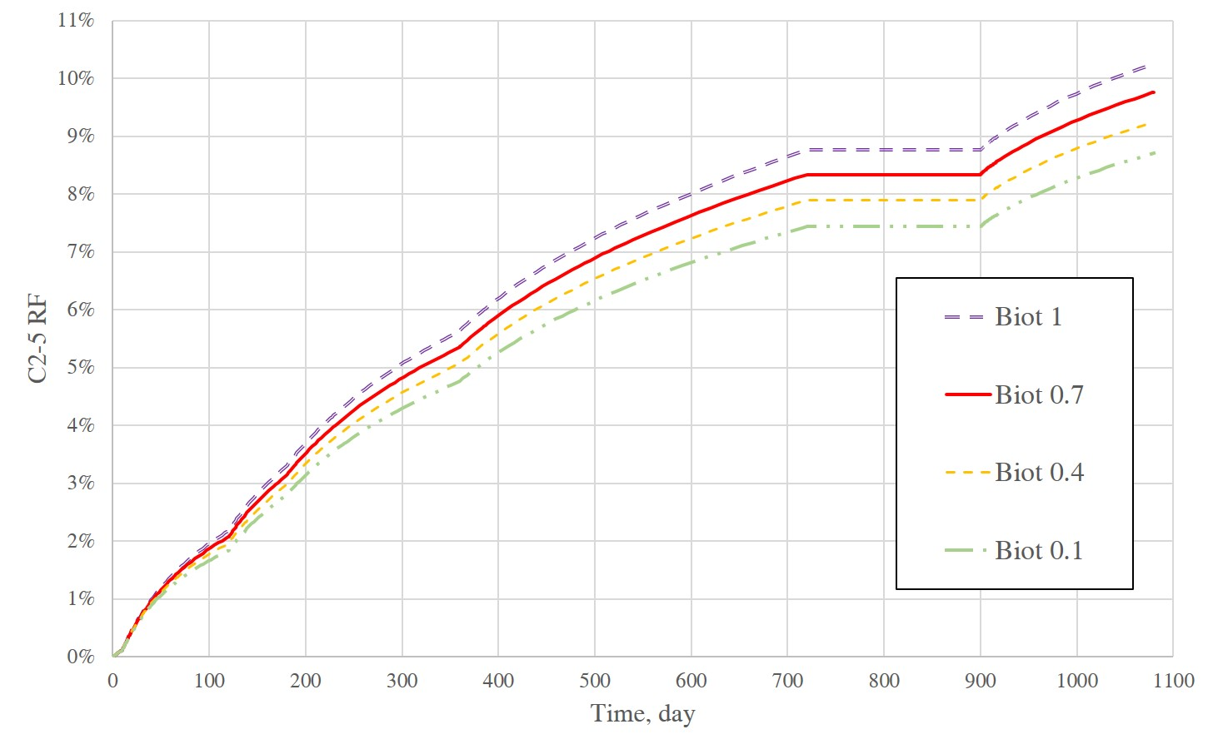
Simulation results
α =0.1 0.4, 0.7, 1 in matrix with same α in fracture
The higher the α in matrix, the higher the RF, due to enhanced compaction drive.
Stress-dependent k dominates fracture, while stress-dependent ϕ dominates matrix.
17
Notes:
However, if we keep the alpha in matrix the same, a higher alpha in matrix would yield a higher RF due to enhanced rock compaction drive. Also, we could say stress dependent permeability dominant fracture flow, while stress dependent por volume dominates matrix depletion.

Slide 18
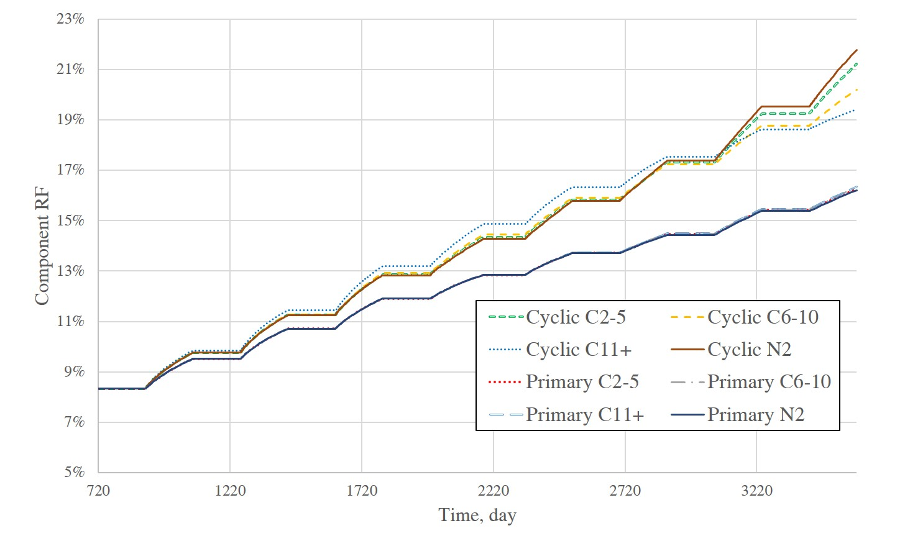
Simulation results
Huff-n-puff for 8 cycles (no Pc). RF improved for all non-injected components.
The heavier the component,
the higher the RF at first.
The lighter the component,
the higher the RF finally.
Crossover at 3080th d, where
the lighter component RF
surpasses the heavier.
Critical gas saturation leads
to gas trapping in matrix,
the light hence has a lower RF
at beginning.
a
18
Notes:
Previous slide shows the RF of early depletion, here we have a case with 8 cycle of huff-n-puff, this base line is the depletion case. And we can say that component RF is improved for all non-injected components.
The blue dotted line is the RF of C11+, and we call tell that the heaver the component, the higher the RF at first, and there is cross over point where the light component RF surpassed the heavier component. And finally, the lighter the component the higher the RF. This phenomenon is because of gas trapping in matrix, which is concentrated with light component.

Slide 19
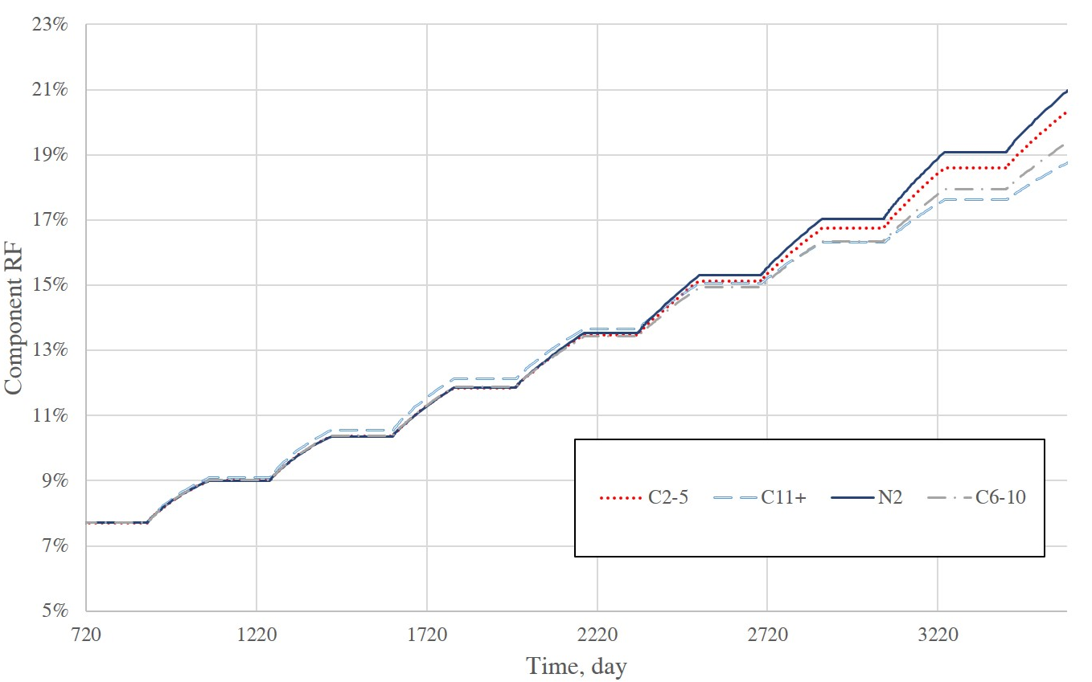
Simulation results
Reduce the critical gas saturation in matrix, the crossover now at 2360th d compared
with 3080th day earlier.
The crossover point is largely
Controlled by gas trapping.
Similar gas trapping behavior
found in CO₂ sequestration
(Juanes, 2006).
b
a
19
Notes:
IF we reduced the critical gas saturation in matrix, we could find out that this cross over point will be around two years earlier than before. Similar gas trapping behavior was found in CO2 sequestration. And such component dependent behavior could only be discovered by a compositional simulator.

Slide 20
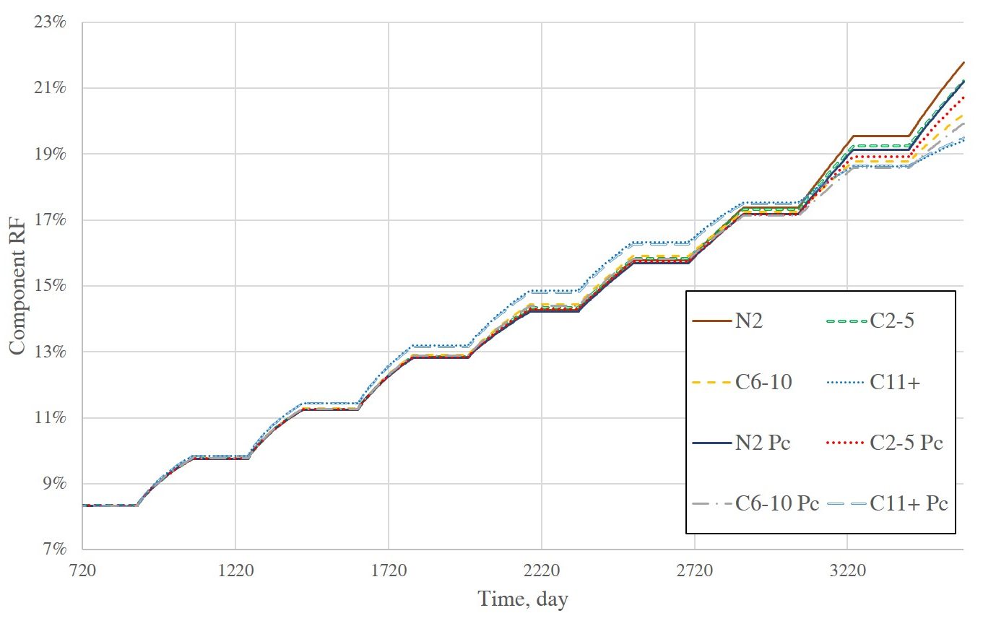
Simulation results
Considering Pc effect will delay the crossover from 3080th to 3120th day.
Pc effect will lower RF
of a lighter component,
and increase RF
of a heavier component.
Because Pc will make the
trapped gas richer with light
component, hence more
N₂, C2-5 will be trapped in
Matrix before crossover.
Only be found by compositional
model with Pc effect.
c
a
20
Notes:
IF we consider the nanopore confinement effect, this cross-over point will be delayed a little bit.
And also, PC effect will lower the RF of light component but increase RF of a heavier component.
This is because the Pc effect will make the trapped gas richer with light component hence more N2 C2-5 would be trapped in the matrix before the cross over point. Again, such phenomenon could only be modelled by a compositional model considering the nanopore confinement effect.

Slide 21
Summary
A multiphase multicomponent model is established for accurately modeling gas injection in fractured unconventional reservoirs.
If the reservoir pressure is much higher than Pb, the nanopore confinement effect will have a very limited impact on RF for depletion and early gas huff-n-puff.
Geomechanics is an important factor, but not always in a detrimental way.
Component RF improved after huff-n-puff, but some vital behaviors (e.g. gas trapping) could only be understood with a compositional model incorporating complex physics mentioned above.
21
Notes:
So to sum up, a multiphase multicomponent model is established and it could accurately model gas injection process in fractured unconventional reservoirs.
If the reservoir pressure is much higher than Pb, the nanopore confinement effect will have a very limited impact on RF during depletion and early huff-n-puff stage.
Geomechanics is an important factor, but not always in a detrimental way.
Last but not the least, the component RF improved after huff-n-puff but some vital behaviors such as gas trapping could only be understood by a compositional model which consider the complex physics.

Slide 22
Thanks for your attention.
Comments or Questions?
Ye Tian, Ph.D. candidate
For more info: yetian@mines.edu
UNCONVENTIONAL RESERVOIR ENGINEERING PROJECT
Advisory Board Meeting, Nov 8, 2019, Golden, Colorado

