Slide 1
UNCONVENTIONAL RESERVOIR ENGINEERING PROJECT
Colorado School of Mines
U R E P
CSM
Phase Behavior – Background & Summary
Modeling ---- Experiments ---- Simulations
Xiaolong Yin
UNCONVENTIONAL RESERVOIR ENGINEERING PROJECT
Advisory Board Meeting, November 8, 2019, Golden, Colorado
Notes:
Title

Slide 2
UREP research on phase behavior
MC simulation
Modeling
Reservoir Simulation
Phase behavior of methane in a single pore
Phase behavior in a single pore due to capillary pressure
Bubble-point suppression in black-oil simulator (NITEC)
Pressure depletion in a medium with pore size distribution
Incorporation of capillary pressure in MSFLOW-COM (EMG)
Multiphase equilibrium Vapor-liquid-adsorption equilibrium in pores
Use DL to pre-condition phase equilibrium calculations (EMG)
SPE 159869, SPE 166459, SPE 187163, SPE 187316
SPE J. (2016), 21:1981; Entropy (2018), 20:452
SPE 175074, SPE 193878
UNCONVENTIONAL RESERVOIR ENGINEERING PROJECT
Advisory Board Meeting, November 8, 2019, Golden, Colorado

Slide 3
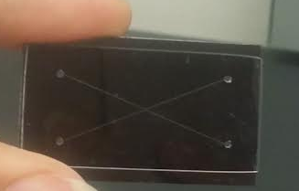
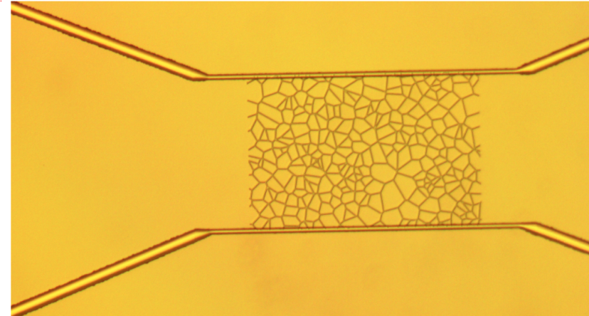
UREP research on phase behavior
Experiments
Micro- / Nanofluidics
Phase behavior of methane in nanofluidics
Non-intrusive measurements of pressure for better determination of phase behavior
Core experiments
Using oscillations to detect and measure capillary condensation in tight rocks
Using acoustics to detect and measure capillary condensation in tight rocks
SPE 175118, SPIE 10973-21 (2019)
Measurement Sci. Tech. (2017), 28:065902
UNCONVENTIONAL RESERVOIR ENGINEERING PROJECT
Advisory Board Meeting, November 8, 2019, Golden, Colorado

Slide 4
Phase behavior in nanopores – integration
Molecular simulations
Molecular scale
Inter-molecular interactions
Nanofluidic experiments
Pore scale
Direct observations
Equilibrium models
Density correlations
Phase transitions
Equilibrium across many pores
Core experiments
Verification of predictions
Reservoir engineering tools
Reserve estimation
Understand decline
Reservoir simulation
UNCONVENTIONAL RESERVOIR ENGINEERING PROJECT
Advisory Board Meeting, November 8, 2019, Golden, Colorado

