Slide 1
Capillary Condensation Effect on Acoustic Properties
UNGI
Aamer Albannay
Notes:
Only CO2 conclude slide

Slide 2
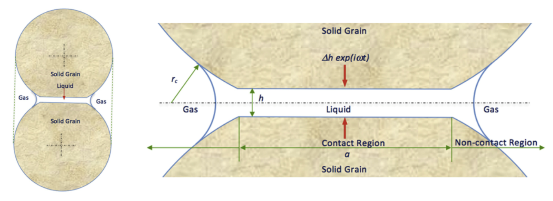
What is Capillary Condensation
Vapor condensation occurs in small pore spaces at pressures lower than the vapor pressure (dew-point). This is the result of the increased van der Waals interactions with pore walls which leads to multilayer vapor adsorption. Adsorption continues until the pore space is filled with condensed liquid while vapor fills the larger pores.
As liquid forms, grain contact strengthens, leading to an increase in bulk density of fluid and increase of acoustic velocity (Bui and Tutuncu, 2015)
2
Notes:
As Pc inc => higher P gas than P liq => contacts under stress

Slide 3
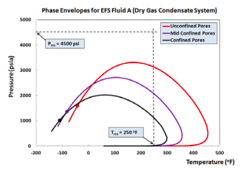
Motivation
Develop a tool to measure the reduced vapor pressure, and for HC systems, the change in dew- and bubble-point pressures associated with confinement.
Eventually, measure the shift of the phase envelop for HC systems due to confinement.
We used CO₂ gas in the experiments.
gas
liquid
gas
Alharthy & Kazemi (2013)
3
Notes:
liquid in nanopores. No way of measuring. But we have an indirect way to find it. Signature of CC
Gas adsorbed in condensed phase is released as we produce.
As we produce gas, gas is vaporized out of liquid phase leaving heavier components behind
Improve HCIP estimation by accounting for CC. Conventional models account for adsorbed and free gas only and don’t account for the favorable conditions that are conducive for CC
Capillary condensation affects fluid flow and transport at the pore throat due to lower mobility of the condensed fluid. (Bui et al., 2016)

Slide 4
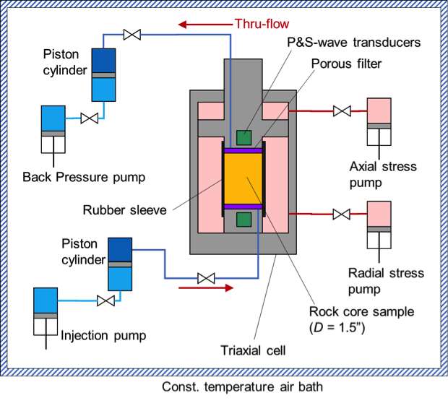
Experimental Facility Design
A tri-axial compression cell was assembled and modified to observe the change in P and S wave velocity as capillary condensation occurred.
4
Notes:
The experimental set-up is capable of the simultaneous acquisition of coupled stress, strain, resistivity, acoustic and flow data.
Both top and bottom axial pistons are equipped with 1 MHz resonant frequency compressional P and S wave transducers.
System T fluctuation is 0.1°C ensuring high-quality data due to minimal temperature disturbance

Slide 5
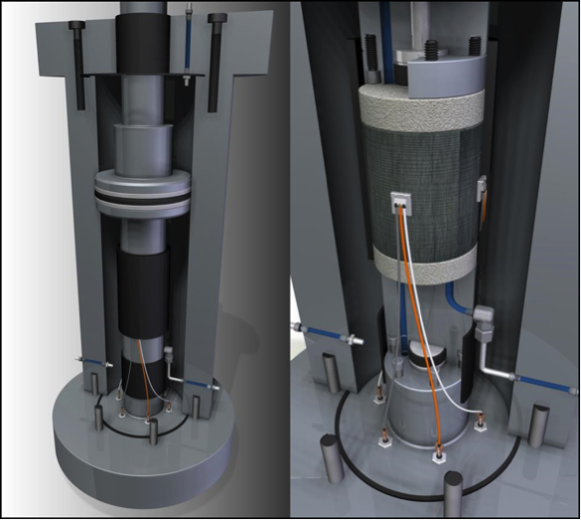
Methodology
We conducted stress-strain measurements and recorded P and S wave wavelets as we increased CO₂ pore pressure.
We believe that as liquid condenses in nanopores, grain contact strengthens resulting in increase in bulk density/modulus of rock witch leads to an increase in P and S wave velocities and higher Young’s Modulus.
5

Slide 6
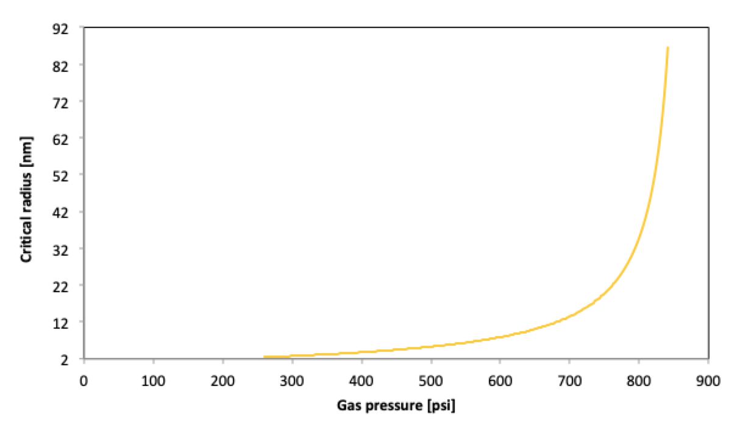
CO₂ Critical Radius
The plot below shows the critical radius at which pores condense at a given saturation pressure for CO₂ using the Kelvin equation.
Smaller nanopores condense first. Bulk sat = 977 psi at 27°C.
6
Notes:
Whereas, pores that are 20-40 nm in size, require 750-800 psi saturation pressure for the pore to condense.

Slide 7
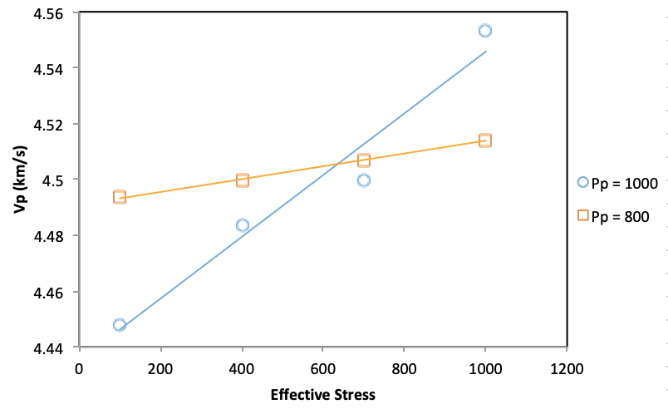
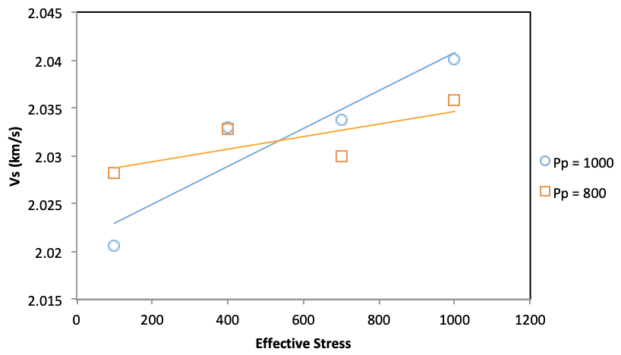
Effect of Stress on Acoustic Velocity
Velocity increase is more noticeable at higher pore pressures.
This indicates that as larger portion of the pore space is filled with liquid, the grain contact is more reinforced; hence, rock becomes stronger.
7

Slide 8
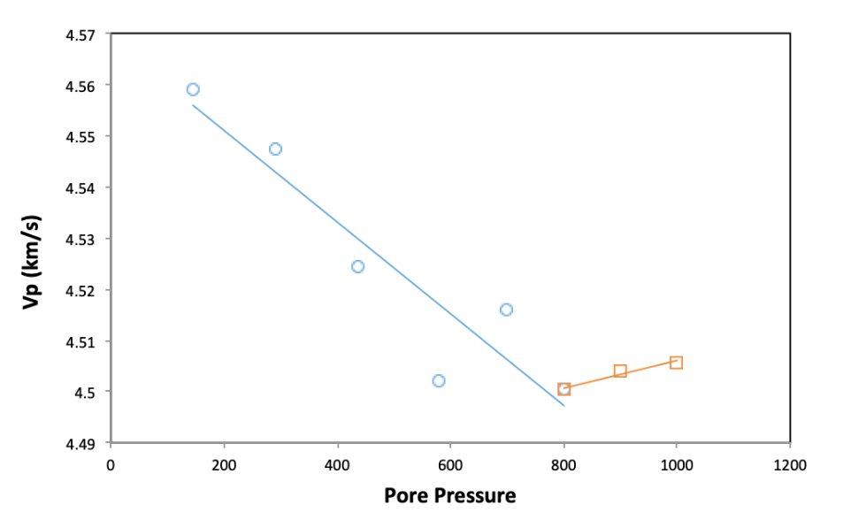
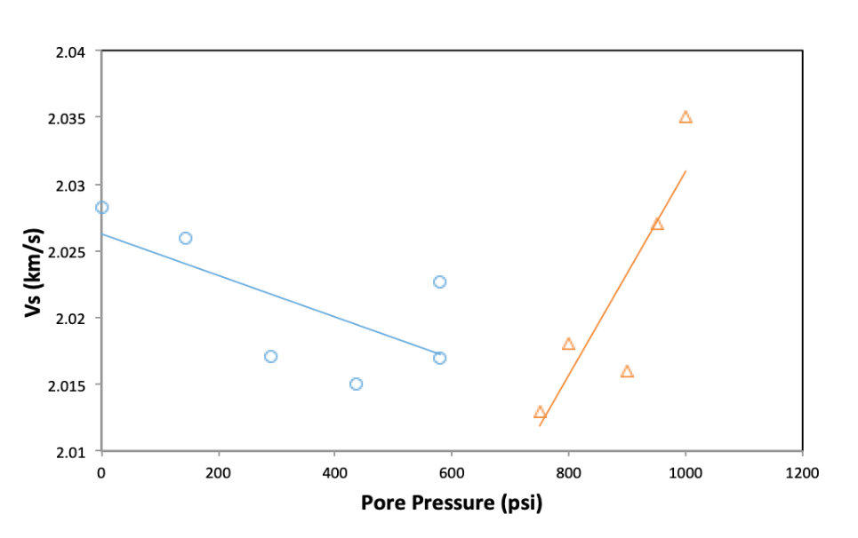
Effect of Condensation on Acoustic Velocity
V decreases due to expansion of pore volume as pore pressure is increased.
At around 750-800 psi, the change in V_{p} and V_{s} slope indicates condensation has occurred in small pores (Occurs in PVT cell at 977 psia at 27°C).
Condensed liquid has lower mobility & higher resistance to shear resulting in shear velocity increase. Grain contacts are reinforced.
8
Notes:
As gas condenses, confined fluid is trapped by strong surface forces. Trapped fluid moves as if it was part of the grains.
The minimum saturation time of each step was 24 hours
The increase in pore pressure slightly increases pore diameter thereby affecting the onset of capillary condensation.

Slide 9
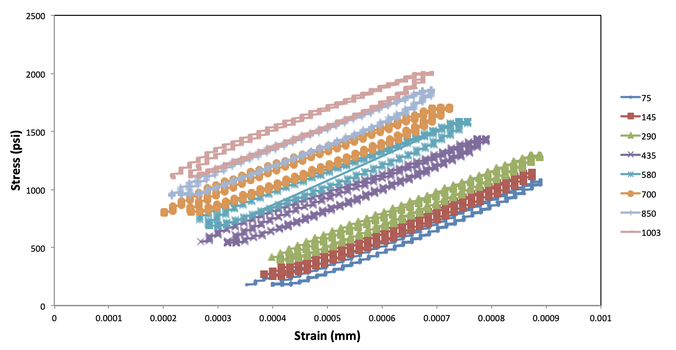
Mechanical Behavior: Stress-Strain
As pore pressure is increased, a more visible hysteresis loop is observed between the loading and unloading cycles.
This represents the loss of energy to the fluid as more liquid condenses.
Smallest nanopores condensing first at lower pressure.
9
Notes:
At each pore P, we increased axial stress steadily (load and unload) recording strain gauge measurements.

Slide 10
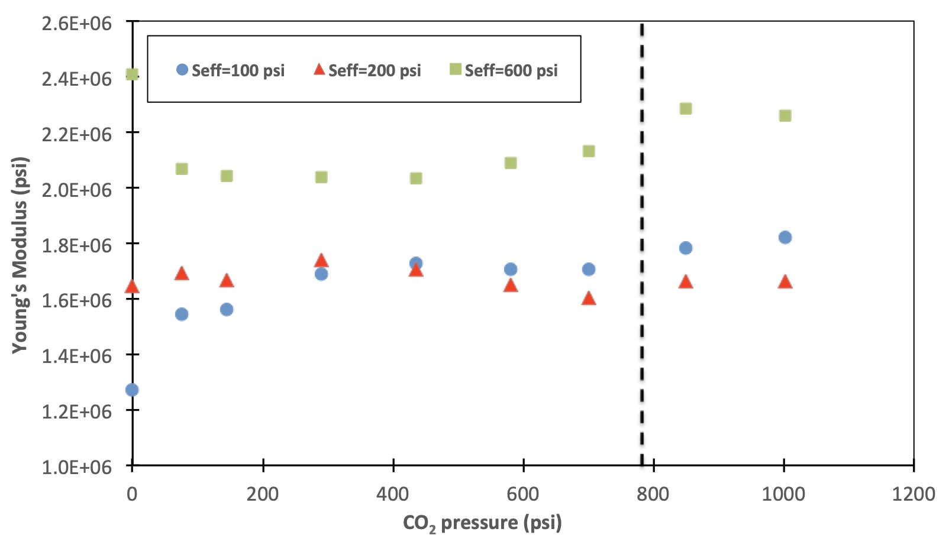
Mechanical Behavior: Young’s Modulus
A change in trend occurs at around 750 - 800 psi: an indication of capillary condensation occurring in the pore space (increase in pore stiffness).
5% increase
10
Notes:
5% increase

Slide 11
Conclusion
This research represents the first experimental endeavor to study the effect of capillary condensation on the acoustic and mechanical properties of shale reservoirs.
Using CO₂ gas in the experiments, we observed a change in mechanical and acoustic behavior of shale at pore pressure around 750 - 800 psi, indicating that capillary condensation in nanopores had occurred at a pressure lower than the normal dew point pressure—in agreement with thermodynamic model prediction.
11

