Slide 1

UNCONVENTIONAL RESERVOIR ENGINEERING PROJECT
Colorado School of Mines
U R E P
CSM
Acoustic Measurements to Detect Phase Changes during Flow
Luis Zerpa
Associate Professor
Petroleum Engineering Department
UNCONVENTIONAL RESERVOIR ENGINEERING PROJECT
Advisory Board Meeting, November 8, 2019, Golden, Colorado

Slide 2
Phase transitions to solid affect flow behavior, reducing permeability
Problem Statement
Formation of a solid phase reduces permeability
Phase transitions into solid can be detected using acoustic and electrical conductivity measurements
Examples:
  Gas hydrates forming from dissolved gas during cold water injection in shallow offshore undersaturated oil reservoirs
  Asphaltenes, paraffins or salt precipitation due to changes in pressure and temperature
UNCONVENTIONAL RESERVOIR ENGINEERING PROJECT
Advisory Board Meeting, November 8, 2019, Golden, Colorado

Slide 3
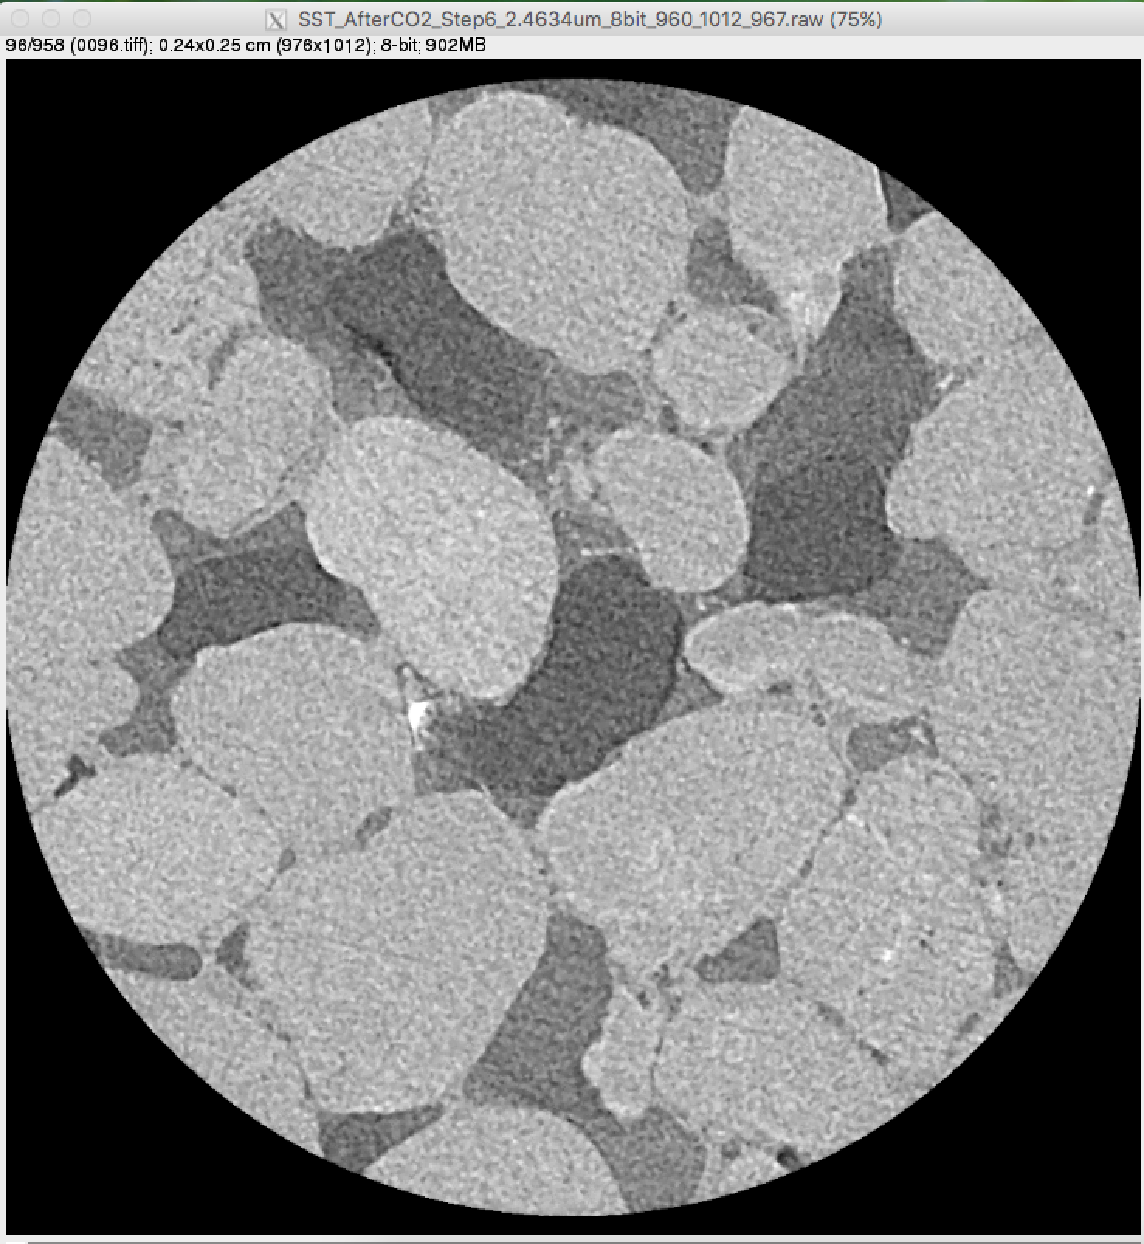
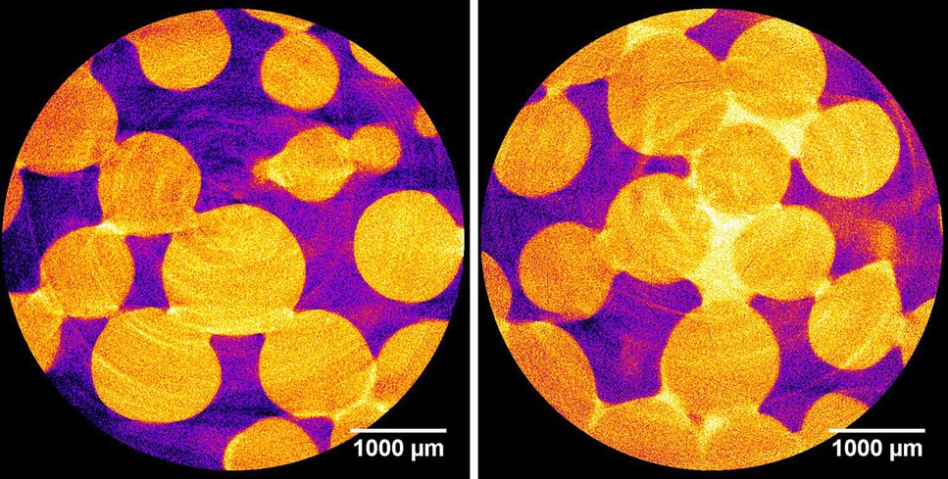
Previous work on solid phase transitions
Problem Statement
X-Ray Micro-CT CO₂-brine test with salt precipitation
X-ray Micro-CT images of hydrate distribution in porous media
(Schindler, Batzle, Prasad, 2017, Geophysical Prospecting 65(4), 1025-1036
2405 µm
(Falcon-Suarez, Livo, Pohl, Prasad, 2019 – under review)
UNCONVENTIONAL RESERVOIR ENGINEERING PROJECT
Advisory Board Meeting, November 8, 2019, Golden, Colorado

Slide 4
Objective
To determine conditions of phase transitions during fluid flow and quantify effect on flow behavior
UNCONVENTIONAL RESERVOIR ENGINEERING PROJECT
Advisory Board Meeting, November 8, 2019, Golden, Colorado

Slide 5
Case Study – Proof of Concept
Bentheimer Sandstone
Provided: Kocurek Industries
Formation: Valiginian
Permeability: 2500 mD
Porosity: 0.25
Analog to undersaturated oil reservoir in the Barents sea
UNCONVENTIONAL RESERVOIR ENGINEERING PROJECT
Advisory Board Meeting, November 8, 2019, Golden, Colorado

Slide 6
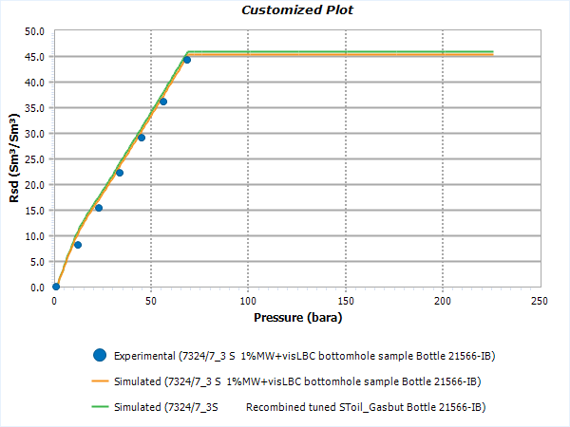
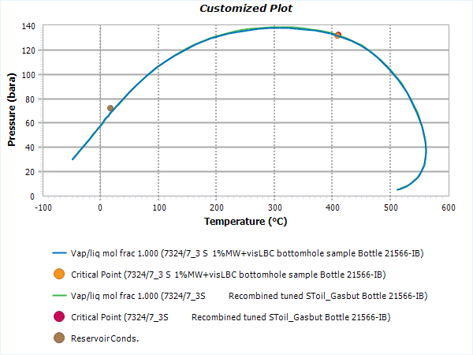
Live-oil recombination
Approach
Tuned PVT fluid model (PVTSim)
Selection of synthetic gas for recombination
UNCONVENTIONAL RESERVOIR ENGINEERING PROJECT
Advisory Board Meeting, November 8, 2019, Golden, Colorado

Slide 7
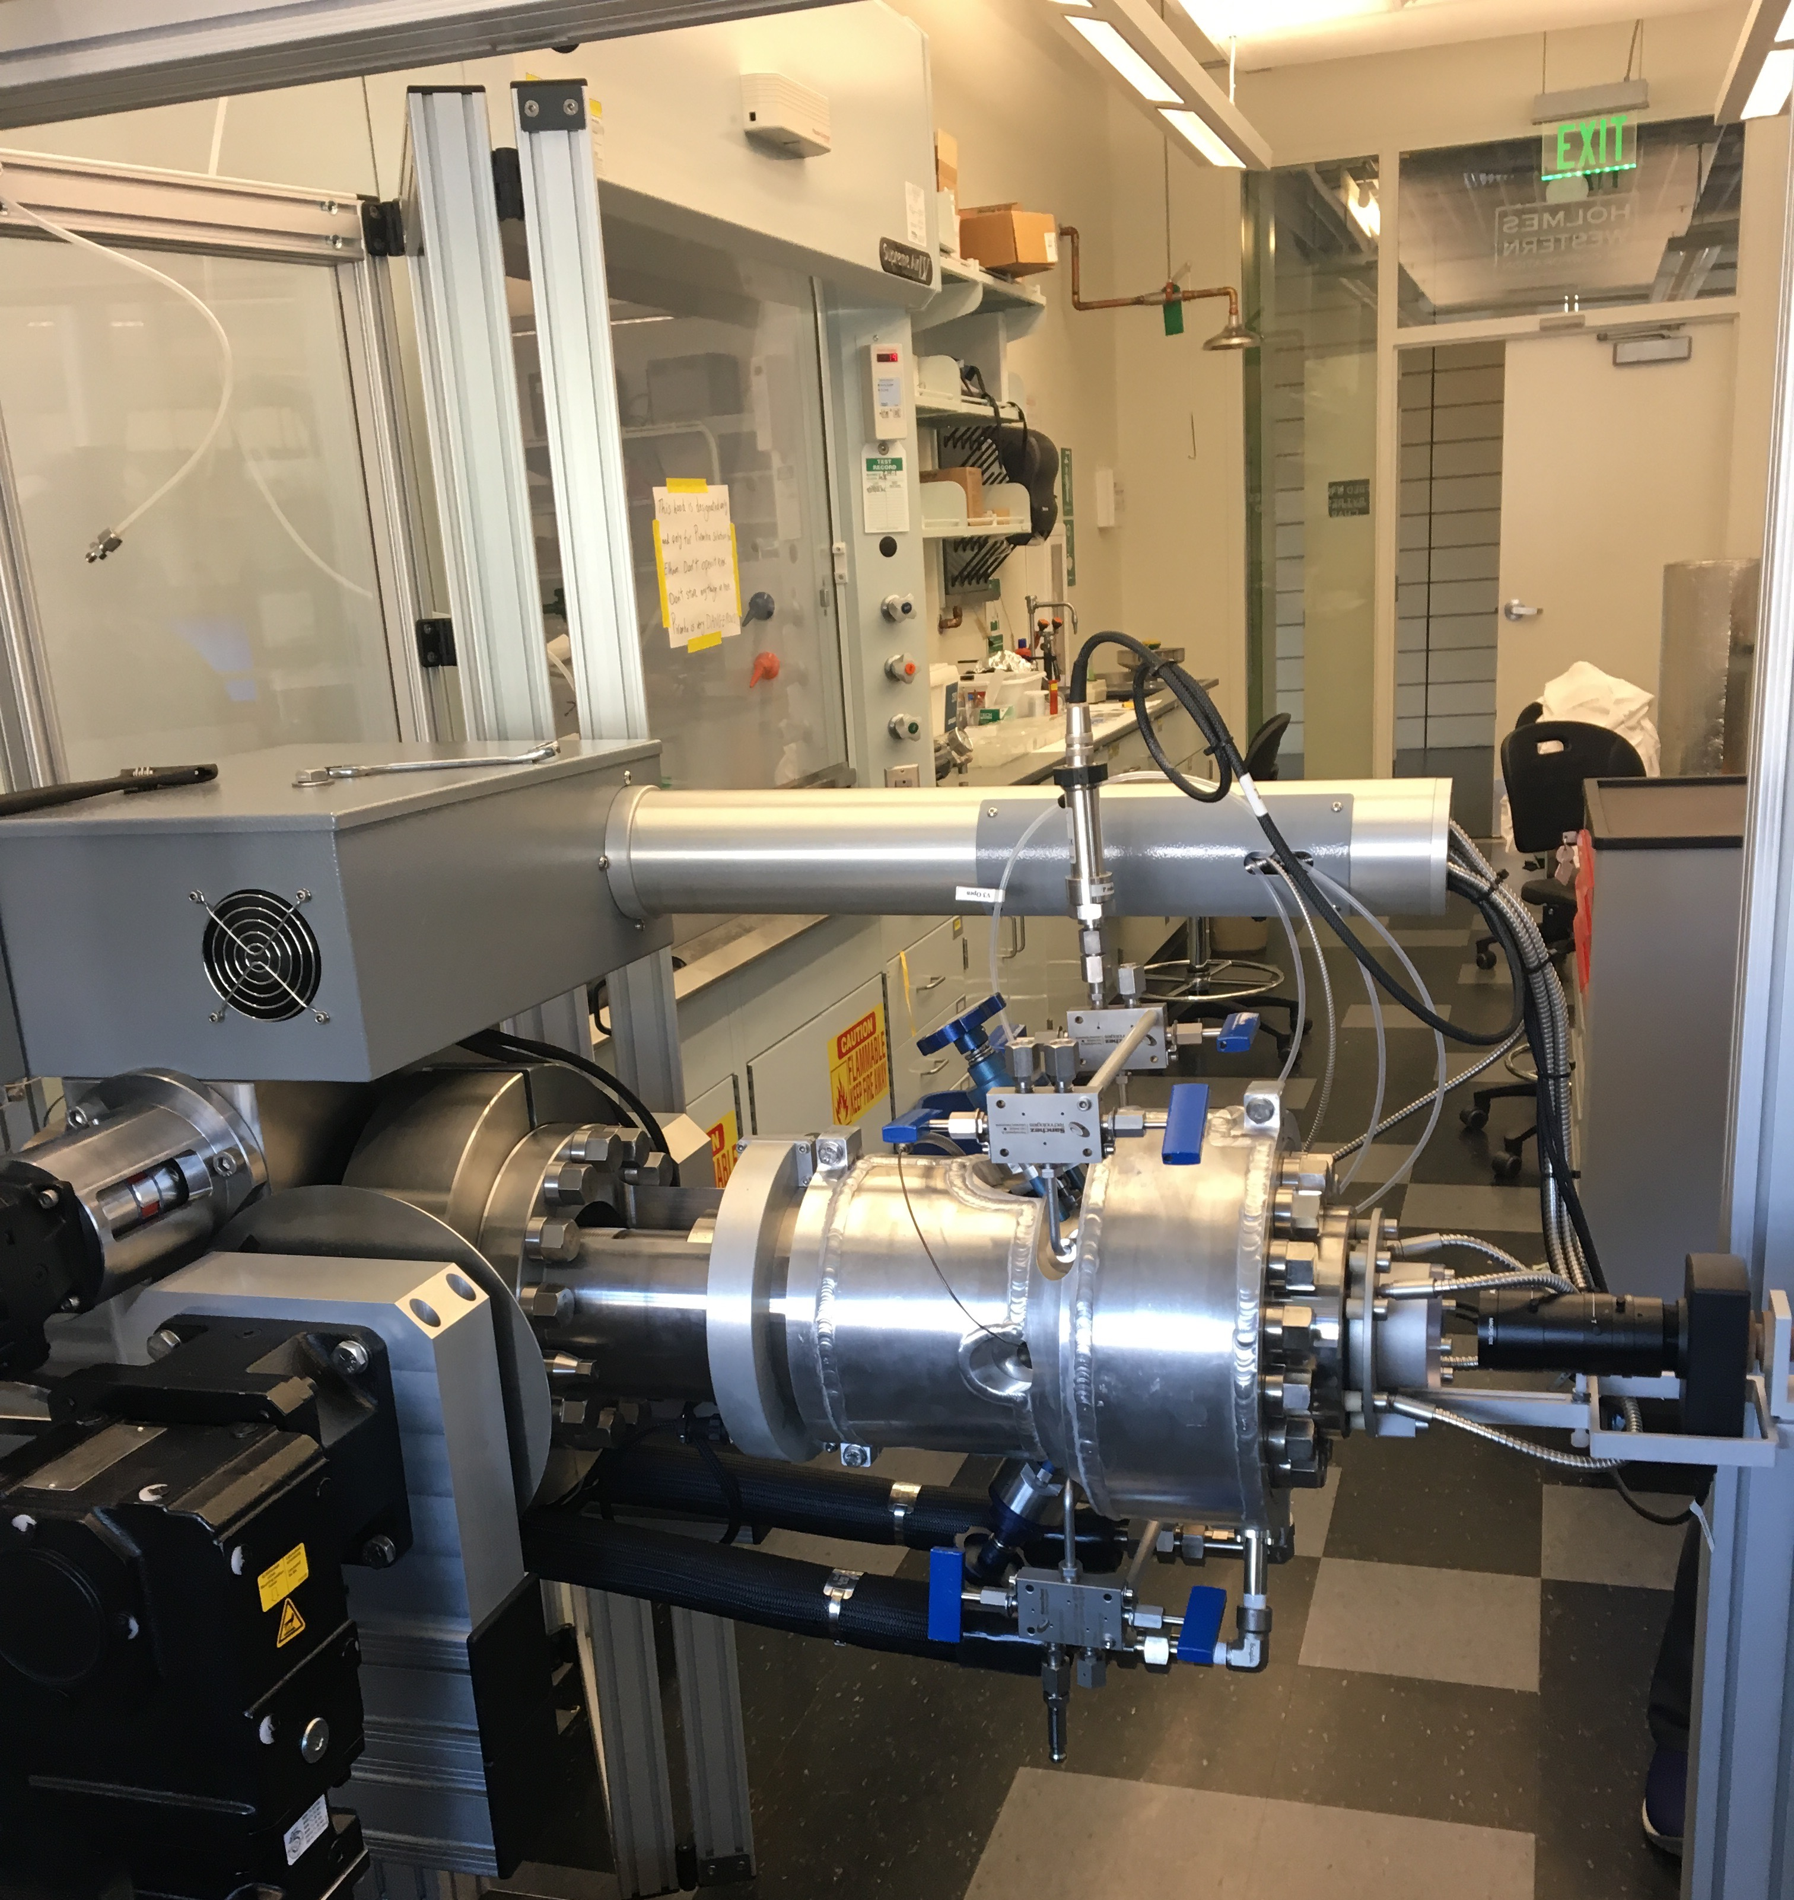
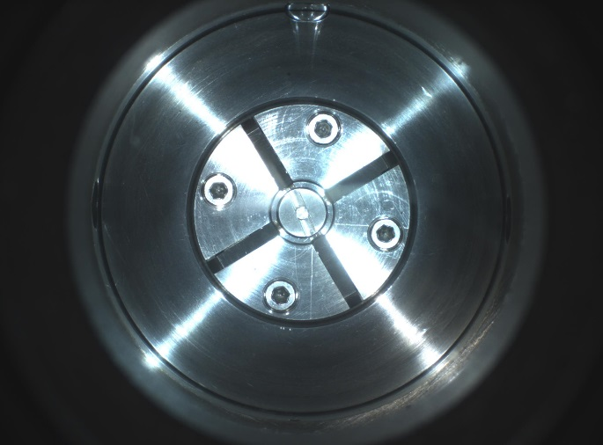
Verification of live-oil recombination
Approach
Live-oil recombination was verified using a phase behavior apparatus (PVT cell)
Measuring bubble-point at reservoir conditions
Full visibility of fluid behavior in real time through a window with a CCD camera
UNCONVENTIONAL RESERVOIR ENGINEERING PROJECT
Advisory Board Meeting, November 8, 2019, Golden, Colorado

Slide 8
Experimental setup
UNCONVENTIONAL RESERVOIR ENGINEERING PROJECT
Advisory Board Meeting, November 8, 2019, Golden, Colorado

Slide 9
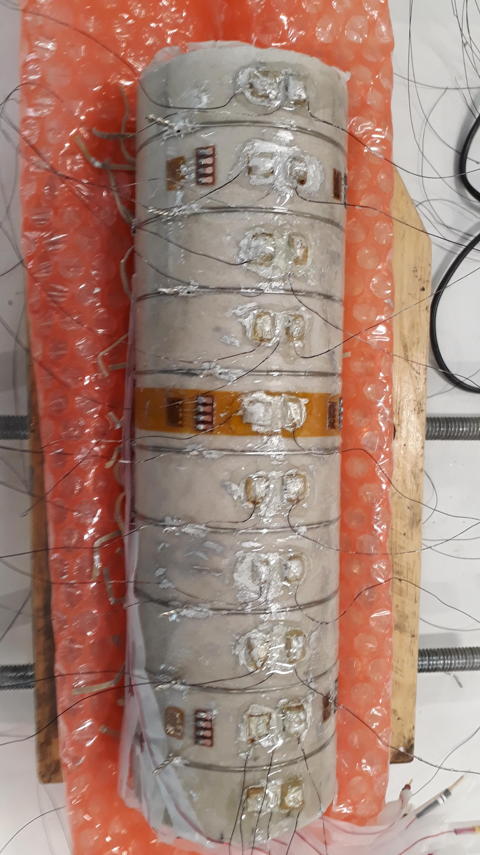
Multiphysics Measurements
Acoustic measurements
P-wave and S-wave Crystals
Velocities and Attenuation
  Velocity increase due to solids formation
Electrical conductivity measurements
Current Electrodes (top and bottom)
Potential Electrodes (Ring Electrodes)
Real Part
  Overall changes in conductivity
Imaginary Part
  Changes along the grains
UNCONVENTIONAL RESERVOIR ENGINEERING PROJECT
Advisory Board Meeting, November 8, 2019, Golden, Colorado

Slide 10
Complex conductivity measurements to determine hydrate formation in porous media
Approach
Long-term complex conductivity measurements show recognizable events in the response of conductivity related to phases of hydrate growth and dissociation
With an initial decrease in conductivity as soon as hydrate begins to form
M. Pohl, PhD thesis, 2018
UNCONVENTIONAL RESERVOIR ENGINEERING PROJECT
Advisory Board Meeting, November 8, 2019, Golden, Colorado

Slide 11
Conclusions
We are developing a procedure for detecting phase transitions using acoustics and electrical conductivity
Currently studying hydrate formation during a waterflooding in an offshore shallow undersaturated oil reservoir
Lab capabilities include:
  Fluid property analysis (PVT cell)
  Coreflooding with multiphysics sensors
UNCONVENTIONAL RESERVOIR ENGINEERING PROJECT
Advisory Board Meeting, November 8, 2019, Golden, Colorado

