Slide 1
UNCONVENTIONAL RESERVOIR ENGINEERING PROJECT
Colorado School of Mines
U R E P
CSM
Research Summary
Hindered Transport in Nanoporous Media
Tugce Calisgan, PhD Student
Colorado School of Mines
UNCONVENTIONAL RESERVOIR ENGINEERING PROJECT
Advisory Board Meeting, November 8, 2019, Golden, Colorado

Slide 2
Summary
Membrane Properties of Shale
Source vs. Reservoir Oils
Hunt and Jameson (1956), Brenneman and Smith (1958), and Hunt (1961) all noted that most of the source oils are composed of heavier components than their reservoir oils.
Production Observations
Most unconventional production is light HCs (CH₄ and light oil)
Experimental Evidence
No direct experimental evidence
Relevant Questions
Does filtration exist and what controls it?
What does it mean for reservoir production and EOR?
UNCONVENTIONAL RESERVOIR ENGINEERING PROJECT
Advisory Board Meeting, November 8, 2019, Golden, Colorado

Slide 3
Summary
Membrane Properties of Nanoporous Media
Filtration of C10 and C17 mixture (experiments by Z. Zhu)
Niabrora core sample
C17 is filtered
Berea core sample
No filtration
UNCONVENTIONAL RESERVOIR ENGINEERING PROJECT
3
Advisory Board Meeting, November 8, 2019, Golden, Colorado

Slide 4
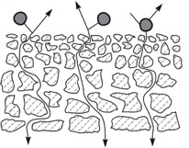
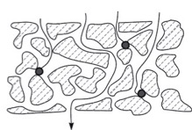
Summary
Pore-Flow Membranes vs. Nanoporous Media
Depth Filter
Mudstone
Screen Filtration
(Baker 2012)
Filtration in nanoporous media resembles depth filtration (hindered transport)
Flow occurs through advection and diffusion
Hindrance is due to adsorption and sieving
Depth Filtration
UNCONVENTIONAL RESERVOIR ENGINEERING PROJECT
Advisory Board Meeting, November 8, 2019, Golden, Colorado

Slide 5
Summary
Size Comparisons of Atoms, Molecules, Microemulsions, Viruses & Bacteria
Surfactant
Microemulsions
(Microbiology Info.com)
Majority of pores in unconventional reservoirs are in nanometer size
UNCONVENTIONAL RESERVOIR ENGINEERING PROJECT
Advisory Board Meeting, November 8, 2019, Golden, Colorado

Slide 6
Summary
Effective HC Molecular Sizes
3.988 $Å$
3.988 $Å$
4.150 $Å$
8.240 $Å$
CH₄
n-C₄H₁₀
3.988 $Å$
4.755 $Å$
4.150 $Å$
8.240 $Å$
C₂H₆
iso-C₄H₁₀
(Mao and Sinnott 2001)
UNCONVENTIONAL RESERVOIR ENGINEERING PROJECT
Advisory Board Meeting, November 8, 2019, Golden, Colorado

Slide 7
Summary
Implications on EOR
Size Comparisons of Gas Molecules vs. Surfactant Microemulsions
100 – 1000 $Å$
1000 – 4000 $Å$
(Baker 2012)
(Shannon et al. 2017)
$>$4000 $Å$
UNCONVENTIONAL RESERVOIR ENGINEERING PROJECT
Advisory Board Meeting, November 8, 2019, Golden, Colorado

Slide 8
Modeling
Components of Hindered Transport
Advective (bulk) transport (larger pores, fractures, …)
Driven by pressure or concentration gradient
Darcy (Fickian) flow (normal diffusion)
Anomalous diffusion
Molecular Diffusion (nano- to micro-pores)
Driven by the thermal energy and concentration gradient
Single or multicomponent
Hindrance (nanopores and pore-throats)
Due to adsorption and molecular sieving
Selective adsorption
UNCONVENTIONAL RESERVOIR ENGINEERING PROJECT
Advisory Board Meeting, November 8, 2019, Golden, Colorado

Slide 9
Modeling
1. Compositional Formulation
1-D continuity equation coupled diffusion, adsorption and sieving (Z. Zhu)
$$Influx−outflux=accumulation$$
Flux: molecular diffusion + advective flow
Accumulation: mobile phase + adsorbed phase + sieved phase
outflux
influx
accumulation
$\vec{J}$diffusional flux, $mol/m^{2}∙s$
$\vec{v}$velocity, $m/s$
$φ$porosity
$c$molar density of mobile phase, $mol/m^{3}$
$A$molar density of adsorbed phase, $mol/m^{3}$
$S$molar density of sieved phase, $mol/m^{3}$
$t$time, $s$
$i$ component i
$$−∇∙{\vec{J}}_{i}−∇\left(\vec{v}c_{i}\right)=φ\frac{∂c_{i}}{∂t}+\frac{∂A_{i}}{∂t}+\frac{∂S_{i}}{∂t}$$
diffusional flux
adsorption
advective flux
sieving
UNCONVENTIONAL RESERVOIR ENGINEERING PROJECT
Advisory Board Meeting, November 8, 2019, Golden, Colorado

Slide 10
Modeling
1. Compositional Formulation
Phenomenological relations (Z. Zhu)
${\vec{J}}_{i}=D_{ij} \frac{φ}{τ} ∇c_{j}$ (or more generally, chemical potential $∇μ_{i}$)
$D_{ij}$ binary diffusion coefficient, $m^{2}/s$
$τ$ tortuosity
$A_{i}=A_{s} ρ a_{i}\left(1−e^{−m_{i}t}\right)$
$A_{s}$ specific surface area of rock sample, $m^{2}/g$
$ρ$ density of rock sample, $g/m^{3}$
$a_{i}$ adsorption capacity of rock sample at current condition
for a specific component, $mol/m^{2}$
$m_{i}$ kinetic coefficient for the exponential model
$t$ time, $s$
$S_{i}=S_{i,max}\left(1−e^{−n_{i}t}\right)$
$S_{i,max}$ maximum amount of component i held due to sieving, $mol/m^{3}$
$n_{i}$ kinetic coefficient for the exponential model
UNCONVENTIONAL RESERVOIR ENGINEERING PROJECT
Advisory Board Meeting, November 8, 2019, Golden, Colorado

Slide 11
Modeling
1. Compositional Formulation
Phenomenological relations (Z. Zhu)
Adsorption models (Kajjumba et al. 2018)
Pseudo first order (Lagergren) model
$q_{t}=q_{e}\left(1−\exp^{{−k}_{1}t}\right)$
Pseudo second order model
$q_{t}=k_{2}q_{e}\left(q_{e}−q_{t}\right)t$
Elovich model
$q_{t}=\frac{1}{β}\left[\ln\left(t+\frac{1}{αβ}\right)−\ln\left(αβ\right)\right]$
Intra-particle diffusion model
$q_{t}=K_{p}\sqrt{t}+C$
UNCONVENTIONAL RESERVOIR ENGINEERING PROJECT
Advisory Board Meeting, November 8, 2019, Golden, Colorado

Slide 12
Modeling
1. Compositional Formulation
Phenomenological relations (Z. Zhu)
Molecular sieving (filtration) models
We have not found much in the literature
Simple first order model
$S_{i}=S_{i,max}\left(1−e^{−n_{i}t}\right)$
$S_{i,max}$ maximum amount of component i held due to sieving, $mol/m^{3}$
$n_{i}$ kinetic coefficient for the exponential model
UNCONVENTIONAL RESERVOIR ENGINEERING PROJECT
Advisory Board Meeting, November 8, 2019, Golden, Colorado

Slide 13
Modeling
2. Black-Oil Formulation
Only small & charged molecules are allowed to pass
Molecules pass across membrane until equal concentration is reached.
Certain molecules enter membrane – not pass through the other side
$$J_{s}={ω{∆Π}_{∞}+\left(1−σ_{f}\right)C_{∞}J}_{v}$$
Solute Flux. :
Volume Flux :
$∆p_{∞}$ : hydraulic pres. gradient (unhindered)
$∆Π_{∞}$ : osmotic pres. gradient (${∆Π}_{∞}=RT{∆C}_{∞}$, unhindered )
$L_{p}$ : hydraulic permeability [$L_{p}={γr_{o}^{2}}/{\left(8μL\right)}]$
$ω$ : permeation coefficient [$ω={\left({J_{s}}/{{∆Π}_{∞}}\right)}_{J_{v}=0}$]
$σ_{o}$ : osmotic reflection (rejection) coefficient [$σ_{o}={\left({∆p_{∞}}/{{∆Π}_{∞}}\right)}_{J_{v}=0}$]
$σ_{f}$ : filtration reflection coefficient {$σ_{f}=1−{\left[{J_{s}}/{\left(C_{∞}J_{v}\right)}\right]}_{∆C_{∞}=0}$}
$σ_{o}≈σ_{f}$ $={\left(1−Φ\right)}^{2}$ Staverman (1951), Anderson (1981), Levitt (1975)
$$J_{v}=L_{p}\left({∆p}_{∞}−σ_{o}{∆Π}_{∞}\right)$$
Baker 2012
UNCONVENTIONAL RESERVOIR ENGINEERING PROJECT
Advisory Board Meeting, November 8, 2019, Golden, Colorado

Slide 14
Modeling
2. Black-Oil Formulation
Partition Coefficient, $Φ={∆C_{y}}/{C_{y}^{L_{1}} }$
$$∆C_{y}=C_{y}^{L_{2}}−C_{y}^{L_{1}}$$
System $L_{1}$
Component y ($C_{y}^{L_{1}})$
$p_{1}$, $T_{1}$
Component y ($C_{y}^{L_{2}})$
System $L_{2}$
$p_{2}$, $T_{2}$
$$∆p=p_{2}−p_{1}$$
$Φ$ represents the filtration efficiency and depends on p & T
UNCONVENTIONAL RESERVOIR ENGINEERING PROJECT
Advisory Board Meeting, November 8, 2019, Golden, Colorado

Slide 15
Modeling
3. Diffusion-Permeation Formulation
Selectivity of gas separation
Gas selectivity is the ratio of permeability coefficients of two gases
Ideal gas selectivity:
$$α=\frac{P_{A}}{P_{B}}={\left(\frac{M_{B}}{M_{A}}\right)}^{1/2}exp⁡(−\frac{∆E_{A}−∆E_{B}}{RT})$$
$$P_{A}$$
= permeability coefficient of gas A
$$P_{B}$$
= permeability coefficient of gas B
Shelekhin et al., 1995
UNCONVENTIONAL RESERVOIR ENGINEERING PROJECT
Advisory Board Meeting, November 8, 2019, Golden, Colorado

Slide 16
Modeling
3. Diffusion-Permeation Formulation
Permeability coefficient
$$P=D_{c,ads}\frac{d\ln\left(p\right)}{d\ln\left(C_{ads}\right)}\frac{θ}{τ}\frac{dC_{ads}}{dp}+\frac{θ}{τ}\frac{D_{c,gas}}{RT}$$
Corrected diffusion coefficients in the adsorbed and gas phase:
$$D_{c,ads}=ρ_{g}d_{p}{\left(\frac{8RT}{πM}\right)}^{1/2}e^{− \frac{∆E_{ads}}{RT}}$$
$$D_{c,gas}=ρ_{g}d_{p}{\left(\frac{8RT}{πM}\right)}^{1/2}e^{− \frac{∆E_{gas}}{RT}}$$
UNCONVENTIONAL RESERVOIR ENGINEERING PROJECT
Advisory Board Meeting, November 8, 2019, Golden, Colorado

Slide 17
Modeling
3. Diffusion-Permeation Formulation
Permeability coefficient for permanent gases:
$$P=D_{c,ads}\frac{d\ln\left(p\right)}{d\ln\left(C_{ads}\right)}\frac{θ}{τ}\frac{dC_{ads}}{dp}+\frac{θ}{τ}\frac{D_{c,gas}}{RT}$$
$$P=ρ_{g}d_{p}{\left(\frac{8}{πMRT}\right)}^{1/2} \frac{θ}{τ} e^{− \frac{∆E_{gas}}{RT}}$$
Shelekhin et al., 1995
UNCONVENTIONAL RESERVOIR ENGINEERING PROJECT
Advisory Board Meeting, November 8, 2019, Golden, Colorado

Slide 18
Modeling
3. Diffusion-Permeation Formulation
Permeability coefficient
“The transport flux of material through the membrane per unit driving force per unit membrane thickness”
$$J=−P\frac{∆p}{L}$$
$$J=−\left(D_{c,ads}\frac{d\ln\left(p\right)}{d\ln\left(C_{ads}\right)}\frac{dC_{ads}}{dp}+\frac{D_{c,gas}}{RT}\right)\frac{θ}{τ}\frac{∆p}{L}$$
UNCONVENTIONAL RESERVOIR ENGINEERING PROJECT
Advisory Board Meeting, November 8, 2019, Golden, Colorado

Slide 19
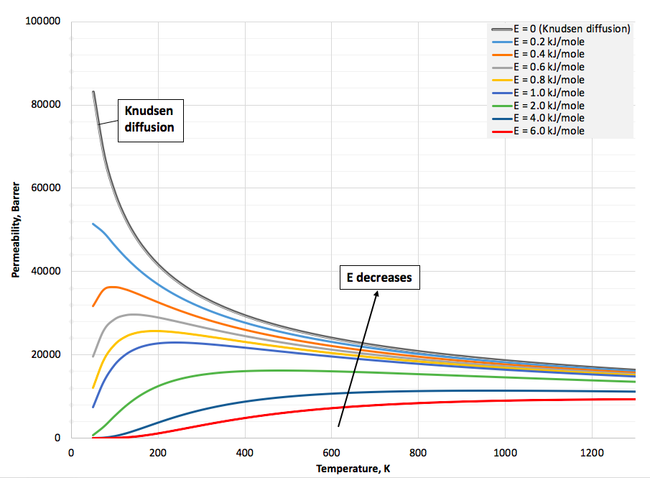
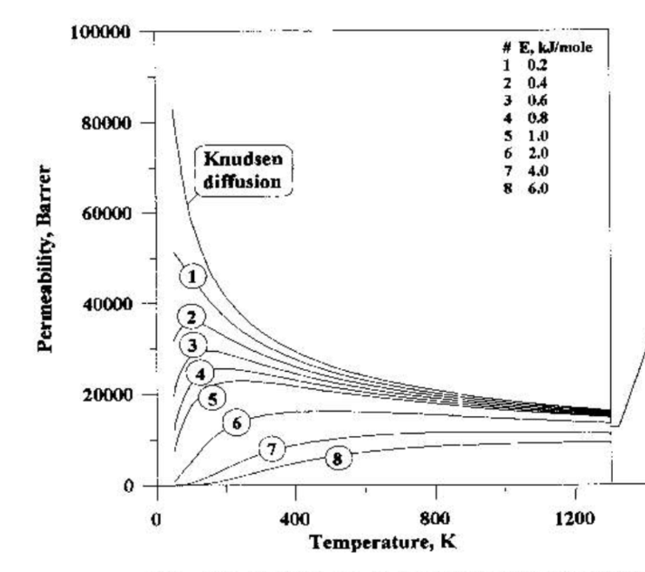
Modeling
3. Diffusion-Permeation Formulation
Permeability coefficient
Assumptions:
Membrane porosity = 0.3
Tortuosity factor = 2
Pore diameter = 15 $Å$ (1.5 nm)
Geometrical factor = 0.1
Shelekhin et al., 1995
UNCONVENTIONAL RESERVOIR ENGINEERING PROJECT
Advisory Board Meeting, November 8, 2019, Golden, Colorado

Slide 20
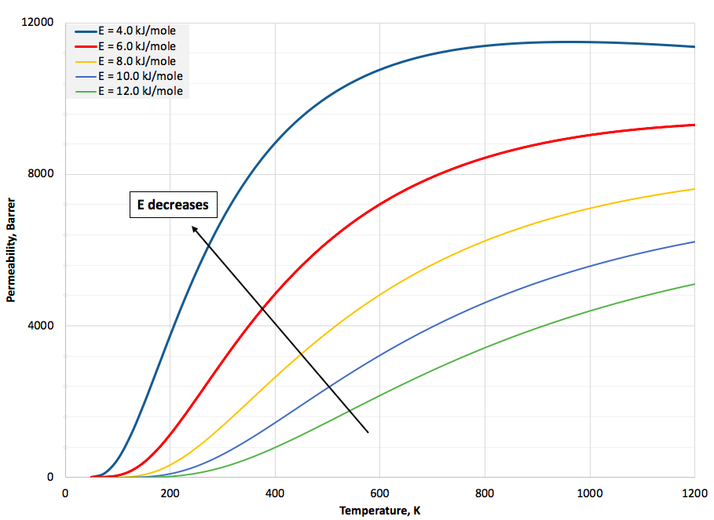
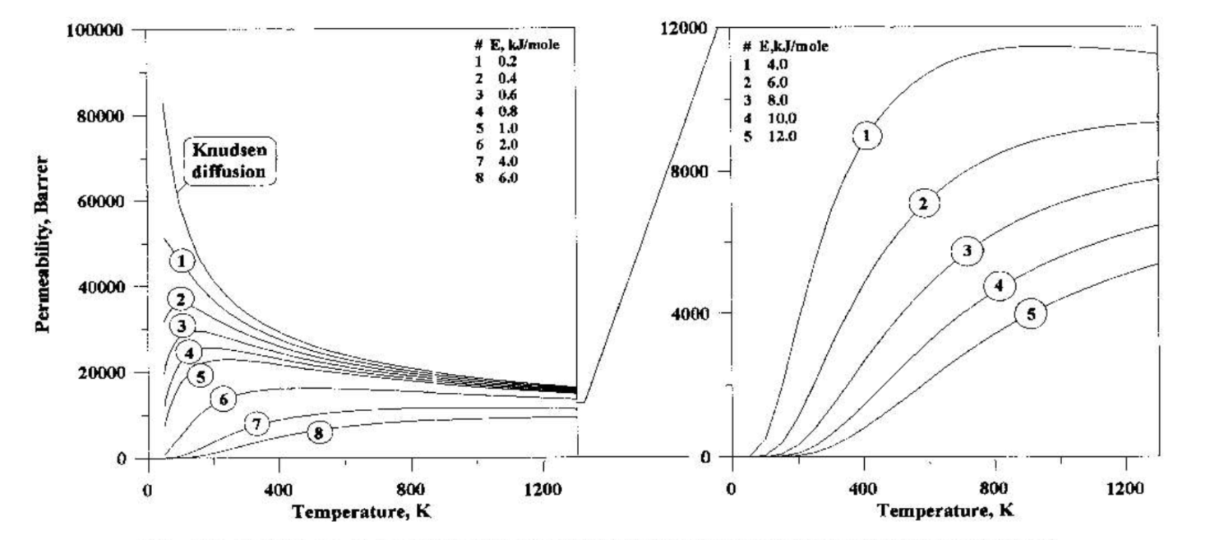
Modeling
3. Diffusion-Permeation Formulation
Permeability coefficient
Shelekhin et al., 1995
UNCONVENTIONAL RESERVOIR ENGINEERING PROJECT
Advisory Board Meeting, November 8, 2019, Golden, Colorado

Slide 21
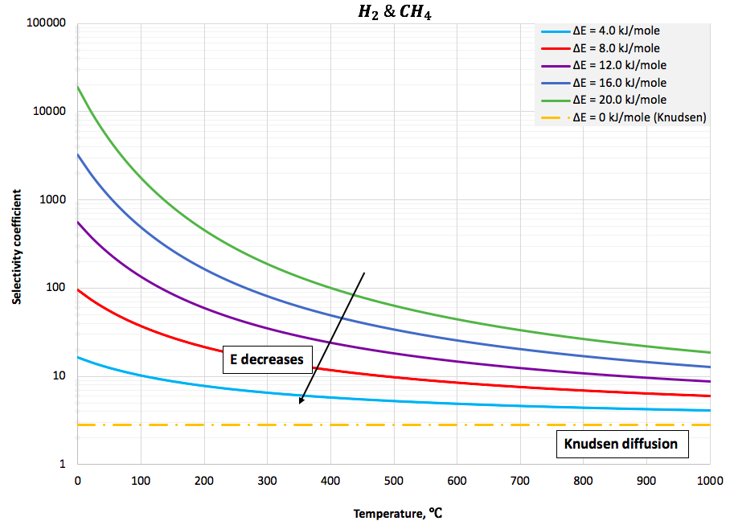
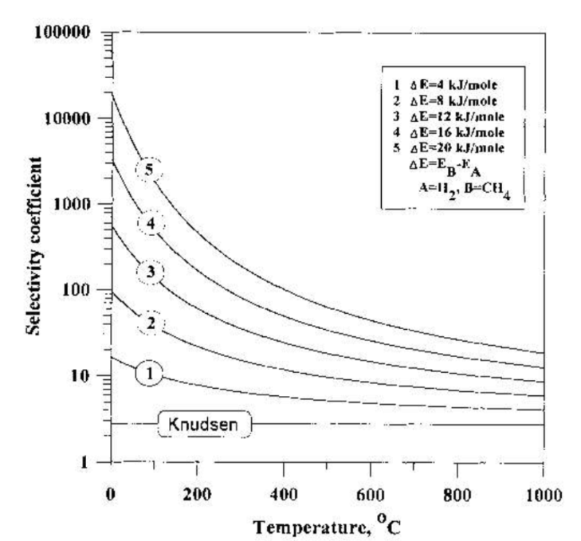
Modeling
3. Diffusion-Permeation Formulation
Selectivity of gas separation
Shelekhin et al., 1995
UNCONVENTIONAL RESERVOIR ENGINEERING PROJECT
Advisory Board Meeting, November 8, 2019, Golden, Colorado

Slide 22
Questions?
Thank you
UNCONVENTIONAL RESERVOIR ENGINEERING PROJECT
Advisory Board Meeting, November 8, 2019, Golden, Colorado

