Slide 1
UNCONVENTIONAL RESERVOIR ENGINEERING PROJECT
Colorado School of Mines
U R E P
CSM
Molecular Modeling of HC Mixtures in Unconventionals
Berk Coskuner
Ph.D. Petroleum Engineering
Colorado School of Mines
UNCONVENTIONAL RESERVOIR ENGINEERING PROJECT
Advisory Board Meeting, Nov 8, 2019, Golden, Colorado

Slide 2
Objective & Outline
Objective
Demonstrate hindrance of HC transport in nanoporous media.
Outline
Investigating the behavior of a single hydrocarbon molecule in closed pore system
Single methane molecule
Single heptane molecule
Mixture of a methane molecule and a heptane molecule
Molecular Dynamics Simulation of a Membrane System
Membrane properties
Initial Configuration
Details of the Simulation
UNCONVENTIONAL RESERVOIR ENGINEERING PROJECT
Advisory Board Meeting, Nov 8, 2019, Golden, Colorado

Slide 3
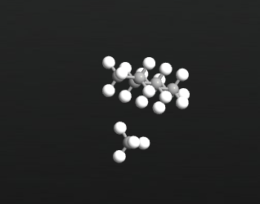
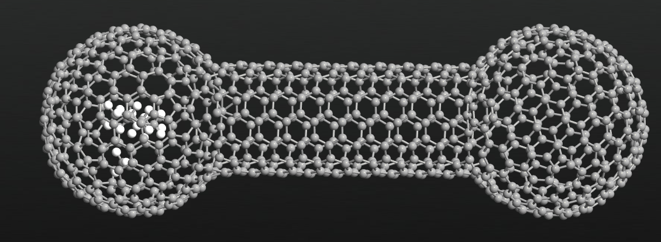
Dimensions & Details of the System
Heptane
1.62462 nm
2.2149 nm
Methane
We used Virtual Nano Lab for the molecular dynamics simulation
Simulations were run for 100,000 – 200,000 time steps
Each time step is 1 femtosecond
Simulations were run at NVT Ensemble (constant # of particles, constant volume, constant temperature)
T = 500 K
For the potential parameters, we used Tersoff_CH_2010
UNCONVENTIONAL RESERVOIR ENGINEERING PROJECT
Advisory Board Meeting, Nov 8, 2019, Golden, Colorado

Slide 4
Purpose of the Simulations
Observe the changes in MSD of a molecule in confined environment
Relate the diffusivity to the molecular chain length
Observe translation and retention motions of a particle (if happens)
The ultimate goal is to find a connection between the permeability constant in anomalous diffusion simulation model and diffusivity coefficient from molecular dynamics simulation
UNCONVENTIONAL RESERVOIR ENGINEERING PROJECT
Advisory Board Meeting, Nov 8, 2019, Golden, Colorado

Slide 5
Motion of a Single Methane Particle in Nanotube
Trapped
Mean Square Displacement, $Å^{2}$
Jumped
Trapped
Time, ps
0-45 ps., the methane molecule is trapped in the pore, causing mean square displacements less than or equal to the square of the pore diameter (262 ${\text{Å}}^{2}$).
45-85 ps, the particle is moving in the nano-tube; as a result, greater mean square displacements (484 ${\text{Å}}^{2}$) observed.
UNCONVENTIONAL RESERVOIR ENGINEERING PROJECT
Advisory Board Meeting, Nov 8, 2019, Golden, Colorado

Slide 6
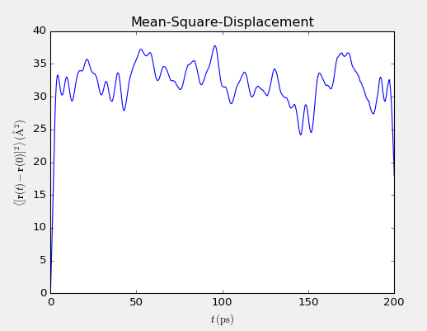
Motion of a Single Heptane Particle in Nanotube
Mean Square Displacement, $Å^{2}$
Trapped
Time, ps
In this simulation, the heptane molecule is trapped and cannot leave the pore in the left.
That’s why we do not observe a sudden jump in the mean square displacement.
UNCONVENTIONAL RESERVOIR ENGINEERING PROJECT
Advisory Board Meeting, Nov 8, 2019, Golden, Colorado

Slide 7
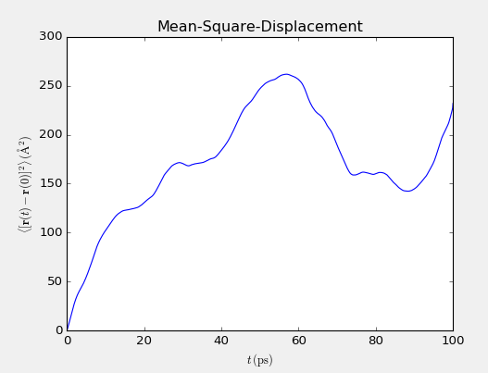
Motion of a Methane & a Heptane Particle in Nanotube
Mean Square Displacement, $Å^{2}$
Time, ps
Because the simulation gives the mean square displacement of methane and heptane together, in this example, the jump in MSD was not clearly observed.
To overcome this problem, we have started using GROMACS software, which is a free molecular dynamics simulation tool.
UNCONVENTIONAL RESERVOIR ENGINEERING PROJECT
Advisory Board Meeting, Nov 8, 2019, Golden, Colorado

Slide 8
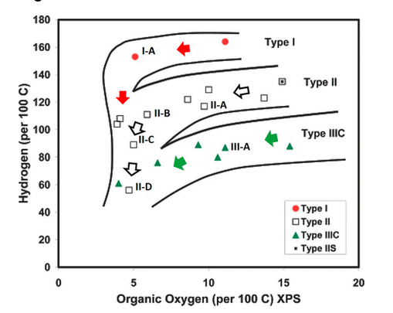
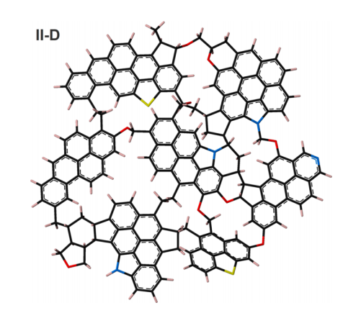
Kerogen Model Used in Membrane Simulation
To be consistent with the literature, we used a kerogen model that is already presented by Ungerer et al 2015.
MD simulation input files are online.
Input files contain the Lennard Jones Parameters, Coulomb Potential Parameters and initial configuration of molecules in Kerogen.
For this work, we chose type II-D, of which the chemical formula is: $C_{175}H_{102}O_{9}N_{4}S_{2}$.
Ungerer et al 2015
UNCONVENTIONAL RESERVOIR ENGINEERING PROJECT
Advisory Board Meeting, Nov 8, 2019, Golden, Colorado

Slide 9
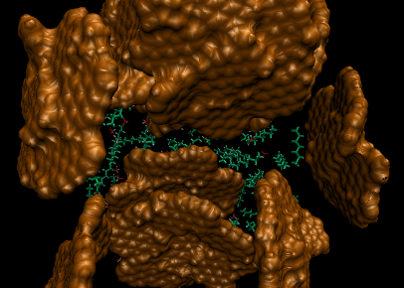
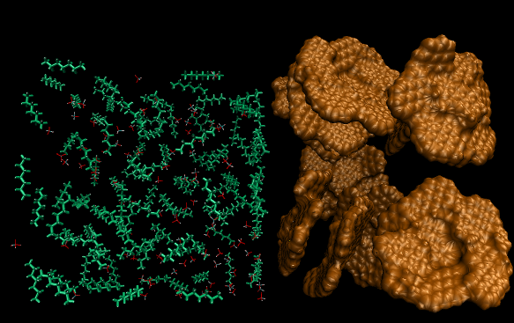
Side and Top Views of the Initial Configuration
YZ
XY
The orange surface represents the kerogen membrane
The red particles represent methane molecules
The green particles represent heptane molecules
The configuration was generated using Gromacs, Packmol, VMD
100 methane and 100 heptane molecules were inserted
In the membrane, we have combination of 10 kerogen molecules presented in the previous slide.
UNCONVENTIONAL RESERVOIR ENGINEERING PROJECT
Advisory Board Meeting, Nov 8, 2019, Golden, Colorado

Slide 10
MD Simulation Details
5 nm
5 nm
5 nm
The maximum pore size is 5nm which lays in the middle of the membrane. (white arrow)
Considering bonded and non bonded force fields between atoms, we will be able to see the impact of adsorption on flow.
UNCONVENTIONAL RESERVOIR ENGINEERING PROJECT
Advisory Board Meeting, Nov 8, 2019, Golden, Colorado

Slide 11
Purpose of the Molecular Dynamics Simulation
Hindered transport model (Z. Zhu)
$$−∇∙{\vec{J}}_{i}−∇\left(\vec{v}c_{i}\right)=φ\frac{∂c_{i}}{∂t}+\frac{∂A_{i}}{∂t}+\frac{∂S_{i}}{∂t}$$
diffusional flux
advective flux
adsorption
sieving
${\vec{J}}_{i}=D_{ij} \frac{φ}{τ} ∇c_{j}$ (or more generally, chemical potential $∇μ_{i}$)
$D_{ij}$ binary diffusion coefficient, $m^{2}/s$
$τ$ tortuosity
$A_{i}=A_{s} ρ a_{i}\left(1−e^{−m_{i}t}\right)$
$A_{s}$ specific surface area of rock sample, $m^{2}/g$
$ρ$ density of rock sample, $g/m^{3}$
$a_{i}$ adsorption capacity of rock sample for component i, $mol/m^{2}$
$m_{i}$ kinetic coefficient for the exponential model
$t$ time, $s$
$S_{i}=S_{i,max}\left(1−e^{−n_{i}t}\right)$
$S_{i,max}$ maximum amount of component i held due to sieving, $mol/m^{3}$
$n_{i}$ kinetic coefficient for the exponential model
UNCONVENTIONAL RESERVOIR ENGINEERING PROJECT
Advisory Board Meeting, Nov 8, 2019, Golden, Colorado

Slide 12
Purpose of the Molecular Dynamics Simulation
Ziming will explain the details of the model
Our goal is to
Verify the adsorption and sieving models
Determine the following parameters of each hydrocarbon component in a mixture
Diffusivity coefficient
Maximum adsorption coefficient
Maximum sieving coefficient
Delineate the impact of different conditions on the diffusivity and adsorption (i.e. temperature, pressure, etc.)
UNCONVENTIONAL RESERVOIR ENGINEERING PROJECT
Advisory Board Meeting, Nov 8, 2019, Golden, Colorado

Slide 13
Thank You
Questions?
UNCONVENTIONAL RESERVOIR ENGINEERING PROJECT
Advisory Board Meeting, Nov 8, 2019, Golden, Colorado

