Slide 1
UNCONVENTIONAL RESERVOIR ENGINEERING PROJECT
Colorado School of Mines
U R E P
CSM
Experimental Study of Transport and EOR in Niobrara Cores
Ziming Zhu
Ph.D. Petroleum Engineering
Colorado School of Mines
UNCONVENTIONAL RESERVOIR ENGINEERING PROJECT
Advisory Board Meeting, Nov 8, 2019, Golden, Colorado

Slide 2
Outline
Review
Sieving effect
Experiments: filtration test + CO₂ huff-n-puff test
Molecular dynamics simulation
Updates
Core analysis: pore size distribution, specific surface area, mineralogy
1-D model, frame and preliminary results
Sieving/EOR of Niobrara crude oil
Future Work
UNCONVENTIONAL RESERVOIR ENGINEERING PROJECT
Advisory Board Meeting, Nov 8, 2019, Golden, Colorado
Notes:
First, I’ll briefly review the work that has been done before the last meeting. (The sieving effect of Niobrara sample on the transport of hydrocarbon molecules, the experiments we performed, including filtration test and CO2 huff-n-puff test, and the molecular dynamics simulation of interactions between Niobrara surface and hydrocarbon molecules.)
After that, I’ll talk about our recent progress.
Then, I’ll close my presentation with our future work.

Slide 3
Sieving Effect
Niobrara sample can sieve hydrocarbons.
Allow the transport of lighter components.
Hinder the transport of heavier components.
Mechanisms
Size exclusion
Niobrara pore/throat size: Å – ${10}^{2}$ nm (Kuila et al 2012, Zhao et al 2017)
Hydrocarbon: Paraffins 0.4 – 1 nm, aromatics 1 – 3 nm
Low end of Niobrara pore/throat has comparable sizes with hydrocarbon molecules.
Preferential adsorption
Different affinity of hydrocarbon molecules to rock surface.
Influences
More lighter components are produced, heavier components are left behind.
UNCONVENTIONAL RESERVOIR ENGINEERING PROJECT
Advisory Board Meeting, Nov 8, 2019, Golden, Colorado
Notes:
Through experiments, we find that Niobrara samples have a sieving effect on the transport of hydrocarbon molecules, which means if you inject hydrocarbon mixtures into Niobrara samples, lighter components can flow through, but heavier components are hindered or restricted. Because of this, more lighter components will be produced from rock or reservoir, while heavier components will be left behind.
From our opinion, we believe there may be two main mechanisms for the sieving effect. The first mechanism is size exclusion. From the literature, we know that some of the pores and pore-throats in Niobrara samples have very similar sizes with hydrocarbon molecules. Therefore, some large molecules can be filtered by smaller pore throats during the flow. The second mechanism is preferential adsorption. Some studies have shown that different hydrocarbon molecules have different affinities to the rock surface, so some specific molecules are more easily adsorbed in Niobrara samples than the others and thus sieved in the flow process.

Slide 4
Filtration Test + CO₂ Huff-n-Puff Test
Filtration test:
Objective: Does sieving effect exist?
Injection Fluid: C₁₀ and C₁₇
Flood Niobrara sample with hydrocarbon fluid, compare the composition of injected and produced fluid.
CO₂ huff-n-puff test:
Objective: Can CO₂ mitigate sieving?
Inject CO₂ from the producing side of Niobrara sample, soak the sample, resume production.
Compare the composition of injected and produced fluid.
UNCONVENTIONAL RESERVOIR ENGINEERING PROJECT
Advisory Board Meeting, Nov 8, 2019, Golden, Colorado
Notes:
The experiments we performed include filtration test and CO2 huff-n-puff test.
For filtration test, its objective is to probe the existence of sieving effect inside Niobrara sample. Basically, we injected a binary mixture of C10 and C17 into Niobrara samples and compared the composition between the injected and the produced fluid using gas chromatography, see if there is any difference.
For CO2 huff-n-puff test, its objective is to see if CO2 can mitigate the sieving effect and enhance oil recovery. Basically, we just shut down the injection of filtration test, injected CO2 into the core sample from the producing side, soak the sample with CO2, and then, resumed injection, and compare the composition of the injected and the produced fluid.

Slide 5
Filtration Test + CO₂ Huff-n-Puff Test
Niobrara Sample 2
CO₂ Injection
UNCONVENTIONAL RESERVOIR ENGINEERING PROJECT
Advisory Board Meeting, Nov 8, 2019, Golden, Colorado
Notes:
This graph shows the experimental result of one sample. The x axis is the number of pore volumes of the fluid that has been produced, and the y axis is the composition of the fluid, expressed by the mole fraction of C10. This horizontal line represents the composition of the injected fluid, and this vertical line represents the CO2 injection. All of these blue and purple points are the compositions of produced fluid.
As you can see, after we started the injection, we produced more C10, which indicates C17 was sieved. After soaking in CO2, we produced more C17 over a period of time, which indicates the sieving effect was mitigated, and then the sieving effect recurred, and we produced more C10 again.

Slide 6
Filtration Test + CO₂ Huff-n-Puff Test
Observations:
Sample # | Filtration test | CO₂ Huff-n-Puff test
 | Sieving (C₁₀% $↑$) | Mitigation of Sieving (C₁₀% $↓$) | Recurrence of Sieving (C₁₀% $↑$) | Flow Rate $↑$
Niobrara 1 | ✓ | ✓ | ✓ | ✓
Niobrara 2 | ✓ | ✓ | ✓ | ✓
Niobrara 3 | ✓ | ✓ | ✓ | ✓
Niobrara 4 | ✓ | ✓ | ✗ | ✓
Niobrara 5 | ✓ | ✗ | -- | ✗
Niobrara 6 | ✓ | ✓ | ✗ | ✓
Note: $↑$ or $↓$ of C₁₀% in the produced fluid is compared with the initial injection fluid.
Findings
Niobrara sample can sieve hydrocarbons.
CO₂ can mitigate the sieving effect to some extent.
CO₂ huff-n-puff can stimulate the production rate.
UNCONVENTIONAL RESERVOIR ENGINEERING PROJECT
Advisory Board Meeting, Nov 8, 2019, Golden, Colorado
Notes:
This table here shows our observations during the experiment. We tested six Niobrara samples, and for each of them, we observed the sieving effect in the filtration test. After CO2 soaking, we observed the mitigation of sieving in 5 samples and recurrence of sieving recurred in 3 samples. Additionally, in 5 Niobrara sample, we observed an increase of flow rate after CO2 soaking.

Slide 7
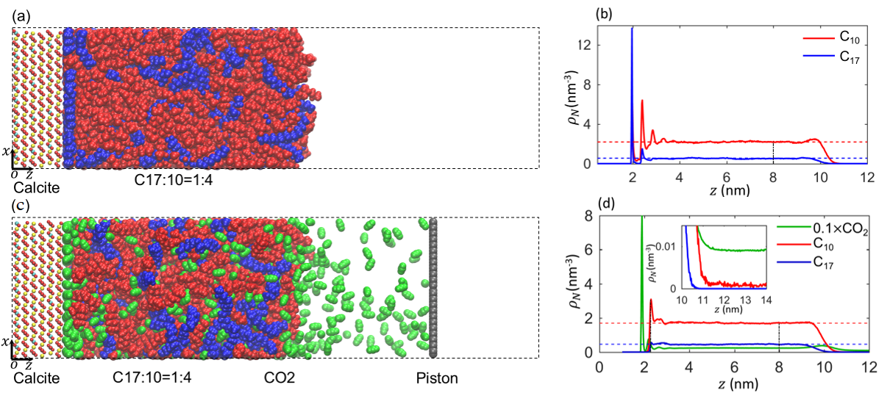
Molecular Dynamics Simulation
Objective
Does Niobrara have preferential adsorption between C₁₀ and C₁₇?
How does CO₂ mitigate the sieving effect?
Snapshot of molecular dynamic simulation system with CO₂ (a) and without CO₂ (c).
Density profile of hydrocarbon mixtures near calcite surface based on center of mass with CO₂ (b) and without CO₂ (d).
Findings
Niobrara sample adsorbs more C₁₇ than C₁₀.
Adsorbed C₁₇ are released due to injected CO₂.
UNCONVENTIONAL RESERVOIR ENGINEERING PROJECT
Advisory Board Meeting, Nov 8, 2019, Golden, Colorado
Notes:
We also did molecular dynamics simulations (of interactions between hydrocarbon molecules and rock with and without the presence of CO2) to try to find out whether Niobrara has preferential adsorption between C10 and C17 and to understand how CO2 mitigates the sieving effect.
Figure (a) shows the simulation system without CO2. We simulate Niobrara rock using calcite. These red and blue dots are C10 and C17 molecules, respectively. Figure (b) shows the density profile of C10 and C17 near the rock surface at equilibrium. You can see the first peak is dominated by C17, which means, Niobrara sample adsorbs more C17 than C10.
Then, as shown in figure (c), we introduce CO2 into the system. the density profile shows that the C17 peak is replaced by CO2, which indicates that adsorbed C17 molecules are released due to the injected CO2.
These are pretty much what we did before our last meeting.

Slide 8
Pore Size Distribution
N₂ adsorption DFT method
Niobrara sample contains a certain number of micropores (< 2 nm).
UNCONVENTIONAL RESERVOIR ENGINEERING PROJECT
Advisory Board Meeting, Nov 8, 2019, Golden, Colorado
Notes:
Next, I will show you our recent progress.
We measured the pore size distribution of our Niobrara sample using nitrogen adsorption, which is shown as this blue line here, and this orange line is the cumulative pore volume. You can see that there are small peaks between 1 and 2 nm, which tells us that our Niobrara sample does have, maybe not much, but a certain amount of micropores.

Slide 9
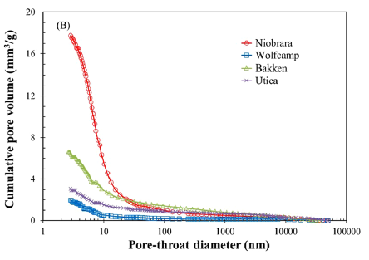
Pore-throat Size Distribution
(Zhao et al. 2017)
MICP method
Majority (~80%) of pore volumes are connected by pore throats less than 10 nm.
UNCONVENTIONAL RESERVOIR ENGINEERING PROJECT
Advisory Board Meeting, Nov 8, 2019, Golden, Colorado
Notes:
From the literature, We found this plot, which shows the pore-throat size distribution measured by mercury injection in several shale samples, including Niobrara, which is represented by this red line.
In this plot, the x-axis is the pore throat diameter and the y-axis is the cumulative pore volume. As you can see, for Niobrara samples, most of the pore volumes are located at the low end of the distribution, which means that most of the pores are connected by very small pore throats, like less than 10 nm. I think this evidence supports our assumption that large molecules can be filtered when flowing through Niobrara samples due to size exclusion.

Slide 10
Specific Surface Area
micropore
Micropores (< 2 nm) and fine pores (< 10 nm) contribute a significant amount to the total surface area in Niobrara sample.
UNCONVENTIONAL RESERVOIR ENGINEERING PROJECT
Advisory Board Meeting, Nov 8, 2019, Golden, Colorado
Notes:
We also measured the specific surface area of our Niobrara sample, which is shown as this blue line here, and this orange line is the cumulative surface area. You can see that the micropores and fine pores, they contribute a significant amount to the total surface area in Niobrara sample.

Slide 11
Sample Mineralogy
Component |  | Niobrara sample
 |  | Wt.% | Vol.%
Tectosilicates | Quartz | 8.9 | 9.2
 | K-spar | -- | --
 | Plag. | 2.0 | 2.1
Carbonates | Calcite | 73.5 | 74.2
 | Dolomite | 2.3 | 2.2
Clay | Chlorite | -- | --
 | Kaolinite | -- | --
 | Illite/Mica | 4.9 | 4.5
 | Mx I/S* | 6.0 | 6.2
Other | Pyrite | 1.8 | 1.0
 | Marcasite | -- | --
 | Apatite | 0.6 | 0.6
Niobrara sample is collected from an outcrop in Longmont, Colorado.
Mineralogy is tested using XRD.
Calcite is the predominant component (73.5 wt.%).
Modeling Niobrara sample using calcite in molecular dynamics simulation is appropriate.
* Ordered interstratified mixed-layer illite/smectite.
UNCONVENTIONAL RESERVOIR ENGINEERING PROJECT
Advisory Board Meeting, Nov 8, 2019, Golden, Colorado
Notes:
We also measured the composition of our Niobrara sample using XRD, which is shown in this table.
You can see that the predominant component of our Niobrara sample is calcite, with a weight percentage of about 73.5%, far more than the second most component, quartz, with a weight percentage of about 8.9%. This means that our modeling of the Niobrara sample using calcite is appropriate.

Slide 12
1-D Model
Continuity equation coupled diffusion, adsorption and sieving
$$Influx−outflux=accumulation$$
Flux: molecular diffusion + advective flow
Accumulation: mobile phase + adsorbed phase + sieved phase
outflux
influx
accumulation
$\vec{J}$diffusional flux, $mol/m^{2}∙s$
$\vec{v}$velocity, $m/s$
$φ$porosity
$c$molar density of mobile phase, $mol/m^{3}$
$A$molar density of adsorbed phase, $mol/m^{3}$
$S$molar density of sieved phase, $mol/m^{3}$
$t$time, $s$
$i$ component i
$$−∇∙{\vec{J}}_{i}−∇\left(\vec{v}c_{i}\right)=φ\frac{∂c_{i}}{∂t}+\frac{∂A_{i}}{∂t}+\frac{∂S_{i}}{∂t}$$
diffusional flux
advective flux
adsorption
sieving
UNCONVENTIONAL RESERVOIR ENGINEERING PROJECT
Advisory Board Meeting, Nov 8, 2019, Golden, Colorado
Notes:
In addition to these measurement of rock properties, like pore size distribution and mineralogy, we also did some simulation work.
To simulate the sieving effect inside Niobrara sample during the flow process, we built a 1-D model based on traditional continuity equation, which is the advective net flux term equals the accumulative term, and we added diffusional flux, adsorption and sieving terms into this equation to better characterize other mechanisms.

Slide 13
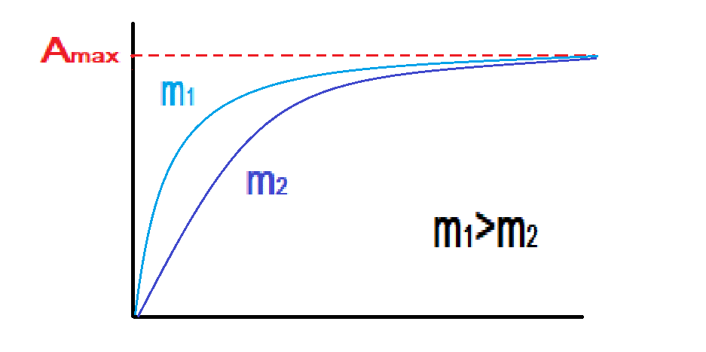
1-D Model
$$−∇∙\vec{J_{1}}−∇\left(\vec{v}c_{1}\right)=φ\frac{∂c_{1}}{∂t}+\frac{∂A_{1}}{∂t}+\frac{∂S_{1}}{∂t}$$
$$−∇∙\vec{J_{2}}−∇\left(\vec{v}c_{2}\right)=φ\frac{∂c_{2}}{∂t}+\frac{∂A_{2}}{∂t}+\frac{∂S_{2}}{∂t}$$
Binary mixture
$\vec{J}=−D \frac{φ}{τ} ∇c$
$D$ binary diffusion coefficient, $m^{2}/s$
$τ$ tortuosity
$A=A_{s} ρ a_{max}\left(1−e^{−mt}\right)$
$A_{s}$ specific surface area of rock sample, $m^{2}/g$
$ρ$ density of rock sample, $g/m^{3}$
$a_{max}$ maximum adsorption capacity of rock sample
for a specific component, $mol/m^{2}$
$m$ speed coefficient for adsorption
$t$ time, $s$
$S=S_{max}\left(1−e^{−nt}\right)$
$S_{max}$ maximum sieving capacity of a single grid block
in a rock sample for a specific component, $mol/m^{3}$
$n$ speed coefficient for sieving
adsorption test
molecular simulation
fitting parameters
UNCONVENTIONAL RESERVOIR ENGINEERING PROJECT
Advisory Board Meeting, Nov 8, 2019, Golden, Colorado
Notes:
So far, we have been able to numerically solve the model for a binary mixture, and we can implicitly calculate the mole fraction of each component in each grid block at each time step.
In the simulation, we used this equation to describe adsorption as a function of time. Most parameters in this equation can be obtained from measurements and molecular simulation, and we change coefficient m to fit the experimental results. You can see in this plot, with the increase of m, the grid block will reach its adsorption saturation more quickly.
Similarly, we brought up this equation to describe size exclusion as a function of time and we change these fitting parameters to fit experimental results.
For now we are just using these equations for preliminary models, but in the future, we will improve them to better characterize the behavior of adsorption and size exclusion .

Slide 14
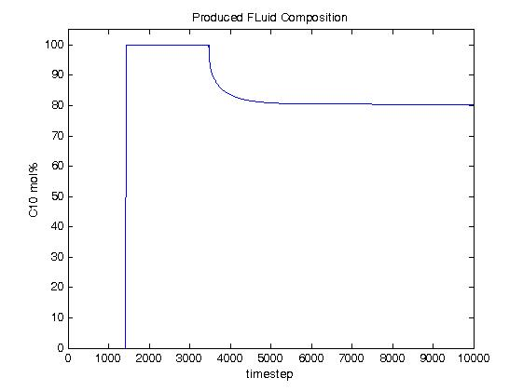
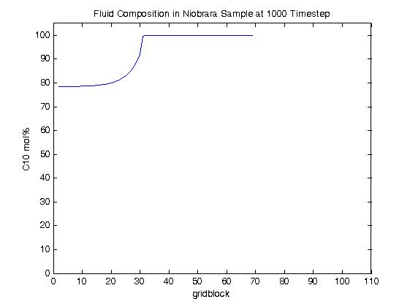
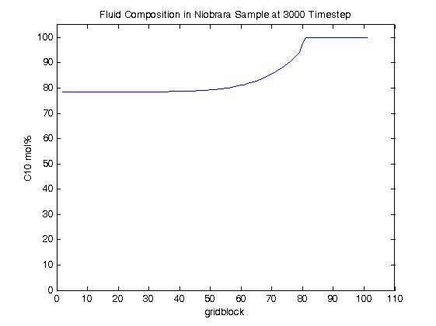
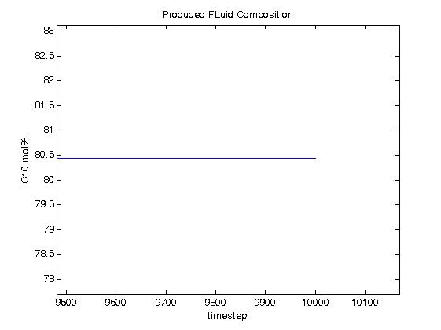
1-D Model
key input parameters
number of grid block |  | 102
injection fluid composition mol% | C₁₀ | 80
 | C₁₇ | 20
adsorption capacity (A_{max}) mol/cm³ | C₁₀ | 1.39e-6
 | C₁₇ | 4.49e-6
sieving capacity (S_{max}) mol/cm³ | C₁₀ | 0
 | C₁₇ | 1e-4
……
UNCONVENTIONAL RESERVOIR ENGINEERING PROJECT
Advisory Board Meeting, Nov 8, 2019, Golden, Colorado
Notes:
This slides shows the preliminary result for a case using C10 and C17.
Here this tables lists some key input parameters for the model. We placed 102 grid blocks in the 1-d model. Injection fluid composition is about 80 mol% C10 and 20 mol% C17. The adsorption capacity of C17 is about three times of C10, and in this case there is no size exclusion for C10.
This plot shows the fluid composition inside Niobrara sample at 1000 timesteps. The x-axis is the grid block, and the y-axis is the fluid composition, expressed in terms of mole fraction of C10. You can see that, since more C17 molecules are adsorbed and filtered during the flow, the frontier of the fluid is pure C10 and more C17 remains inside the rock, making this part slightly less than 80%. Then, comes to 3000 timesteps, we can see C10 has broken through, C17 has not.
This plot shows the produced fluid composition vs. timestep. As you can see, C10 breakthrough first, and then C17 comes up and is produced. Due to the size exclusion of C17, we still produce a bit more C10 at the later stage here.

Slide 15
Sieving/EOR of Niobrara Crude Oil
Filtration test + CO₂ huff-n-puff test using Niobrara crude oil and Niobrara sample.
Divide oil into 4 groups of components:
light, C₃ – C₆
medium 1, C₇ – C₁₀
medium 2, C₁₁ – C₂₀
heavy, C₂₀+
Observations:
C₃ – C₆
$$↓$$
Sample 1
$$↑$$
C₇ – C₁₀
$$↑$$
$$↓$$
 | Sieving | Sieving Mitigation | Sieving Recurrence | Flow Rate $↑$
Sample 1 | ✓ | ✓ | ✓ | ✓
Sample 2 | ✓ | ✓ | ✓ | ✗
Sample 3 | ✓ | ✓ | ✓ | ✓
C₁₁ – C₂₀
CO₂ Injection
C₂₀+
$$↓$$
$$↓$$
UNCONVENTIONAL RESERVOIR ENGINEERING PROJECT
Advisory Board Meeting, Nov 8, 2019, Golden, Colorado
Notes:
That’s about simulation. To investigate the effect of sieving and CO2 on crude oil, we did the exact same tests on 3 Niobrara samples using crude oil. So basically we did filtration test first, and followed by CO2 huff-n-puff.
For the analysis, we divide the oil components into four major groups, the light group, which is C3 to C6, medium group 1, which is C7 to C10, medium group 2, which is C11 to C20, and heavy group, which is C20 plus.
This is the experimental result from 1st Niobrara sample. The x-axis is the number of pore volumes that have been produced, and the y-axis is the peak area percentage obtained from gas chromatography, which can approximately represent fluid composition. As you can see, after the start of injection, due to the sieving effect, the fraction of the light group increases, and the heavy group decreases. After soaking the sample with CO2, the fraction of the light group decreases, while the medium group 2 and the heavy group increase, which indicates the mitigation of the sieving effect., and then, the sieving occurs again. For the other two Niobrara samples, we observed very similar results. And in the experiment, we observed an increase in flow rate in 2 samples after CO2 soaking.

Slide 16
Future Work
Tune 1-D model to simulate experiment.
Investigate the effect of timing of CO₂ injection on production.
Test the effect of cyclic CO₂ injection on production.
Further study using molecular simulations.
UNCONVENTIONAL RESERVOIR ENGINEERING PROJECT
Advisory Board Meeting, Nov 8, 2019, Golden, Colorado
Notes:
For the future work, we plan to …

Slide 17
Thank You
Questions?
UNCONVENTIONAL RESERVOIR ENGINEERING PROJECT
Advisory Board Meeting, Nov 8, 2019, Golden, Colorado

Slide 18
References
Zhao, J., Jin, Z., Hu, Q. et al. 2017. Integrating SANS and Fluid-Invasion methods to Characterize Pore Structure of Typical American Shale Oil Reservoirs. Scientific Reports 7(1): 15413. http://doi.org/10.1038/s41598-017-15362-0
Kuila, U., Prasad, M., Derkowski, A. et al. 2012. Compositional Controls on Mudrock Pore-Size Distribution: An Example from Niobrara Formation. Presented at the SPE Annual Technical Conference and Exhibition, San Antonio, Texas, 8-10 October. https://doi.org/10.2118/160141-MS
Zhu, Z., Chao, F., Rui, Q. et al. 2019. Experimental and Molecular Insights on Sieving of Hydrocarbon Mixtures in Niobrara Shale. Presented at Unconventional Resources Technology Conference, Denver, Colorado, 22-24 July. https://doi.org/10.15530/urtec-2019-69
Zhu, Z., Chao, F., Rui, Q. et al. 2019. Experiemntal and Molecular Insights on Mitigation of Hydrocarbon Sieving in Niobrara Shale by CO2 Huff-n-Puff. Presented at SPE Annual Technical Conference and Exhibition, Calgary, Alverta, 30 September – 2 October. https://doi.org/10.2118/196136-MS.
UNCONVENTIONAL RESERVOIR ENGINEERING PROJECT
Advisory Board Meeting, Nov 8, 2019, Golden, Colorado

