Slide 1
UNCONVENTIONAL RESERVOIR ENGINEERING PROJECT
Colorado School of Mines
U R E P
CSM
Research Progress Report
Investigation of Hindered Transport of Large Hydrocarbon Molecules in Nanoporous Materials
PhD Candidate: Zhijun (Julian) Liu
UNCONVENTIONAL RESERVOIR ENGINEERING PROJECT
Advisory Board Meeting, Nov 8 2019, Golden, Colorado

Slide 2
Research Objectives
1. Demonstrate and quantify the “hindered transport” of large hydrocarbon molecules through artificial membranes in the lab
2. Investigate factors that affect filtration process
Temperature/Pressure/CO₂
3. Investigate the mechanism of different effects on filtration
UNCONVENTIONAL RESERVOIR ENGINEERING PROJECT

Slide 3
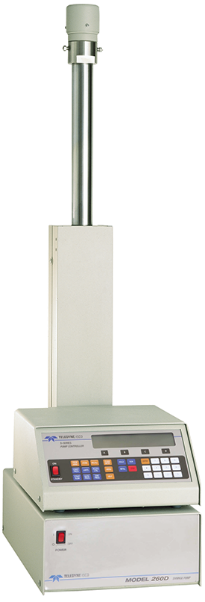
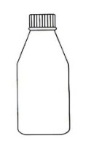
Experimental Setup
Treated
Hydrocarbon
Mixture
Membrane:
Polyimide polymer
1.4nm pore size
Gas Tank
Hydrocarbons:
30% crude (Solute)
in toluene (Solvent)
Pressure Gauge
Filtered
Hydrocarbon
Mixture
Gas Chromatography
(Mass Spectrometry)
ISCO Syringe Pump
UNCONVENTIONAL RESERVOIR ENGINEERING PROJECT

Slide 4
Retention Efficiency Calculation
C_{i,l}
RE = 1 -
C_{i,0}
RE - Retention Efficiency of heavy component
C_{i,l} - Concentration of component i downstream
C_{i,0} - Concentration of component i upstream at time 0,
i.e. in original sample
UNCONVENTIONAL RESERVOIR ENGINEERING PROJECT

Slide 5
What’s Happening on the Membrane Level
Upstream
Downstream
Filtering of “large” molecules
Membrane
Flow direction
Concentration Polarization
Decrease flux
Membrane
UNCONVENTIONAL RESERVOIR ENGINEERING PROJECT

Slide 6
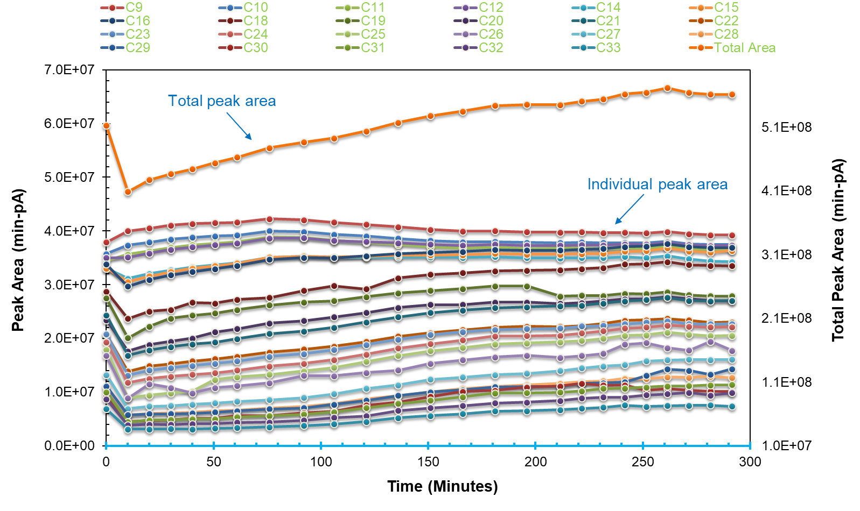
Raw Peak Area
UNCONVENTIONAL RESERVOIR ENGINEERING PROJECT

Slide 7
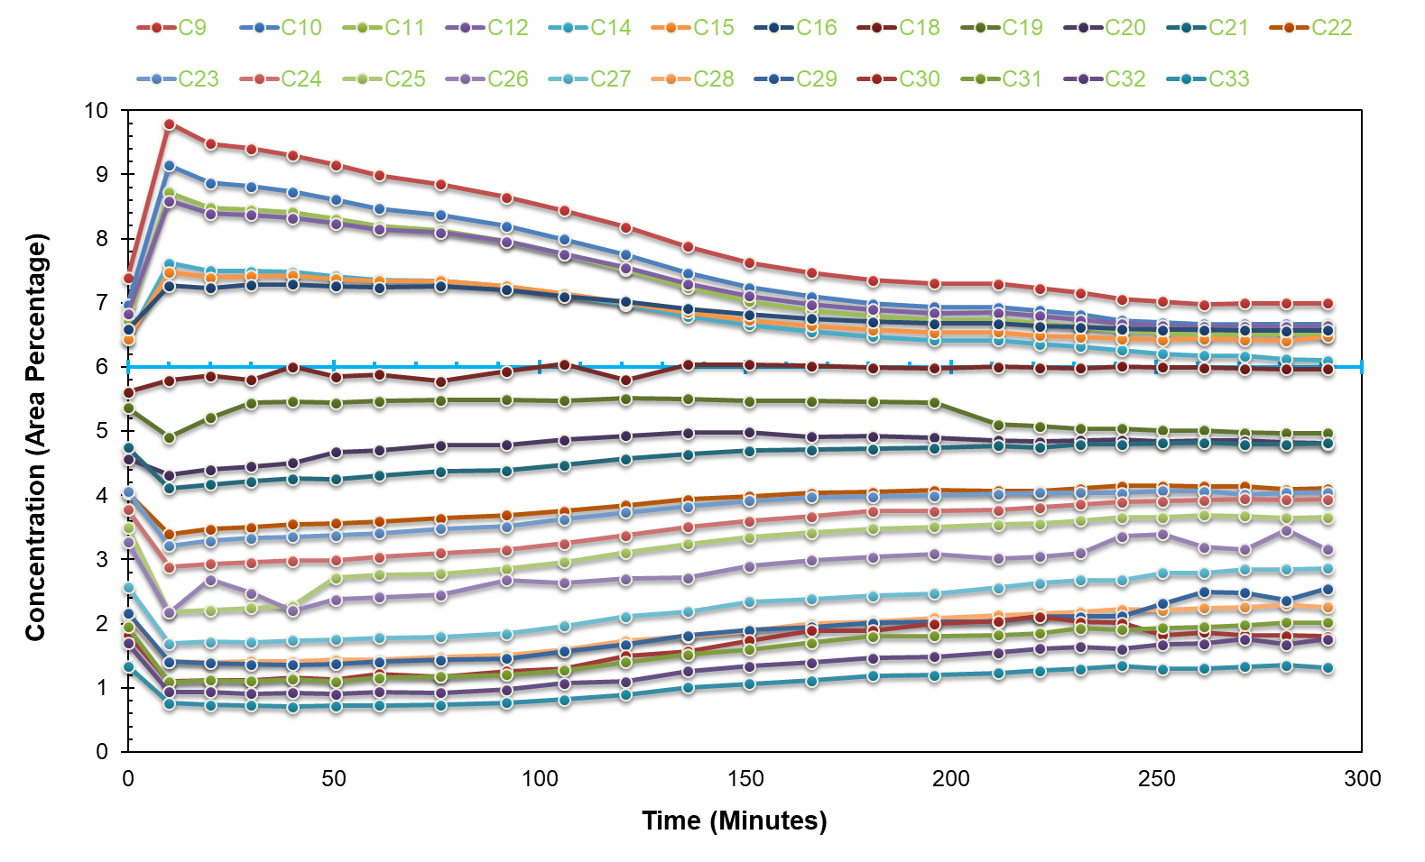
Concentration Changes with Time
UNCONVENTIONAL RESERVOIR ENGINEERING PROJECT

Slide 8
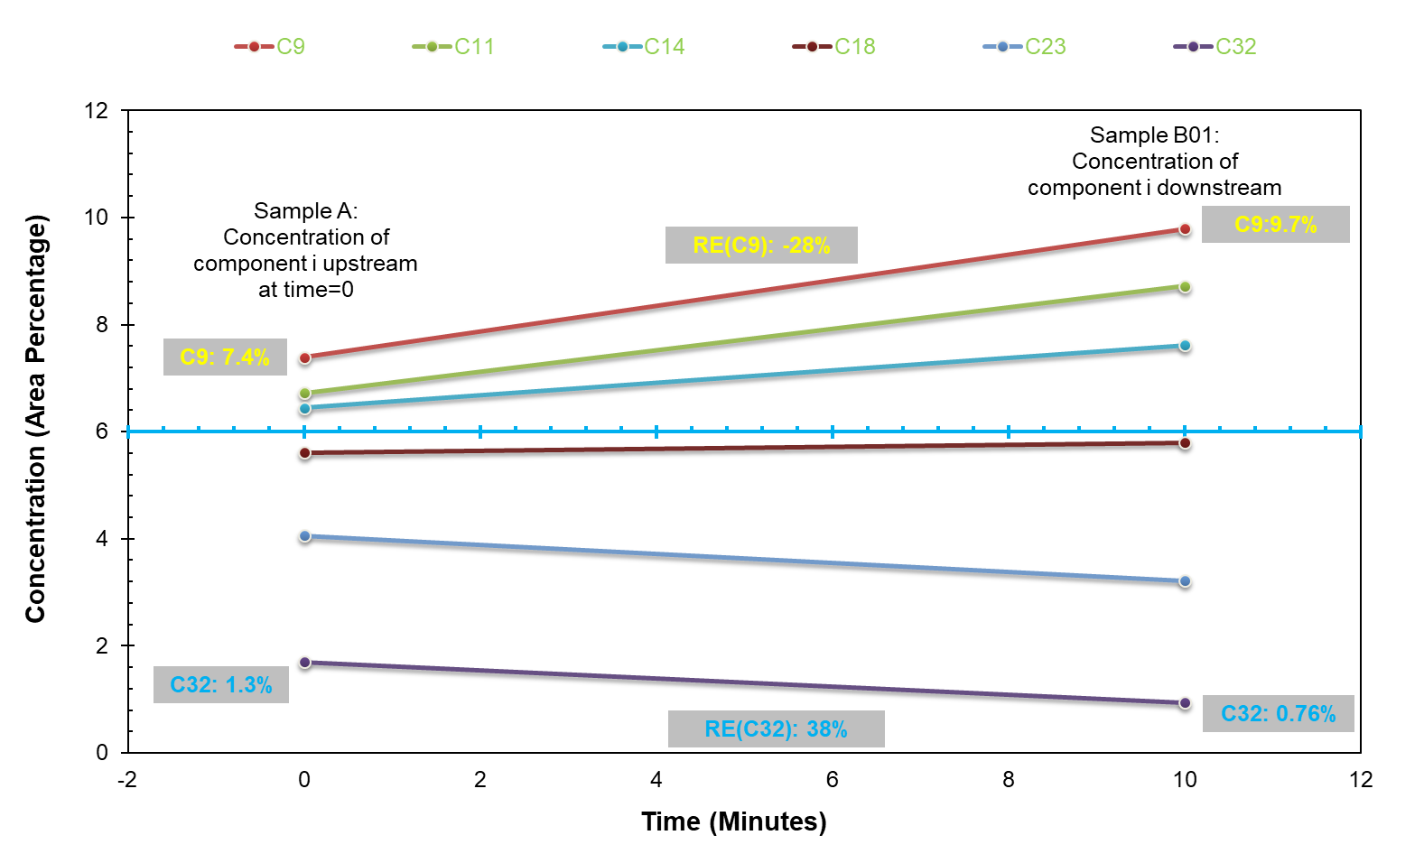
Concentration of Original vs. Downstream
UNCONVENTIONAL RESERVOIR ENGINEERING PROJECT

Slide 9
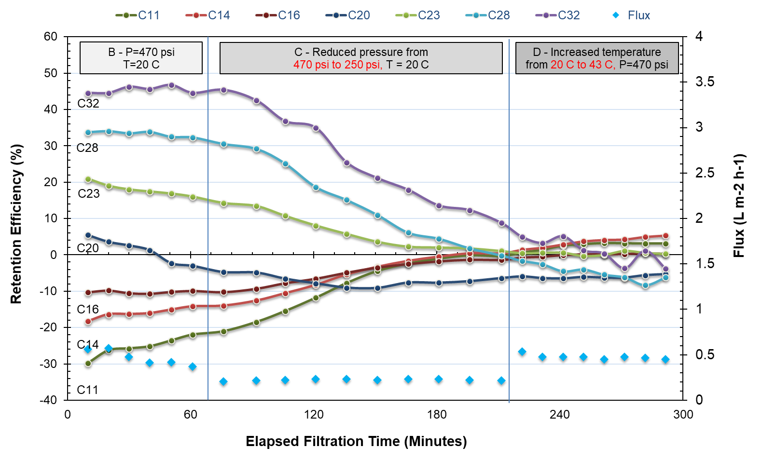
Pressure Effect
UNCONVENTIONAL RESERVOIR ENGINEERING PROJECT
Notes:
Pressure effect agrees with literature

Slide 10
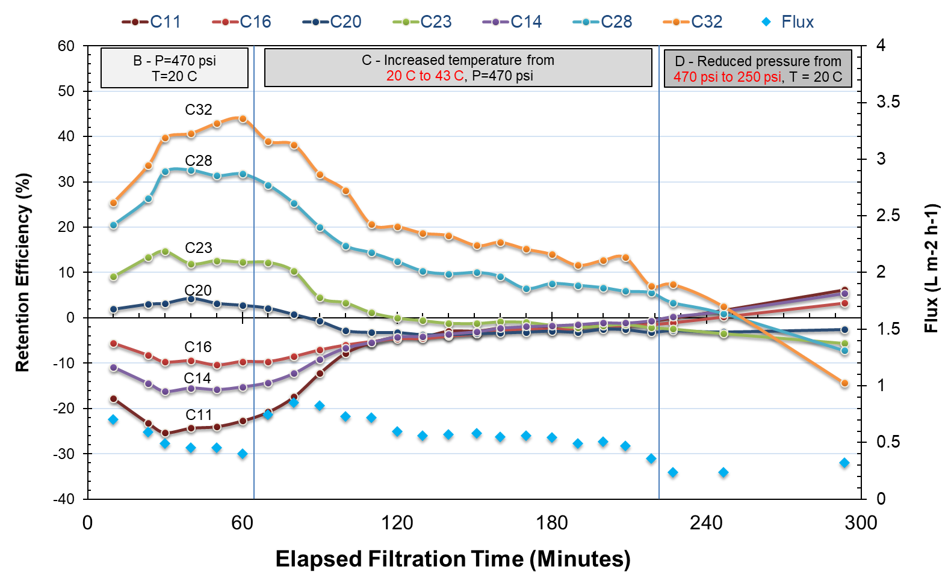
Temperature Effect
UNCONVENTIONAL RESERVOIR ENGINEERING PROJECT

Slide 11
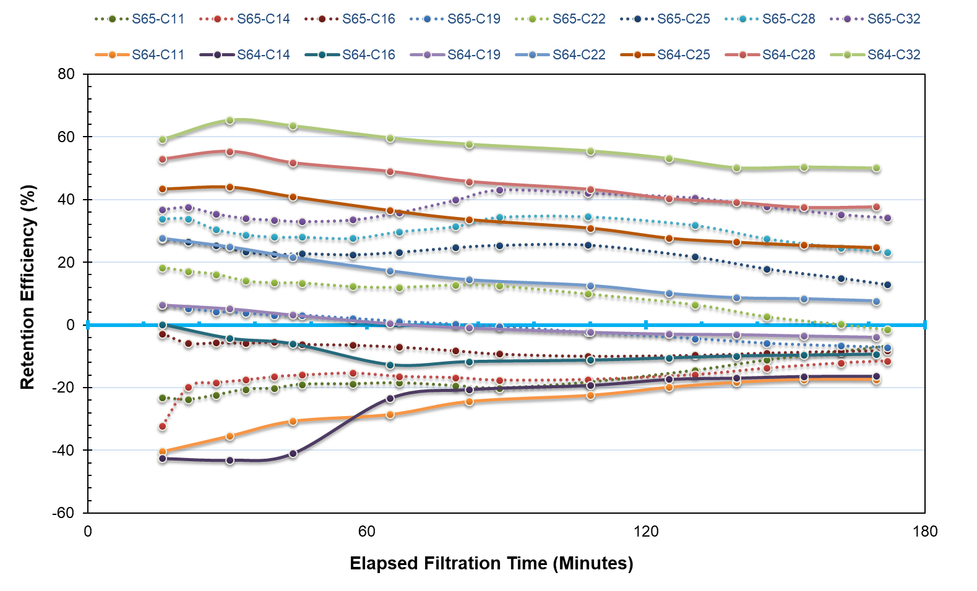
CO₂ Effect
Flowed pure toluene for 4 hours before tests to condition membranes
UNCONVENTIONAL RESERVOIR ENGINEERING PROJECT

Slide 12
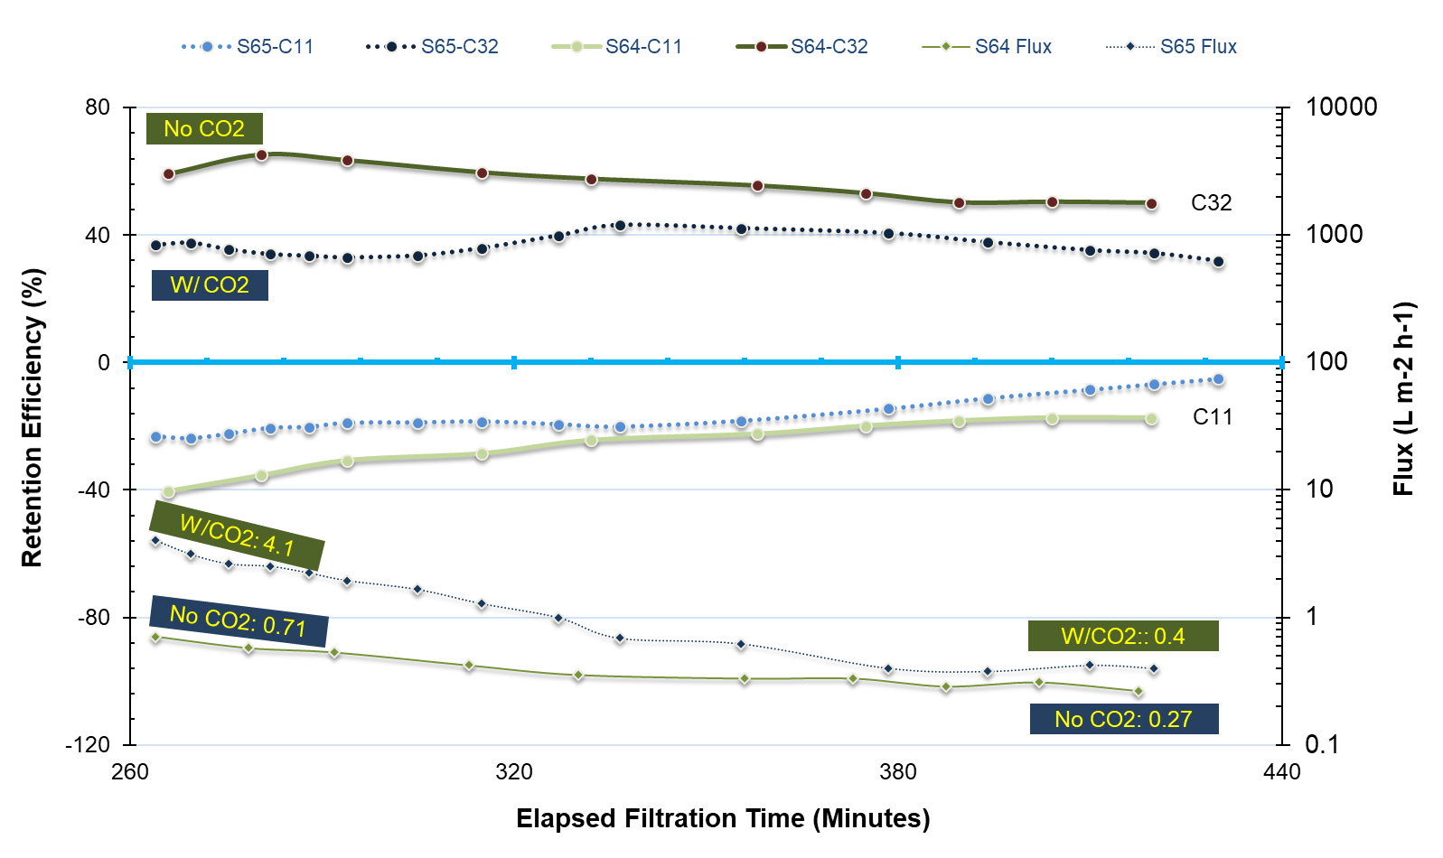
CO₂ Effect
UNCONVENTIONAL RESERVOIR ENGINEERING PROJECT

Slide 13
Conclusions
(1) Temperature and pressure effect
Increasing temperature and decreasing pressure led to lower retention efficiency
Increasing temperature and increasing pressure led to higher flux
(2) CO2 effect
CO2 reduced retention efficiency and increased flux
(3) The change of filtration due to P/T/CO2
Change of temperature, pressure and addition of CO2 changes the diffusion and sieving of “solutes”
UNCONVENTIONAL RESERVOIR ENGINEERING PROJECT

Slide 14
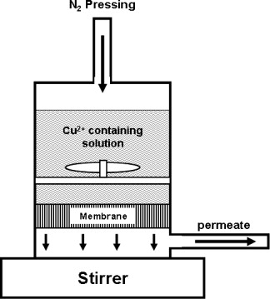
Future Work
Conduct filtration test using “stirred cell” so that upstream concentration on the membrane surface remains relatively constant
Gas Pressurize
Hydrocarbon Mixture
Stir bar
UNCONVENTIONAL RESERVOIR ENGINEERING PROJECT
Advisory Board Meeting, Nov 8 2019, Golden, Colorado

Slide 15
UNCONVENTIONAL RESERVOIR ENGINEERING PROJECT
Colorado School of Mines
U R E P
UNCONVENTIONAL RESERVOIR ENGINEERING PROJECT
Advisory Board Meeting, Nov 8 2019, Golden, Colorado

