Slide 1
UNCONVENTIONAL RESERVOIR ENGINEERING PROJECT
Colorado School of Mines
U R E P
CSM
Experimental and Modeling Studies of CO₂ Huff-n-Puff in Niobrara Cores with Sieving Effect
Ziming Zhu
Ph.D. Petroleum Engineering
Colorado School of Mines
UNCONVENTIONAL RESERVOIR ENGINEERING PROJECT
Advisory Board Meeting, Spring 2020, Golden, Colorado
Notes:
Hello Everyone, I'm Ziming, currently a Ph.D. student in Petroleum Engineering. The topic of my today’s presentation is Experimental and Modeling Studies of CO₂ Huff-n-Puff in Niobrara Cores with Sieving Effect

Slide 2
Outline
Review
Experiment
sieving effect in Niobrara cores
mitigation of sieving effect through CO₂ huff-n-puff
Simulation
preferential adsorption in Niobrara cores (MD)
displacement of adsorbed hydrocarbons through CO₂ (MD)
1-D flow of hydrocarbons (binary) in Niobrara cores
Progress
extension from binary-component model to multi-components model
publications
Future work
Cyclic huff-puff injection using CH₄
UNCONVENTIONAL RESERVOIR ENGINEERING PROJECT
Advisory Board Meeting, Spring 2020, Golden, Colorado
Notes:
Here is the outline of my presentation.
First, I’ll briefly review the work we have finished before our last meeting back in 2019.
Then, I’ll talk about our recent progress.
After that, I’ll close my presentation with our future plan.

Slide 3
Sieving effect
Niobrara sample can sieve hydrocarbons.
allow the transport of lighter components, hinder the transport of heavier components.
Mechanisms
size exclusion
a portion of Niobrara pore throat sizes is comparable with hydrocarbon molecules.
preferential adsorption
different hydrocarbon molecules has different affinity to rock surface.
Influences
lighter components increase in the produced fluid
heavier components get hindered and are left in the reservoir
UNCONVENTIONAL RESERVOIR ENGINEERING PROJECT
Advisory Board Meeting, Spring 2020, Golden, Colorado
Notes:
By doing experiments, we demonstrated the presence of sieving effect in Niobrara cores.
Basically, the Sieving effect refers to the phenomenon that when oil flowing through cores heavier hydrocarbon molecules are hindered and more lighter hydrocarbons are getting produced, which is what we have been seeing from some producing wells in the field. And, by analyzing the results from experiments and molecular dynamics simulation, we found there are mainly two reasons that leads to this sieving effect, 1st, size exclusion, essentially means larger molecules can not pass through smaller pores and pore throats because they are too big. 2nd, preferential adsorption, which refers to that certain hydrocarbon molecules could be more easily adsorbed and therefore stuck in pores during the flow process.

Slide 4
Filtration + CO₂ huff-n-puff test
Filtration test:
objective: does sieving effect exist?
fluid: (a) C₁₀ C₁₇ (b) Niobrara crude oil
procedure:
flood Niobrara cores with hydrocarbon fluid, compare compositions of injected and produced fluids.
CO₂ huff-n-puff test:
objective: does CO₂ mitigate sieving effect?
procedure:
inject CO₂ from the producing side of cores, soak the sample, resume production, and compare the composition of injected and produced fluid.
UNCONVENTIONAL RESERVOIR ENGINEERING PROJECT
Advisory Board Meeting, Spring 2020, Golden, Colorado
Notes:
We performed filtration tests and demonstrated the presence of the sieving effect in Niobrara cores and confirmed that CO2 has the potential to alleviate this sieving effect by doing a huff-n-puff test following the filtration test.
Basically, the procedure is we first inject hydrocarbon mixtures into a Niobrara core which is fixed in a mini core holder and analyze the composition of the produced fluid using gas chromatography, and it shows that there are fewer heavy components in the produced fluid which means the sieving effect exists in Niobrara cores, then, we shut down the injection of hydrocarbon and inject CO2 from the producing side of the core sample and soak it for a period, after that we resume the injection and found that the fraction of heavy components becomes higher than that before soaking, which tells us CO2 can mitigate the sieving effect.

Slide 5
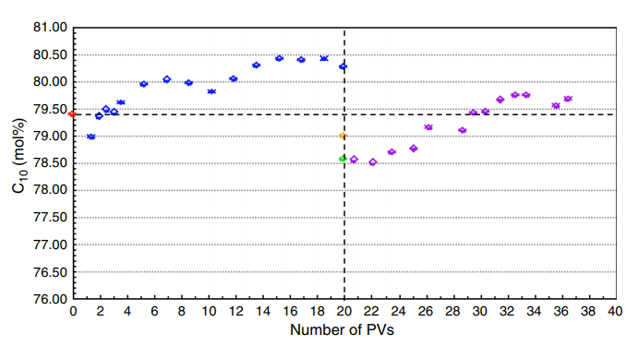
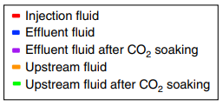
Experimental results – C₁₀ C₁₇ mixture
CO₂ injection
Test:
filtration + CO₂ huff-n-puff
Fluid:
C₁₀ C₁₇
Observations:
sieving | ✓
sieving mitigation | ✓
sieving recurrence | ✓
flow rate $↑$ | ✓
UNCONVENTIONAL RESERVOIR ENGINEERING PROJECT
Advisory Board Meeting, Spring 2020, Golden, Colorado
Notes:
This slide shows the experimental result of the filtration test and CO2 huff-n-puff test on a Niobrara sample using a binary mixture of C10 and C17.
As you can see, after the start of injection, the fraction of light component C10 in the produced fluid increases, indicating the heavy component C17 was sieved. After soaking with CO2, more C17 was produced over a period of time, indicating the sieving effect was mitigated, then, after producing a few more pore volumes, C17 was sieved again. Additionally, we observed an increase in production rate after CO2 soaking, suggesting CO2 might be able to help enhance the oil recovery.

Slide 6
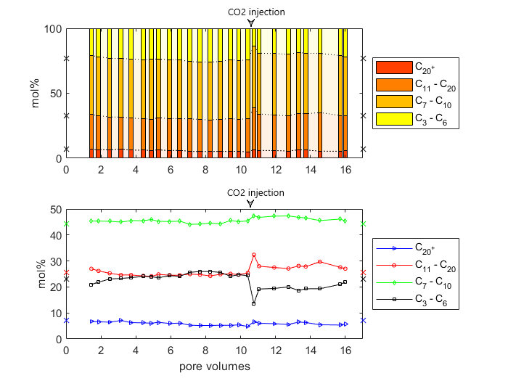
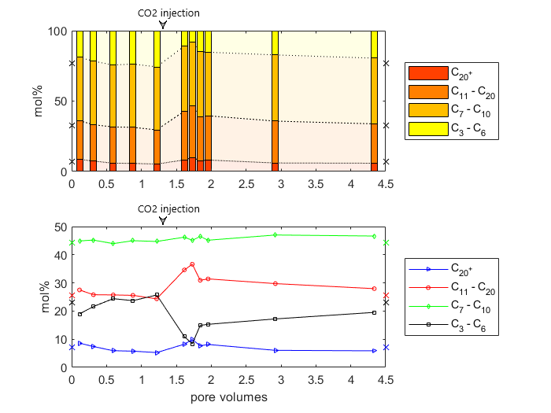
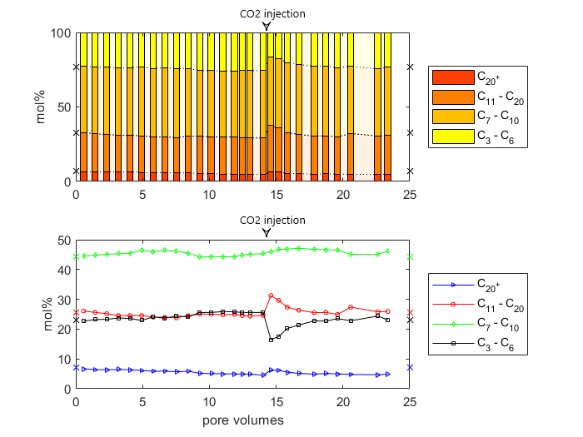
Experimental results – Niobrara crude oil
Sample 3
Test:
filtration + CO₂ huff-n-puff
Fluid:
Niobrara crude oil.
oil components are divided into 4 groups:
light, C₃ – C₆
intermediate I, C₇ – C₁₀
intermediate II, C₁₁ – C₂₀
heavy, C₂₀+
Observations:
Sample 1
Sample 2
Sieving | Sieving Mitigation | Sieving Recurrence | Flow Rate $↑$
✓ | ✓ | ✓ | ✓
UNCONVENTIONAL RESERVOIR ENGINEERING PROJECT
Advisory Board Meeting, Spring 2020, Golden, Colorado
Notes:
This slide shows the experimental result of the filtration test and CO2 huff-n-puff test on Niobrara samples using Niobrara crude oil.
To better analyze the results, we divided the components of this Niobrara crude into four subgroups: light group, including C3 to C6; intermediate group 1, including C7 to C10, intermediate group 2, including C11 to C20, and heavy group which is C20+.
In the filtration test, due to sieving effect, the fraction of heavy group in the produced fluid decreases and light group increases. After soaking, the fraction of light group decreases and the medium group 2 and heavy group increase, which indicates the sieving effect is sort of mitigated, and then after producing a few more pore volumes, the sieving occurs again.
For the 2nd sample, the result is very similar to the 1st one, and for the 3rd one, very similar as well.

Slide 7
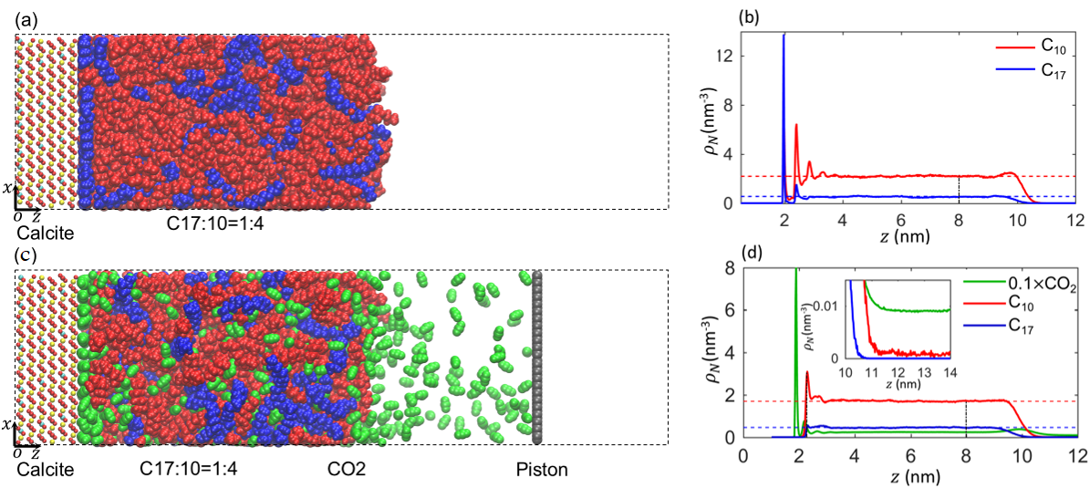
Molecular dynamics simulation
Objective:
a) does Niobrara have preferential adsorption between C₁₀ and C₁₇?
b) how does CO₂ mitigate the sieving effect?
Snapshot of molecular dynamic simulation system with CO₂ (a) and without CO₂ (c).
Density profile of hydrocarbon mixtures near calcite surface based on center of mass with CO₂ (b) and without CO₂ (d).
Findings:
Niobrara sample adsorbs more C₁₇ than C₁₀.
adsorbed C₁₇ and C₁₀ are released due to injected CO₂.
UNCONVENTIONAL RESERVOIR ENGINEERING PROJECT
Advisory Board Meeting, Spring 2020, Golden, Colorado
Notes:
On the simulation side, using Molecular dynamics Simulation, we demonstrated the presence of preferential adsorption in Niobrara cores, and showed that CO2 mitigates the sieving effect by displacing adsorbed hydrocarbon molecules from the wall of the pore.
As shown in Figure (a) here, we simulated the distribution of C10 C17 molecules near a calcite surface at equilibrium to mimic the interaction inside Niobrara pores, figure (b) is the corresponding density profile. You can see the first adsorbed layer is occupied by C17 molecules, indicating Niobrara sample preferentially adsorbs more C17 molecules than C10.
Figure (c) and (d) are the molecule distribution and density profile at equilibrium after introducing CO2 into the system. You can see C17 molecules that occupied the first adsorbed layer before are now displaced by CO2, indicating adsorbed hydrocarbon molecules can be released by using CO2.

Slide 8
1-D flow model – binary mixture
continuity equation coupled with diffusion, adsorption and sieving
accumulation
flux | molecular diffusion
 | advective flow
accumulation | mobile phase
 | adsorbed phase
 | size excluded phase
influx
outflux
$$influx−outflux=accumulation$$
$\vec{J}$diffusional flux, $mol/{cm}^{2}∙s$
$\vec{v}$interstitial velocity, $cm/s$
$φ$porosity
$c$molar density of mobile phase in the pore space, $mol/cm^{3}$
a molar density of adsorbed phase in the rock, $mol/{cm}^{3}$
s molar density of size excluded phase in the pore space, $mol/{cm}^{3}$
$t$time, $s$
$i$ component $i$
$$−∇∙{\vec{J}}_{i} − ∇\left(\vec{v}c_{i}\right) = φ\frac{∂c_{i}}{∂t} + \frac{∂a_{i}}{∂t} + φ\frac{∂s_{i}}{∂t}$$
diffusional flux
mobile phase
size excluded phase
advective flux
adsorbed phase
sieving
UNCONVENTIONAL RESERVOIR ENGINEERING PROJECT
Advisory Board Meeting, Spring 2020, Golden, Colorado
Notes:
Other than molecular dynamics simulation, we also built a 1D finite difference model which is incorporated with sieving effect to simulate the flow of the binary mixture in Niobrara cores. Basically, we decomposed the accumulation term in the continuity equation into three phases, a mobile phase, an adsorbed phase and a size excluded phase, and also, we added a diffusional term to the flux term.

Slide 9
Progress: 1-D flow model – multicomponent
$\vec{J_{i}}=−D_{ij}\frac{φ}{τ} ∇c_{i}$
$D_{ij}$ multicomponent diffusion coefficient, ${cm}^{2}/s$ derived from Chapman-Enskog theory
$D_{ij}=2.2646×{10}^{−5}\sqrt{T\left(\frac{1}{M_{i}}+\frac{1}{M_{j}}\right)}\frac{1}{cσ_{ij}^{2}Ω_{ij}}$
$τ$ tortuosity
$a_{i}=A_{max, i}\left(1−e^{−m_{i}(t−t_{i}^{∗})}\right)=A_{s} ρ a_{max}\left(1−e^{−m_{i}(t−t_{i}^{∗})}\right)$
$A_{max,i}$ maximum adsorption capacity of component $i$ per unit volume of rock sample, $mol/{cm}^{3}$
$A_{s}$ specific surface area of rock sample, $m^{2}/g$
$ρ$ density of rock sample, $g/{cm}^{3}$
$a_{max}$ maximum adsorption capacity of component $i$ per unit area of rock sample, $mol/{cm}^{2}$
$m_{i}$ adsorption speed coefficient
$t_{i}^{∗}$ the moment from which component $i$starts contacting with a grid block, $s$
$t−t_{i}^{∗}$ length of time that component $i$has been contacting with a grid block, $s$
$s=S_{max}\left(1−e^{−n_{i}(t−t_{i}^{∗})}\right)$
$S_{max}$ maximum size exclusion capacity of component $i$ per unit pore space, $mol/{cm}^{3}$
$n_{i}$ size exclusion speed coefficient
molecular simulation
fitting parameters
UNCONVENTIONAL RESERVOIR ENGINEERING PROJECT
Advisory Board Meeting, Spring 2020, Golden, Colorado
Notes:
now I’m gonna show you the progress we just made recently.
We extended our 1D flow model from a binary-component model to a multi-components model and simulated the flow of crude oil inside Niobrara cores.
𝐷_𝑖𝑗 is the diffusion coefficient of component 𝑖 with respect to the pseudo component j, which is the lump of all rest components and is calculated using Chapman-Enskog theory in this preliminary model.
The molar density of the adsorbed phase in a rock, a, is described as a function of time and can be characterized using molecular dynamics simulation results.
Similarly, the molar density of the size excluded phase in pore space, s, is described as a function of time as well. By changing the value of Smax, we can match the simulation results with the experiment.
Speed coefficient m and n can be changed to adjust the time the sample takes to reach adsorption and size exclusion saturation, which typically is very fast.

Slide 10
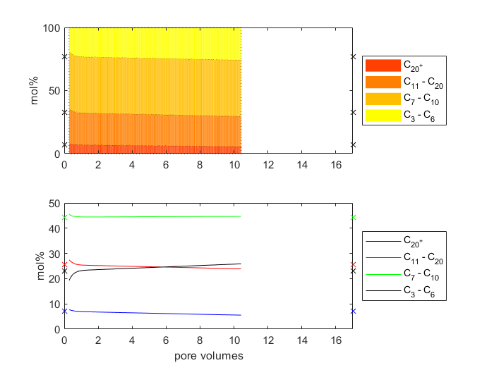
Progress: 1-D flow model – multicomponent
Simulation:
filtration test of Niobrara crude oil
Note: no CO₂ huff-n-puff simulated
Input parameters:
experiment
result
filtration test
spatial discretization $x∙y∙z$ | $$102×1×1$$
grid block dimension, $∆x∙∆y∙∆z$ | $$0.018 cm×1.25 cm×1.25 cm$$
time step size, $∆t$ | 1 s
inlet/outlet pressure | 2200/0 psig
temperature | 20 °C
porosity | 8%
flow rate | 0.5 PV/day
 | C₃ – C₆ | C₇ – C₁₀ | C₁₁ – C₂₀ | C₂₀⁺
oil composition, mol% | 23.4 | 44.4 | 25.5 | 7.07
$A_{max}$, mol/cm³ | 1.39e-6 | 4.49e-6 | 6.34e-6 | 8.45e-6
$S_{max}$, mol/cm³ | 0 | 1.12e-6 | 3.17e-6 | 4.23e-6
m | 1 | 1 | 1 | 0.2
n | 1 | 1 | 1 | 0.2
filtration test
simulation
result
MD
fitting parameters
Compositional trend is consistent with experimental result
light, C₃ – C₆ ↑
intermediate 1, C₇ – C₁₀ →
intermediate 2, C₁₁ – C₂₀ →
Heavy, C₂₀+ ↓
UNCONVENTIONAL RESERVOIR ENGINEERING PROJECT
Advisory Board Meeting, Spring 2020, Golden, Colorado
Notes:
This slide here shows the simulation result of filtration test on a Niobrara core sample using crude oil, and the parameters we used in the model.
In this 1D model, we have 102 grid blocks along the x-direction and the dimension of total grids is the same with the rock we tested in experiment. The time step is 1 sec, inlet and outlet pressures are 2200 and 0 PSIG respectively and the pressure is set to be uniformly decreasing along the x direction, the temperature is 20 C, rock porosity is 8% and the flow rate is set to be 0.5 pore volume per day.
To compare with the experimental results, we divided the components of oil into four groups as well, and the initial composition of each group is listed in the table and also marked on the y-axis in the plot. At this point, we are using arbitrary numbers for adsorption and size exclusion capacities in this preliminary model, in the future, we would use calibrated data obtained from MD for Amax and adjust Smax to match the experimental result. By matching simulation result with experimental result, we would be able to estimate the size exclusion capacity of a rock sample for each component.
In general, you can see that our simulation result has a very similar compositional trend with the experimental results: compared to the initial oil composition, the fraction of light components increases in the produced fluid, intermediate groups change just a little bit, and heavy group decreases.
There’s one point I need to mention, in the experiment, we observed that, as the experiment goes on, it becomes more and more difficult for heavier components to enter the rock, leading to the accumulation of these heavier molecules in the upstream injection fluid. Therefore, to simulate this, we multiplied the injection composition of heavier components by a coefficient of less than one to make it gradually decrease over time.

Slide 11
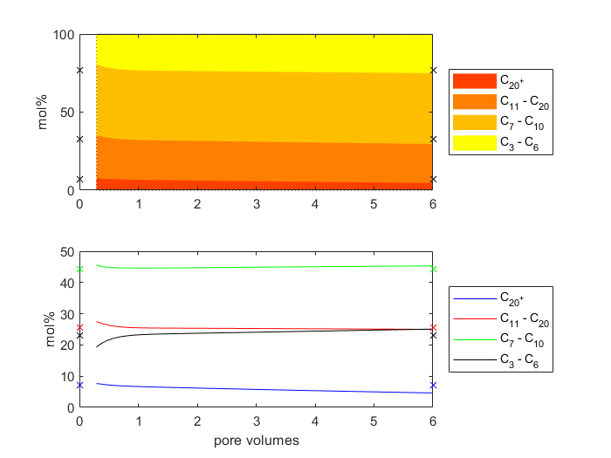
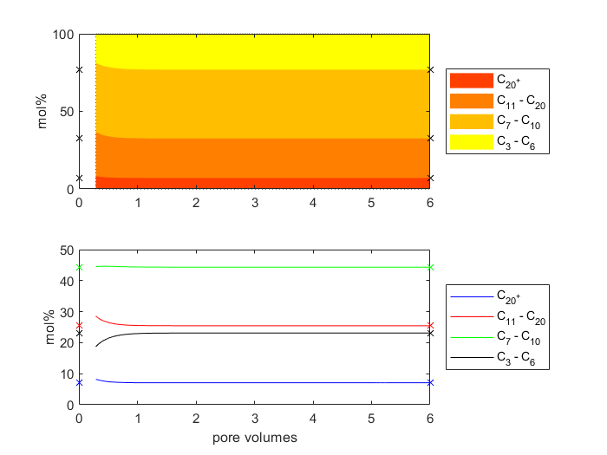
Progress: 1-D flow model – multicomponent
Simulation:
filtration test of Niobrara crude oil
(a) w/ sieving effect
(b) w/o sieving effect
without sieving (preferential adsorption and size exclusion), the composition of produced fluid will eventually be the same as the originally injected crude oil, meaning that heavier components will not be sieved inside the rock.
UNCONVENTIONAL RESERVOIR ENGINEERING PROJECT
Advisory Board Meeting, Spring 2020, Golden, Colorado
Notes:
Additionally, we simulated the flow of crude oil in Niobrara cores without the presence sieving effect and compared it with the case with sieving. From these two plots here, it can be noticed that without sieving the composition of produced fluid will eventually be the same as the originally injected oil, meaning that heavier components are not sieved during the flow process, thus confirms the influences of adsorption and size exclusion on hydrocarbon transport in Niobrara shale.

Slide 12
Publications
Zhu, Z., Fang, C., Qiao, R., Yin, X., Ozkan, E. 2019. Experimental and Molecular Insights on Sieving of Hydrocarbon Mixtures in Niobrara Shale. Presented at the Unconventional Resources Technology Conference, Denver, Colorado, 22-24 July. https://doi.org/10.15530/urtec-2019-69.
Zhu, Z., Fang, C., Qiao, R., Yin, X., Ozkan, E. 2019. Experimental and Molecular Insights on Mitigation of Hydrocarbon Sieving in Niobrara Shale by CO₂ Huff‘n’puff. Presented at the SPE Annual Technical Conference Exhibition, Calgary, Canada, 30 Sep - 2 Oct. https://doi.org/10.2118/196136-MS.
Zhu, Z., Fang, C., Qiao, R., Yin, X., Ozkan, E. 2020. Experimental and Molecular Insights on Mitigation of Hydrocarbon Sieving in Niobrara Shale by CO2 Huff‘n’puff. SPE Journal. https://doi.org/10.2118/196136-PA.
Zhu, Z., Yakup, C., Yin, X., Ozkan, E. 2020. Experimental and Modeling Studies of CO₂ EOR in Niobrara Shales with Sieving Effect. Presented at the Unconventional Resources Technology Conference, Austin, Texas, 20-22 July.
UNCONVENTIONAL RESERVOIR ENGINEERING PROJECT
Advisory Board Meeting, Spring 2020, Golden, Colorado
Notes:
Here we listed papers have been published related to this project. If you are interested in our research, you are very welcome to check these out.

Slide 13
Future Work
Investigate the impact of different factors on mitigating sieving effect and enhance production
different gases, especially CH₄
soaking period
number of cyclic gas injection
Investigate the mechanism of sieving mitigation through molecular dynamics simulations
UNCONVENTIONAL RESERVOIR ENGINEERING PROJECT
Advisory Board Meeting, Spring 2020, Golden, Colorado
Notes:
In the end, I’d like to talk a little bit about our future work.
We plan to investigate the impact of some other factors on mitigating sieving effect and enhancing oil production, for instance, using different kinds of gas for huff-n-puff, like methane, carbon monoxide, etc. changing soaking period, testing different numbers of cyclic gas injection.
And also, we plan to further investigate the mechanism of sieving mitigation of different kinds of gas using molecular dynamics simulations.

Slide 14
Thank You
zizhu@mines.edu
UNCONVENTIONAL RESERVOIR ENGINEERING PROJECT
Advisory Board Meeting, Spring 2020, Golden, Colorado
Notes:
That’s pretty much about my presentation. Thank you for your time. If you’re interested in our research or have any questions, please feel free to contact me through email.

