Slide 1
UNCONVENTIONAL RESERVOIR ENGINEERING PROJECT
Colorado School of Mines
U R E P
CSM
Assessing the technical and economic viability of non-source, tight-oil formations as high potential oil resource
Research Overview
Mohammed Althani, Colorado School of Mines
UNCONVENTIONAL RESERVOIR ENGINEERING PROJECT
Advisory Board Meeting, Spring 2020, Golden, Colorado

Slide 2
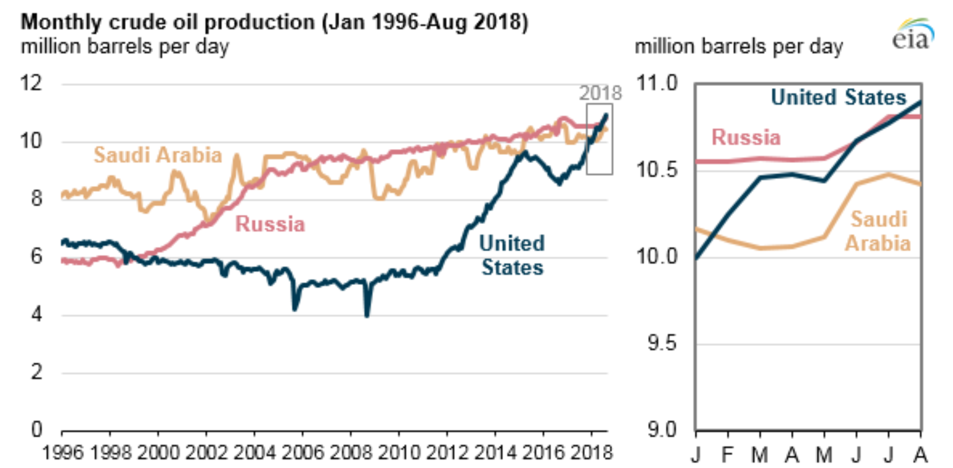
Introduction
The Largest Oil Producer
UNCONVENTIONAL RESERVOIR ENGINEERING PROJECT
Advisory Board Meeting, Spring 2020, Golden, Colorado

Slide 3
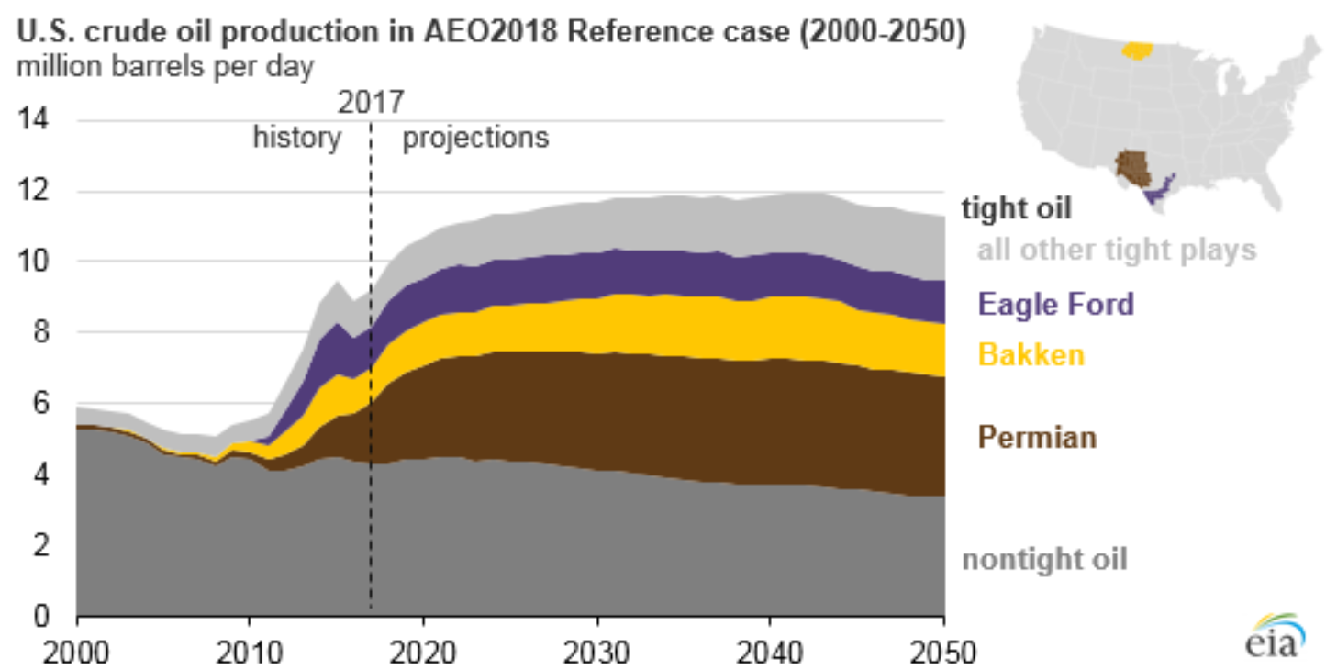
Introduction
Tight Oil Leading the Surge
UNCONVENTIONAL RESERVOIR ENGINEERING PROJECT
Advisory Board Meeting, Spring 2020, Golden, Colorado

Slide 4
Introduction
EIA Definition of Tight Oil
Tight oil: Oil produced from petroleum-bearing formations with low permeability such as the Eagle Ford, the Bakken, and other formations that must be hydraulically fractured to produce oil at commercial rates. Shale oil is a subset of tight oil.
UNCONVENTIONAL RESERVOIR ENGINEERING PROJECT
Advisory Board Meeting, Spring 2020, Golden, Colorado

Slide 5
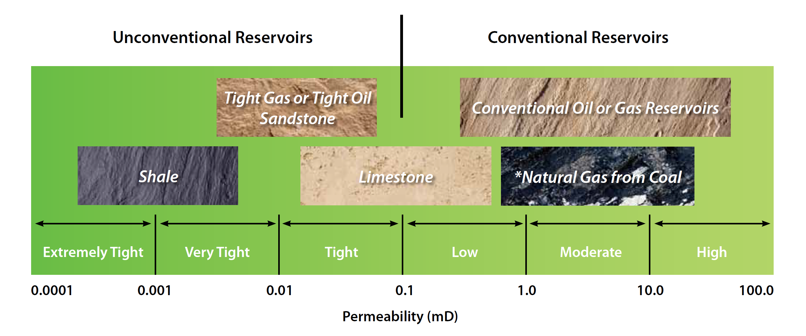
Introduction
Resource Classification Based on Permeability
from Canadian Society for Unconventional Resources (CSUR)
UNCONVENTIONAL RESERVOIR ENGINEERING PROJECT
Advisory Board Meeting, Spring 2020, Golden, Colorado

Slide 6
Introduction
Two Tight-Oil Types:
1. Source-Related, Tight-Oil
Oil accumulations located in source rocks (Eagle Ford) or very close to a source rock (Bakken).
2. Non-Source, Tight-Oil
Oil accumulations in conventional non-source low permeability formations (Middle East Carbonates).
UNCONVENTIONAL RESERVOIR ENGINEERING PROJECT
Advisory Board Meeting, Spring 2020, Golden, Colorado

Slide 7
Problem Statement
Most of the best practices for resources development that are available in the literature are specific either to conventional, high-permeability reservoirs or for source-related, tight-oil accumulations. This research will bridge that gap by assessing the technical and economic viability of non-source, tight-oil formations as another high potential oil resource.
UNCONVENTIONAL RESERVOIR ENGINEERING PROJECT
Advisory Board Meeting, Spring 2020, Golden, Colorado

Slide 8
Scope of Research
To provide a comprehensive assessment of the development potential of non-source, tight-oil formations in the Middle East. This objective will be achieved by addressing three main aspects of resource development:
Detailed characterization of non-source, tight-oil formations in relation to the development challenges they pose.
Investigation of recovery strategies for non-source, tight-oil formations based on simulation models.
Economics of the development.
UNCONVENTIONAL RESERVOIR ENGINEERING PROJECT
Advisory Board Meeting, Spring 2020, Golden, Colorado

Slide 9
Approach
1. Simulation Study
3D conceptual reservoir model using CMG.
Assessing key parameters on production from tight naturally fractured reservoirs that include:
Reservoir heterogeneity and natural fractures density
Well design and complexity
Geomechanics considerations
UNCONVENTIONAL RESERVOIR ENGINEERING PROJECT
Advisory Board Meeting, Spring 2020, Golden, Colorado

Slide 10
Approach
2. Economic Evaluation
Economic factors affecting the resource development plans:
OPEX and CAPEX
Long-term and short-term development plans
Well count and stimulation requirements
Special completion justifications
UNCONVENTIONAL RESERVOIR ENGINEERING PROJECT
Advisory Board Meeting, Spring 2020, Golden, Colorado

Slide 11
Background & Literature Review
Tight Oil Characterization
Comparison between source-related, tight-oil and non-source, tight oil with respect to:
Rock Properties
Geologic Structure and Hydrocarbon Storage
Flow Characteristics
UNCONVENTIONAL RESERVOIR ENGINEERING PROJECT
Advisory Board Meeting, Spring 2020, Golden, Colorado

Slide 12
Background & Literature Review
Tight Oil Characterization
Rock Properties
Property | Non-Source, Tight-Oil | Source-Related, Tight-Oil
Permeability | 1 - 10 md with a minimum of 0.01 md | micro- to nano-darcies
Property | Non-Source, Tight-Oil | Source-Related, Tight-Oil
Permeability | 1 - 10 md with a minimum of 0.01 md | micro- to nano-darcies
Pore Size Diameter | 10 - 0.1 micron and could fall below 0.1 micron | usually below 0.1 micron (Niobrara and Haynesville)
UNCONVENTIONAL RESERVOIR ENGINEERING PROJECT
Advisory Board Meeting, Spring 2020, Golden, Colorado

Slide 13
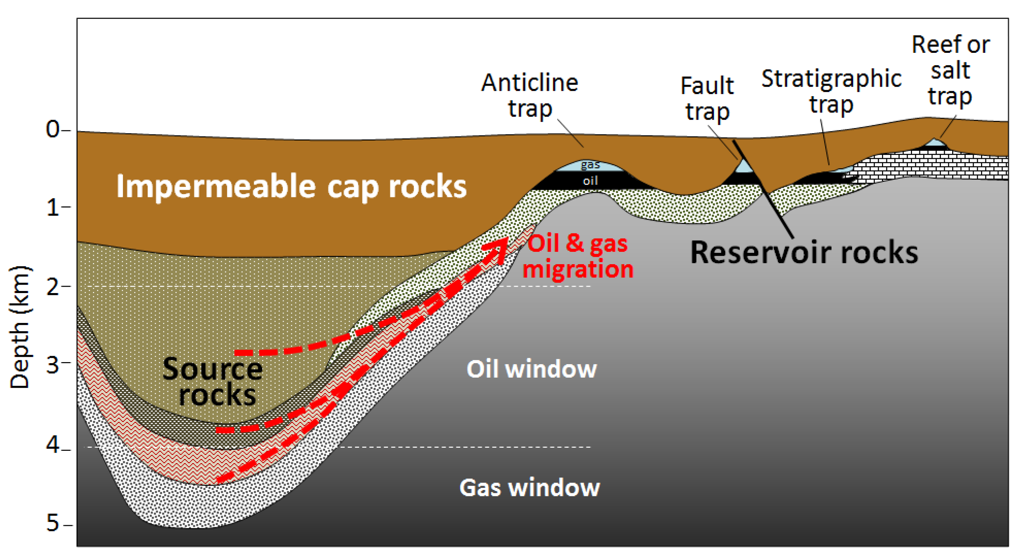
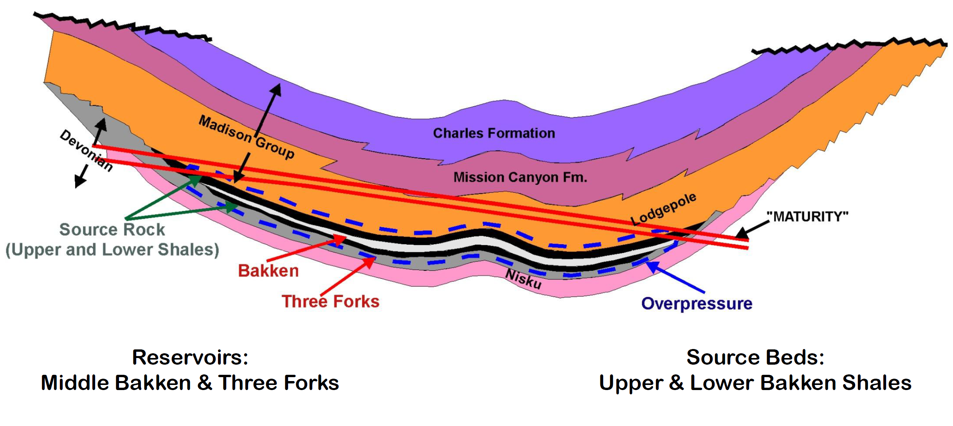
Background & Literature Review
Tight Oil Characterization
Geologic Structure and Hydrocarbon Storage
Non-Source, Tight-Oil
Source-Related, Tight-Oil (Bakken)
Earle, 2019
Sonnenberg, 2012
UNCONVENTIONAL RESERVOIR ENGINEERING PROJECT
Advisory Board Meeting, Spring 2020, Golden, Colorado

Slide 14
Background & Literature Review
Tight Oil Characterization
Flow Characteristics
Advection transport by pressure gradient (Darcy’s law)
Other mechanisms studied with tight rocks
Mechanisms | Comments
Knudson Diffusion, slip-flow, gas diffusion in kerogen, and desorption from organic pore and fracture surfaces | Mostly focused on gas flow in rocks with nano-darcy permeability
Molecular diffusion | Associated with EOR using gas injection, such as CO₂ or CH₄
Osmotic pressure effect | Considered in the interaction between the rock matrix and injection fluid as in the case of low salinity waterflooding
Mechanisms | Comments
Knudson Diffusion, slip-flow, gas diffusion in kerogen, and desorption from organic pore and fracture surfaces | Mostly focused on gas flow in rocks with nano-darcy permeability
Molecular diffusion | Associated with EOR using gas injection, such as CO₂ or CH₄
Mechanisms | Comments
Knudson Diffusion, slip-flow, gas diffusion in kerogen, and desorption from organic pore and fracture surfaces | Mostly focused on gas flow in rocks with nano-darcy permeability
UNCONVENTIONAL RESERVOIR ENGINEERING PROJECT
Advisory Board Meeting, Spring 2020, Golden, Colorado

Slide 15
Background & Literature Review
Development Challenges
Natural fractures
Permeability contrast
Fracture characterization uncertainty
Economics
Low production rate
Well design and stimulation cost
UNCONVENTIONAL RESERVOIR ENGINEERING PROJECT
Advisory Board Meeting, Spring 2020, Golden, Colorado

Slide 16
Results/Status
The research is in the stage of building and fine tuning the simulation model.
UNCONVENTIONAL RESERVOIR ENGINEERING PROJECT
Advisory Board Meeting, Spring 2020, Golden, Colorado

Slide 17
References
Al-Rubaiyea, J., Al-Bader, A., Al-Houli, M., Al-Najim, A., Al-Duwaish, M., & Elsherif, A. (2015, September 14). An Innovative Approach to Formation Evaluation with a Sourceless LWD Technology for the First Time in Joint Operations, A Case Study From Partitioned Zone Between Kuwait and Saudi Arabia. Society of Petroleum Engineers. doi:10.2118/175707-MS.
Alharthy, N., Teklu, T., Kazemi, H., Graves, R., Hawthorne, S., Braunberger, J., & Kurtoglu, B. (2015, September 28). Enhanced Oil Recovery in Liquid-Rich Shale Reservoirs: Laboratory to Field. Society of Petroleum Engineers. doi:10.2118/175034-MS
BP (2019). BP Statistical Review of World Energy, 68th Edition. https://www.bp.com/content/dam/bp/business-sites/en/global/corporate/pdfs/energy-economics/statistical-review/bp-stats-review-2019-full-report.pdf
CSUR (Canadian Society for Unconventional Resources). Understanding Tight Oil. Downloaded from https://www.mpgpetroleum.com/home/docs/Understanding_TightOil_FINAL.pdf.
Earle, S. (2019). Physical Geology – 2nd Edition. Victoria, B.C.: BCcampus. https://opentextbc.ca/physicalgeology2ed/
EIA (2018a), The United States is now the largest global crude oil producer. Last modified: 18 September 2018. https://www.eia.gov/todayinenergy/detail.php?id=37053
EIA (2018b), Tight oil remains the leading source of future U.S. crude oil production. Last modified: 22 February 2018. https://www.eia.gov/todayinenergy/detail.php?id=35052
EIA (2019), Glossary. Accessed on: 23 October, 2019. https://www.eia.gov/tools/glossary/index.php?id=T
Farouk, A., Wibowo, S., Aillud, G., Al Shehhi, A., & Kingsley, K. (2014, September 16). Water Saturation Uncertainty of Tight, Microporosity Dominated Carbonate Reservoirs and the Impact on Hydrocarbon Volume; Case Study from Abu Dhabi, UAE. Society of Petrophysicists and Well-Log Analysts.
Hillgartner, H., Paino, W. F., Hadhrami, F., Mukhopadhyay, A., Al-Sinani, I. S., Naamani, A., Vander Heyden, F. (2011, January 1). Integrated Reservoir Modeling for Water Flood Development in a Heterogeneously Fractured Carbonate Reservoir, North Oman. Society of Petroleum Engineers. doi:10.2118/148380-MS.
Javadpour, F. (2009, August 1). Nanopores and Apparent Permeability of Gas Flow in Mudrocks (Shales and Siltstone). Petroleum Society of Canada. doi:10.2118/09-08-16-DA
Jobe, Tiffany Dawn, 2013, Sedimentology, chemostratigraphy and quantitative pore architecture in microporous carbonates: examples from a giant oil field offshore Abu Dhabi, U.A.E.: Colorado School of Mines. Arthur Lakes Library.
Karimi, S., Kazemi, H., & Simpson, G. (2019, February 1). Capillary Pressure and Wettability Indications of Middle Bakken Core Plugs for Improved Oil Recovery. Society of Petroleum Engineers. doi:10.2118/185095-PA
Kazemi, H., Atan, S., Al-Matrook, M., Dreier, J., & Ozkan, E. (2005, January 1). Multilevel Fracture Network Modeling of Naturally Fractured Reservoirs. Society of Petroleum Engineers. doi:10.2118/93053-MS.
Ozkan, E., Raghavan, R. S., & Apaydin, O. G. (2010, January 1). Modeling of Fluid Transfer From Shale Matrix to Fracture Network. Society of Petroleum Engineers. doi:10.2118/134830-MS.
Saidian, Milad, 2015. Effect of rock composition and texture on pore size distributions in shales: applications in low field nuclear magnetic resonance. PhD Dissertation. Colorado School of Mines.
Senger, J.-C., Al-Harthi, N. R., Avest, D. ter, al-Bahry, A., & Bigno, Y. (2001, January 1). Producing the Ultimate from the Saih Rawl Shuaiba Reservoir. Society of Petroleum Engineers. doi:10.2118/68222-MS.
Sonnenberg, S. A., 2012. The New Bakken Play in Eastern Montana. Search and Discovery Article #10424. AAPG.
Sonnenberg, S. A. and Meckel, L., 2017. Our Current Working Model for Unconventional Tight Petroleum Systems: Oil and Gas. Search and Discovery Article #80589. AAPG.
Warrlich, G. M. D., Abu-Shiekah, I., Alexander, D. M., Zhu, F., Goossens, P. M., Tull, S. S., & Al-Lamki, A. A. (2009, January 1). Maintaining an &apos;Evergreen&apos; Model to Optimise a Waterflood Development in a Carbonate Transition Zone Field. Society of Petroleum Engineers. doi:10.2118/125552-MS.
UNCONVENTIONAL RESERVOIR ENGINEERING PROJECT
Advisory Board Meeting, Spring 2020, Golden, Colorado

