Slide 1


UNCONVENTIONAL RESERVOIR ENGINEERING PROJECT
Colorado School of Mines
U R E P
CSM
Research Summary
Overview of Hydrogen Sulfide Removal
Meruyert Makhatova
PhD student
Petroleum Engineering
Colorado School of Mines
UNCONVENTIONAL RESERVOIR ENGINEERING PROJECT
Advisory Board Meeting, Spring Spring 2020, Golden, Colorado

Slide 2
Motivation
Very toxic and pungent gas that causes harm
to equipment by reacting with steels causing pitting and stress cracking corrosion and deposition of iron sulfide scales;
to the environment, and to humans;
It is preferable to remove H₂S downhole and prevent from reaching the surface;
Required concentration of H₂S < 4 ppm;
Area | H₂S, %
Bearberry, Canada | 91
Big Escambia Creek, US | 21
Abu Dhabi, UAE | 0.7 - 8
Mississippi, US | 29.0 – 45.2
Saudi Arabia | 1.0 - 23
Tengiz, Kazakhstan | 17
H₂S content of sour gas worldwide (Ramachandran, 2015)
UNCONVENTIONAL RESERVOIR ENGINEERING PROJECT
Advisory Board Meeting, Spring 2020, Golden, Colorado

Slide 3

Physical characteristics of H₂S
Weak acid partially dissociating into bisulfide and sulfide ions:
Parameter | Value
Molecular weight, g/g-mol | 34.1
Kinetic diameter, pm | 360
Vapor pressure, mm Hg at 25°C | 15 600
Density, g/mL at 0°C, 760 mm Hg | 1.5392
Boiling point, °C | -60.33
Water solubility, mg/L at 20 °C | 3980
$$H_{2}S+H_{2}O=H_{3}O^{+}+HS^{−};pK_{a}=6.9$$
$$HS^{−}+H_{2}O=H_{3}O^{+}+S^{2−};pK_{a}=19$$
Obakore, 2017
UNCONVENTIONAL RESERVOIR ENGINEERING PROJECT
Advisory Board Meeting, Spring 2020, Golden, Colorado

Slide 4




Sources of H₂S
bacterial sulphate reduction (BSR); (at temperature from 0°C up to about 60-80°C )
thermochemical sulphate reduction (TSR); (at temperature of about 100 -140°C and depth greater than 4000 m) (Mariott, 2015)
thermal decomposition of organic sulphur compounds; (Hoffmann, 1995 )
reaction of elemental sulphur with organic matter;
$$Hydrocarbon+SO_{4}^{2−}+VFA^{∗}→altered hydrocarbon+HCO_{3}^{−}\left(CO_{2}\right)$$
$$+HS^{−}(H_{2}S)+H_{2}O$$
$$3/4∙xCaSO_{4}+C_{x+1}H_{2x+4}$$
$$→3/4∙xH_{2}S+1/4∙xCO_{2}$$
$$+1/4∙xH_{2}O+3/4∙xCaCO_{3}+CH_{4}$$
$$RCH_{2}SSCH_{2}R→RCH=CHR+H_{2}S+1/8{ S}_{8}$$
$$4S^{0}+1.33\left(−CH_{2}−\right)+2.66H_{2}O+1.33OH^{−}→4H_{2}S+1.33HCO_{3}^{−}$$
*VFA - Volatile Fatty Acids: acetic, proprionic, and butyric acids
UNCONVENTIONAL RESERVOIR ENGINEERING PROJECT
Advisory Board Meeting, Spring 2020, Golden, Colorado

Slide 5


Sources of H₂S cont’d
Acidizing process:
- dissolution of iron sulfide
$$FeS+2H^{+}=Fe^{2+}+H_{2}S$$
Sea-water flood: source of sulfate ions that may be converted to H₂S;
Thermal recovery:
- high temperature (from 200 C up to 350 C) induces TSR reaction;
- thermal decomposition reactions of organosulfur compound;
Hydraulic fracturing: the additives (e.g. sodium dodecyl sulfate (SDS), Mariott (2015)
$$NaC_{12}H_{25}SO_{4}+2/3H_{2}O→NaHCO_{3}+H_{2}S+1/3CO_{2}+2/3C_{11}H_{23}OH+1/3C_{10}H_{21}OH$$
UNCONVENTIONAL RESERVOIR ENGINEERING PROJECT
Advisory Board Meeting, Spring 2020, Golden, Colorado

Slide 6
Hydrogen Sulfide Scavengers
Gas sweetening - removal of acid gas components from sour gas streams based upon physical or chemical absorption (to liquid) or adsorption (solid)
Non-regenerative
Solid, basic metallic compounds (iron sponge);
Oxidizing chemicals;
Aldehydes and aldehyde-related products;
Triazines - reaction products of aldehydes and amines, including;
Metal carboxylates and chelates.
Regenerative
Aqueous amines (alkanolamines)
Physical solvents - methanol and glycols follow Henry’s law for dissolution of the H₂S;
Membranes - based on the principle that different gases permeate at different rates due to differences in diffusivity and solubility;
Ionic liquids - molten salts consisting of large organic cations and organic or inorganic anions
UNCONVENTIONAL RESERVOIR ENGINEERING PROJECT
Advisory Board Meeting, Spring 2020, Golden, Colorado

Slide 7


Solid scavengers: Metal-based processes
Hydrogen Sulfide Scavengers
Generally zinc- or iron-based materials
Reaction product with iron (II,III) oxide - iron pyrite (FeS₂):
Trivalent iron oxidize some of the sulphide to elemental Sulphur:
Water- and oil-soluble metal chelates (carboxylate groups ) - for treating drilling fluids
$Fe_{3}O_{4}+6H_{2}S→3FeS_{2}+4H_{2}O+2H_{2}$
2$Fe^{+++}+{3S}^{=}→Fe_{2}S_{3}$
$$Fe{\left(III\right)}_{2}S_{3}→2Fe\left(II\right)S+S$$
UNCONVENTIONAL RESERVOIR ENGINEERING PROJECT
Advisory Board Meeting, Spring 2020, Golden, Colorado

Slide 8

Oxidizing chemicals
Hydrogen Sulfide Scavengers
Oxidizing agents: water-soluble salts with oxidizing anions:
NaClO_{2,} NaBrO₃, NaNO₂ (downhole squeeze injection), persalts: peroxides, perchlorates, percarbonates, and others;
Reaction product - elemental Sulphur;
Peroxide chemicals convert sulfide to sulfate (Obakore, 2017)
$$H_{2}S+4H_{2}O_{2}→SO_{4}^{2−}+4H_{2}O+2H^{+}$$
$$H_{2}O_{2}+H_{2}S→S^{0}+H_{2}O$$
UNCONVENTIONAL RESERVOIR ENGINEERING PROJECT
Advisory Board Meeting, Spring 2020, Golden, Colorado

Slide 9
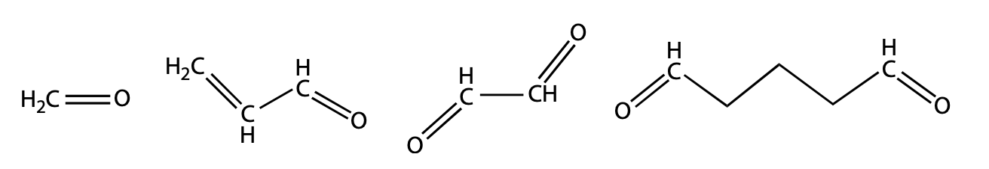
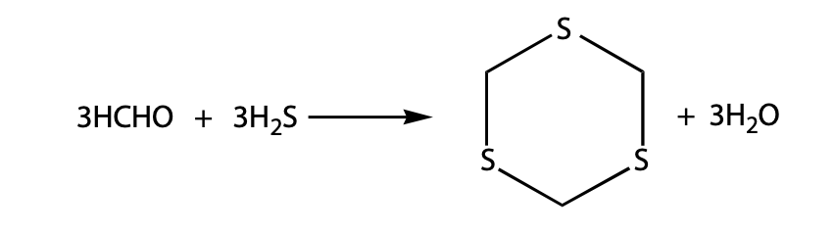
Aldehydes
Hydrogen Sulfide Scavengers
Typical aldehydes: formaldehyde, glutaraldehyde, acrolein, and glyoxal
Reaction of formaldehyde with H₂S - poorly soluble in water (Kelland, 2014)
Formaldehyde is a suspected carcinogen;
Used in acid stimulation - (HMTA) forms formaldehyde in situ;
Biocides - kill sulphate-reducing bacteria;
Aldehydes do not raise the pH;
Corrosive to metals
From left to right: formaldehyde, acrolein, glyoxal, glutaraldehyde
UNCONVENTIONAL RESERVOIR ENGINEERING PROJECT
Advisory Board Meeting, Spring 2020, Golden, Colorado

Slide 10
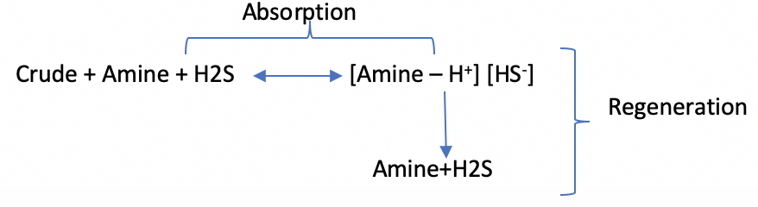
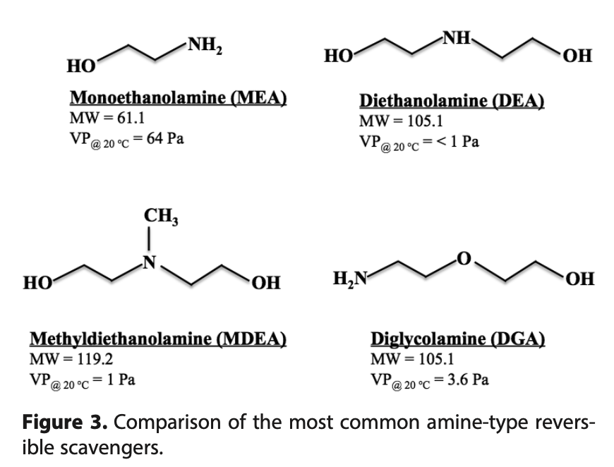


Alkanolamines
Hydrogen Sulfide Scavengers
Alcohol derivatives of ammonia: $NH_{3}$
Weak organic bases with pH of 10–12;
Reaction leads to a Lewis acid-base complex (Maddox, 1987)
Regeneration by applying heat
The general way of removing H₂S is through transformation of the H₂S to elemental sulfur – Claus process (Gary, 1984)
$$H_{2}S+H_{2}N{\left(CH_{2}\right)}_{2}){\left(CH_{2}\right)}_{2}OH$$
$$↔HSH:NH_{2}{\left(CH_{2}\right)}_{2}O{\left(CH_{2}\right)}_{2}OH$$
$$2{ H}_{2}S+3{ O}_{2}→2 SO_{2}+2{ H}_{2}O$$
$$4 H_{2}S+2 SO_{2}→3 S_{2}+4 H_{2}O$$
UNCONVENTIONAL RESERVOIR ENGINEERING PROJECT
Advisory Board Meeting, Spring 2020, Golden, Colorado

Slide 11
Traizines
Hydrogen Sulfide Scavengers
Reaction product of alkanolamines with formaldehyde;
Water-soluble;
Raise the pH of the produced water
H₂S absorbs into the aqueous triazine solution – H₂S dissociates to HS⁻ due to alkaline pH;
React with the HS⁻ ion;
Nitrogen-sulphur replacement stages
Low solubility in water
UNCONVENTIONAL RESERVOIR ENGINEERING PROJECT
Advisory Board Meeting, Spring 2020, Golden, Colorado

Slide 12





Ionic liquids
Hydrogen Sulfide Scavengers
Molten salts consisting of large organic cations and organic or inorganic anions;
A variety of cation and anion combinations form ILs with great potential for H₂S treatment of gas
Solubility of gases
PR EOS - fugacity in gas phase
Henry’s law – fugacity in liquid solution
Activity coefficient
Unsymmetric activity coefficient
Absorption selectivity
$$f_{i}^{l}=γ_{i}^{∗}x_{i}H_{i}$$
$$lnH_{12}=α+\frac{β}{T}+\frac{εP}{T}$$
$$γ_{i}=exp\left(\frac{μ_{i}−μ_{i}^{0}}{RT}\right)$$
$$γ_{i}^{∗}={γ_{i}}/{γ_{i}^{∞}}$$
$$S_{i/j}(T,P)=\frac{\left.x_{i}(T,P\right)}{\left.x_{j}(T,P\right)}$$
Mortazavi-Manesh, 2013
UNCONVENTIONAL RESERVOIR ENGINEERING PROJECT
Advisory Board Meeting, Spring 2020, Golden, Colorado

Slide 13



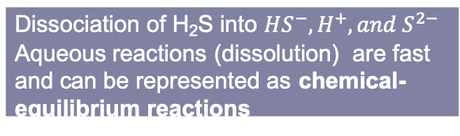


Partitioning of Hydrogen Sulfide
Theoretical model
Thermodynamic equilibrium – equality of fugacities;
The fugacity, $f_{ig}, f_{io}$ are calculated from the PR EOS
The fugacity $f_{iw}$is calculated using Henry’s law
Henry’s constant
Harvey, 1996
$T^{∗}$ - reduced temperature
$$lnH={\ln{P_{i}}}^{S}+A/{T^{∗}}+{B{\left(1−T^{∗}\right)}^{0.355}}/{T^{∗}}+C exp\left(1−T^{∗}\right){\left(T^{∗}\right)}^{−0.41}$$
$$f_{ig}=f_{io}=f_{iw}, i=1,…,n_{c}$$
H₂S | A | B | C
 | -5.7131 | 5.3727 | 5.4227
$$f_{iw}=y_{iw}∙H_{i}$$
Dissociation of H₂S into $HS^{−}, H^{+}, and S^{2−}$
Aqueous reactions (dissolution) are fast and can be represented as chemical-equilibrium reactions
Mineral dissolution/precipitation or slow kinetics reactions with scavengers are rate-dependent reactions.
UNCONVENTIONAL RESERVOIR ENGINEERING PROJECT
Advisory Board Meeting, Spring 2020, Golden, Colorado

Slide 14








Reaction Stoichiometry - Chemical Equilibrium
The governing equations
$n_{aq}$ – number of aqueous components
$K_{eq,α}$ – the chemical equilibrium constant
$a_{k}$ – the activity of component k
$ν_{kα}$ – stoichiometry coefficients
$Q_{α}$ – the activity product
$R_{aq}$– number of reactions between aqueous components
Activity as a function of molality
Activity coefficient (B-dot model)
$A_{γ}, B_{γ}, B$ - temperature dependent parameters;
${\dot{a}}_{i}$ – ion size parameter;
$z_{k}$ – charge of k-th ion;
$I$ – ionic strength
$$a_{i}=γ_{i} m_{i}, i=1,…,n_{aq}$$
$$Q_{α}−K_{eq,α}=0, α=1,…,R_{aq}$$
$$Q_{α}= \prod_{k=1}^{n_{aq}}{a_{k}^{ν_{kα}}}$$
$$log γ_{i}=−\frac{A_{γ}z_{i}^{2}\sqrt{I} }{1+{\dot{a}}_{i}B_{γ}\sqrt{I}}+ \dot{B}I$$
$$K_{eq}=\frac{\left.\left[H^{+}\right][SH^{−}\right]}{\left[H_{2}S\right]}$$
$$I=\frac{1}{2}\sum_{k=1}^{n_{aq}}{m_{k} z_{k}^{2}}$$
Nghiem, 2004
UNCONVENTIONAL RESERVOIR ENGINEERING PROJECT
Advisory Board Meeting, Spring 2020, Golden, Colorado

Slide 15








Reaction Stoichiometry – Mineral Reactions
Rate law
$r_{β}$ – the rate
${\hat{A}}_{β}$ – reactive surface area
$k_{β}$ – the rate constant of mineral reaction
$K_{eq,β}$ – chemical equilibrium constant
$Q_{β}$ – activity product
$Q_{β}/K_{eq,β}$ – saturation index (if >1 – mineral dissolution; if <1 – mineral precipitation)
$N_{β}$ – mole number
$R_{mn}$- number of reactions between mineral and aqueous components
Porosity change:
$φ^{∗}$ - reference porosity without mineral reaction
Permeability reduction (Kozeny-Carman eq.)
$r_{β}={\hat{A}}_{β} k_{β} \left(1−\frac{Q_{β}}{K_{eq,β}}\right), β=1,…,R_{mn}$
$${\hat{φ}}^{∗}≡φ^{∗}−\sum_{β=1}^{n_{m}}{\left(\frac{N_{β}}{ρ_{β}}−\frac{N_{β}^{0}}{ρ_{β}}\right)}$$
$${\hat{A}}_{β}= {\hat{A}}_{β}^{0} \frac{N_{β}}{N_{β}^{0}}$$
$$φ=φ^{∗}\left[\left.1+c_{φ}(p−p^{∗}\right)\right]$$
$$Q_{β}=\prod_{k=1}^{n_{aq}}{a_{k}^{ν_{kβ}}}$$
$$\frac{k}{k^{0}}={\left(\frac{φ}{φ^{0}}\right)}^{3}∙{\left(\frac{1−φ^{0}}{1−φ}\right)}^{2}$$
Nghiem, 2004
UNCONVENTIONAL RESERVOIR ENGINEERING PROJECT
Advisory Board Meeting, Spring 2020, Golden, Colorado

Slide 16



Reaction Stoichiometry – Reaction Rates
The rate of removal of hydrogen sulfide is limited by the rate of mass transfer of H₂S from the gas phase to scavenger solution droplets (Fisher et al., 2003)
$y_{H_{2}S}$ - mole fraction of H₂S in gas phase;
$K_{G}$ - mass transfer coefficient;
$a$ – interfacial area;
$G$ – molar gas velocity
e.g. triazine liquid reacting with gaseous H₂S (Buhaug, 2002)
for pH<10 reaction is fast
$$\frac{dy_{H_{2}S}}{dz}=\frac{K_{G}a P y_{H_{2}S}}{G}$$
$${\left.d[T\right]}/{dt}=−k_{a}\left[TH^{+}\right]\left[HS^{−}\right] for pH>10$$
Rajagopal, 2009
UNCONVENTIONAL RESERVOIR ENGINEERING PROJECT
Advisory Board Meeting, Spring 2020, Golden, Colorado

Slide 17
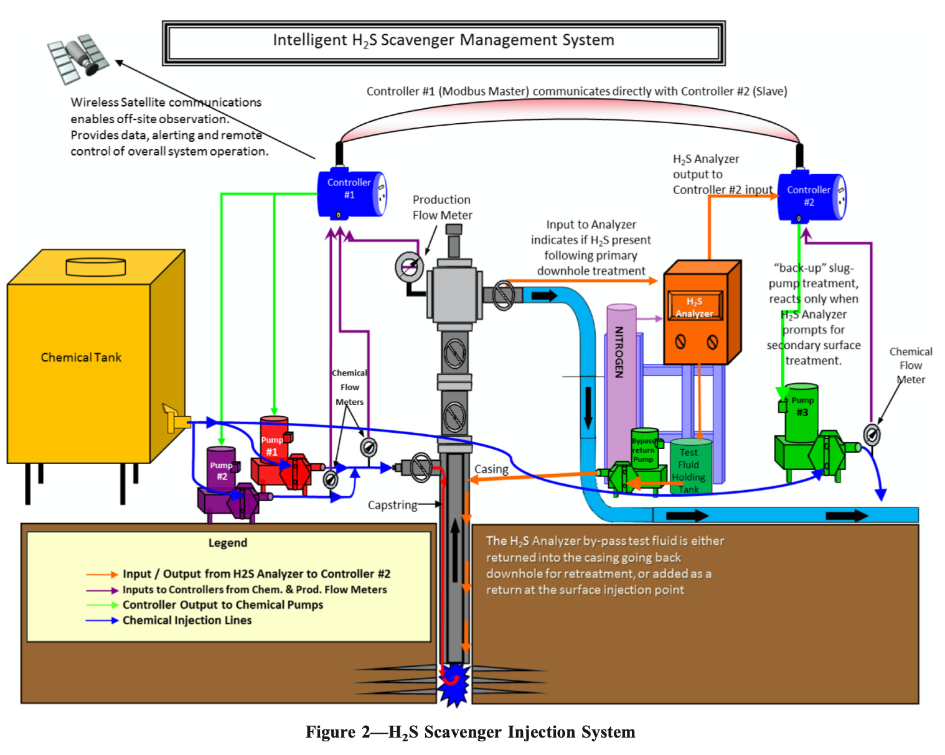
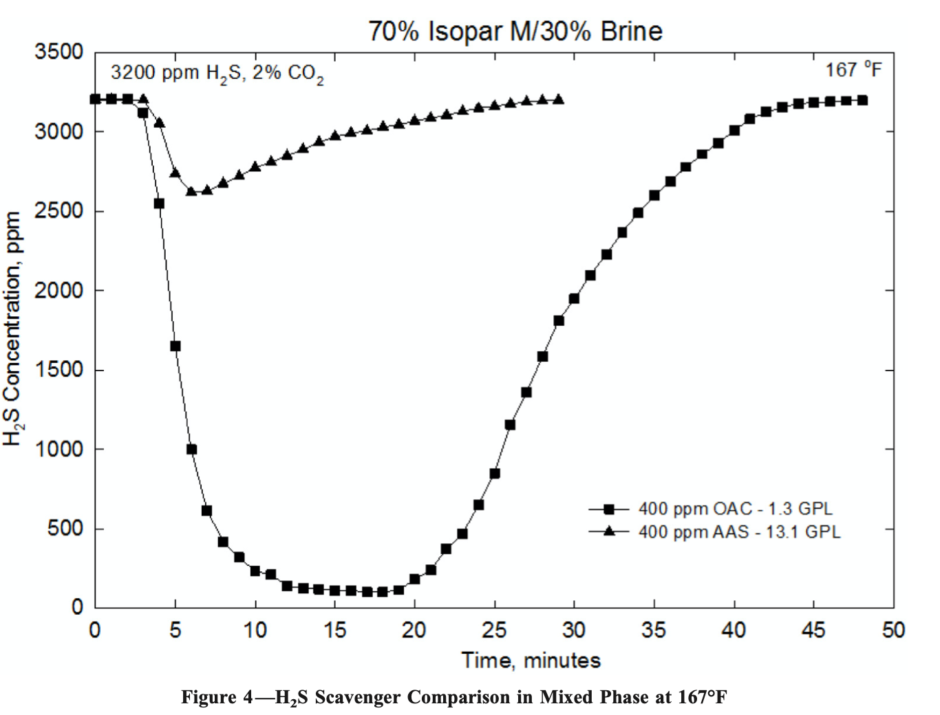
Field Cases – Downhole injection
New non-triazine, organic acid metal complex- based H₂S scavenger (OAC) ;
continuous injection through a capillary string
H₂S Scavenger Injection System (Lehrer et al, 2015)
H₂S Scavenger Comparison (Lehrer et al, 2015)
UNCONVENTIONAL RESERVOIR ENGINEERING PROJECT
Advisory Board Meeting, Spring 2020, Golden, Colorado

Slide 18
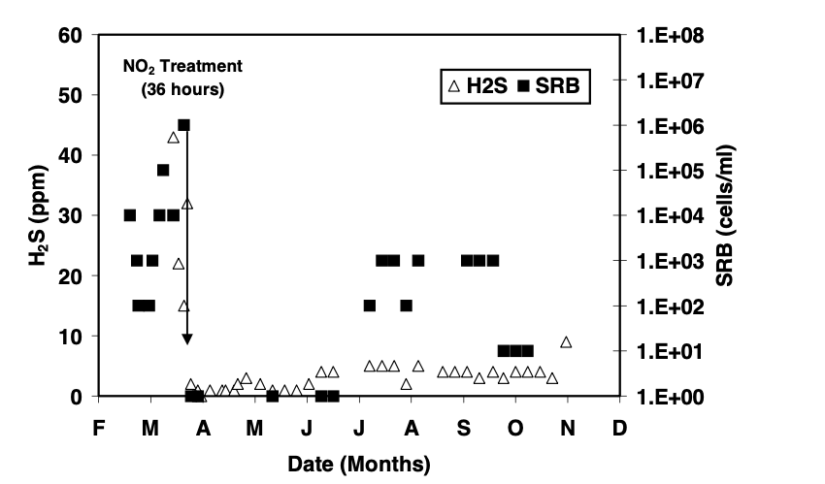


Field Cases – Nitrate/Nitrite injection
The downhole injection of nitrite NO₂⁻ :
- effectively remove H₂S) – for the next 7 months after 36-hour treatment;
- prevent the activity of SRB due to enhancement of denitrifying bacteria (DNB) that utilize volatile fatty acids
Dissolution of precipitated iron sulfide
$$5 FeS_{2}+14NO_{3}^{−}+4 H^{+}$$
$$→7 N_{2}+5 Fe^{2+}+10 SO_{4}^{2−}+2 H_{2}O$$
$$NaNO_{2}+3H_{2}S$$
$$→3S+NH_{3}+NaOH+H_{2}O$$
H₂S(gas phase) and SRB in water (Sturman et al, 1999)
UNCONVENTIONAL RESERVOIR ENGINEERING PROJECT
Advisory Board Meeting, Spring 2020, Golden, Colorado

Slide 19
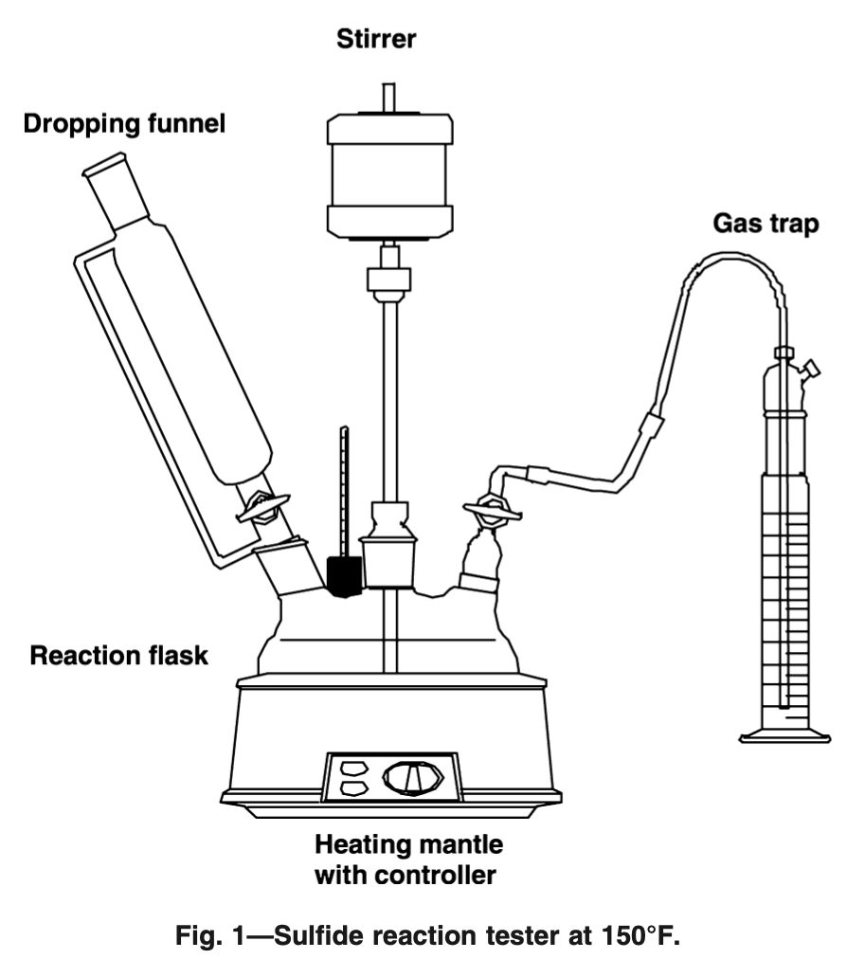
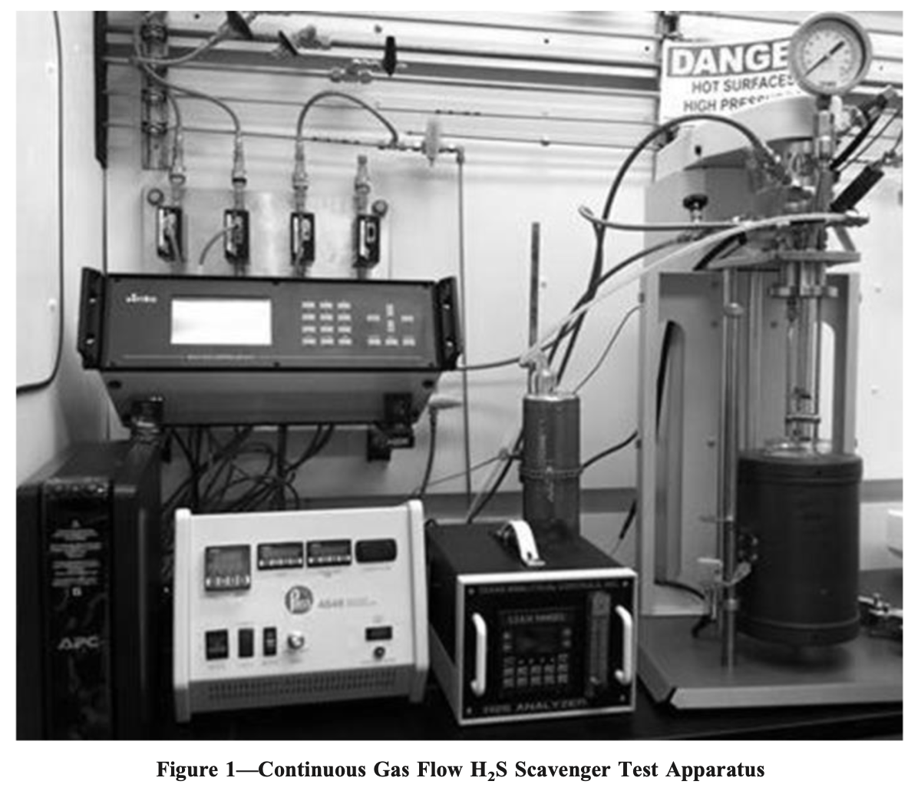
Overview of Experimental Procedures
The test apparatus includes
- glass reaction vessel with gas: nitrogen (N₂), carbon dioxide (CO2), and H₂S;
- H₂S analyzer;
H₂S scavenger is injected through a port at the top
H₂S concentration is continuously monitored.
The acid gas is swept to a NaOH scrubber;
At high pressure and high temperature test is conducted in corrosion autoclave
H₂S Scavenger Test Apparatus (Lehrer et al, 2015)
Sulfide Reaction Tester (Nasr-El-Din et al, 2002)
UNCONVENTIONAL RESERVOIR ENGINEERING PROJECT
Advisory Board Meeting, Spring 2020, Golden, Colorado

Slide 20

Conclusion
Source of H₂S are (1) BSR, (2) TSR, (3) Thermal decomposition of organic Sulphur, and (4) reaction with elemental Sulphur;
H₂S scavengers are chemical compounds and physical solvent that neutralize H₂S;
Partitioning of H₂S is calculated by PR EOS and Henry’s law;
Dissociation of H₂S into ions is determined by activity product ($Q_{α}$) and chemical equilibrium constant $Keq$;
Mineral dissolution/precipitation and slow reactions with scavengers are the rate-dependent reactions;
Nitrate/nitrite downhole injection effectively reduced H₂S concentration.
UNCONVENTIONAL RESERVOIR ENGINEERING PROJECT
Advisory Board Meeting, Spring 2020, Golden, Colorado

Slide 21
Future Work
Kinetic modeling study: chemical kinetic model to study reaction of H₂S with scavengers;
Validate model by comparing the outputs with the data reported in the literature;
Compositional reservoir modeling coupled with kinetic model to estimate the effectiveness of downhole removal of H₂S.
UNCONVENTIONAL RESERVOIR ENGINEERING PROJECT
Advisory Board Meeting, Spring 2020, Golden, Colorado

Slide 22
Thank you!
Questions?
UNCONVENTIONAL RESERVOIR ENGINEERING PROJECT
Advisory Board Meeting, Spring 2020, Golden, Colorado

