Slide 1

UNCONVENTIONAL RESERVOIR ENGINEERING PROJECT
Colorado School of Mines
U R E P
CSM
Feasibility Study of Gas Injection in Low-Perm Changqing Oilfield
Ye Tian, Ozan Uzun, Yizi Shen
Hossein Kazemi, Yu-Shu Wu
https://doi.org/10.1016/j.fuel.2020.117831
UNCONVENTIONAL RESERVOIR ENGINEERING PROJECT
Advisory Board Meeting, Spring, 2020, Golden, Colorado

Slide 2
Outline
Introduction
Compositional modeling
Sensitivity Analysis
Conclusions
UNCONVENTIONAL RESERVOIR ENGINEERING PROJECT
Advisory Board Meeting, Spring, 2020, Golden, Colorado

Slide 3
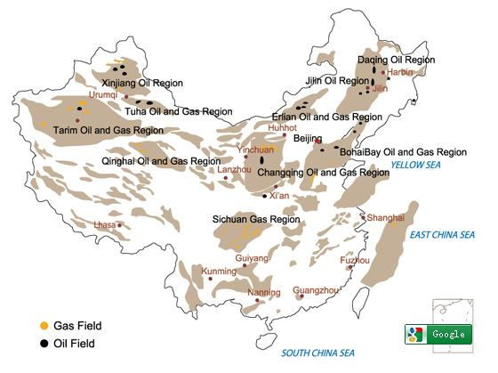
Introduction
  Changqing is the largest oilfield in China, 1.15 MMBOED in 2019
  Oil prd at south<2800m, gas prd at north>2800m
  Prd est. 1971, Jurassic formation~10mD
  Now from Upper Triassic Yanchang
    Low perm ~0.1 mD
    Low pressure 0.3~0.4 psi/ft
    Fracturing is a must, but still fast decline
    Waterflood inefficient, RF is low ~10%
Ordos Basin
Source:
PetroChina
Notes:
China produced 3.8 MMBOED in 2019;
Changqing oil field is a general term that represents many individual oil and gas fields across a large area in Ordos basin.
Quite a few reservoirs have a pressure coefficient of only 0.6~0.7.

Slide 4
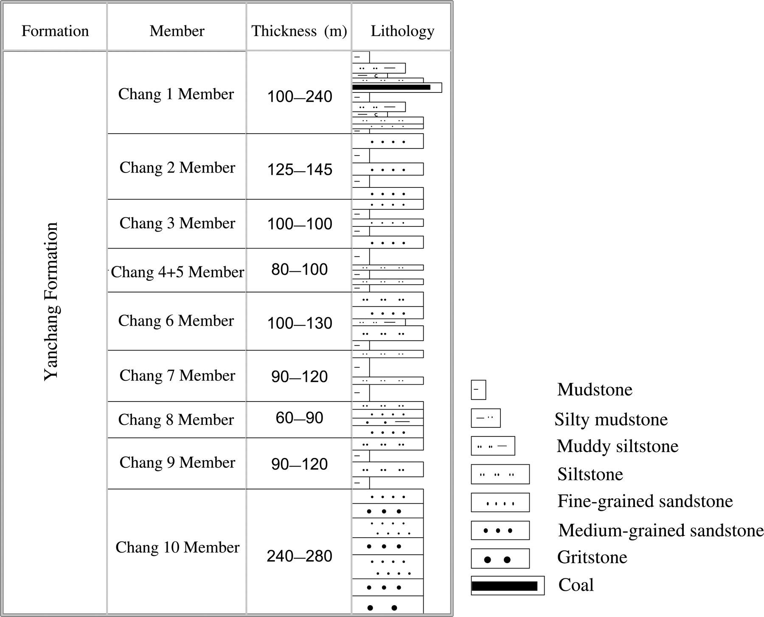
Stratigraphic column in the Yanchang Formation
Introduction
Siltstone
Chang 6₁ 25–40 m
Fine-grained sandstone
Chang 6₂ 25–40 m
Muddy Siltstone
Siltstone
Chang 6₃ 60–90 m
Mudstone
main producing layer
1. Green-greyish siltstones with dark grey mud intercalation.
2. Isolated from Chang 6₂ above and Chang 7 below.
Zeng&Li (2009) AAPG Bull.

Slide 5
Introduction
Y284 Unit and its main prd interval is Chang 6₃¹, top of Chang 6₃
Avg k_{air} without confining stress 0.38 mD; Avg ϕ=12.1%;
Avg Thickness=21.2 m; Avg Swi=55%;Pi=15.8 MPa; Ti=69.7°C
756 prd (perf at top)+384 w inj (perf at bottom) for better conformance
But still, waterflood RF<<10%
Notes:
Chang 6₃ is the 3rd sub-member of the 6th member of the upper Triassic Yanchang formation (also known as Chang 6₃)
The main producing interval is Chang 6₃¹, which is a continuous sand body at the top of Chang 6₃ with the average thickness as 21.2 m, porosity as 12.1% and initial oil saturation as 55%.

Slide 6
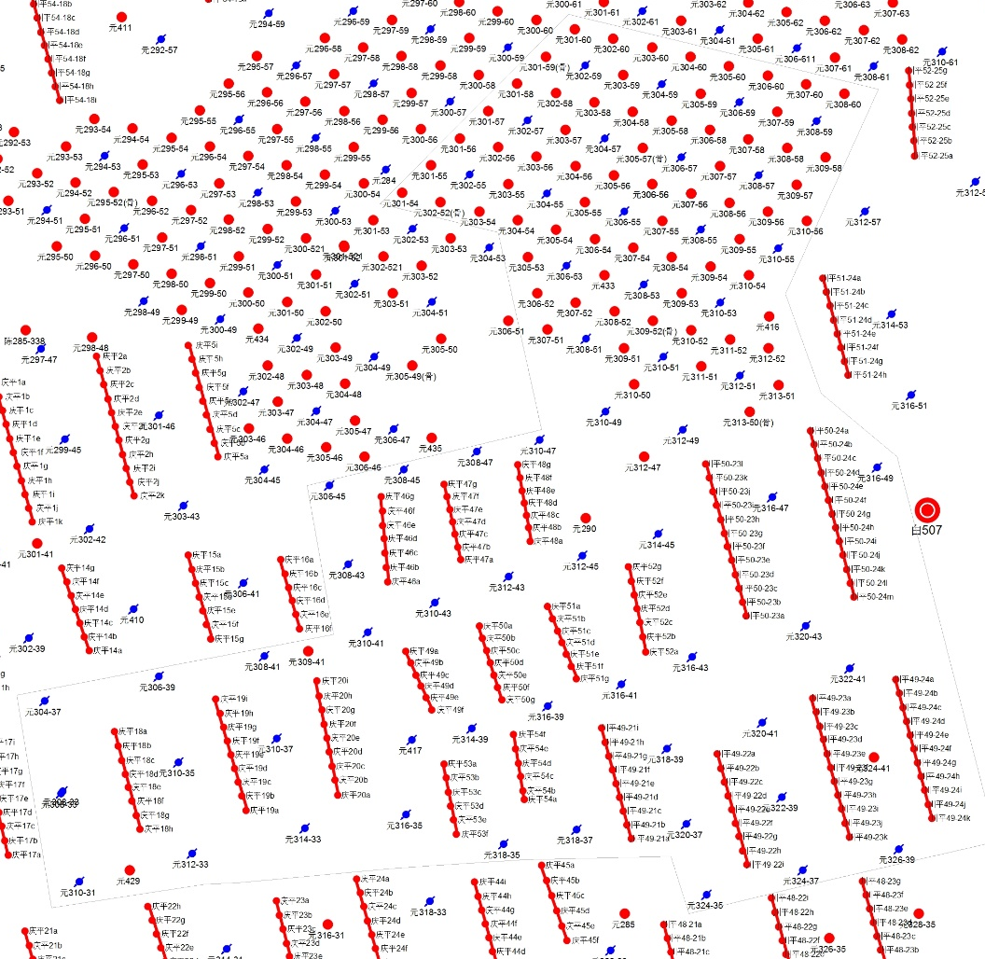
Objectives
Is gas huff-n-puff feasible?
  Gas field at north Ordos Basin
  Multistage fractured well
  Successful pilots in U.S.
Compositional modeling
  Select a typical well pattern
  Fluid characterization
  Core measurement
  History match
  Sensitivity studies

Slide 7
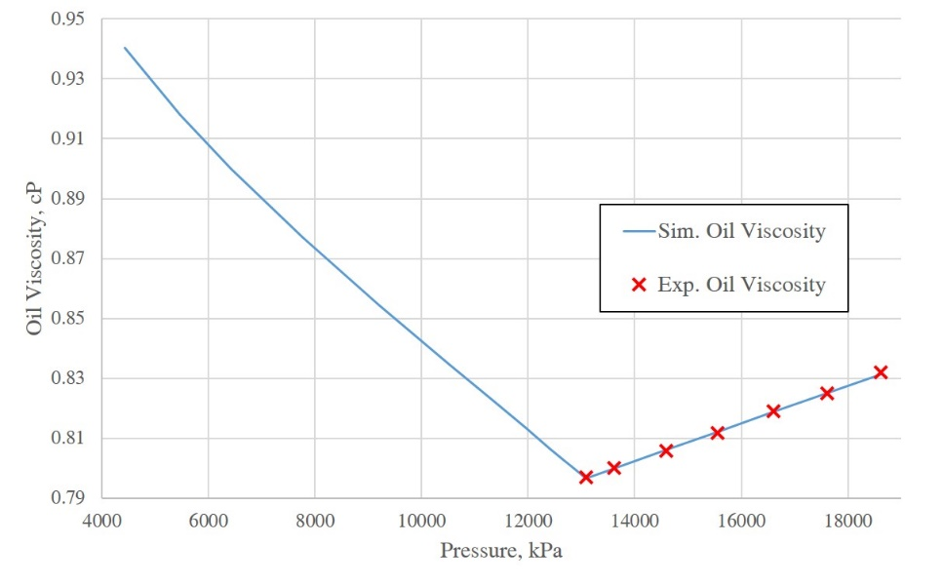
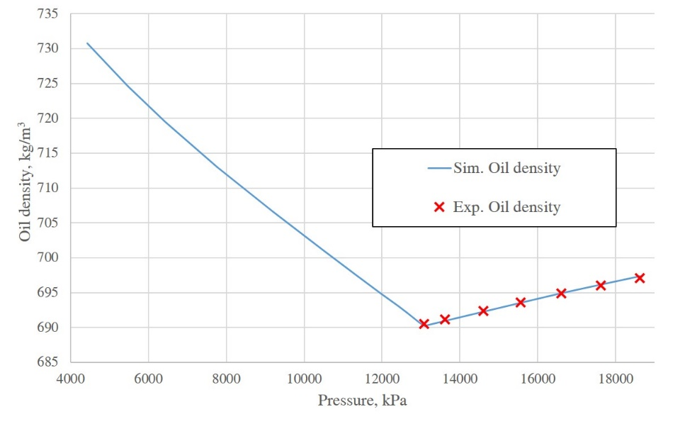
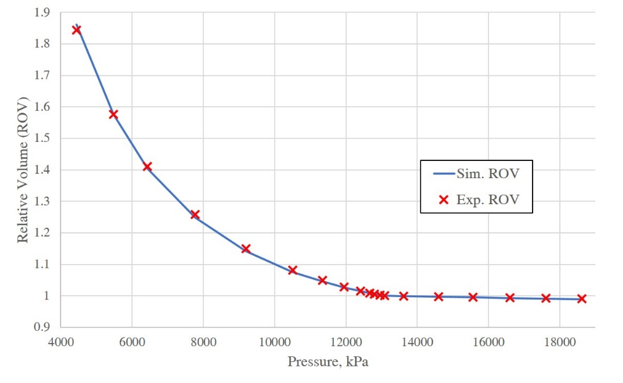
Reservoir fluid characterization
8-comp fluid model
CCE, separator test
Matched Pb=13.09 MPa
GOR 120.1m³/m³
 | Molar fraction, % | Pc, atm | Tc, K | Acentric factor | MW, g/mol | Volume shift
CO₂ | 0.12 | 72.80 | 304.20 | 0.225 | 44.01 | 0
N₂ | 0.75 | 33.50 | 126.20 | 0.040 | 28.01 | 0
CH₄ | 31.72 | 45.40 | 190.60 | 0.009 | 16.04 | 0
C₂H₆ | 8.35 | 48.20 | 305.40 | 0.098 | 30.07 | 0
C₃H₈ | 9.70 | 41.90 | 369.80 | 0.152 | 44.10 | 0
C4-6 | 12.82 | 29.03 | 457.53 | 0.173 | 68.58 | 0
C7-10 | 12.86 | 21.87 | 463.77 | 0.354 | 118.75 | -0.870
C11+ | 23.67 | 13.40 | 593.72 | 1.975 | 401.94 | 0.238

Slide 8
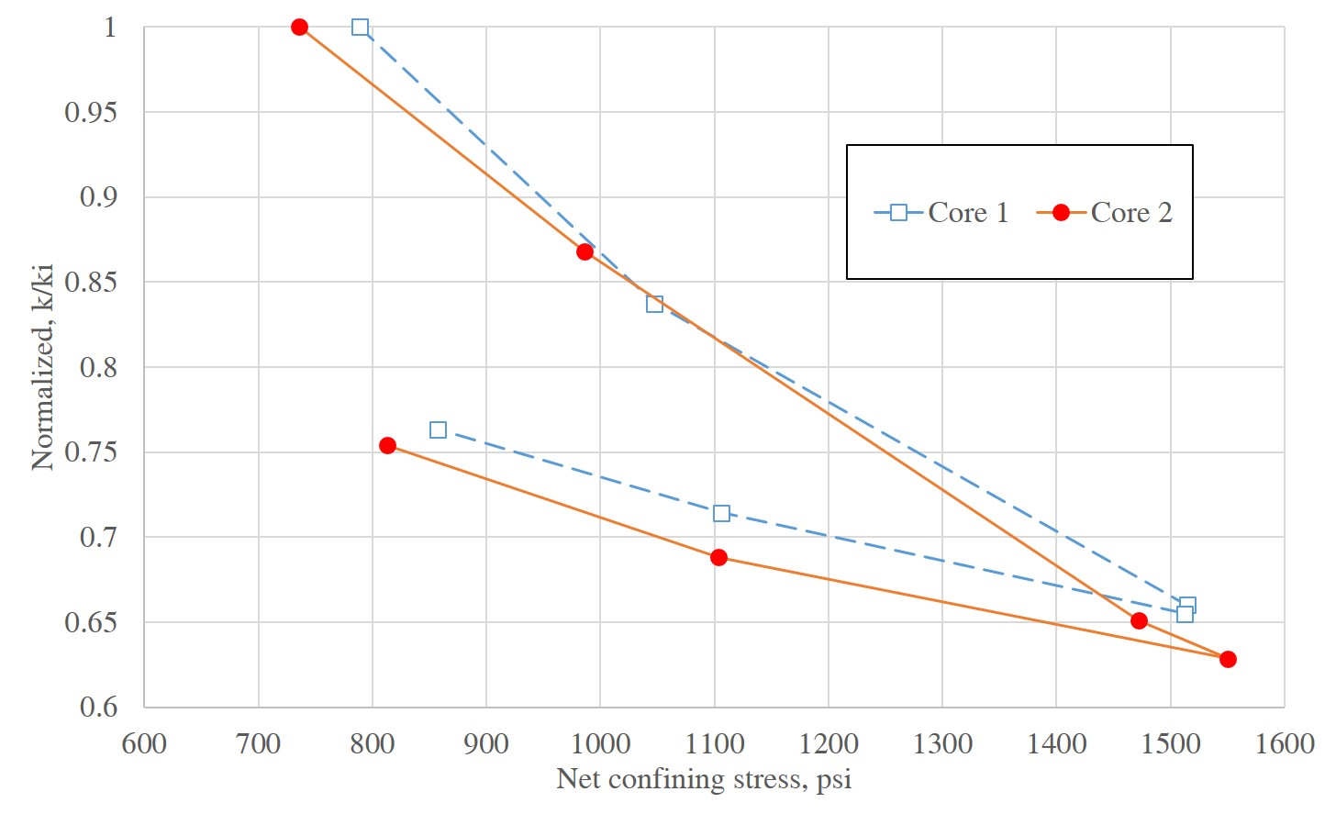
Core measurement
<<0.38mD
14 cores from 2 wells
N₂ under confining stress (CMS-300)
k~2 orders of magnitudes lower than labelled
Unloading curve used
Core #1
Net confining stress, psi | ϕ, % | k, 10⁻³ mD
788.7 | 12.30 | 2.03
1047.4 | 12.18 | 1.70
1514.7 | 12.05 | 1.34
1512.4 | 12.02 | 1.33
1106.1 | 12.10 | 1.45
857.1 | 12.16 | 1.55
Core #2
Net confining stress, psi | ϕ, % | k, 10⁻³ mD
735.8 | 13.64 | 6.22
985.8 | 14.12 | 5.40
1472.3 | 14.16 | 4.05
1550.5 | 14.17 | 3.91
1103.7 | 14.19 | 4.28
813.2 | 14.30 | 4.69

Slide 9
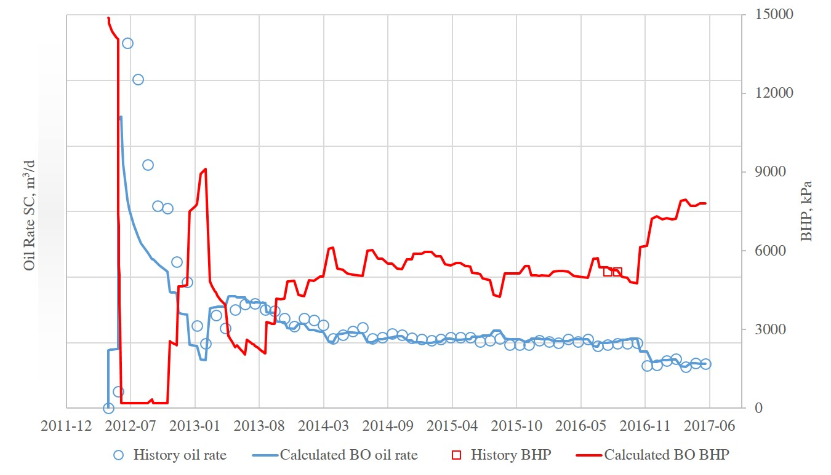
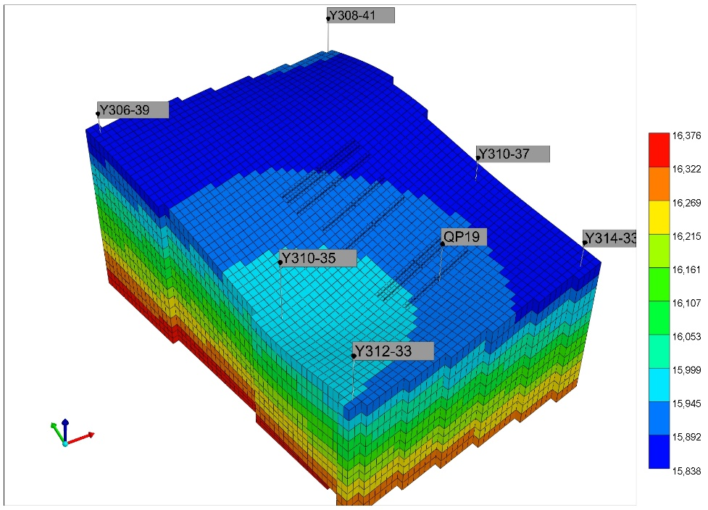
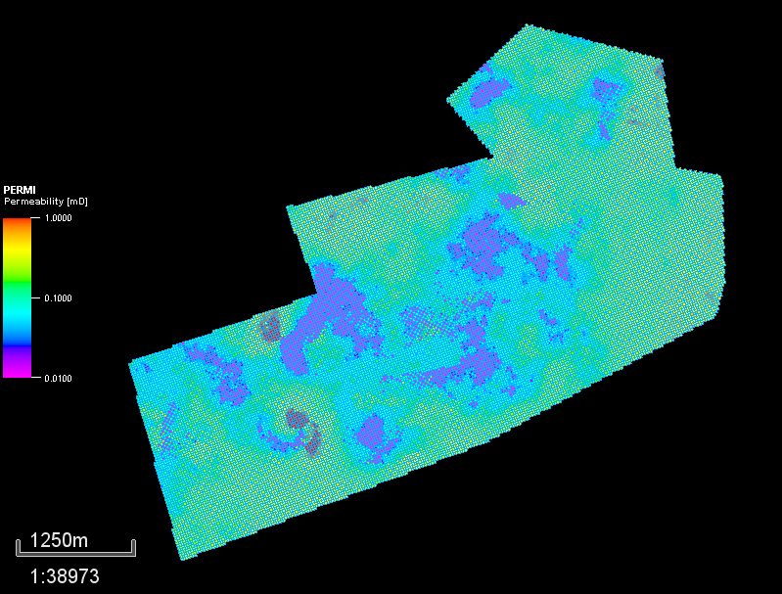
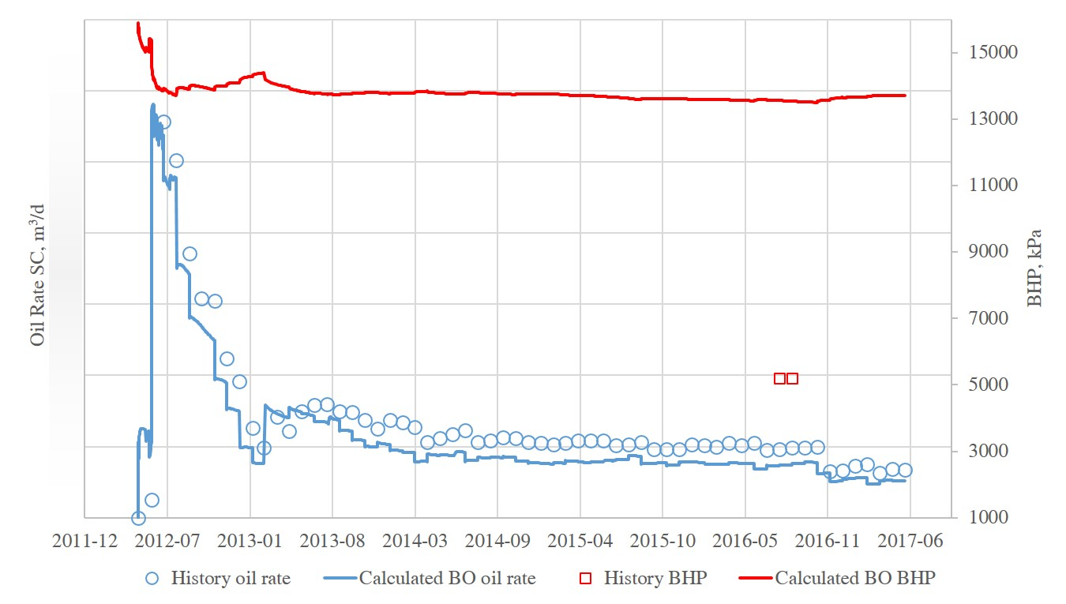
Sector model
1 prd+6 inj subtracted from full-field model
  Replace black oil with compositional
  Matrix k×0.01 (based on lab measurement)
  k_{NF}=0.015 mD, ϕ_{NF}=0.001, NF spacing 0.6×0.6×3m (input tuned based on Liu, 2010; Liu et al., 2015)
  Endpoint krwo slightly tuned
Better match
Single-porosity black-oil
model by Hu (2018)
Poor match,
e.g. BHP

Slide 10
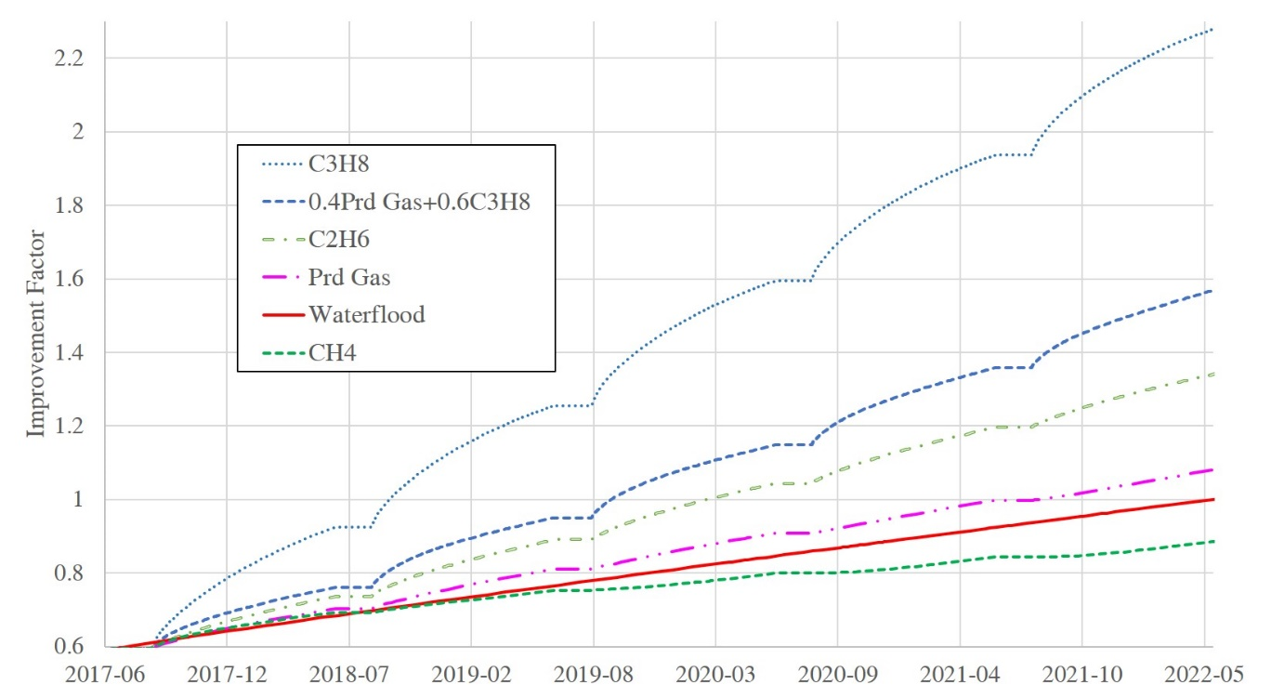
Compositional effect of injectant
 | Light |  |  | Intermediate |  |  | Heavy |  | Calculated MMP, MPa
 | CO₂ | N₂ | CH₄ | C₂H₆ | C₃H₈ | C4-6 | C7-10 | C11+
Lean gas | 0% | 0% | 100% | 0% | 0% | 0% | 0% | 0% | 27.0
 | 100% |  |  | 0% |  |  | 0%
Produced gas | 0.2% | 1.3% | 55.4% | 14.3% | 15.6% | 12.5% | 0.6% | 0.0% | 14.2
 | 57.0% |  |  | 42.4% |  |  | 0.6%
Rich gas | 0% | 0% | 0% | 100% | 0% | 0% | 0% | 0% | 6.9
 | 0% |  |  | 100% |  |  | 0%
Solvent | 0% | 0% | 0% | 0% | 100% | 0% | 0% | 0% | 3.5
 | 0% |  |  | 100% |  |  | 0%
50-d inj; 10-d soaking; 300-d Prd; 5 cycles
C₃H₈ ×2.28
Inj @30MPa (fracture pressure 31 MPa)
0.6C₃H₈ + 0.4Prd Gas ×1.57
C₂H₆ ×1.34
Prd Gas ×1.08
Waterflood×1
Waterflood ×1
CH₄ ×0.89

Slide 11
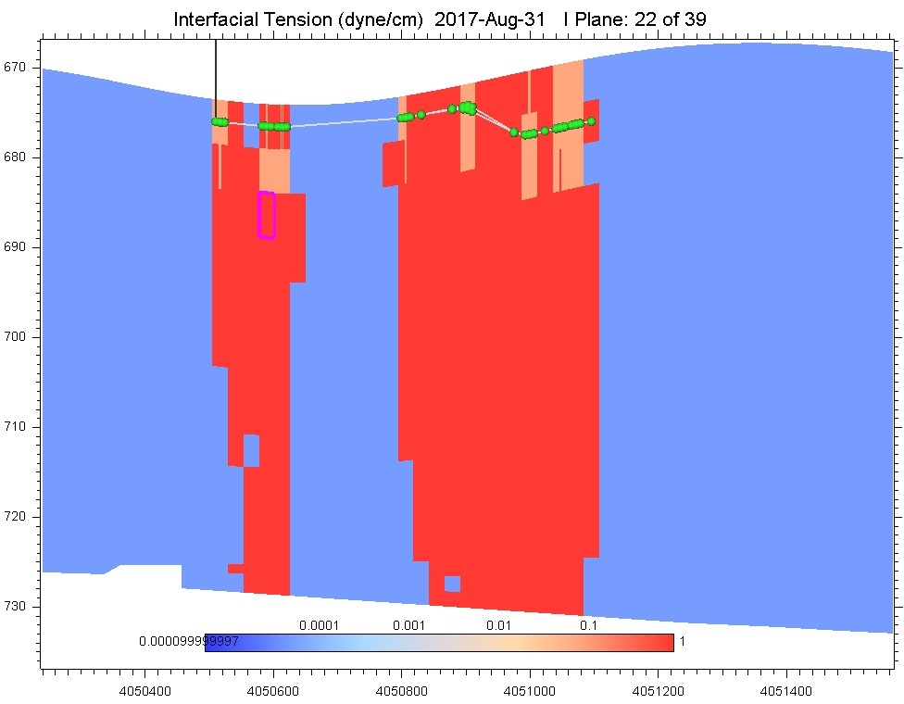
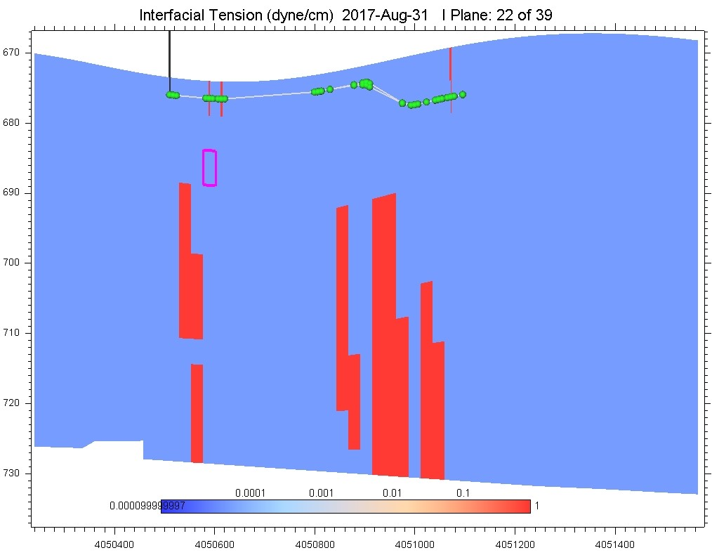
Why is rich gas better than lean gas?
Well placement designed for waterflood with prd at top and water inj at bottom
Rich gas MMP<lean gas MMP
Lean gas achieves miscibility at front and oil bank is displaced out of SRV
Rich gas achieves miscibility at tail and oil bank flows back more effectively
CH₄ injection
C₃H₈ injection

Slide 12
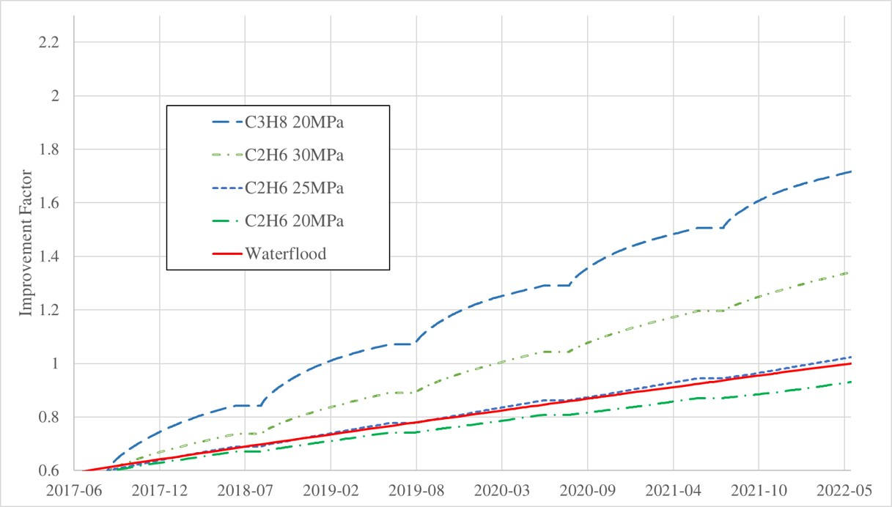
Effect of injection pressure
Higher the pressure, higher the oil rate;
But C₂H₆ @ 30MPa cannot surpass C₃H₈ @20MPa;
C₂H₆ has to >25MPa to achieve improvement;

Slide 13
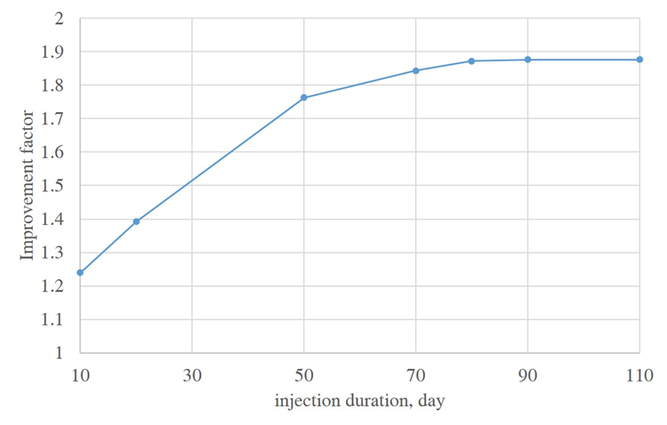
Effect of injection duration
At first, longer injection time leads to higher RF
Then it reaches a plateau with 80-day injection.
10-day inj; 10-day soaking; 340-day Prd;
20-day inj; 10-day soaking; 330-day Prd;
50-day inj; 10-day soaking; 300-day Prd;
70-day inj; 10-day soaking; 280-day Prd;
80-day inj; 10-day soaking; 270-day Prd;
90-day inj; 10-day soaking; 260-day Prd;
110-day inj; 10-day soaking; 300-day Prd;
C₂H₆, 8 cycles

Slide 14
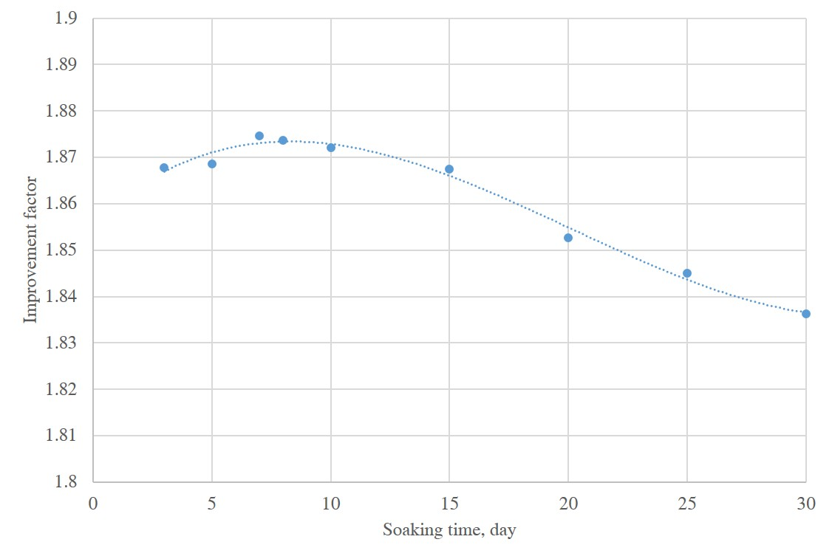
Effect of soaking duration
At first, longer soaking time leads to higher RF
Then starts to decline, maximum at 7-day soaking.
80-day inj; 3-day soaking; 277-day Prd;
80-day inj; 5-day soaking; 275-day Prd;
80-day inj; 7-day soaking; 273-day Prd;
80-day inj; 8-day soaking; 272-day Prd;
80-day inj; 10-day soaking; 270-day Prd;
80-day inj; 15-day soaking; 265-day Prd;
80-day inj; 20-day soaking; 260-day Prd;
80-day inj; 25-day soaking; 255-day Prd;
80-day inj; 30-day soaking; 250-day Prd;
C₂H₆, 8 cycles

Slide 15
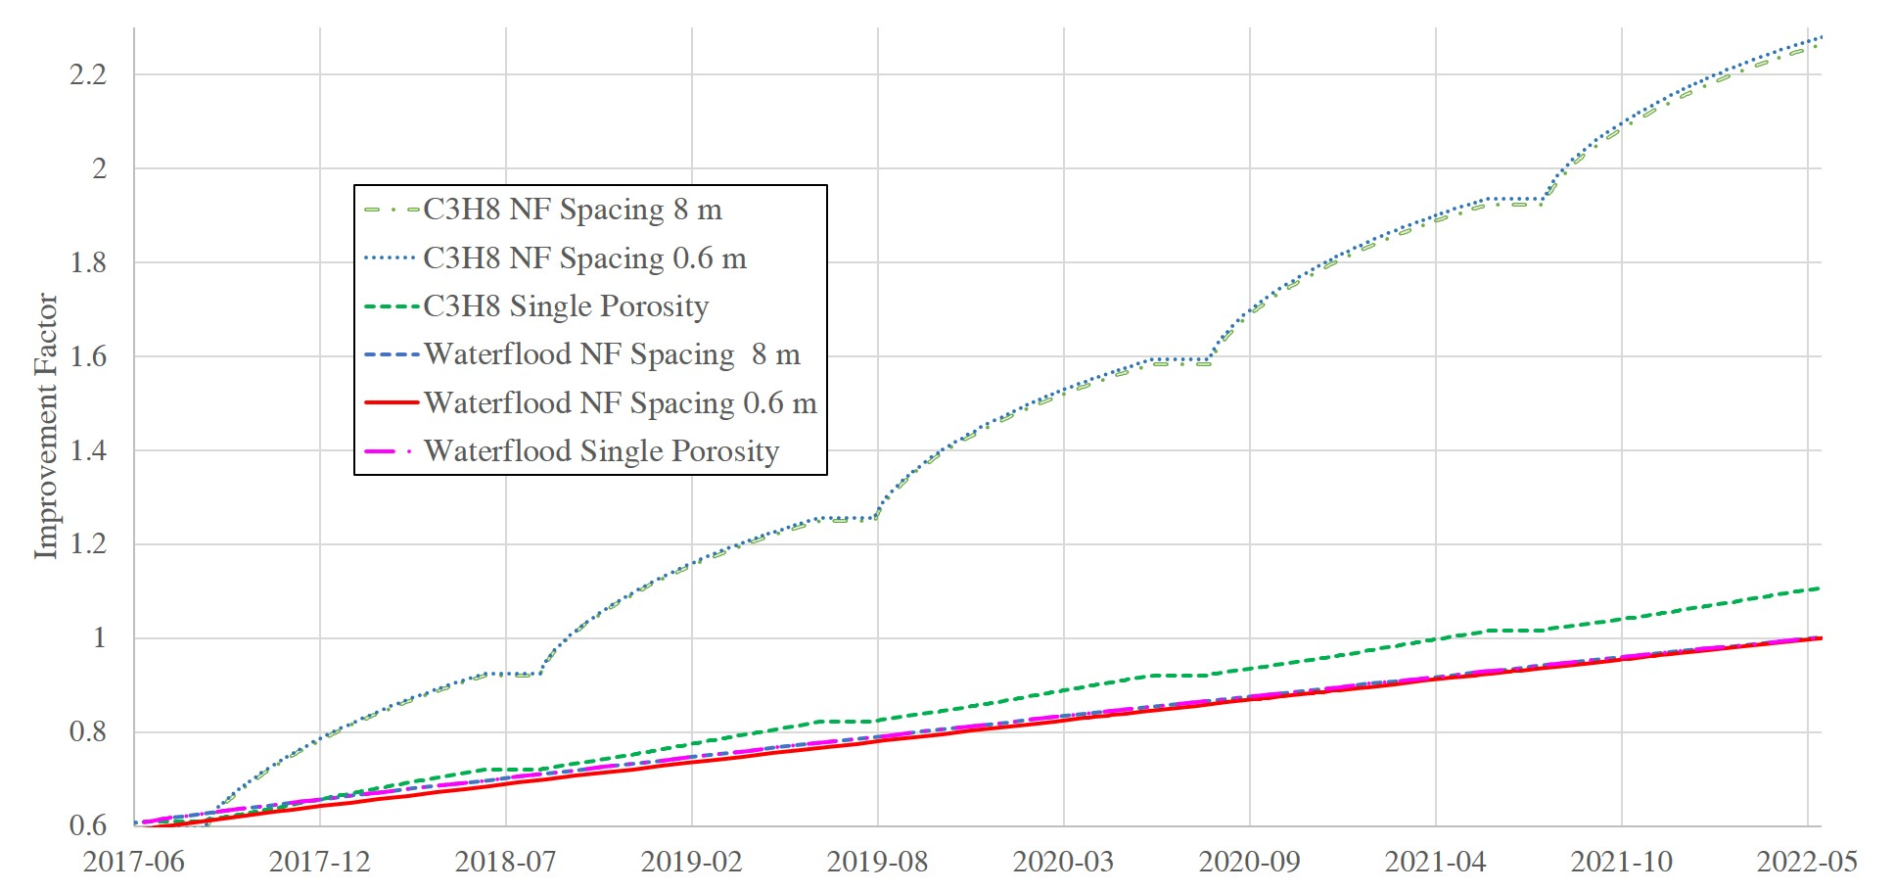
Effect of NF spacing
Base case uses 0.6 m. We then simulate 0.3, 8, ∞ m based on the published data
Using single porosity (NF spacing=∞) leads to little improvement even with C₃H₈
After re-history matching, difference is minor among 0.3, 0.6, 8m NF spacing
4. Hence using published NF data, we can confirm technical feasibility of rich gas injection
NF spacing from Liu (2010)
Well Name | NF spacing, m
Y284 | 0.3
Y414 | 0.4
Y286 | 0.5
Y411 | 0.7
Y287 | 1.3
Y293 | 1.4
Y285 | 3.3
Y295 | 4.3
Y290 | 7.7

Slide 16
Conclusions
We used a compositional framework to study gas injection feasibility in Changqing Oifield
For the first time, we confirm technical feasibility of rich gas injection in low-perm Chang 6₃
Such feasibility is impacted by the injectant composition and well placement design
CH₄ injection has a lower RF than waterflood, due to its high MMP
Rich gas works better with current well placement as miscible bank forms at injection tail
Huff-n-puff insensitive to uncertainties in NF spacing after history-matching BHP & water cut.
UNCONVENTIONAL RESERVOIR ENGINEERING PROJECT
Advisory Board Meeting, Spring, 2020, Golden, Colorado

Slide 17
Thanks for your attention.
Stay safe and productive!
Ye Tian, Ph.D. candidate
For more info: yetian@mines.edu
Or read: https://doi.org/10.1016/j.fuel.2020.117831
UNCONVENTIONAL RESERVOIR ENGINEERING PROJECT
Advisory Board Meeting, Spring, 2020, Golden, Colorado

