Slide 1
UNCONVENTIONAL RESERVOIR ENGINEERING PROJECT
Colorado School of Mines
U R E P
CSM
Simulation study of water cut surge after CO₂ injection in tight oil reservoirs
Chi Zhang
Ph.D. Student
Colorado School of Mines
UNCONVENTIONAL RESERVOIR ENGINEERING PROJECT
Advisory Board Meeting, Spring 2020, Golden, Colorado

Slide 2
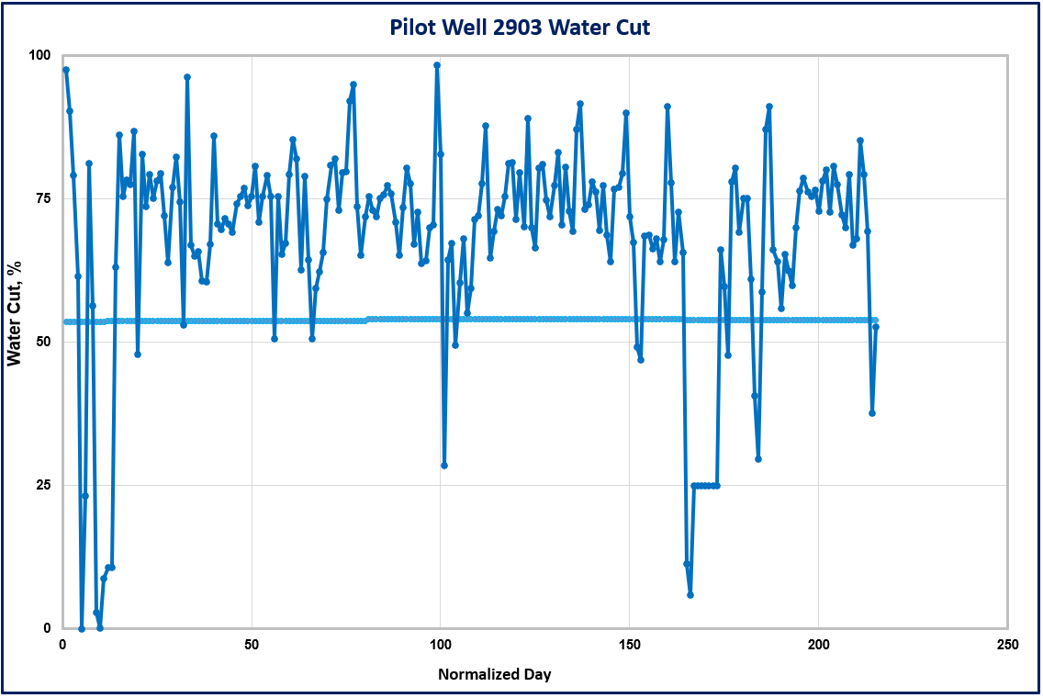
Problem Statement
Gas huff-n-puff in tight oil has shown successes in field pilots.
But elevated water cut is a challenge
To explore potential solutions, investigating the complex transport processes in tight reservoirs is needed.
Water cut response of one pilot well after HnP
UNCONVENTIONAL RESERVOIR ENGINEERING PROJECT
Advisory Board Meeting, Spring 2020, Golden, Colorado
Notes:
As we may know, Gas huff-n-puff in tight oil has shown successes in field pilots.
A recent CO2 huff-n-puff pilot implemented in the Midland Basin suggested a significant oil rate improvement, however, As shown in the left figure
an elevated water cut increase around 0.3.
To explore potential solutions, we need to investigate the complex transport processes in tight reservoirs

Slide 3
Problem Statement
CO₂ HnP in conventional all witness reduced water cut, except one case above MMP.
(Hsu & Brugman, 1986; Denoyelle & Lemonnier,1987; Torabi & Asghari, 2010; Abedini et al.,2014)
Possible reasons for elevated water cut
Bone Spring
(water-bearing)
Water flowback after massive fracturing (Pankaj et al. 2018)
High initial Sw in the Wolfcamp
Excessive fracture propagation (Pettit & Muirhea, 2016)
Injection above MMP (Monger & Coma, 1998)
HF reactivation due to gas injection
Wolfcamp
(Pettit & Muirhea, 2016)
UNCONVENTIONAL RESERVOIR ENGINEERING PROJECT
Advisory Board Meeting, Spring 2020, Golden, Colorado
Notes:
From the literature, we noticed CO₂ HnP in conventional reservoirs all witness reduced water cut, except one case above MMP
We also found following possible reasons for elevated water cut after CO₂ HnP in tight oil reservoirs:
Fracturing was performed in the wolfcamp, above it, there is a water-bearing layer, which is called
Researcher believed it was because of the excessive fracture propagation leads to the high water cut

Slide 4
Objective of Research
Establish fluid PVT and lab-scale model and tune to obtain the critical inputs for the compositional model.
Build a half-stage model of five fractures representing a typical completion design in the research area.
Identify several possible mechanisms on abnormal water cut behaviors
UNCONVENTIONAL RESERVOIR ENGINEERING PROJECT
Advisory Board Meeting, Spring 2020, Golden, Colorado
Notes:
In this study, we have three objectives

Slide 5
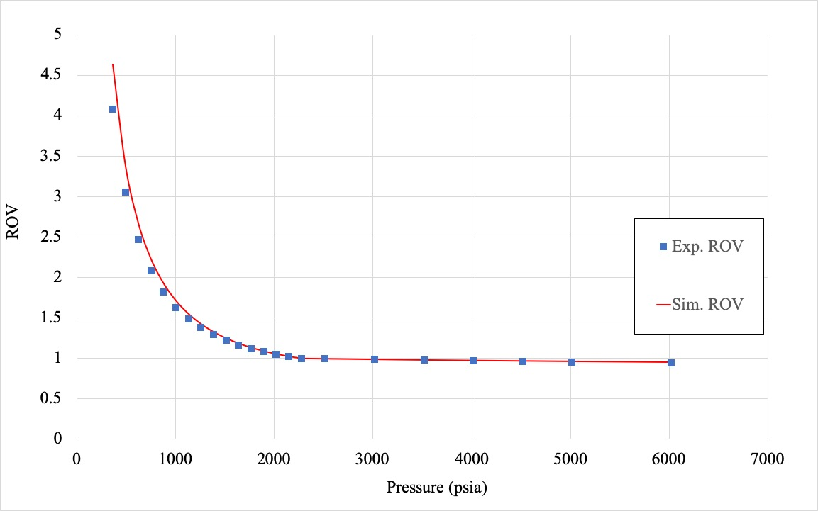
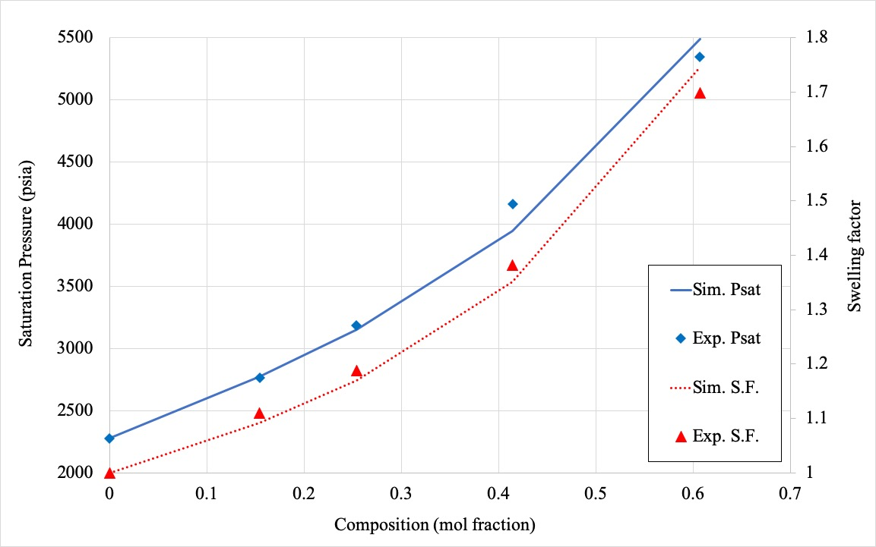
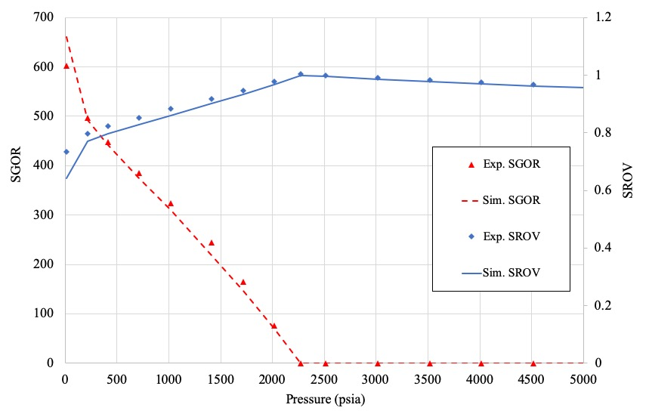
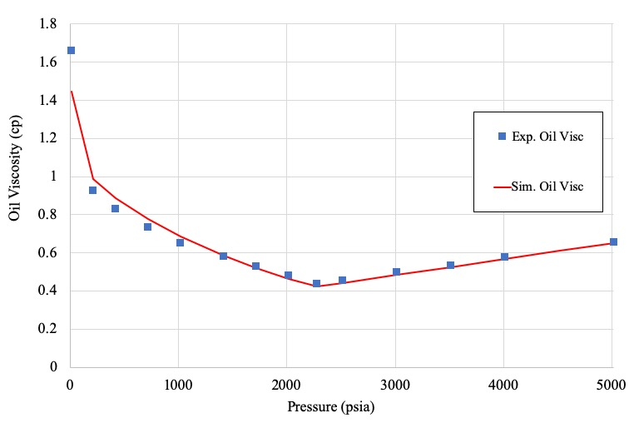
Results/Status
An 8-comp PVT model was established to match the lab results
(a) ROV from the CCE test
(b) Swelling test with the produced gas
(c) Differential liberation test
(d) Oil viscosity
UNCONVENTIONAL RESERVOIR ENGINEERING PROJECT
Advisory Board Meeting, Spring 2020, Golden, Colorado
Notes:
First, a fluid model was established based on the Peng-Robinson (PR) equation of state (EOS) with eight pseudo-components. Their thermodynamic properties were tuned to match the various experiment results, including the constant composition expansion (CCE), differential liberation, swelling test, and viscosity measurement. As shown in those four figures.
the calculated curves after regression by CMG-WinProp satisfactorily matched the original experimental data, which was provided by a third-party laboratory

Slide 6
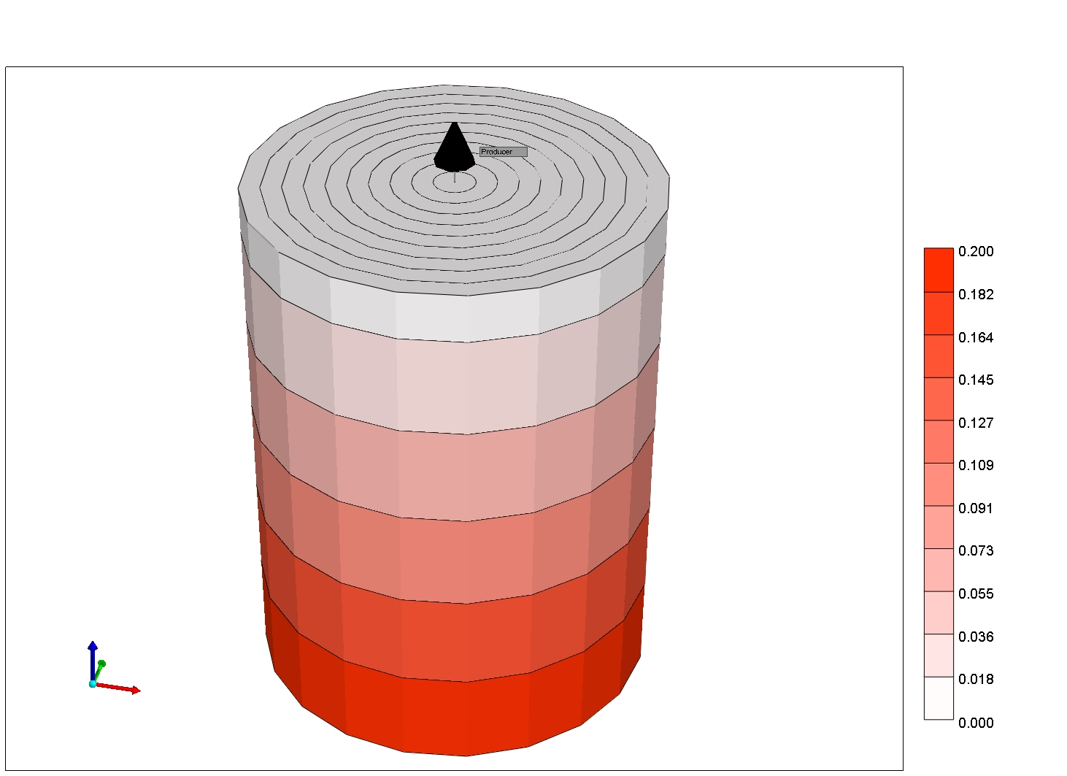
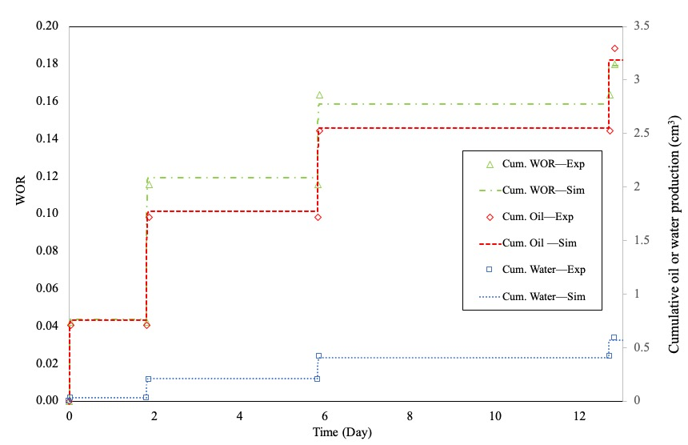
Results/Status
A lab-scale model was built to match the Lab data provided
History matching achieved by primarily tuning Kr and pore compressibility
Lab-scale model for gas HnP in the composite core
Matching the results of HnP experiments in the composite core
UNCONVENTIONAL RESERVOIR ENGINEERING PROJECT
Advisory Board Meeting, Spring 2020, Golden, Colorado
Notes:
Gas huff-n-puff lab tests were designed and conducted by our industry partner in a composite core
We then used a lab-scale cylindrical model to match the results of huff-n-puff experiments
There were 10 grids in the radial direction and 6 grids in the axial direction. The fluid model established earlier was used in this lab-scale compositional model.
The composite core consists of two plugs as shown in Figure 1.5.
The underlying five layers simulated the Wolfcamp shale core has the porosity 0.082 and the permeability 0.11 mD.
The first layer is A high permeability Berea sandstone core disk (𝑘 = 2200 mD, 𝜙 = 0.224), is stacked at the top shale core to represent a hydraulic fracture.
The system was first depleted to 600 psi (4.14 × 106 Pa) to simulate the primary production before the gas injection.
Gas (CH4) was then injected through top rock and pressurized the system to 4000 psi (2.76 × 107 Pa). The system was subsequently closed to simulate soaking processes and was depleted again to 600 psi (4.14 × 106 Pa) , representing the puff stage. The production stage stopped when no additional fluid could be produced.
History matching of the experimental results were then completed
Relative permeability curves of the low permeability rock representing matrix were tuned primarily to match the cumulative oil and water production
The underlying Wolfcamp shale core has a diameter of 2.11 inch (5.36 × 10−2 m) and a length of 2.57 inch (6.53 × 10−2 m). The porosity is 0.082 and the permeability is 0.11 mD.
A high permeability Berea sandstone core disk (𝑘 = 2200 mD, 𝜙 = 0.224), which has a diameter of 2.11 (5.36 × 10−2 m) inch and a length of 0.25 inch (0.64 × 10−2 m)

Slide 7
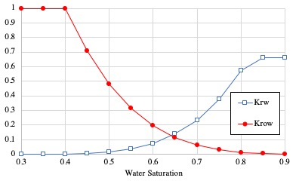
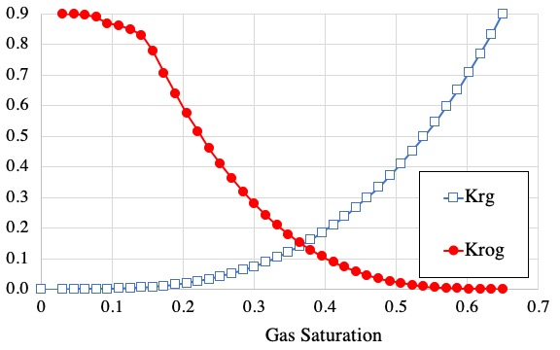
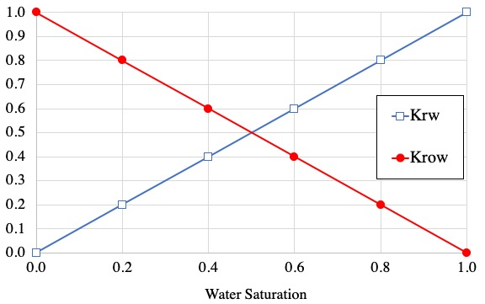
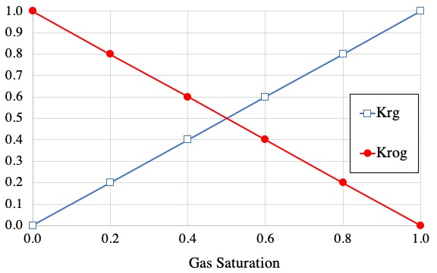
Results/Status
Water-oil kr curve
Liquid-gas kr curve
Water-oil kr curve
Liquid-gas kr curve
UNCONVENTIONAL RESERVOIR ENGINEERING PROJECT
Advisory Board Meeting, Spring 2020, Golden, Colorado
Notes:
The relative permeability curves for high permeability rock representing fractures were generated as straight lines by assuming negligible capillary pressures.
The final relative permeability curves that led to the best match are shown in. Matrix rock compressibility was also found important in the matching process and a final value of 5×10−6 psi−1 (7.25×10−10 Pa−1) was found to provide the best match.

Slide 8
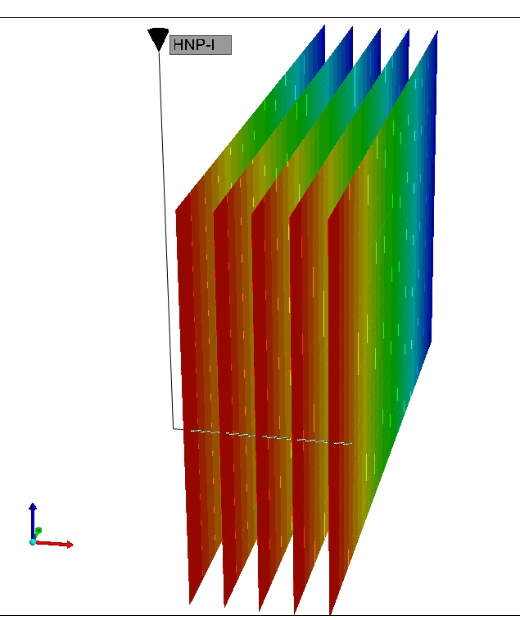
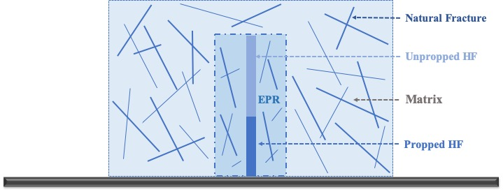
Results/Status
A half-stage model of five fracs representing a typical well design as base case
Injecting water with the same vol. of frac fluid to capture water cut peak due to flowback.
Half-stage model for fractured horizontal wells
Realization of the conceptual half-stage model in CMG
UNCONVENTIONAL RESERVOIR ENGINEERING PROJECT
Advisory Board Meeting, Spring 2020, Golden, Colorado
Notes:
As shown in left, Propped and unpropped hydraulic fracture, enhanced permeability region, and natural fracture and matrix were taken into consideration in the model, as shown in Figure
The dual permeability model was used to capture natural fracture networks. Within a hydraulic fracture, it is assumed that the fracture tip region is unpropped, therefore has a smaller conductivity (blue region

Slide 9
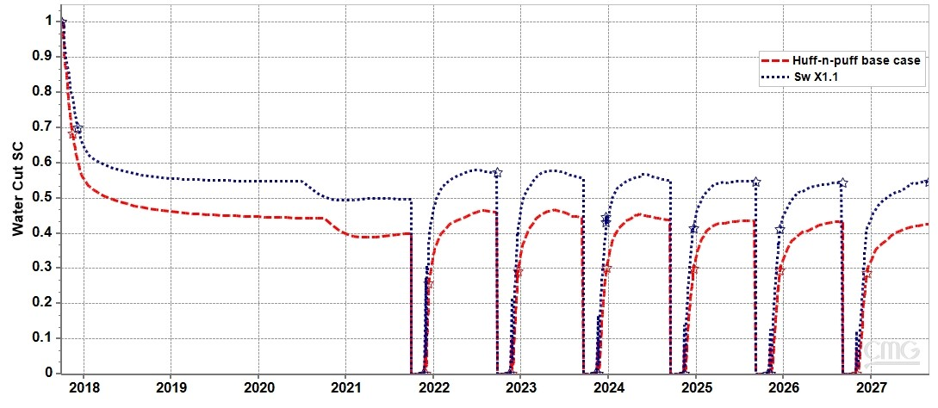
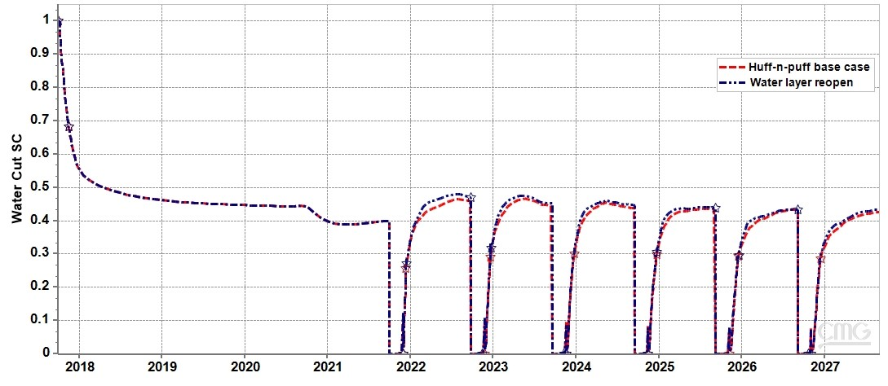
Water cut response before and after increasing Swi
Water cut response with and without the reactivation of NF
(NF perm increased from 0.025 to 0.25 md)
UNCONVENTIONAL RESERVOIR ENGINEERING PROJECT
Advisory Board Meeting, Spring 2020, Golden, Colorado
Notes:
The base model was established with six CO2 huff-n-puff cycles simulated
With respect to the water cut, red line, it initially reached a peak at 1.0 due to flowback, then it fell and remained almost constant as 0.39 which represented a typical water cut behavior during depletion.
For huff-n-puff, the water cut would start at a very low value as only CO2 was being produced when the well was first opened. It then would reach a peak as 0.47 in around 250 days and remain constant for the rest of the puff stage. With more cycles, the peak would gradually decrease but remain at a level still higher than the primary depletion
First, we assumed there were errors in the estimation of initial water saturation, and hence raised the initial water saturation 𝑆𝑤𝑖 of each layer by 10%.
The new water cut color by blue showed approximately a translation of 0.1 in vertical axis based on the previous curve as shown in Figure 1.19. But the trend still could not match the field observation as the water cut of primary depletion also witness and increase of 0.1.
Though initial water saturation could potentially impact water production, it might not be the main reason behind the above-mentioned abnormal water cut behaviors after huff-n-puff.
Then we simulated the reopening of several water bearing layers in the research area i.e. layer 9, 10, 11, and 12 by increasing the permeability of NF grid blocks from 0.025 mD (2.47 × 10−17 m2) to 0.25 mD (2.47 × 10−16 m2), on the assumption that natural fracture in these layers were reactivated due to gas injection. As shown in Figure 1.21, the water cut did increase, but the increase was minor and the peak value was still far lower than the observation from the field. Hence we do not recognize it as the major mechanism behind the surging water cut.

Slide 10
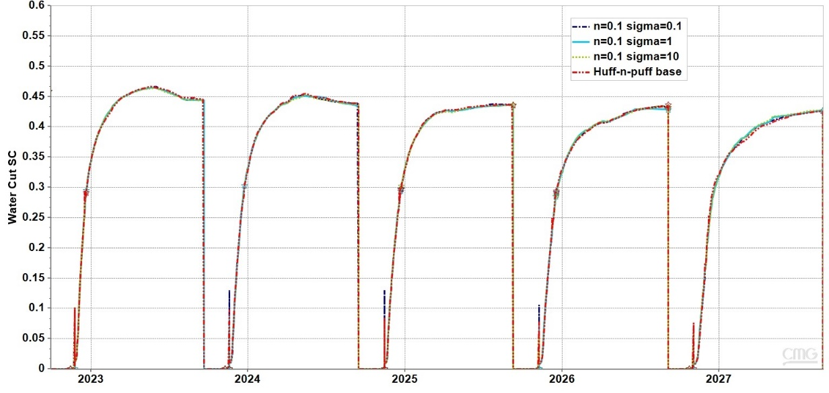
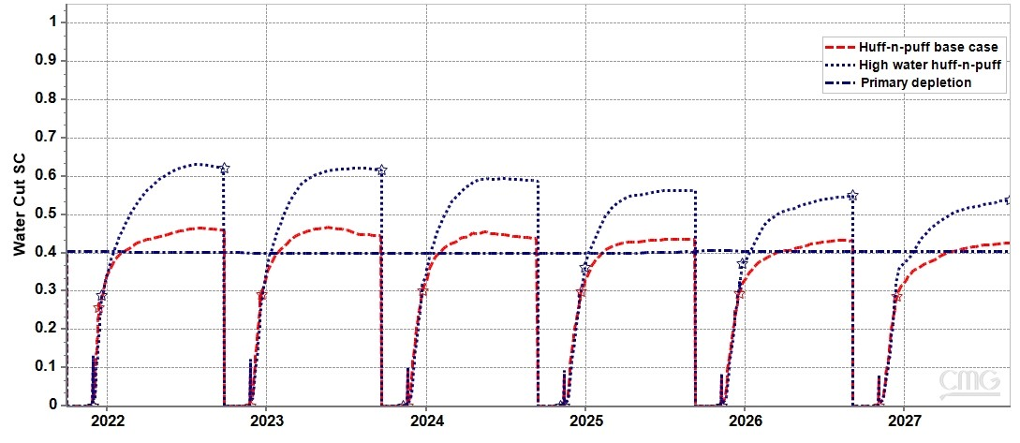
Results/Status
Water cut with different levels of IFT-dependent krog
Water cut response with and without reactivation of the unpropped HF
Matrix Kr to Fracture Kr
Field observation matched
UNCONVENTIONAL RESERVOIR ENGINEERING PROJECT
Advisory Board Meeting, Spring 2020, Golden, Colorado
Notes:
the effect of interfacial tension (IFT) on relative permeability is a very important mechanism for the dynamics between immiscible and miscible displacement, which is the case in this study.
The simulator (CMG-GEM) used in this study has an option of interpolating relative permeability curves as a function of IFT. The relative permeability curves for gas and oil will become linear functions of the respective saturations when the phases become nearly indistinguishable
We initially had expected a rising water cut behavior similar as the observed in the Wolfcamp CO2 huff-n-puff pilots. But as shown in Figure 1.20, the water cut increase was minor despite considering different levels of relative permeability’s dependency on IFT. One possible reason might be that only oil and gas phase relative permeability are treated as function of IFT, but the relative permeability to the water phase is not. Neither could the current model account for the dependency of water relative permeability on the water/oil or water/gas IFT. Hence future work on IFT-dependent water relative permeability might be required to further correlate the MMP with high water cut after CO2 injection.
Next, The injected CO2 in our case was in supercritical state under the injection pressure and in-situ [in'saitu:]temperature, and it might easily reopen the unpropped hydraulic fractures during huff-n-puff.
we hypothetically changed the relative permeability curve of unpropped fractures from the matrix type, as shown in Figure 1.8 to the fracture type, as shown in Figure 1.9, assuming that unpropped hydraulic fractures were reopened due to CO2 injection. Finally, we were able to obtain a relatively good match with field observations. As shown in Figure 1.22, the water cut did increase due to enhanced fractional flow of water, and the water cut reached a maximum as 0.63. which is close to the field observations.

Slide 11
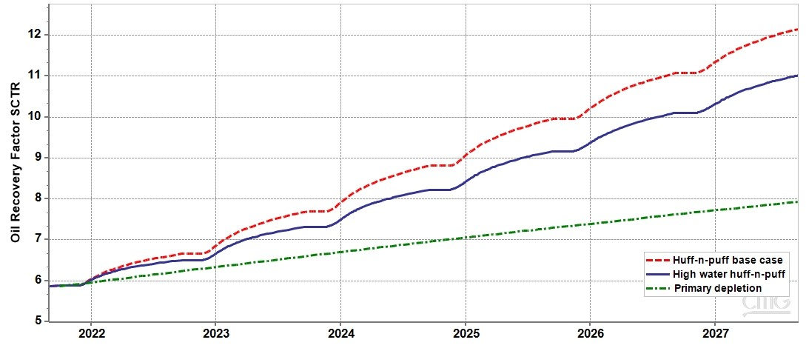
Results/Status
Improved oil RF from 7.96% of depletion to 12.16% after six cycles of CO2 huff-n-puff
Improvement factor 1.53 which matches the published results of gas EOR in unconventional reservoirs.
Comparison of recovery factors among three representative cases
UNCONVENTIONAL RESERVOIR ENGINEERING PROJECT
Advisory Board Meeting, Spring 2020, Golden, Colorado
Notes:
Figure 1.23 exhibits the different recovery factors among depletion, huff-n-puff base and huff-n-puff with high water cut. It is obvious excessive water production is detrimental and would reduce the RF from 12.16% to 11.02%.

Slide 12
Summary
A compositional modeling framework was established and implemented to investigate the reasons and the impact of the excessive water production during CO₂ huff-n-puff in tight oil reservoirs.
Fluid PVT and lab-scale model were established and tuned to match the experimental data. A half-stage model of five fractures representing a typical well design was then simulated as the base case.
Underestimation of Swi, IFT-dependent Kr, reactivation of water-bearing layers, and re-opening of un-propped HF on water-cut were all simulated. Our sensitivity studies based on simulation identified the re-opening of unpropped hydraulic fractures as the most plausible cause.
UNCONVENTIONAL RESERVOIR ENGINEERING PROJECT
Advisory Board Meeting, Spring 2020, Golden, Colorado
Notes:
providing the critical inputs for the compositional model.
https://authors.elsevier.com/a/1b4IP_KxNwDWNN/ 'plɔzəbl/

Slide 13
18
Thank you! Questions?
For more, please contact: chizhang1@mines.edu
Or visit: https://authors.elsevier.com/a/1b4IP_KxNwDWNN
UNCONVENTIONAL RESERVOIR ENGINEERING PROJECT
Advisory Board Meeting, Spring 2020, Golden, Colorado

