Slide 1
UNCONVENTIONAL RESERVOIR ENGINEERING PROJECT
Colorado School of Mines
U R E P
CSM
CO injection is being performed to check if it enhances the permeability of shale rock with high clay content
Experimental CO Injection Test in Shale Rock
Berk Coskuner, PhD. Student
Dr. Paul Trost, Mtarri
UNCONVENTIONAL RESERVOIR ENGINEERING PROJECT
Advisory Board Meeting, Spring 2020, Golden, Colorado

Slide 2
Problem Statement
Oil recovery from shale reservoirs is very low due to low permeability.
Due to the nature of shale rock, types of EOR techniques that can be applied are limited.
A recent field application of CO injection showed an enhancement in the permeability of the rock around the wellbore.
A laboratory experiment is required to verify the field application.
UNCONVENTIONAL RESERVOIR ENGINEERING PROJECT
Advisory Board Meeting, Spring 2020, Golden, Colorado

Slide 3
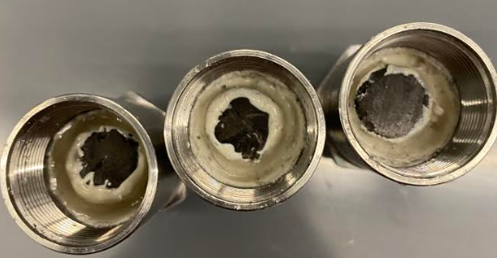
Scope of Research
We are testing rock samples from Niobrara formation.
We drilled cores with 0.5” diameter and 0.5” - 0.8” length.
The permeability of the cores are being measured by N₂ injection test.
It will be followed by CO injection for 2 days.
After soaking CO, the permeabilities will be remeasured to check if CO caused any change.
UNCONVENTIONAL RESERVOIR ENGINEERING PROJECT
Advisory Board Meeting, Spring 2020, Golden, Colorado

Slide 4
Chemical Background
CO is defined as a strong reducing agent, which reduces metal oxides (ferric oxide/hydroxide)
There is a significant amount of metal oxides in swelling clays. (bentonite, illite, montmorillonite etc.)
CO liberates water attached to the swelling clays and reduces their diameter. The permeability of the rock is hence enhanced.
Due to its smaller diameter compared to CO₂, it could easily penetrate to clay rich and lower perm. zones.
UNCONVENTIONAL RESERVOIR ENGINEERING PROJECT
Advisory Board Meeting, Spring 2020, Golden, Colorado
Notes:
Please add Paul’s patent number as a reference.

Slide 5
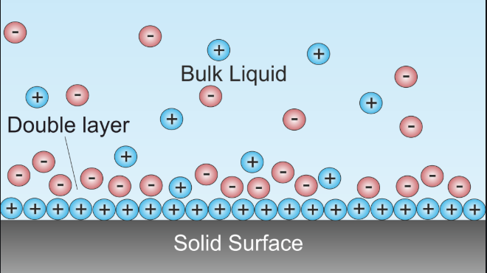
Chemical Background
The ferric oxides reside between clay platelets and also coating clay edges
Then the formation water is adsorbed on to the ferric oxide molecule.
Immobile water is tightly held then more layers of water are also bound to the ferric oxide
All this bound water protrudes into the pore throat blocking or nearly blocking the perm and resulting in clay swelling due to adsorbed waters.
UNCONVENTIONAL RESERVOIR ENGINEERING PROJECT
Advisory Board Meeting, Spring 2020, Golden, Colorado

Slide 6
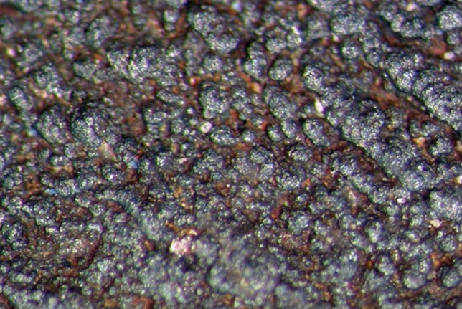
Chemical Background
CO molecules tend to react with the oxidized metal ions to reduce them; hence liberating water molecules.
CO goes thru the bound water to reduce the ferric ion to ferrous and form none-water adsorbing FeO a mineral known as wustite.
A chemical reaction representing the reduction of ferric oxide is given below. The reaction is thermodynamically favorable.
$$Fe{\left(OH\right)}_{3}∙nH_{2}O+CO →FeO+CO_{2}+2H_{2}O+H^{+}$$
Hence, the pore throat opens up increasing perm, and clays shrink.
UNCONVENTIONAL RESERVOIR ENGINEERING PROJECT
Advisory Board Meeting, Spring 2020, Golden, Colorado
Notes:
Please add Paul’s patent number as a reference.

Slide 7
Chemical Background
In addition to enhancement in the permeability, the CO lowers the interfacial tension.
Trost (2016) showed that even at atmospheric conditions, CO lowered the IFT by 15%.
Because at the atmospheric conditions the solubility of CO is highly lower than the solubility of CO in the reservoir conditions, it is expected to have higher decrease in the IFT in the reservoir conditions.
UNCONVENTIONAL RESERVOIR ENGINEERING PROJECT
Advisory Board Meeting, Spring 2020, Golden, Colorado
Notes:
Please add Paul’s patent number as a reference.

Slide 8
To Summarize..
We are working on a new experimental EOR study
It has already been proved that the CO injection EOR application is working in the field scale
The experiments are being run to validate the field application
We established a setup from the scratch and we are using it to run the experiments
The setup is identical to Ziming’s setup, we followed his procedure to create ours
We will share our results in the next UREP presentation
UNCONVENTIONAL RESERVOIR ENGINEERING PROJECT
Advisory Board Meeting, Spring 2020, Golden, Colorado
Notes:
Please add Paul’s patent number as a reference.

Slide 9
Thanks
UNCONVENTIONAL RESERVOIR ENGINEERING PROJECT
Advisory Board Meeting, Spring 2020, Golden, Colorado
Notes:
Please add Paul’s patent number as a reference.

