Slide 1
UNCONVENTIONAL RESERVOIR ENGINEERING PROJECT
Colorado School of Mines
U R E P
CSM
Research Summary
A Trilinear Hindered Transport Model
in Nanoporous Media
Tugce Calisgan, PhD Student
Colorado School of Mines
UNCONVENTIONAL RESERVOIR ENGINEERING PROJECT
Advisory Board Meeting, Spring 2020, Golden, Colorado

Slide 2
Summary
The initial production from tight-oil formations due to depletion of fracture network
Production slows down most of the oil is left in the matrix system
Understanding fluid retention mechanisms Design more efficient EOR techniques
Field and experimental evidence: Heavier HCs are filtered & retained in porous matrix - molecular sieving and adsorption
Flow cannot be appropriately modeled with advective transport only; hindrance transport needs to be incorporated
UNCONVENTIONAL RESERVOIR ENGINEERING PROJECT
Advisory Board Meeting, Spring 2020, Golden, Colorado

Slide 3
Summary
Ziming Zhu: Niobrara sample can sieve hydrocarbons
allows the lighter components flow
hinder the transport of heavier components
The impact of hindrance on production depends on the composition of hydrocarbons, pores surface chemistry, and the pores & pore-throat sizes.
Experimental observations indicate that CO₂ injection provides a means of reducing the hinderance effects and mobilizing heavier hydrocarbons into the oil stream.
Composition of reservoir oil and produced oil change as production continues & the effect of hindrance becomes noticeable at later times.
UNCONVENTIONAL RESERVOIR ENGINEERING PROJECT
Advisory Board Meeting, Spring 2020, Golden, Colorado

Slide 4
Summary
Hindered Transport Theory
When the sizes of HC molecules become comparable to the sizes of the pores, some molecules might be sieved and molecular motion can be hindered (Han et al., 2007).
Adsorption may also hinder transport by holding the liquid or gas molecules on the surface of the pores (Suzuki, M., 1990).
Components of Transport:
Advective (bulk) transport (larger pores, fractures, …)
Driven by pressure or concentration gradient
Darcy flow (normal diffusion)
Anomalous diffusion
Molecular Diffusion (nano- to micro-pores)
Driven by the thermal energy and concentration gradient
Single or multicomponent
Hindrance (nanopores and pore-throats)
Due to adsorption and molecular sieving
Selective adsorption
UNCONVENTIONAL RESERVOIR ENGINEERING PROJECT
Advisory Board Meeting, Spring 2020, Golden, Colorado

Slide 5
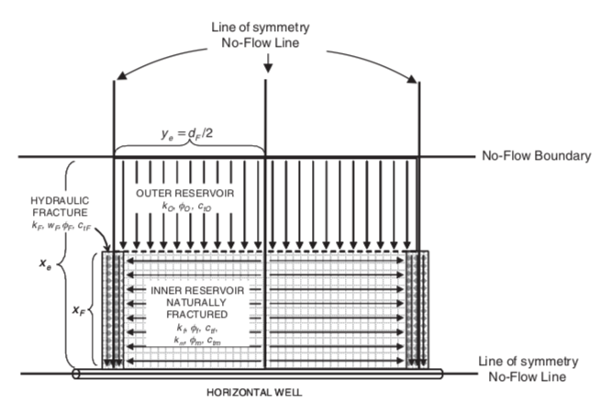
Scope of Research
Propose a mechanistic model, which couples advective flow in microscale pores & fractures with diffusion in nanoporous matrix, molecular sieving in pores and pore throats, and selective adsorption in matrix pore surfaces
The compositional hindered transport model is formulated in a trilinear flow setup for ease of demonstration and comparison with existing models.
Ozkan et al., 2011
UNCONVENTIONAL RESERVOIR ENGINEERING PROJECT
Advisory Board Meeting, Spring 2020, Golden, Colorado

Slide 6
Scope of Research
Trilinear Flow Model
Can be used as a quick EOR screening and assessment tool for fractured horizontal wells
Solves for 1D, hindered transport model for each flow region and couples them with pressure and flux continuity at the interfaces
Significance
Ozkan et al., 2011
The conventional EOR models focus on bulk flow mechanisms and bulk fluid properties. This may be acceptable for the fracture network & larger pores. However, the forces retaining fluids in the nanoporous matrix pores are mostly on the molecular level.
Hindered transport modeling approach differs from conventional models by focusing on the effect of EOR on the fluids retained in matrix.
UNCONVENTIONAL RESERVOIR ENGINEERING PROJECT
Advisory Board Meeting, Spring 2020, Golden, Colorado

Slide 7
Numerical Modeling
Inner Reservoir Solution (Naturally Fractured)
Single phase multicomponent 1-D continuity equation
Matrix flow equation
$$−∇∙{\left[{\vec{J}}_{o,c}+\left(z_{c}ξ_{o}{\vec{ν}}_{o}\right)\right]}_{m}−τ_{f/m,c}=\frac{∂}{∂t}{\left[ ∅\left(z_{c}ξ_{o}\right) \right]}_{m}+\frac{∂}{∂t}{\left[ A_{s} ρ a_{c}\left(1−e^{−m t_{a}}\right) \right]}_{m}+\frac{∂}{∂t}{\left[{ S}_{c,max} ∅_{m}\left(1−e^{−n t_{s}}\right) \right]}_{m}$$
Diffusional
flux
Advective
flux
Transfer function
Adsorption
Sieving
where,
Transfer function:
$$τ_{f/m,c}={\left(z_{c}ξ_{o}τ_{o}\right)}_{f/m}$$
$$τ_{o_{f/m}}=σ\frac{k_{m}}{μ_{o}}\left(p_{o_{m}}−p_{o_{f}}\right)$$
$${{{\vec{J}}_{o,c,m}=\vec{J}}_{o,c,m}}^{\left(x\right)}=−\frac{∅_{m}}{τ_{m}}\left(ξ_{o,m}\right)\sum_{d=1}^{nc}{D_{o,c,d,m} ∇z_{d}} ; c=1,2,…nc ;nc≥2$$
Molecular diffusion:
Effective binary diffusion coefficient:
$$D_{o,c,d,m}=D_{o,i,m}=\frac{1−z_{i}}{\sum_{j=1}^{nc}{\frac{z_{j}}{D_{ij}}}}$$
$$D_{ij}=1.8583x{10}^{−3} T \sqrt{T \left(\frac{1}{M_{i}}+\frac{1}{M_{j}}\right)} \frac{1}{p σ_{ij}^{2} Ω_{ij}}$$
Binary diffusivities:
where,
$σ_{ij}$ = collision diameter, $Å$
$Ω_{ij}$ = collision integral
Bird et al., 2002
UNCONVENTIONAL RESERVOIR ENGINEERING PROJECT
Advisory Board Meeting, Spring 2020, Golden, Colorado

Slide 8
Numerical Modeling
Inner Reservoir Solution (Naturally Fractured)
Single phase multicomponent 1-D continuity equation
Matrix flow equation
$$−∇∙{\left[{\vec{J}}_{o,c}+\left(z_{c}ξ_{o}{\vec{ν}}_{o}\right)\right]}_{m}−τ_{f/m,c}=\frac{∂}{∂t}{\left[ ∅\left(z_{c}ξ_{o}\right) \right]}_{m}+\frac{∂}{∂t}{\left[ A_{s} ρ a_{c}\left(1−e^{−m t_{a}}\right) \right]}_{m}+\frac{∂}{∂t}{\left[{ S}_{c,max} ∅_{m}\left(1−e^{−n t_{s}}\right) \right]}_{m}$$
Diffusional
flux
Advective
flux
Transfer function
Adsorption
Sieving
where,
Adsorption:
$$\frac{∂}{∂t}{\left[{ A}_{s} ρ a_{c}\left(1−e^{−m{ t}_{a}}\right) \right]}_{m}$$
$A_{s}$ = specific surface area of rock sample (from adsorption test), $m^{2}/g$
$ρ$ = density of rock sample, $g/m^{3}$
$a_{c}$ = $a_{max}$ = maximum adsorption capacity of rock sample for a specific component c (from molecular simulation), $mol/m^{2}$ … is a function of $p$ and $z_{c}$
$m$ = speed coefficient for adsorption (fitting parameter)
$t_{a}$ = time, recorded from the start of adsorption, $s$
* Molecular simulations indicate that it is quick to achieve adsorption equilibrium; $m$ is very large number. Therefore,
$\frac{∂}{∂t}{\left[{ A}_{s} ρ a_{c}\left(1−e^{−m{ t}_{a}}\right) \right]}_{m}$ = $\frac{∂}{∂t} {\left[{ A}_{s} ρ a_{c} \right]}_{m}$
UNCONVENTIONAL RESERVOIR ENGINEERING PROJECT
Advisory Board Meeting, Spring 2020, Golden, Colorado

Slide 9
Numerical Modeling
Inner Reservoir Solution (Naturally Fractured)
Single phase multicomponent 1-D continuity equation
Matrix flow equation
$$−∇∙{\left[{\vec{J}}_{o,c}+\left(z_{c}ξ_{o}{\vec{ν}}_{o}\right)\right]}_{m}−τ_{f/m,c}=\frac{∂}{∂t}{\left[ ∅\left(z_{c}ξ_{o}\right) \right]}_{m}+\frac{∂}{∂t}{\left[ A_{s} ρ a_{c}\left(1−e^{−m t_{a}}\right) \right]}_{m}+\frac{∂}{∂t}{\left[{ S}_{c,max} ∅_{m}\left(1−e^{−n t_{s}}\right) \right]}_{m}$$
Diffusional
flux
Advective
flux
Transfer function
Adsorption
Sieving
where,
Sieving:
$\frac{∂}{∂t}{\left[{ S}_{c,max} ∅_{m}\left(1−e^{−n t_{s}}\right) \right]}_{m}$
$S_{c,max}$ = maximum sieving capacity of component c in the fluid in a rock sample (fitting parameter), $mol/m^{3}$ (molar density of sieved component in pore fluid) … is a function of $p$ and $z_{c}$
$n$ = speed (kinetic) coefficient for sieving (fitting parameter)
$t_{s}$ = time, recorded from the start of sieving, $s$
* $n$ is probably a large number too. Therefore, by assuming it is a large value,
$$\frac{∂}{∂t}{\left[{ S}_{c,max} ∅_{m}\left(1−e^{−n t_{s}}\right) \right]}_{m}=\frac{∂}{∂t}{\left[{ S}_{c,max} ∅_{m} \right]}_{m}$$
UNCONVENTIONAL RESERVOIR ENGINEERING PROJECT
Advisory Board Meeting, Spring 2020, Golden, Colorado

Slide 10
Numerical Modeling
Inner Reservoir Solution (Naturally Fractured)
Single phase multicomponent 1-D continuity equation
Fracture flow equation
$$−∇∙{\left(z_{c}ξ_{o}{\vec{ν}}_{o}\right)}_{f} + τ_{f/m,c}=\frac{∂}{∂t}{\left[ ∅ \left(z_{c}ξ_{o}\right) \right]}_{f}$$
Transfer function
where
$$τ_{f/m,c}={\left(z_{c}ξ_{o}τ_{o}\right)}_{f/m}$$
UNCONVENTIONAL RESERVOIR ENGINEERING PROJECT
Advisory Board Meeting, Spring 2020, Golden, Colorado

Slide 11
Numerical Modeling
Inner Reservoir Solution (Naturally Fractured)
Multi-phase multicomponent 1-D continuity equation
Matrix flow equation
Transfer function
$$−∇∙{\left[{\vec{J}}_{c}+\left(x_{c}ξ_{o}{\vec{ν}}_{o}+y_{c}ξ_{g}{\vec{ν}}_{g}+w_{c}ξ_{w}{\vec{ν}}_{w}\right)\right]}_{m}− τ_{f/m,c}=\frac{∂}{∂t}{\left[∅\left(x_{c}ξ_{o}S_{o}+y_{c}ξ_{g}S_{g}+w_{c}ξ_{w}S_{w}\right)\right]}_{m}+\frac{∂}{∂t}{\left[A_{s}ρa_{c}\left(1−e^{−m t_{a}}\right)\right]}_{m}+\frac{∂}{∂t}{\left[S_{c,max} ∅_{m} \left(1−e^{−n t_{s}}\right)\right]}_{m}$$
Adsorption
Sieving
* For adsorption, gas phase is assumed to be in the middle of the pore
liquid phase is the only phase interacts with the pore wall
Fracture flow equation
$−∇∙{\left(x_{c}ξ_{o}{\vec{ν}}_{o}+y_{c}ξ_{g}{\vec{ν}}_{g}+w_{c}ξ_{w}{\vec{ν}}_{w}\right)}_{f} + τ_{f/m,c}=\frac{∂}{∂t}{\left[ ∅ \left(x_{c}ξ_{o}S_{o}+y_{c}ξ_{g}S_{g}+w_{c}ξ_{w}S_{w}\right) \right]}_{f}$
Transfer function
UNCONVENTIONAL RESERVOIR ENGINEERING PROJECT
Advisory Board Meeting, Spring 2020, Golden, Colorado

Slide 12
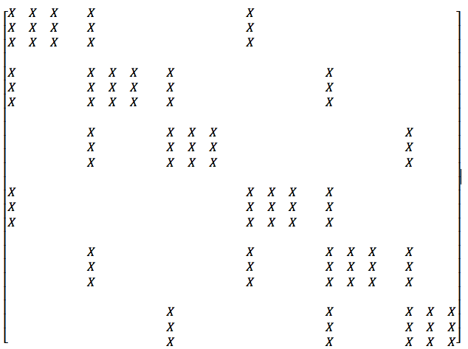
Numerical Modeling
Inner Reservoir Solution (Naturally Fractured)
Workflow
The unknowns: phase pressures ($p_{om},p_{of}$..) and overall compositions ($z_{cm},z_{cf}$)
phase saturations & liquid-vapor-water phase compositions
Compositional model formulation: implicit pressure and overall compositions, explicit saturations (IMPES - similar to Eker, I., 2018)
Workflow: Solve for pressures and overall compositions
Flash overall compositions and pressure at fixed T to obtain liquid-vapor phase compositions ($x_{1}, x_{2},… y_{1}, y_{2},… , L, V$)
Solve for phase saturations
The incident matrix representation for a 1D dual-porosity 3 grids & 3-components system:
MATRIX
FRACTURE
UNCONVENTIONAL RESERVOIR ENGINEERING PROJECT
Advisory Board Meeting, Spring 2020, Golden, Colorado

Slide 13
Status
Inner Reservoir Solution (Naturally Fractured)
Single- & Multi-phase dual porosity fluid flow equations w/ molecular diffusion, adsorption, and sieving formulized & discretized
Single-phase DP compositional solution in progress
Ozkan et al., 2011
*Currently, numerical solution is in progress for inner reservoir only; will be extended to the other flow regions, outer reservoir and hydraulic fracture.
UNCONVENTIONAL RESERVOIR ENGINEERING PROJECT
Advisory Board Meeting, Spring 2020, Golden, Colorado

Slide 14
Questions?
Thank you
UNCONVENTIONAL RESERVOIR ENGINEERING PROJECT
Advisory Board Meeting, Spring 2020, Golden, Colorado

