Slide 1
UNCONVENTIONAL RESERVOIR ENGINEERING PROJECT
Colorado School of Mines
U R E P
CSM
CO₂, CH₄, C₁₇H₃₆ and C₁₀H₂₂ molecules were simulated in a calcite pore to obtain their adsorption coefficients
Adsorption of Hydrocarbons on a Calcite Wall by MD Simulation
Berk Coskuner, PhD. Student
UNCONVENTIONAL RESERVOIR ENGINEERING PROJECT
Advisory Board Meeting, Spring 2020, Golden, Colorado
Notes:
I think calcite is better.

Slide 2
Problem Statement
Zhu et al. (2019) showed that long chained hydrocarbon molecules are hindered in a shale rock.
To include the hinderance effect in a simulator, T. Calisgan and Z. Zhu are developing numerical simulations that can predict adsorption and sieving behaviors of molecules in cores / reservoirs
For this purpose, at a certain temperature, an empirical equation for adsorption is required to get the derivative of the adsorption with respect to pressure.
On the other hand, Ziming is running experiments to see the differences between CO₂ and CH₄ EOR applications.
To contribute to his results, we run 2 identical hydrocarbon mixture simulations. In one of them we presented CO₂ and in the other one we presented CH₄ and checked the changes in the adsorptions of the H.C. on a calcite surface.
UNCONVENTIONAL RESERVOIR ENGINEERING PROJECT
Advisory Board Meeting, Spring 2020, Golden, Colorado

Slide 3
Scope of Research
We are working on the development of empirical equations for adsorption of carbon dioxide (CO₂) and methane (CH₄) on calcite wall, which are presented in a decane (C₁₀) and heptadecane (C₁₇) mixture separately.
Gromacs (a molecular dynamics simulator) is used for this purpose.
We used the high performance computers at Mines.
UNCONVENTIONAL RESERVOIR ENGINEERING PROJECT
Advisory Board Meeting, Spring 2020, Golden, Colorado
Notes:
I suggest to use C10/C17 instead of DEC/HTP.

Slide 4
Approach
CO₂, C₁₀, C₁₇ MIXTURE
CHANGE THE NUMBER OF CO₂ MOLECULES ONLY
KEEP THE MOLE FRACTIONS CONSTANT BY CHANGING THE NUMBER OF EVERY MOLECULE TYPE AT THE SAME RATIO
CH₄, C₁₀, C₁₇ MIXTURE
CHANGE THE NUMBER OF CH₄ MOLECULES ONLY
KEEP THE MOLE FRACTIONS CONSTANT BY CHANGING THE NUMBER OF EVERY MOLECULE TYPE AT THE SAME RATIO
Color Code
Completed
In progress (some results are presented)
Not started
UNCONVENTIONAL RESERVOIR ENGINEERING PROJECT
Advisory Board Meeting, Spring 2020, Golden, Colorado

Slide 5
Approach
We followed the same procedure for CO₂ and CH₄. To keep it simple, below we only explain the procedure for CO₂.
For this mixture, we run two different simulations, at first we had a constant number of C₁₀ and C₁₇, but changing number of CO₂ to control the pressure.
In the second one, we kept the mole fraction constant and changed the number of each molecule type at a same ratio to control the pressure.
The first one tells us how does the adsorption changes with addition of CO₂, whereas the second one shows how does the adsorption change with respect to the pressure only.
UNCONVENTIONAL RESERVOIR ENGINEERING PROJECT
Advisory Board Meeting, Spring 2020, Golden, Colorado

Slide 6
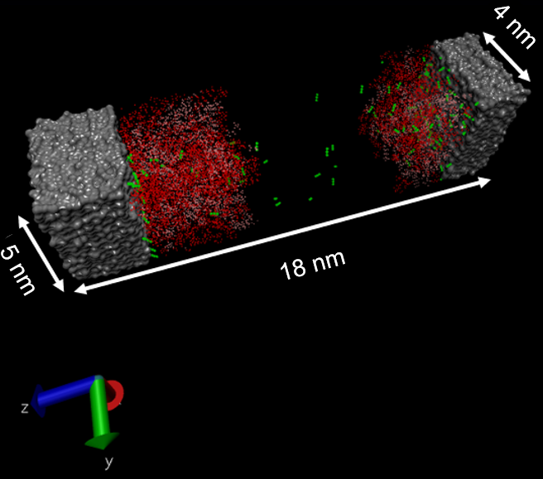
Simulation Details
Changing Number of CO₂
Constant Mole Fraction
Number of molecules
260 C₁₀
65 C₁₇
50 to 1100 CO₂/CH₄ molecules (50, 100,150, … 1050, 1100)
Mole fraction
0.28 C₁₀
0.07 C₁₇
0.65 CO₂/CH₄
Temperature: 300 K
Simulated for 3000 picoseconds (3 ns)
Fluid in between two calcite sheet
In the figure, the green, red and pink molecules represent CO₂, C₁₀ and C₁₇ respectively. The grey surfaces are the calcite walls.
UNCONVENTIONAL RESERVOIR ENGINEERING PROJECT
Advisory Board Meeting, Spring 2020, Golden, Colorado

Slide 7
Simulation Details
CO2 molecules in this void space are in gas phase. To calculate the pressure of CO2, we captured it’s density in this volume and read the pressure from the density vs pressure graph of CO2.
The graph below is constructed by using the EOS.
From: nist.gov
UNCONVENTIONAL RESERVOIR ENGINEERING PROJECT
Advisory Board Meeting, Spring 2020, Golden, Colorado

Slide 8
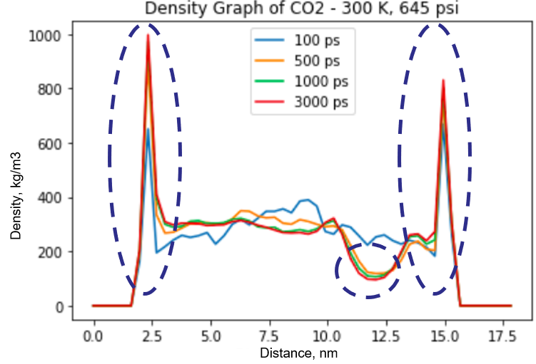
Results: CO₂ (Changing # of CO₂)
The figures represent results of 1 single simulation (at 300 K and 645 psi)
The graph shows the distribution of the density of CO₂ along the simulation box (figure below) at different time steps.
One can see that as the time steps approach to 3000 ps, the density stabilizes.
To get the density of CO₂ adsorbed on the CaCO₃ wall at 645 psi and 300 K, we take the average of the densities on each surfaces.
UNCONVENTIONAL RESERVOIR ENGINEERING PROJECT
Advisory Board Meeting, Spring 2020, Golden, Colorado

Slide 9
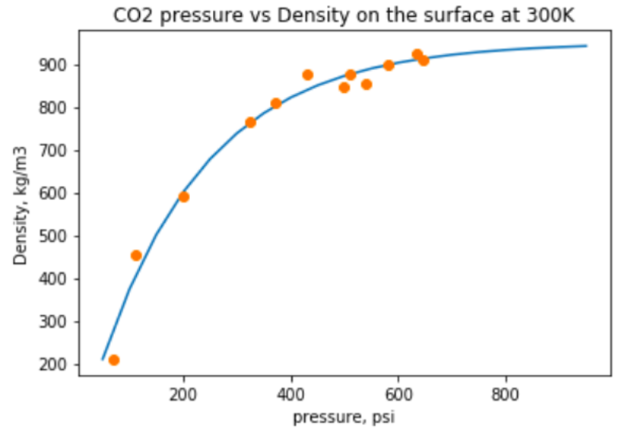
Results: CO₂ (Changing # of CO₂)
Running the simulation at different pressures and capturing the density data of adsorbed CO₂ molecules on the CaCO₃ surface, we get the following graph.
The orange dots represent the results of each MD simulation.
The blue line is the equation that we fit on the dots.
$y=A∗\left(1−e^{−B∗pressure}\right)$
A = 950 kg/m³
B = 0.005 psi⁻¹
UNCONVENTIONAL RESERVOIR ENGINEERING PROJECT
Advisory Board Meeting, Spring 2020, Golden, Colorado
Notes:
Why density is in the unit of kg/m^3 not kg/m^2?
Can you add C10 on the wall and C17 on the wall as well?

Slide 10
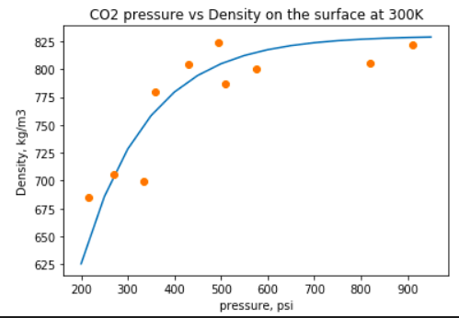
Results: CO₂ (Constant Mole Fraction)
To increase the pressure, the number of molecules of each component is increased at the same ratio.
The orange dots represent the results of each MD simulation.
The blue line is the equation that we fit on the dots.
$y=A∗\left(1−e^{−B∗pressure}\right)$
A = 830 kg/m³
B = 0.007 psi⁻¹
UNCONVENTIONAL RESERVOIR ENGINEERING PROJECT
Advisory Board Meeting, Spring 2020, Golden, Colorado
Notes:
Why density is in the unit of kg/m^3 not kg/m^2?
Can you add C10 on the wall and C17 on the wall as well?

Slide 11
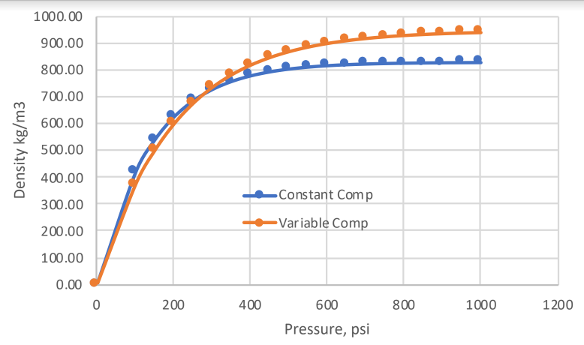
Results: Constant vs. Variable Composition
The graph compares the equations that we matched to the adsorption data from the MD simulations. The results suggest a significant difference between two approaches.
To get the derivative of adsorption with respect to pressure only, we’ll use constant composition results.
To check the results of CO₂ injection experiments, we’ll use the variable compositions results, at which the number of CO₂ molecules only were increased to pressurize the system, and the # of hydrocarbons were not changed.
$y=950∗\left(1−e^{−0.005∗p}\right)$
$y=830∗\left(1−e^{−0.007∗p}\right)$
UNCONVENTIONAL RESERVOIR ENGINEERING PROJECT
Advisory Board Meeting, Spring 2020, Golden, Colorado
Notes:
Why density is in the unit of kg/m^3 not kg/m^2?
Can you add C10 on the wall and C17 on the wall as well?

Slide 12
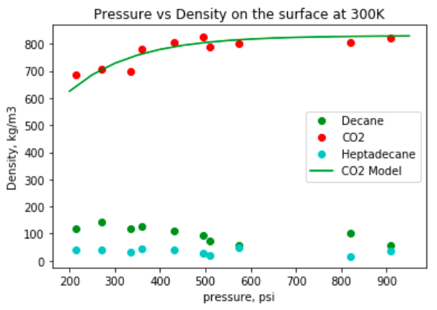
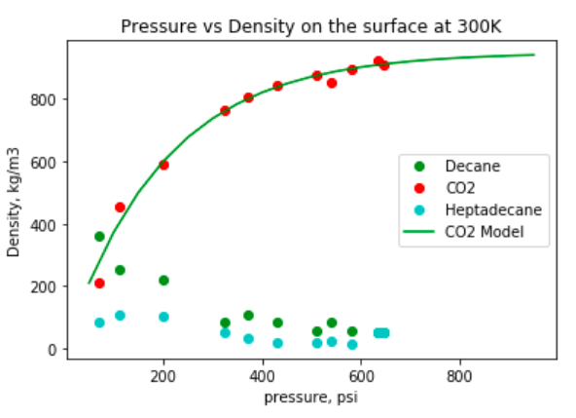
Results: Constant vs. Variable Composition
The graphs compare the adsorption of different types of molecules in constant composition and constant variable simulation cases.
It’s observed that in both scenarios, CO₂ adsorption is significantly higher than the hydrocarbon adsorptions because of its affinity to calcite surface.
As pressure increases the hydrocarbon molecules are replaced by CO₂ molecules. Hence, the number of adsorbed CO₂ molecules increases, whereas the number of adsorbed hydrocarbon molecules decreases.
$y=830∗\left(1−e^{−0.007∗p}\right)$
$y=950∗\left(1−e^{−0.005∗p}\right)$
UNCONVENTIONAL RESERVOIR ENGINEERING PROJECT
Advisory Board Meeting, Spring 2020, Golden, Colorado
Notes:
Why density is in the unit of kg/m^3 not kg/m^2?
Can you add C10 on the wall and C17 on the wall as well?

Slide 13
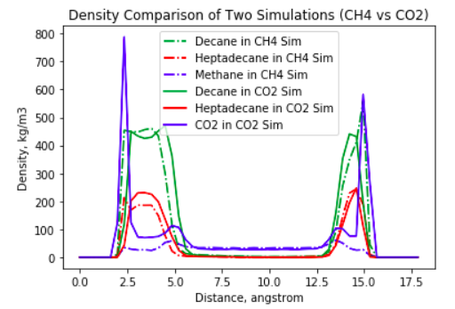
Results: CO₂ vs CH₄
The graph shows the results of two different simulations at 200 psi 300K.
1st simulation contains decane, heptadecane and methane. (Represented by solid lines)
2nd simulation contains decane heptadecane and carbon dioxide. (Represented by dashed lines)
To visualize it better, we put an illustration of the simulation box under the graph. The x axis of the simulation box is visually adjusted to make it identical to the x axis of the graph, for a better vision.
Distance, nm
Calcite walls
UNCONVENTIONAL RESERVOIR ENGINEERING PROJECT
Advisory Board Meeting, Spring 2020, Golden, Colorado
Notes:
Why density is in the unit of kg/m^3 not kg/m^2?
Can you add C10 on the wall and C17 on the wall as well?

Slide 14
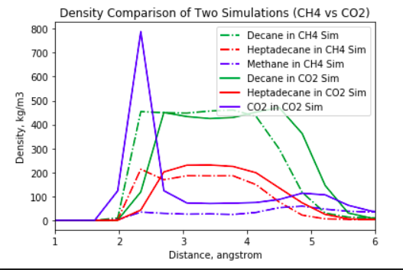
Results: CO₂ vs CH₄
Dashed blue line (1st simulation) shows the adsorption of CH₄, which is replaced by CO₂ in the second simulation (solid blue line).
The presence of CO₂ swept the hydrocarbons from the calcite wall (See black lines) due to its high adsorption on the surface. We did not observe such a phenomenon in the 1st simulation.
UNCONVENTIONAL RESERVOIR ENGINEERING PROJECT
Advisory Board Meeting, Spring 2020, Golden, Colorado
Notes:
Why density is in the unit of kg/m^3 not kg/m^2?
Can you add C10 on the wall and C17 on the wall as well?

Slide 15
Conclusion & Future Work
So far:
We run MD simulations to capture the adsorption vs pressure graph of CO₂, CH₄, C₁₇H₃₆ and C₁₀H₂₂ .
We completed simulations of CO₂ at constant mole fraction and changing mole fraction cases.
We investigated the effect of the composition and the pressure on the adsorption.
Adsorption coefficients are captured and an empirical model developed.
Effect of CO₂ and CH₄ on the adsorptions of other hydrocarbon molecules are compared.
Next:
We will complete the remaining simulations that are proposed in this presentation.
We are working on an MD simulation of a real oil composition used by Ziming in his experiments.
UNCONVENTIONAL RESERVOIR ENGINEERING PROJECT
Advisory Board Meeting, Spring 2020, Golden, Colorado

Slide 16
Future Work Initial Results
Model setup
Niobrara pore – calcite wall, slit geometry
Niobrara oil - simplified, 4 components
OPLS-AA force field for hydrocarbons
TraPPE force field for $CO_{2}$
5 nanoseconds
300 K
Simulated in GROMACS 2020.1
Configuration of the Niobrara oil molecules and the calcite walls in the simulation box.
UNCONVENTIONAL RESERVOIR ENGINEERING PROJECT
Advisory Board Meeting, Spring 2020, Golden, Colorado

Slide 17
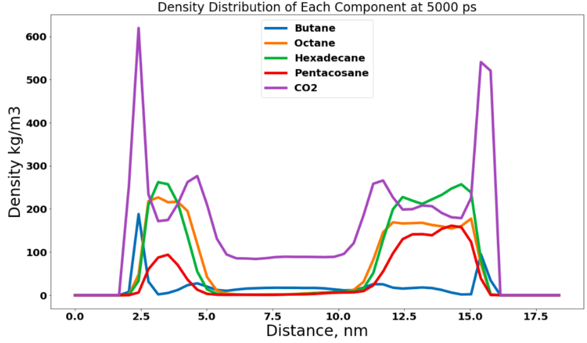
Future Work Initial Results
Observations
CO₂ molecules sweep adsorbed hydrocarbon molecules from calcite surface.
CO₂ molecules adsorb to calcite surface.
butane molecules (representative of light hydrocarbon group) show an excess near the walls (now mostly occupied by CO₂).
support the experimental observation that CO₂ is able to alleviate selective hindrance that occurred during flow of crude oil in Niobrara shale.
UNCONVENTIONAL RESERVOIR ENGINEERING PROJECT
Advisory Board Meeting, Spring 2020, Golden, Colorado

Slide 18
THANK YOU
UNCONVENTIONAL RESERVOIR ENGINEERING PROJECT
Advisory Board Meeting, Spring 2020, Golden, Colorado

