Slide 1
CO₂-Mediated Decane Transport in Nanopores
Rui Qiao
Laboratory of Transport Phenomena for Advanced Technologies
Department of Mechanical Engineering
Virginia Tech
Notes:
Rui Qiao
Email: ruiqiao@vt.edu
Web: http://www.me.vt.edu/people/faculty/rui-qiao/

Slide 2
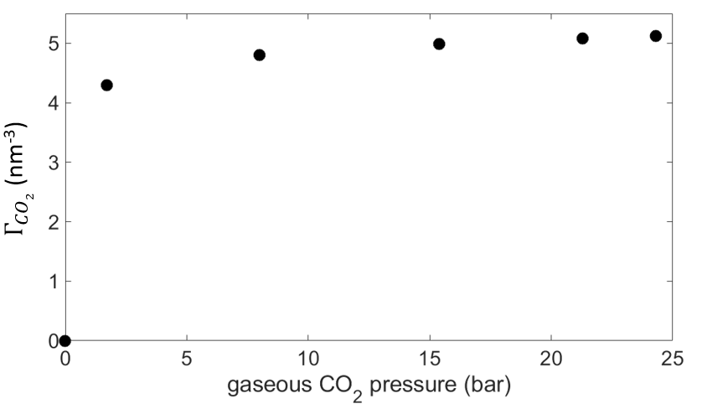
Interfacial effects in CO₂-based EOR
Question
How do CO₂ molecules adsorbed on pore walls affect the permeation of oil through nanometer-wide pores?
Motivation
The transport of nanoconfined fluids is modulated by their confining surfaces
CO₂ molecules adsorb profusely on many mineral surfaces
significant surface coverage even when CO₂ density in bulk is very low
The adsorbed CO₂ molecules change the nature of pore walls seen by oil molecules
gaseous CO₂
liquid C10
CO₂ adsorption isotherm at calcite-C10 interfaces

Slide 3
Simulation system and methods
System
8nm-wide calcite pore + C10 + CO₂
well-defined interfacial CO₂ density
Methods
molecular dynamics simulations
drive oil transport by applying a horizontal acceleration a_{x}
velocity embedding technique
upscale MD velocity profile in 8nm-pores to wider pores
compute pore permeability $k$ from velocity and density profiles
virtual graphene layer
CO₂
$$a_{x}$$
CO₃²⁻
$w$ = 8 nm
Ca²⁺
C₁₀H₂₂
$k=\dot{m}\overline{μ}/{\overline{ρ}}^{2}w_{e}a_{x}$
$\dot{m}=\int_{0}^{w}{ρ_{c10}(z)u(z)dz}$
z
y
virtual graphene layer
x
$k\sim function(Γ_{CO2},pore width$)
Notes:
Care was taken to ensure the position of the virtual plane does not affect the density and velocity profiles.

Slide 4
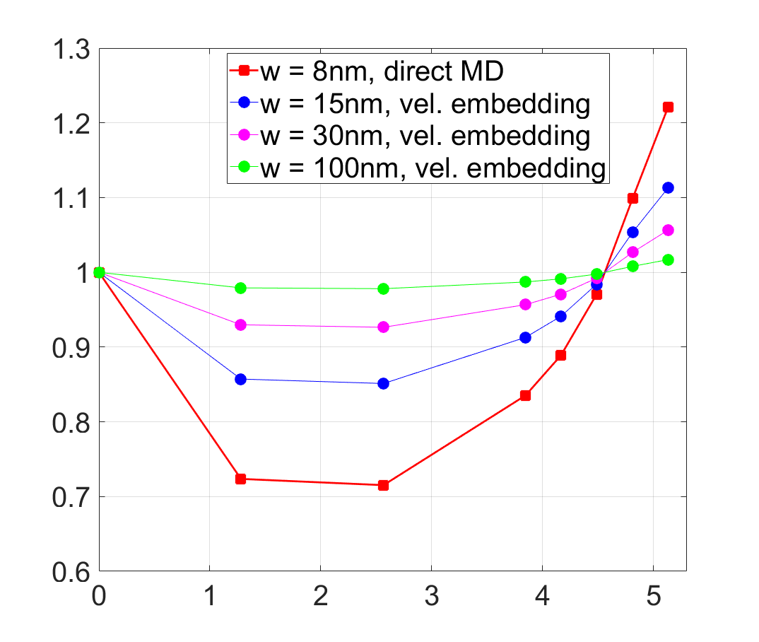
Permeability: Impediment vs. Enhancement
Considerable effects in 8nm-pore
Impediment up to ~30%
enhancement up to ~22%
Effects depend on pore size
stronger in narrower pores
weaker in wider pores
becomes <5% only if $w_{e}>30$nm
$$k(Γ)/k(0)$$
$Γ_{CO2}$ (nm⁻²)

Slide 5
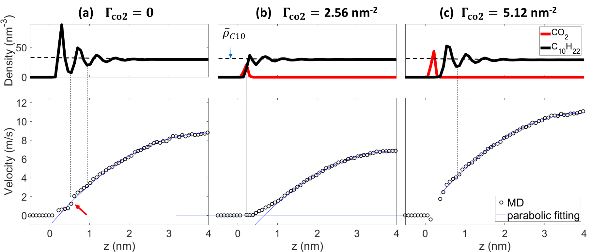
Hydrodynamic mechanisms
slow 1st C10 layer
slippage between the 1st and 2nd C10 layers
Immobile 1st C10 layer
no slippage between C10 layers
Slippage between CO₂ and 1st C10 layer
no slippage between C10 layers

Slide 6
Molecular mechanisms
C10 adsorbed on calcite in a co-planar manner
Little mixing between 1st and 2nd C10 layers
2nd
1st
1st C10 layer intercalates into the coarse CO₂ layer well
Excellent mixing between 1st and 2nd C10 layers
2nd
1st
1st C10 layer does not inter-calate into the dense CO₂ layer
Good mixing between 1st and 2nd C10 layers
2nd
1st

Slide 7
Conclusions
Interfacial CO₂ can impede/enhance oil transport by 5-30% in 8-30nm-wide pores → important in unconventional reservoirs
Adsorption of CO₂ on pore walls → molecular structure of interfacial oil molecules → liquid-solid slippage and interlayer slippage → oil transport in nanopores
Newsletters for pore-scale research on oil & gas recovery
CO₂-based enhanced oil recovery
Low-salinity waterflooding – 1
Low-salinity waterflooding – 2
Machine learning
Notes:
Therefore this is relevant to unconventional reservoirs

