Slide 1
UNCONVENTIONAL RESERVOIR ENGINEERING PROJECT
Colorado School of Mines
U R E P
CSM
Estimating relative permeability from two-phase flow experiments in microfluidic micromodels
Medet Madalimov
UNCONVENTIONAL RESERVOIR ENGINEERING PROJECT
Advisory Board Meeting, Spring 2020, Golden, Colorado

Slide 2
Table of contents
Objectives
Introduction
Methodology
3.1. Micromodel
3.2. Experimental preparation and set up
3.3. Data Analysis
Experimental Result
Conclusion and future work
References
UNCONVENTIONAL RESERVOIR ENGINEERING PROJECT
Advisory Board Meeting, Spring 2020, Golden, Colorado
Notes:
Here is a content of my presentation . I will start with the Objective part, what were the aims of this work. Then move on to introduction, describing briefly theory behind conducted work. In methodology part I will present the network pattern and materials that were used to fabricate the micromodels, show experimental set up and preparation, and data analysis workflow will be presented. Afterward, will show the experimental results and end up with preliminary conclusion and future work.

Slide 3
Objectives
Conduct two phase flow displacement experiments in transparent microfluidic micromodel
Define the experimental procedure to estimate relative permeability from microfluidics experiments;
Develop procedures to obtain relative permeability from image processing
UNCONVENTIONAL RESERVOIR ENGINEERING PROJECT
Advisory Board Meeting, May 30, 2020, Golden, Colorado

Slide 4
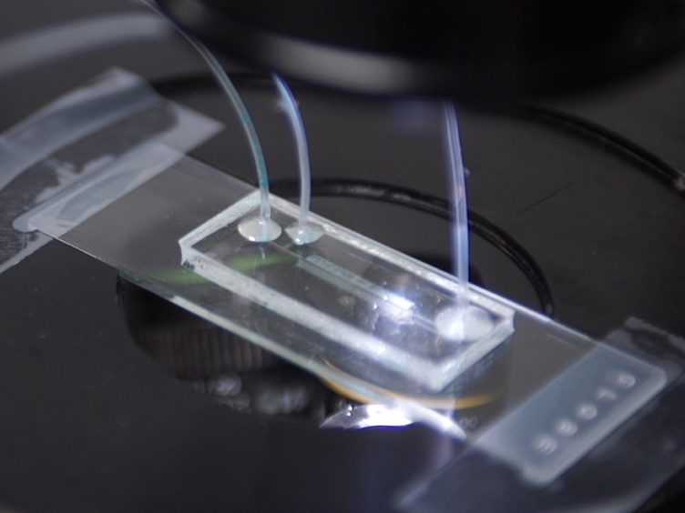
Introduction
Multiphase fluid flow in reservoir is particularly important to achieve optimum recovery. Particular interest lay on understanding of multiphase fluid flow in micron scale pore channels of the medium.
Micromodels have become popular to visualize and measure multiphase flows through porous media.
Fig.1 – Microfluidic micromodel
UNCONVENTIONAL RESERVOIR ENGINEERING PROJECT
Advisory Board Meeting, Spring 2020, Golden, Colorado
Notes:
In this work, two phase flow experiments were conducted, oil and water. And the understanding of multiphase fluid flow in pore scale is challenging but very important to achieve optimum recovery. Meanwhile, microfluidic micromodel allow us to simulate multiphase fluid flow in pore scale, visualize and measure fluid flows though porous media.

Slide 5
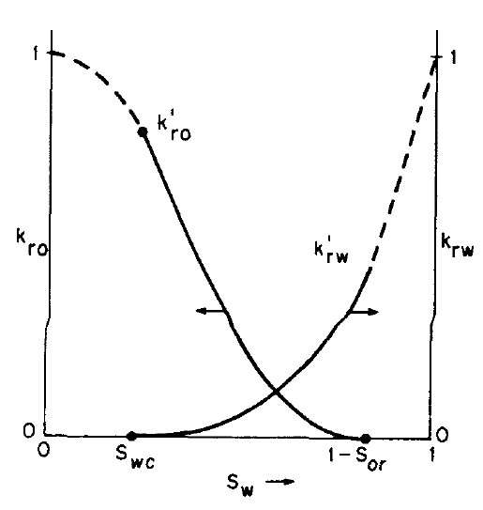
Introduction – Relative Permeability
Absolute permeability – property of the rock
Effective permeability in two phase fluid flow
Multiphase flow in porous media
is governed by Darcy’s law:
$$u= −\frac{kρ}{μ}\left(\frac{dΦ}{dx}\right)$$
$k_{ro}=\frac{k_{o}\left(S_{w}\right)}{k}$ and ${ k}_{rw} =\frac{k_{w}\left(S_{w}\right)}{k}$
Fig. 2 - Relative permeability
(Dake, 1971)
UNCONVENTIONAL RESERVOIR ENGINEERING PROJECT
Advisory Board Meeting, Spring 2020, Golden, Colorado
Notes:
Absolute permeability – property of the rock, obtained when the rock is completely saturation with single fluid.
If there are two fluids (oil and water) flowing simultaneously through porous media, then each fluid has its own effective permeability

Slide 6
Introduction – Relative permeability (Johnson et al. (1957))
USS technique to measure relative permeability – Johnson et al (1957)
Theory assumes two conditions:
high flow velocity;
constant flow rate.
$k_{ro}=\frac{f_{o}∗d\left(\frac{1}{Q_{i}}\right)}{d\left(\frac{1}{Q_{i}I_{r}}\right)}$ and $k_{rw}= \frac{\left(1−f_{o}\right) }{f_{o}}\frac{μ_{w}}{μ_{o}}k_{ro}$
where:
- $f, f_{o}$are fraction of displacing and displaced phase in flowing system;
- $I_{r}$ - relative injectivity
UNCONVENTIONAL RESERVOIR ENGINEERING PROJECT
Advisory Board Meeting, Spring 2020, Golden, Colorado
Notes:
Johnson et al (1957) method was developed for calculating water-oil relative permeability from waterflood data (from core sample).
Theory assumes two conditions: high flow velocity (ignore capillary pressure) and constant flow rate.
Where $f, f_{o}$are fraction of displacing and displaced phase in flowing system; $I_{r}$ designated as relative injectivity, defined as the ratio of the intake capacity at any given flood stage to the intake capacity of the system at the very initiation of the flood.

Slide 7
Introduction – NOA81 microfluidic micromodel
Norland Optical Adhesive 81 (NOA81)
NOA81 has properties to work as a microfluidic device material:
Cured NOA81 is perfectly transparent
NOA81 has better chemical resistance to organic solvents (than PDMS)
Many surface treatments of NOA81 are available (hydrophilic or hydrophobic).
NOA81 has high Young’s modulus (around 1GPa)
Fabrication of NOA81 devices is simple and fast.
UNCONVENTIONAL RESERVOIR ENGINEERING PROJECT
Advisory Board Meeting, Spring 2020, Golden, Colorado

Slide 8
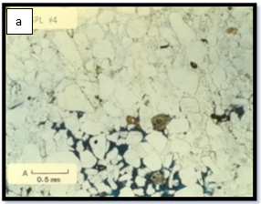
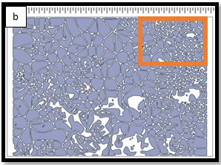
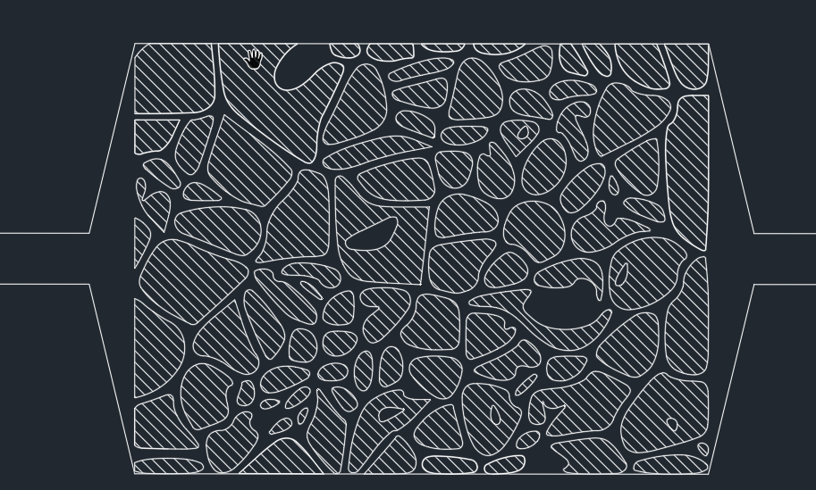
Methodology – Micromodel
Text
Scanned image of sandstone cross-section was used as a network design.
Pattern dimension is 1130 $μm$ x 850 $μm$
Channel depth is 15 $μm$
Porosity – 25%
Fig. 3 – original (a) and CAD format (b) of rock cross-section pattern.
Fig. 4 - Network design. Dashed area indicates solid material
UNCONVENTIONAL RESERVOIR ENGINEERING PROJECT
Advisory Board Meeting, Spring 2020, Golden, Colorado

Slide 9
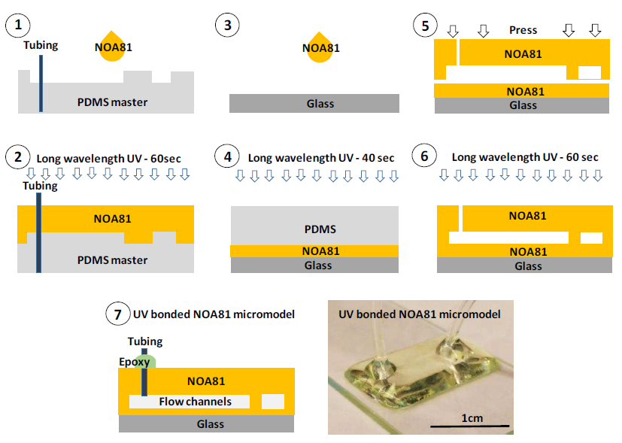
Methodology – Micromodel
Fabrication of micromodel devices is based on the technique of soft lithology
Two-layer etching was applied:
channel depth – 15 $μm$
inlet/outlet channel – 100 $μm$
Half curing method was used to transfer network design from master to NOA81 by UV-light exposure
Fig 5. NOA81 micromodel fabrication process. (Kenzhekhanov, 2016).
UNCONVENTIONAL RESERVOIR ENGINEERING PROJECT
Advisory Board Meeting, Spring 2020, Golden, Colorado

Slide 10
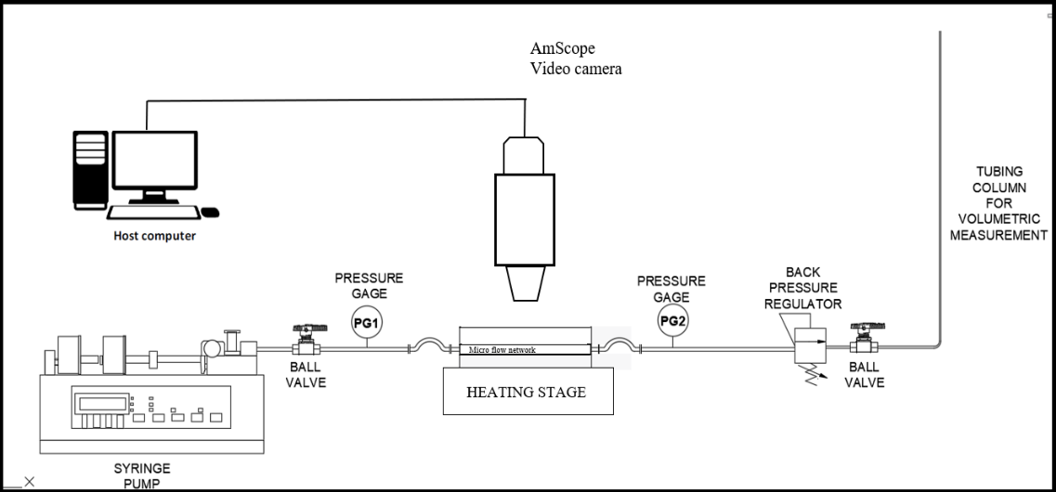
Methodology – Experimental preparation and set-up
Water and oil were injected through a syringe (3mL) using a syringe pump.
Injection rate was kept constant over experiment (5mL/ min)
Temperature was controlled by heating stage
AmScope 600 digital camera was used to record all two-phase flow experiments
Fig. 6 - Schematic of experimental set-up
UNCONVENTIONAL RESERVOIR ENGINEERING PROJECT
Advisory Board Meeting, Spring 2020, Golden, Colorado

Slide 11
Methodology – Data Analysis
Absolute permeability of NOA81 micromodel
Before test, micromodel was flooded with brine (2% KCl) to fully displace the air inside.
Calculate absolute permeability using Darcy’s Law
$$Q=\frac{kA}{μ}\frac{∆p}{L}$$
Flow rate is measure by
$$Q=\frac{πd^{2}}{4}\frac{∆l}{∆t}$$
where $d$ and $l$ are diameter and marked scale of the measuring tube,
Table 4.1 – Absolute permeability measurements
UNCONVENTIONAL RESERVOIR ENGINEERING PROJECT
Advisory Board Meeting, Spring 2020, Golden, Colorado

Slide 12
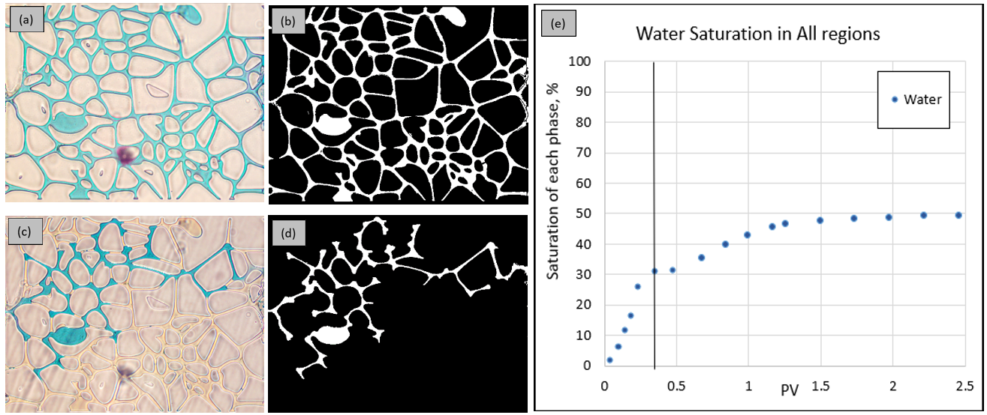
Methodology – Data Analysis
Use MATLAB Image Processing Toolbox for image processing
image was converted to a binary image
$$S_{w}= \frac{N_{W}@S_{w}}{N_{w}@S_{w}=100\%}$$
Fig. 7 – Example of data processing result.
UNCONVENTIONAL RESERVOIR ENGINEERING PROJECT
Advisory Board Meeting, Spring 2020, Golden, Colorado
Notes:
Image processing used MATLAB Image Processing Toolbox. Water saturation was determined by refining regions in a cropped image (Figure 7 (a) and (b)), masking image in the foreground (water) and the background (“rocks and oil”) and performing background segmentation.
Then, the image was converted to a binary image (b) where “1” and “0” represent the white and black pixels, respectively.
Fig. 7 – Example of data processing result. (a) reservoir micromodel fully saturated with water (Sw = 100%) (b) binary image with Sw = 100%, (c) a frame of water-oil displacement, (d) a frame of water-oil displacement binary image, and (e) phase saturation screening. Black line indicates moment of (c) and (d).

Slide 13
Methodology – Data Analysis
Relative Permeability from Image Processing
$$v_{s}=\frac{k_{r}k}{μ_{d}}\frac{∆p}{L}$$
Volumetric rate of displaced fluid (oil): $V_{p}=PV∗\left(S_{t1} −S_{t2}\right)$
Velocity of displaced fluid: $v_{d}=\frac{V_{d}}{t_{2} −t_{1}}\frac{1}{H∗W}$
Superficial velocity: $v_{s}= \frac{v_{d}\left(S_{t1}\right)− v_{d}\left(S_{t2}\right)}{2};$
Relative permeability of displaced fluid:
$$k_{r}= \frac{μ_{d}∗v_{s}∗L}{k\frac{[∆p\left(t_{1}\right)+∆p(t_{2})]}{2}}$$
From water – oil displacement process, find $k_{ro}$; from oil – water displacement, find $k_{rw}$
UNCONVENTIONAL RESERVOIR ENGINEERING PROJECT
Advisory Board Meeting, Spring 2020, Golden, Colorado

Slide 14
Methodology – Data Analysis
Relative Permeability using Johnson et al. method
$$k_{rw}= \frac{μ_{w}f_{w2}}{λ_{2}^{−1}} and k_{ro}= \frac{μ_{o}f_{o2}}{λ_{2}^{−1}}$$
Water saturation: $\overline{S_{w}}=S_{wi}+\frac{N_{p}}{PV}$
Saturation at the outlet of the core: $S_{w2}=\overline{S_{w}} −Q_{i}\frac{d\overline{S_{w}}}{dQ_{i}}$
Fractional flow of oil and water: $f_{o2}= \frac{\overline{S_{w}} −S_{w2}}{Q_{i}}$ and $f_{w2}=1−f_{o2}$
Effective viscosity (reciprocal relative mobility)
$λ^{−1}=\left(\frac{q_{b}μ_{b}}{Δp_{b}}\right)∗\frac{1}{q}∗\left(\frac{dp}{dx}\right)$ and $λ_{2}^{−1}= λ^{−1}−Q_{i}\frac{dλ^{−1}}{dQ_{i}}$
where
$N_{p}$ - volume of oil produced;
$Q_{i}$ - pore volume injected relative to the entire core; subscripts;
b – refers to single phase flow (abs permeability measurement);
2 – outlet face of the porous body.
Ref. SPE-6045-PA
UNCONVENTIONAL RESERVOIR ENGINEERING PROJECT
Advisory Board Meeting, Spring 2020, Golden, Colorado

Slide 15
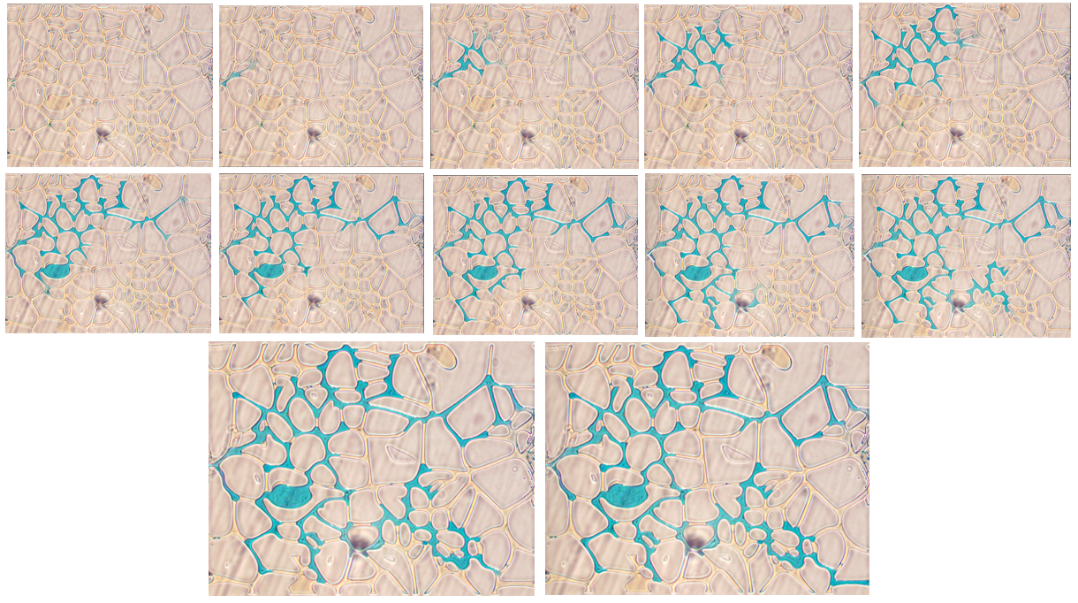
Experimental Results –
Relative Permeability from Image Processing
Capture images from water-oil displacement test, Fig 11.
Calculate superficial velocity
$$V_{p}=PV∗\left(S_{t1} −S_{t2}\right)$$
$$v_{d}=\frac{V_{d}}{t_{2} −t_{1}}\frac{1}{H∗W}$$
$$v_{s}= \frac{v_{d}\left(S_{t1}\right)+ v_{d}\left(S_{t2}\right)}{2}$$
Fig 11 – First few seconds of the water- oil displacement test.
UNCONVENTIONAL RESERVOIR ENGINEERING PROJECT
Advisory Board Meeting, Spring 2020, Golden, Colorado

Slide 16
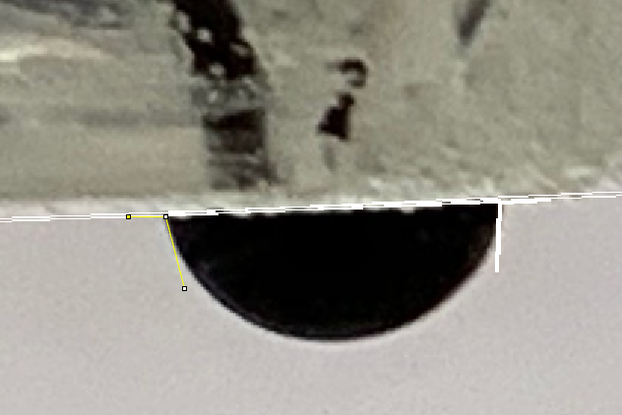
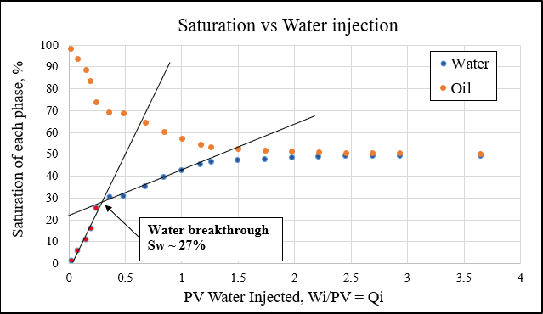
Experimental Results –
Relative Permeability from Image Processing
The contact angle is 105° (Fig 12).
Water and oil saturations as a function of injected water pore volume (Fig 13)
Fig 12 – Contact angle
Water breakthrough ~ Sw = 27%
Fig 13 – Saturation profile along cumulate water injection converted to PV (Qi).
UNCONVENTIONAL RESERVOIR ENGINEERING PROJECT
Advisory Board Meeting, Spring 2020, Golden, Colorado

Slide 17
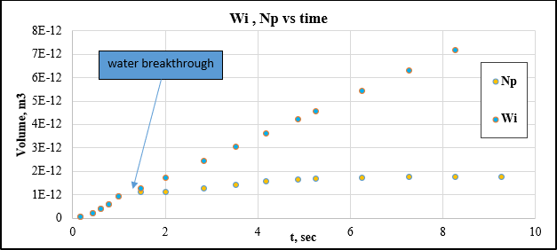
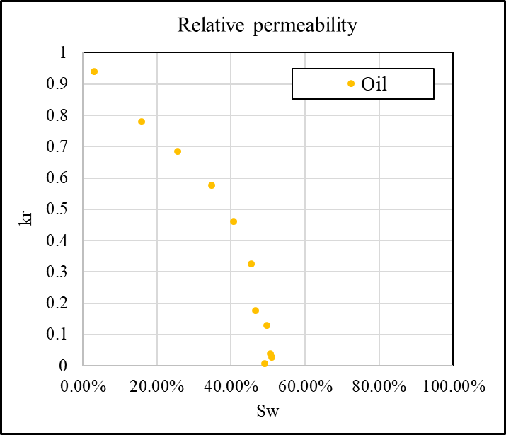
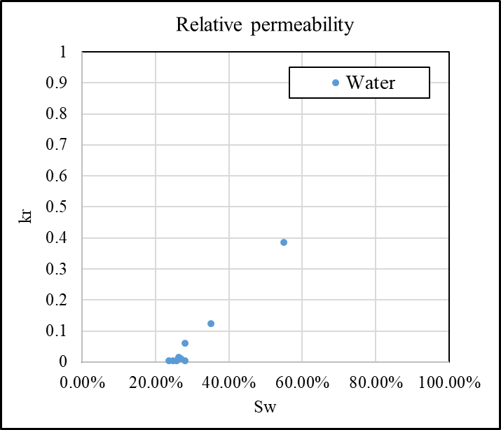
Experimental Results –
Relative Permeability from Image Processing
Cumulative injected volume and produced oil versus time (Fig 14)
Water and oil relative permeabilities (Fig 15).
Fig 14 – Cumulative water injection (Wi) and cumulative produced oil (Np) vs time.
Fig 15 - Relative permeability from displacement experiment
UNCONVENTIONAL RESERVOIR ENGINEERING PROJECT
Advisory Board Meeting, Spring 2020, Golden, Colorado

Slide 18
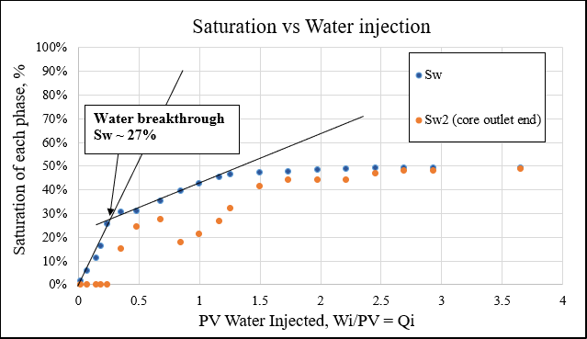
Experimental Results –
Relative Permeability using Johnson et al method
Average water saturation as a function of the injected PV of water, $Q_{i}$, and the water saturation at the outlet end of the core shows in Fig 16
Fig 16 - Sw and Sw2 vs Injected PV
UNCONVENTIONAL RESERVOIR ENGINEERING PROJECT
Advisory Board Meeting, Spring 2020, Golden, Colorado

Slide 19
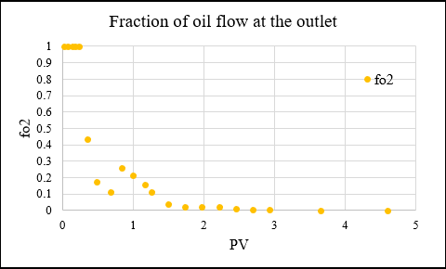
Experimental Results –
Relative Permeability using Johnson et al method
oil flow fraction at the outlet of the core, $f_{o2}$, (Fig 17) and reciprocal relative mobility $λ_{2}^{−1}$
oil and water relative permeabilities (Figure 18).
Fig 17 - Fraction of oil flow at the outlet of the core
Fig 18 - Relative Permeability
UNCONVENTIONAL RESERVOIR ENGINEERING PROJECT
Advisory Board Meeting, Spring 2020, Golden, Colorado

Slide 20
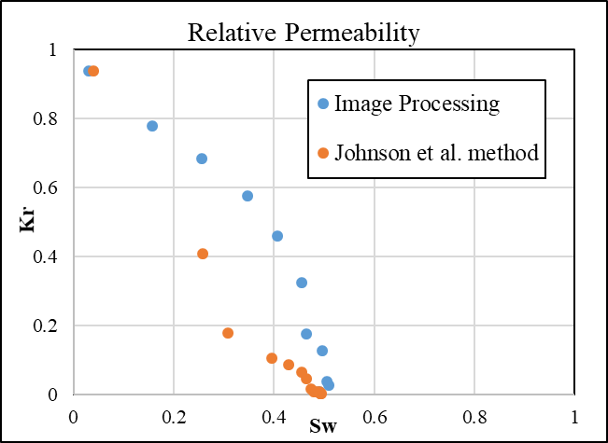
Conclusion and Future work
Experimental workflow and analytical calculation procedures have been developed
Relative permeabilities (Fig 19).
Cross-over of kro and krw from both methods is the same (at Sw = 45%)
There are some differences in the results, and we will further analyze and confirm by conducting more experiments
Study the effects of oil-water viscous ratio and wettability change on relative permeability
Fig 19 – Relative permeability vs Sw from both method
UNCONVENTIONAL RESERVOIR ENGINEERING PROJECT
Advisory Board Meeting, Spring 2020, Golden, Colorado

Slide 21
Reference
Bryant, S. and Blunt, M., 1992. Prediction of relative permeability in simple porous media. Physical Review A, 46(4), pp.2004-2011.
Buckley, S. E. and Leverett, M. C.: “Mechanism of Fluid Displacement in Sands” Thans., AIME (1942) 146, 107-116
Dake, L. P. 1983. Fundamentals of Reservoir Engineering. Elsevier, Amsterdam, 2nd Edition.
Johnson, E. F., Bossler, D. P., and Naumann, V. O., 1957. Calculation of Relative Permeability from Displacement Experiments. Trans., AIME (1959) 216, 370-372.
Jones, S. C., Roszelle, W. O., 1978. Graphical Techniques for Determining Relative Permeability From Displacement Experiments. Society of Petroleum Engineers of AIME
Julian David, O. A., 2009. Pore level Investigation of the Effect of Viscous Coupling, Displacement Flow Rates and Porous Medium Topology on Two-Phase Flow Relative Permeabilities. MS. University of Calgary.
Kenzhekhanov Sh. 2016. “Chemical EOR Process Visualization using NOA81 Micromodels”. MS. Colorado School of Mines.
Martin K. B., 2017. Multiphase flow in Permeable Media. A pore-scale perspective. Imperial College. London.
UNCONVENTIONAL RESERVOIR ENGINEERING PROJECT
Advisory Board Meeting, Spring 2020, Golden, Colorado

