Slide 1
UNCONVENTIONAL RESERVOIR ENGINEERING PROJECT
Colorado School of Mines
U R E P
CSM
New Pseudopressure Formulation for Multiphase Flow in Naturally Fractured Reservoirs
Multiphase Transient Analysis for Unconventional Reservoirs
Mohammed M. Al Ali - UREP
UNCONVENTIONAL RESERVOIR ENGINEERING PROJECT
Advisory Board Meeting, Spring 2020, Golden, Colorado

Slide 2
Problem Statement
One of the approaches to analyze multiphase pressure or rate data is to define an appropriate pseudopressure to (approximately)
convert the multiphase well responses to those of an equivalent single-phase case
or use single-phase flow diagnostics in the analysis
Current use of pseudopressure for unconventional reservoirs do not consider special features, such as
strong influence of capillary pressure in phase behavior
effect of pore size on thermodynamic properties
complex interactions between fractures and tight matrix
UNCONVENTIONAL RESERVOIR ENGINEERING PROJECT
Advisory Board Meeting, Spring 2020, Golden, Colorado

Slide 3
Scope of Research
Pseudopressure definition attempts to incorporate the variation of fluid properties with respect to pressure changes for each phase into a single “pseudo” variable.
The ultimate objective is to linearize the global multiphase diffusivity equation to arrive in a formulation that is comparable to single-phase diffusivity equation
The applicability of pseudopressure to unconventional reservoirs has not been rigorously investigated
In this research, a pseudopressure definition will be formally derived for unconventional reservoirs and its working conditions will be delineated
UNCONVENTIONAL RESERVOIR ENGINEERING PROJECT
Advisory Board Meeting, Spring 2020, Golden, Colorado

Slide 4
Multiphase Pseudopressure Function Derivation
Flow Equation
Oil
Component
Fracture
Matrix
$$\frac{∂}{∂x}\left(\frac{k_{fro}}{μ_{o}B_{o}}\frac{∂p_{fo}}{∂x}\right)−{\left(\frac{2k_{m}}{k_{f}h_{f}}\frac{k_{mro}}{μ_{o}B_{o}}\frac{∂p_{mo}}{∂z}\right)}_{z=\frac{h_{m}}{2}}=\frac{φ_{f}c_{fot}}{k_{f}B_{o}}\frac{∂p_{fo}}{∂t}$$
$$\frac{∂}{∂z}\left(\frac{k_{mro}}{μ_{o}B_{o}}\frac{∂p_{mo}}{∂z}\right)=\frac{φ_{m}c_{fmot}}{k_{m}B_{o}}\frac{∂p_{mo}}{∂t}$$
Define Pseudopressure Function
Fracture
Matrix
$$m_{fo}=\int_{p_{ob}}^{p_{fo}}{\frac{k_{fro}}{μ_{o}B_{o}}}dp^{′}$$
Pore Confinement
&
Capillary Pressure
Effects
$$m_{mo}=\int_{p_{ob}}^{p_{mo}}{\frac{k_{mro}}{μ_{o}B_{o}}}dp^{′}$$
Apply Pseudopressure Functions into Flow Equations
Fracture
Matrix
$$\frac{∂^{2}Δm_{fo}}{∂x^{2}}−{\left(\frac{2k_{m}}{k_{f}h_{f}}\frac{∂Δm_{mo}}{∂z}\right)}_{z=\frac{h_{m}}{2}}=\frac{1}{η_{fo}}\frac{∂Δm_{fo}}{∂t}$$
$$\frac{∂^{2}Δm_{mo}}{∂z^{2}}=\frac{1}{η_{mo}}\frac{∂Δm_{mo}}{∂t}$$
UNCONVENTIONAL RESERVOIR ENGINEERING PROJECT
Advisory Board Meeting, Spring 2020, Golden, Colorado

Slide 5
Multiphase Pseudopressure Function Derivation
Oil
Component
Apply Laplace Transform (PDE → ODE)
Fracture
Matrix
$$\frac{∂^{2}Δ\overline{m_{fo}}}{∂x^{2}}−{\left(\frac{2k_{m}}{k_{f}h_{f}}\frac{∂Δ\overline{m_{mo}}}{∂z}\right)}_{z=\frac{h_{m}}{2}}=\frac{s}{η_{fo}}Δ\overline{m_{fo}}$$
$$\frac{∂^{2}Δ\overline{m_{mo}}}{∂z^{2}}=\frac{s}{η_{mo}}Δ\overline{m_{mo}}$$
Couple the Fracture and Matrix Equation
Solve matrix and fracture equations by using the continuity of flux and pseudopressure at the matrix-fracture interface. (The correct assumption of the continuity of pressure at the interface creates a jump discontinuity, which is currently ignored)
The resulting equation for the Oil Flow in Dual Porosity Model is the following:
$$\frac{d^{2}{∆\overline{m}}_{fo}}{dx^{2}}−{\tilde{s}}_{nfo}∆{\overline{m}}_{fo}=0$$
$${\tilde{s}}_{nfo}=\frac{s}{η_{fo}}f_{o}\left(L^{2}\frac{s}{η_{fo}}\right)$$
where
Note: Assuming equal pseudopressure at the fracture-matrix interface
$$f_{o}\left(s\right)=\sqrt{\frac{λ_{o}ω_{o}}{3s}}tanh\left(\sqrt{\frac{3ω_{o}}{λ_{o}}}\right)+1$$
UNCONVENTIONAL RESERVOIR ENGINEERING PROJECT
Advisory Board Meeting, Spring 2020, Golden, Colorado

Slide 6
Multiphase Pseudopressure Function Derivation
System of Differential Equations for Multiphase:
$$\frac{d^{2}{∆\overline{m}}_{fg}}{dx^{2}}−{\tilde{s}}_{nfg}∆{\overline{m}}_{fg}=0$$
“Gas”
$$\frac{d^{2}{∆\overline{m}}_{fo}}{dx^{2}}−{\tilde{s}}_{nfo}∆{\overline{m}}_{fo}=0$$
“Oil”
$$\frac{d^{2}{∆\overline{m}}_{fw}}{dx^{2}}−{\tilde{s}}_{nfw}∆{\overline{m}}_{fw}=0$$
“Water”
UNCONVENTIONAL RESERVOIR ENGINEERING PROJECT
Advisory Board Meeting, Spring 2020, Golden, Colorado

Slide 7
Multiphase Diffusivity Equation in Dual-Porosity
The Sum of the DE’s for each phase yields a single DE for Multiphase Flow in Laplace Domain
$$\frac{d^{2}{∆\overline{m}}_{f}}{dx^{2}}−sf_{ogw}{∆\overline{m}}_{f}=0$$
Multiphase Pseudopressure Function
$$m_{f}=\int_{p_{ob}}^{p_{fo}}{\left[{\left(\frac{k_{fro}}{μ_{o}B_{o}}\right)}_{p^{′}}+{\left(\frac{k_{frg}}{μ_{g}B_{g}}+\frac{{R_{sfo}k}_{fro}}{μ_{o}B_{o}}\frac{∂p_{fo}}{∂p_{fg}}+\frac{{R_{sfw}k}_{frw}}{μ_{w}B_{w}}\frac{∂p_{fw}}{∂p_{fg}}\right)}_{p^{′}+p_{cog}}\right.\left.+{\left(\frac{k_{frw}}{μ_{w}B_{w}}\right)}_{p^{′}−p_{cow}}\right]}dp^{′}$$
Multiphase Dual-Porosity Transfer Function
$$f_{ogw}=\frac{\left(\frac{f_{o}}{η_{fo}}\right)∆{\overline{m}}_{fo}+\left(\frac{f_{g}}{η_{fg}}\right)∆{\overline{m}}_{fg}+\left(\frac{f_{w}}{η_{fw}}\right){∆\overline{m}}_{fw}}{{∆\overline{m}}_{fo}+{∆\overline{m}}_{fg}+{∆\overline{m}}_{fw}}$$
UNCONVENTIONAL RESERVOIR ENGINEERING PROJECT
Advisory Board Meeting, Spring 2020, Golden, Colorado

Slide 8
Multiphase Diffusivity Equation in Dual-Porosity
Definition of the Dual-Porosity (Fracture-Matrix) Transfer Function $\left(f_{ogw}\right)$
$$f_{ogw}=\frac{\left(\frac{f_{o}}{η_{fo}}\right)∆{\overline{m}}_{fo}+\left(\frac{f_{g}}{η_{fg}}\right)∆{\overline{m}}_{fg}+\left(\frac{f_{w}}{η_{fw}}\right){∆\overline{m}}_{fw}}{{∆\overline{m}}_{fo}+{∆\overline{m}}_{fg}+{∆\overline{m}}_{fw}}$$
$$f_{γ}=\sqrt{\frac{λ_{γ}ω_{γ}}{3s}}tanh\left(\sqrt{\frac{{3ω}_{γ}}{λ_{γ}}s}\right)+1$$
$$where: γ=g,o,w$$
$$η_{fo}=\frac{k_{fo}}{φ_{f}c_{fot}μ_{o}}$$
$$η_{fw}=\frac{k_{fw}}{φ_{f}c_{fwt}μ_{w}}$$
$$ω_{γ}=\frac{φ_{m}c_{mγt}h_{m}}{φ_{f}c_{fγt}h_{f}}$$
$$η_{fg}=\frac{k_{fg}}{φ_{f}c_{fgt}μ_{g}}\left(1+\frac{R_{sfo}μ_{g}B_{g}k_{fo}}{μ_{o}B_{o}k_{fg}}\frac{∂p_{fo}}{∂p_{fg}}+\frac{R_{sfw}μ_{g}B_{g}k_{fw}}{μ_{w}B_{w}k_{fg}}\frac{∂p_{fw}}{∂p_{fg}}\right)$$
$$λ_{γ}=12\frac{k_{mγ}h_{m}L^{2}}{k_{fγ}h_{f}h_{m}^{2}}$$
UNCONVENTIONAL RESERVOIR ENGINEERING PROJECT
Advisory Board Meeting, Spring 2020, Golden, Colorado

Slide 9
Multiphase Diffusivity Equation in Dual-Porosity
Linearity Spectrum of the DE
$$\frac{d^{2}{∆\overline{m}}_{f}}{dx^{2}}−sf_{ogw}{∆\overline{m}}_{f}=0$$
$$f_{ogw} is independent of{∆\overline{m}}_{f}$$
$$f_{ogw} is dependent of{∆\overline{m}}_{f}$$
Linear
DE
Non-linear DE
Pseudopressure concept is promising
Pseudopressure concept is inapplicable
UNCONVENTIONAL RESERVOIR ENGINEERING PROJECT
Advisory Board Meeting, Spring 2020, Golden, Colorado

Slide 10
Multiphase Diffusivity Equation in Dual-Porosity
What makes the multiphase diffusivity equation linear?
$$f_{ogw}=\frac{\left(\frac{f_{o}}{η_{fo}}\right)∆{\overline{m}}_{fo}+\left(\frac{f_{g}}{η_{fg}}\right)∆{\overline{m}}_{fg}+\left(\frac{f_{w}}{η_{fw}}\right){∆\overline{m}}_{fw}}{{∆\overline{m}}_{fo}+{∆\overline{m}}_{fg}+{∆\overline{m}}_{fw}}$$
$$\frac{d^{2}{∆\overline{m}}_{f}}{dx^{2}}−sf_{ogw}{∆\overline{m}}_{f}=0$$
$Where$:
“Tow conditions are required”
$$f_{ogw}\begin{matrix}? \\ ≈\end{matrix}\left(\frac{f_{o}}{η_{fo}}\right)+\left(\frac{f_{g}}{η_{fg}}\right)+\left(\frac{f_{w}}{η_{fw}}\right)$$
1.
2.
$η_{fo}$, $η_{fg},η_{fw}≠f\left(p\right)$
or weak functions of pressure
UNCONVENTIONAL RESERVOIR ENGINEERING PROJECT
Advisory Board Meeting, Spring 2020, Golden, Colorado

Slide 11
Approach
Step # 1
Single Phase Flow Simulation
Step # 2
Multiphase Flow Simulation
Step # 3
Single Phase vs. Multiphase Simulation
This will be our baseline for the next step
Modified Black Oil Simulation “COZSim”
Compare the dimensionless pressure response (Single Phase) with the dimensionless pseudopressure response (Multiphase)
UNCONVENTIONAL RESERVOIR ENGINEERING PROJECT
Advisory Board Meeting, Spring 2020, Golden, Colorado

Slide 12
Approach
Calculation of the Multiphase Pseudopressure Function
$$m_{f}=\int_{p_{ob}}^{p_{fo}}{\left[{\left(\frac{k_{fro}}{μ_{o}B_{o}}\right)}_{p^{′}}+{\left(\frac{k_{frg}}{μ_{g}B_{g}}+\frac{{R_{sfo}k}_{fro}}{μ_{o}B_{o}}\frac{∂p_{fo}}{∂p_{fg}}+\frac{{R_{sfw}k}_{frw}}{μ_{w}B_{w}}\frac{∂p_{fw}}{∂p_{fg}}\right)}_{p^{′}+p_{cog}}\right.\left.+{\left(\frac{k_{frw}}{μ_{w}B_{w}}\right)}_{p^{′}−p_{cow}}\right]}dp^{′}$$
Saturation profile is required
Using produced GOR
UNCONVENTIONAL RESERVOIR ENGINEERING PROJECT
Advisory Board Meeting, Spring 2020, Golden, Colorado

Slide 13
Challenges
Saturation profile assessment is the key to analyze multiphase flow in hydrocarbon reservoir. Yet, most of the methods to predict the saturation profile is related to the Gas-Oil system via using produced GOR.
There is no rigorous procedure that assess saturation distribution when water phase is included in the flow.
Determining the capillary pressure and relative permeability curves for unconventional reservoirs.
Multiphase flow rate measurements could be questionable. As flow meters require constant calibrations.
UNCONVENTIONAL RESERVOIR ENGINEERING PROJECT
Advisory Board Meeting, Spring 2020, Golden, Colorado

Slide 14
Potential Conclusions
Good Matching
“Overlapping”
No Match
Pattern Matching
“Parallel Shift”
Pseudopressure Data
Pseudopressure Data
Pseudopressure Data
Single Phase Data
Single Phase Data
Single Phase Data
$$y$$
$$y$$
$$y$$
$$x$$
$$x$$
$$x$$
UNCONVENTIONAL RESERVOIR ENGINEERING PROJECT
Advisory Board Meeting, Spring 2020, Golden, Colorado

Slide 15
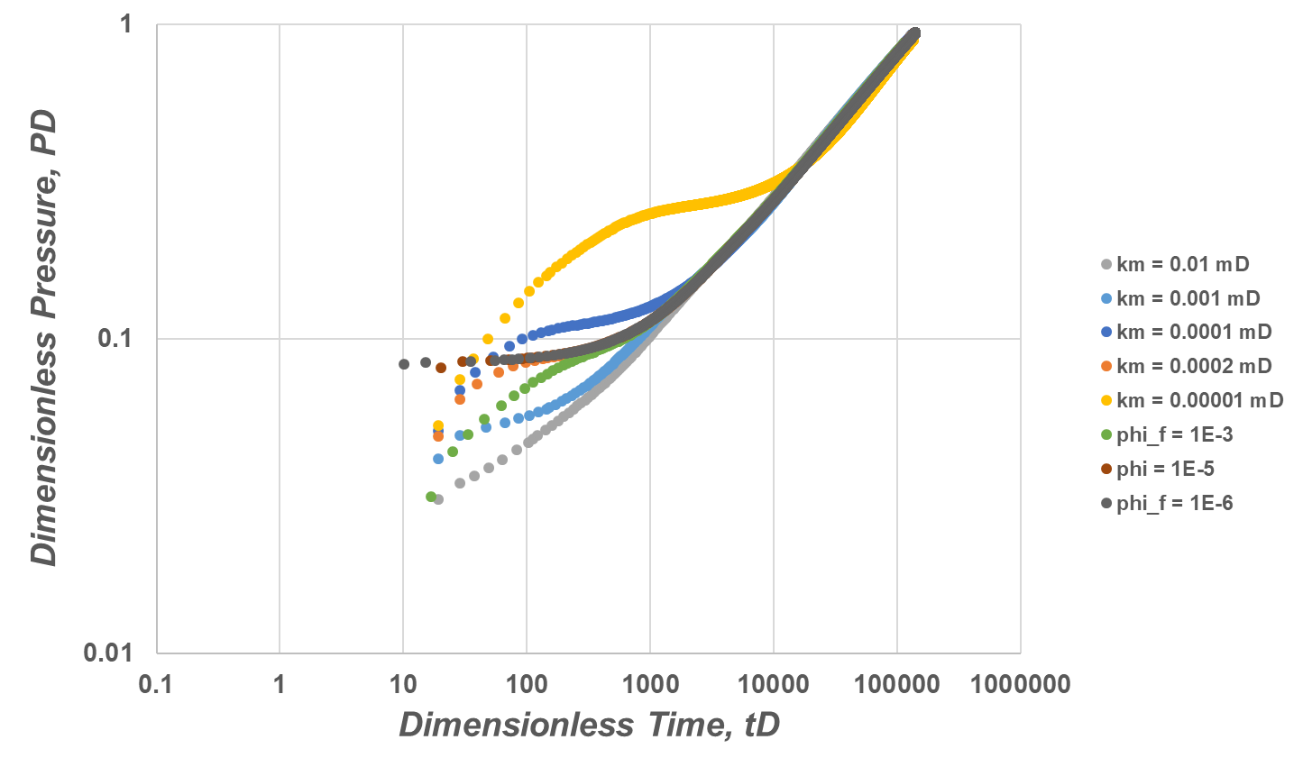
Results/Status
Baseline of pressure signature for single phase flow is generated
$$ω$$
$$λ$$
UNCONVENTIONAL RESERVOIR ENGINEERING PROJECT
Advisory Board Meeting, Spring 2020, Golden, Colorado

Slide 16
Results/Status
Remaining work:
Create a multiphase flow simulation of a dual-porosity reservoir model
Convert the pressure data to pseudopressure and use the produced GOR in order to determine saturation-relative permeability relation
Compare single phase pressure signature with multiphase pseudopressure profile
Investigate the validity of the assumption of pseudopressure continuity at the matrix fracture interface
UNCONVENTIONAL RESERVOIR ENGINEERING PROJECT
Advisory Board Meeting, Spring 2020, Golden, Colorado

Slide 17
UNCONVENTIONAL RESERVOIR ENGINEERING PROJECT
Colorado School of Mines
U R E P
CSM
THANK YOU!
UNCONVENTIONAL RESERVOIR ENGINEERING PROJECT
Advisory Board Meeting, Spring 2020, Golden, Colorado

