Slide 1
UNCONVENTIONAL RESERVOIR ENGINEERING PROJECT
Colorado School of Mines
U R E P
CSM
Research Summary
TRANSIENT FLOW MODELING OF DIAGNOSTIC FRACTURE INJECTION TESTS IN FRACTURED FORMATIONS
Mohamed Mohamed, Colorado School of Mines
UNCONVENTIONAL RESERVOIR ENGINEERING PROJECT
Advisory Board Meeting, November 8, 2019, Golden, Colorado

Slide 2
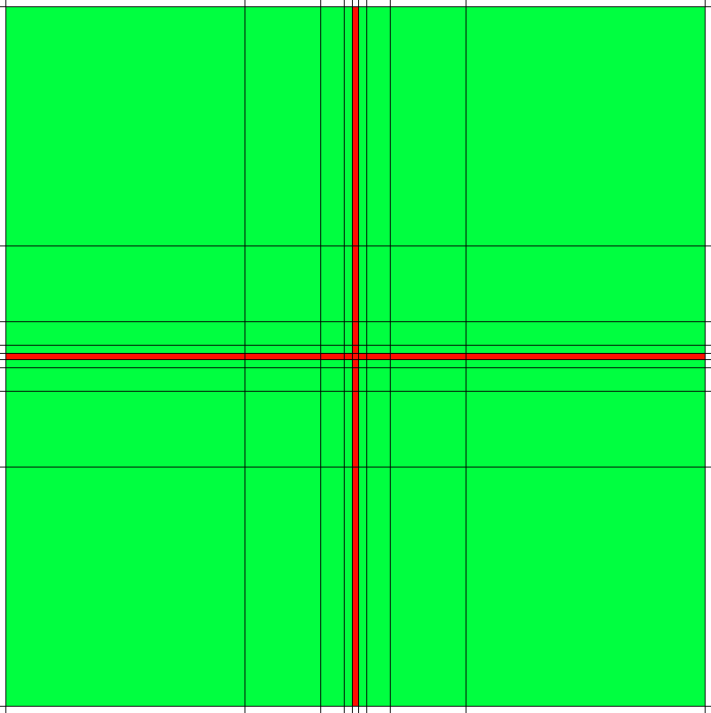
Geomechanics Coupled Reservoir Flow Simulation Numerical Simulator
Black-oil unconventional simulator
Logarithmically Spaced, Locally Refined, Dual-Porosity (LS-LR-DP) reservoir model.
Create refinement around the fracture, to capture the crucial pressure transient changes with the least amount of grid blocks.
Logarithmically Spaced, Locally Refined grids
Dual porosity formulation defines the naturally fractured system.
Flow is allowed from fracture to fracture, and fracture to matrix.
Fractures
Matrices
Schematic of flow connections in the dual porosity system.
UNCONVENTIONAL RESERVOIR ENGINEERING PROJECT
2
Advisory Board Meeting, November 8, 2019, Golden, Colorado
Notes:
Black-oil unconventional simulator (IMEX) is numerical reservoir flow simulation tool with a coupled geomechanics feature that can model fracture initiation, propagation, closure, and pressure falloff of a typical minifrac.
(LS-LR-DP) was adopted to adequately represent the complex natural fracture and mini fracture behavior.
The dual permeability model is used to incorporate the effect of random distributed secondary fracture intersecting the mini fracture, and the logarithmic spaced is used to create refinement around the fracture where it’s crucial to capture the pressure transient with the least amount of grid blocks.
In this model a secondary fracture system is defined in the grid via the standard dual permeability formulation.
Flow is allowed to occur from fracture to fracture, and fracture to matrix, and each of the matrix and fracture have different porosity valued per grid block.

Slide 3
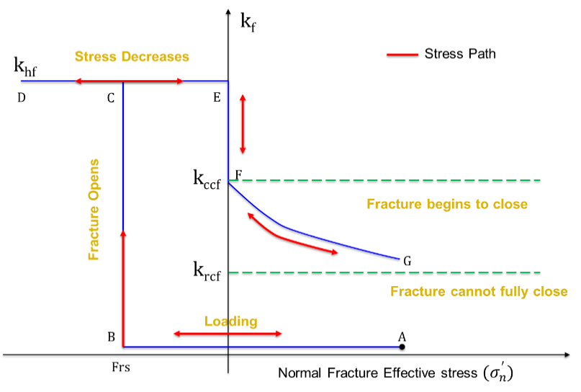
Geomechanics Coupled Reservoir Flow Simulation Numerical Simulator
Describes relationship between permeability of the fracture system and fracture opening.
Barton-Bandis stress permeability relationship model
UNCONVENTIONAL RESERVOIR ENGINEERING PROJECT
3
Advisory Board Meeting, November 8, 2019, Golden, Colorado
Notes:
Barton-Bandis parameters were obtained by history matching a field case.
History matching was done by using
Actual field injection schedule and BHP
As pressure increases in regular grid, the normal effective stresses on the fractures decrease.
Stress breaks past the failure envelope of the rock → fracture propagates and allow fluid to flow through the fracture system in addition to the underlying matrix system.
In this model, the secondary fracture system is described in the grid system using the dual permeability formulation where the secondary fracture represents the secondary fractures in the system and was coupled with a porous rock matrix on a one-to-one basis such that the stresses were specified for every grid block.
The rock material is assumed to be brittle such that when rock cracks, the value of fracture permeability increases from zero to maximum permeability k_{hf}
The fracture aperture continues to open until the pressure within the rock is reduced. The decrease in pressure causes normal fracture effective stress to increase, and the size of the aperture(e) to decrease. Due to asperities, the fracture aperture cannot be closed completely, and thus the fracture permeability does not follow the first permeability path and follow the subsequent stress path shown in Fig. 3 and the fracture permeability will follow the curve FG when the value of fracture normal effective stress changes its direction from negative to positive, allowing the fluids to flow through the crack. The residual value of fracture closure permeability indicates that the aperture cannot be closed completely. If the fracture is mainly caused by tensile stress, the threshold normal fracture effective stress is negative or zero. If the fracture is mainly due to shear stress and is parallel to the crack as shown in Fig. 3, the threshold value may be positive as the failure may obey the Mohr-Coulomb criteria rather than tensile criteria. The threshold value for the rock used in this study is obtained from laboratory tests under different loading conditions.

Slide 4
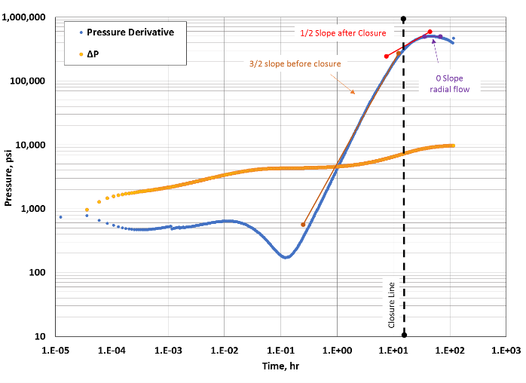
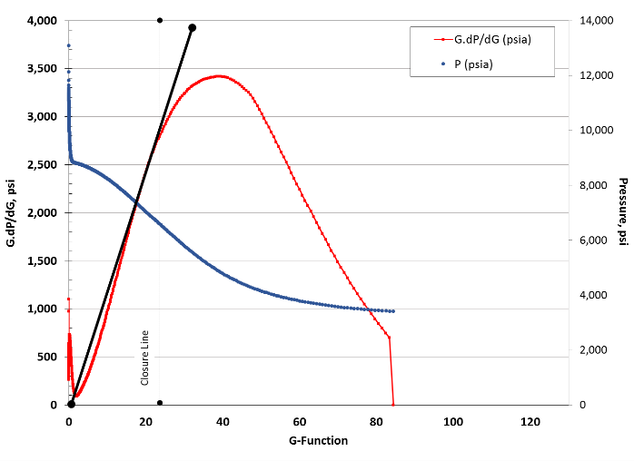
Geomechanics Coupled Reservoir Flow Simulation Different Formation Types
Formation Type 1: Non-Fractured
(Homogenous)
Constant overburden stress and minimum horizontal stress.
Constant permeability for fracture and matrix.
Estimated P_{c} = 6,411 psi.
Comparable to the input minimum horizontal stress of 6,248 psi.
3/2-slope defining the before closure;
½-slope → linear flow;
zero-slope → pseudoradial flow.
P_{c}=6,411 psi
UNCONVENTIONAL RESERVOIR ENGINEERING PROJECT
4
Advisory Board Meeting, November 8, 2019, Golden, Colorado
Notes:
Permeabilities of the fracture and matrix systems are assumed to be equal.

Slide 5
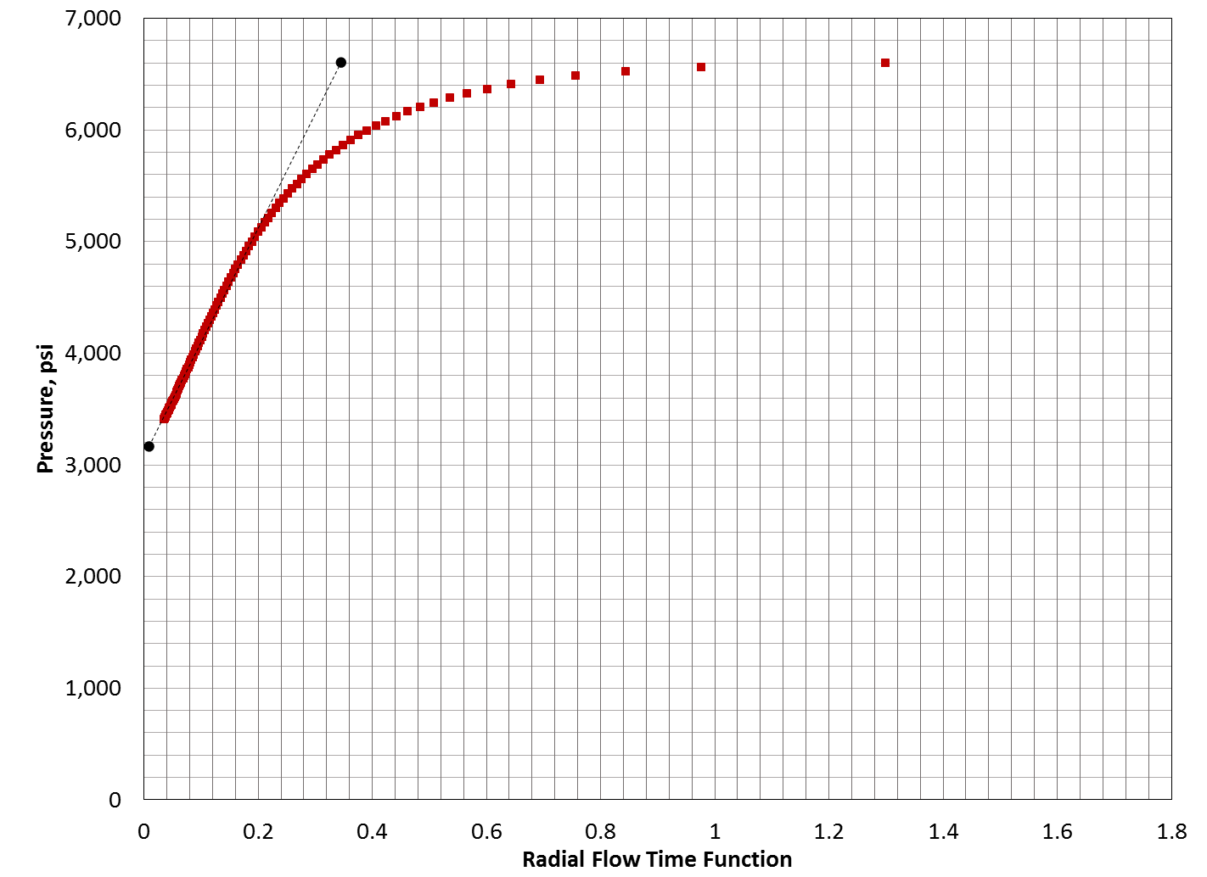
Geomechanics Coupled Reservoir Flow Simulation Different Formation Types
Formation Type 1: Non-Fractured
(Homogenous)
Estimated P_{i} = 3,106 psi.
Input P_{i} = 3,206 psi.
Effective reservoir permeability = 0.004 mD. Input permeability = 0.007 mD
$$\frac{kh}{μ}=251,000[\frac{V_{i}}{m_{R}t_{c}} ]$$
UNCONVENTIONAL RESERVOIR ENGINEERING PROJECT
5
Advisory Board Meeting, November 8, 2019, Golden, Colorado

Slide 6
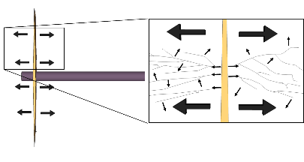
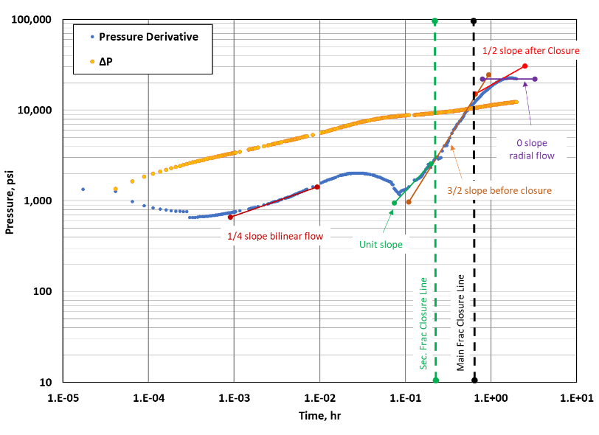
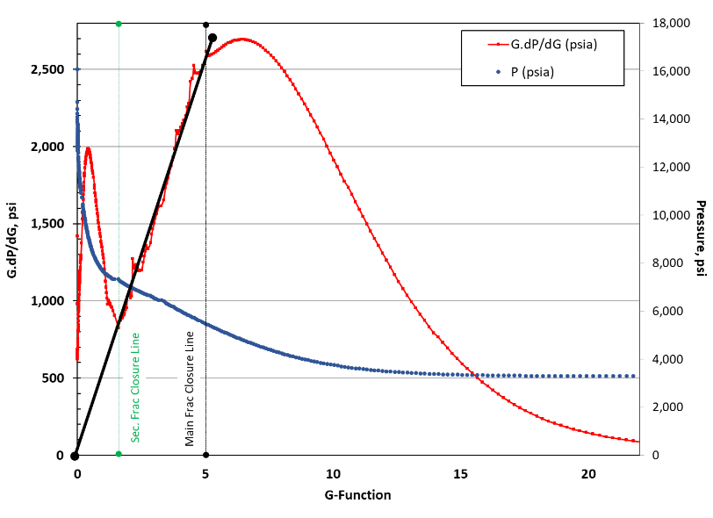
Geomechanics Coupled Reservoir Flow Simulation Different Formation Types
Formation Type 2: Naturally Fractured (Multiple Closures)
Scenario A (less dense NF)
Main Fracture (SH_{Min})
G-Plot | Bourdet
5,578 | 5,655
UNCONVENTIONAL RESERVOIR ENGINEERING PROJECT
6
Advisory Board Meeting, November 8, 2019, Golden, Colorado
Notes:
Composite flow behavior before closure
The main fracture closure is somewhere between the end of the unit slope and before the beginning of the linear flow regime.

Slide 7
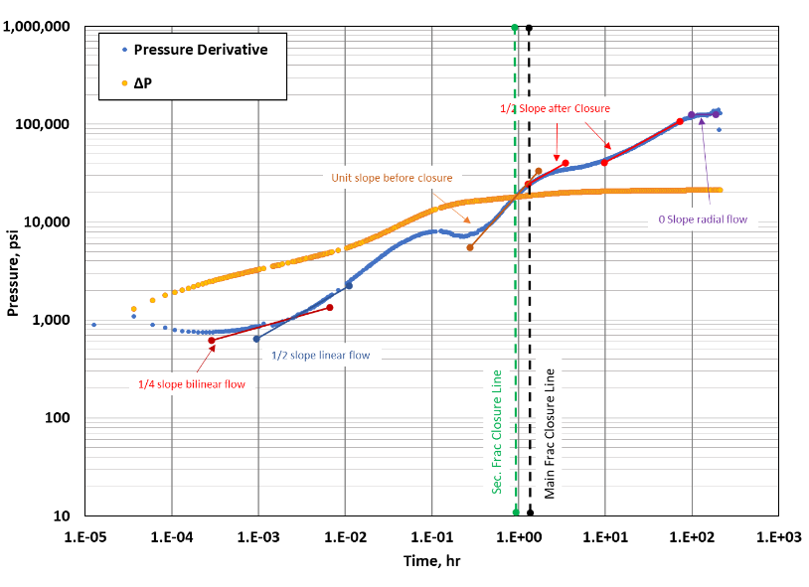
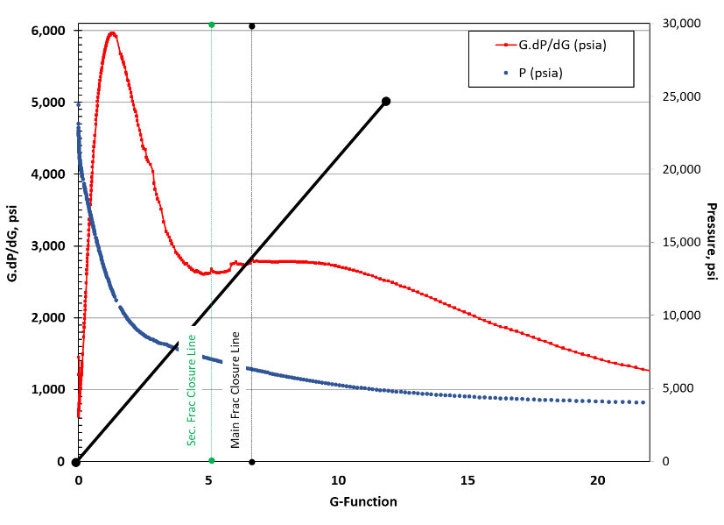
Geomechanics Coupled Reservoir Flow Simulation Different Formation Types
Formation Type 2: Naturally Fractured (Multiple Closures)
Scenario B (denser NF)
Main Fracture (SH_{Min})
G-Plot | Bourdet
6,238 | Masked
UNCONVENTIONAL RESERVOIR ENGINEERING PROJECT
7
Advisory Board Meeting, November 8, 2019, Golden, Colorado
Notes:
Composite flow behavior before closure
The main fracture closure is somewhere between the end of the unit slope and before the beginning of the linear flow regime.

Slide 8
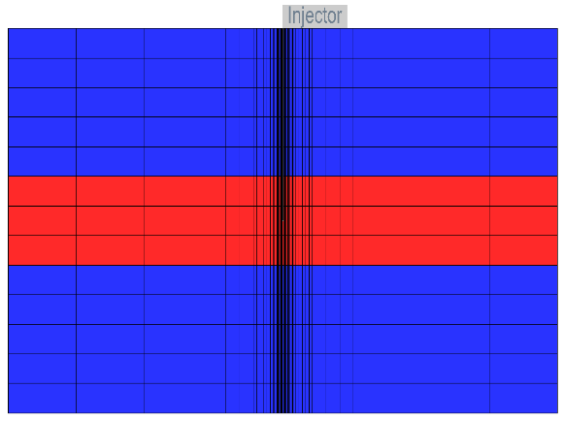
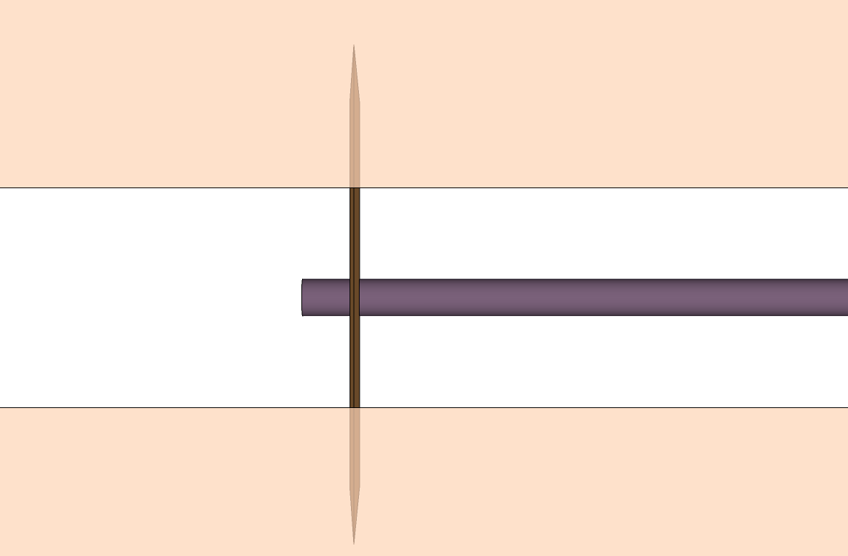
Geomechanics Coupled Reservoir Flow Simulation Different Formation Types
Formation Type 3: Height Recession
Lower Stress Target
End of injection ∆t=0
∆t=11 hrs
As fracture continues closing;
Fracture tips are forced to close first in the high-stress; overlying and underlying layers.
Fracture permeability increases at the target layer
UNCONVENTIONAL RESERVOIR ENGINEERING PROJECT
8
Advisory Board Meeting, November 8, 2019, Golden, Colorado
Notes:
As fracture continues closing, fracture tips (at the high-stress layers and low permeability zones) are forced to close first.

Slide 9
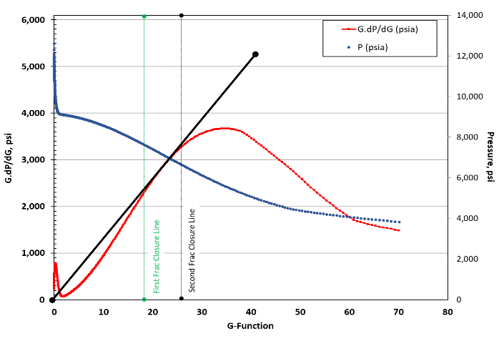
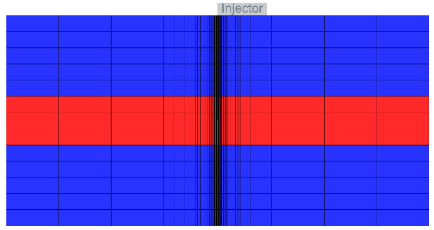
Geomechanics Coupled Reservoir Flow Simulation Different Formation Types
Formation Type 3: Height Recession
P_{c} from Bourdet plot is in excellent agreement with the input stress parameter
P_{c}=6,255 psi
First P_{c}=7,500 psi > SH_{MAX}
Second P_{c}=6,627 psi > SH_{MIN}
SH_{MIN}= 6,248
SH_{MAX}= 6,498
SH_{MIN}= 6,548
SH_{MAX}= 6,798
UNCONVENTIONAL RESERVOIR ENGINEERING PROJECT
9
Advisory Board Meeting, November 8, 2019, Golden, Colorado
Notes:
“Belly” below the straight line

Slide 10
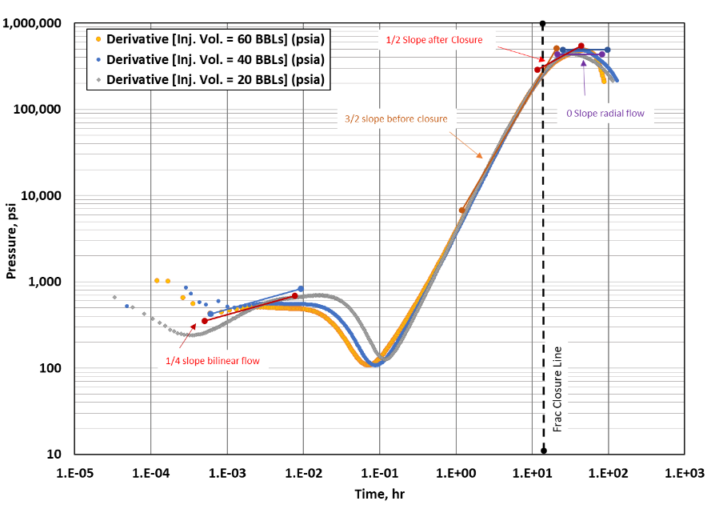
Geomechanics Coupled Reservoir Flow Simulation Injection Volume
Effect of Injection Volume on Observed Flow Regimes
Fixed permeability of 0.007 mD for matrix and fracture.
Injection volumes of 20 bbls, 40 bbls, and 60 bbls.
The time to reach linear flow is approximately equal for all cases;
Nonetheless, the period of the linear flow is dependent on the injection volumes.
Volumes increases linear flow period
UNCONVENTIONAL RESERVOIR ENGINEERING PROJECT
10
Advisory Board Meeting, November 8, 2019, Golden, Colorado
Notes:
The end of the 3/2-slope period coincides in all three cases, which indicates that time to closure is not a function of the injection volume.

Slide 11
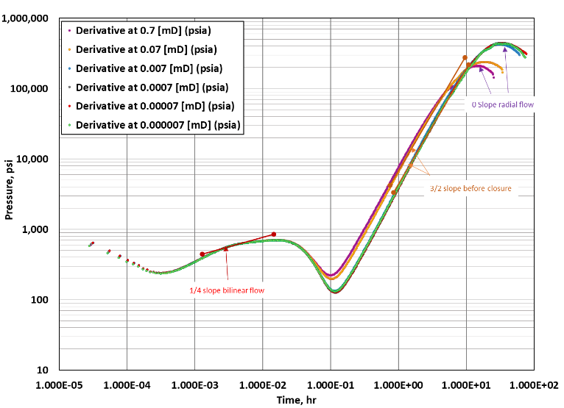
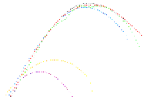
Geomechanics Coupled Reservoir Flow Simulation Matrix Permeability
Effect of System Permeability
Early time period: Identical for all cases → created fracture geometry is equal.
Transition period: Fluid transfer between matrix and fractures is dominant.
Late time period: For higher permeability formations, fracture closure can happen too quickly, and pseudoradial flow develop quickly after closure.
Macroscopic permeability ratio
κ $=\frac{k_{hf}}{k_{hf}+k_{m}}$
Increase κ
Early time
Transition region
Late time
UNCONVENTIONAL RESERVOIR ENGINEERING PROJECT
11
Advisory Board Meeting, November 8, 2019, Golden, Colorado
Notes:
since the injected volume is the same and constant stress parameters are used; hence,
As the matrix permeability decreases the macroscopic permeability ratio, κ , increases, and thus a bigger dip is observed.

Slide 12
Geomechanics Coupled Reservoir Flow Simulation
Conclusions
Pressure falloff from dual-porosity reservoir flow model coupled with geomechanics is responsive to the intensity of the secondary fractures.
G-Function plot can qualitatively identify the secondary fracture density.
Tangent method to determine $P_{c}$works well in homogenous formations.
The interpretations from G-function cannot solely describe reservoir properties, while Bourdet plot capture flow regimes and helps in characterization of the reservoir.
$t_{c}$is not a function of V_{injection}. However, the time needed for the pressure transient to reach pseudoradial flow is proportional to the V_{injection}.

