Slide 1
UNCONVENTIONAL RESERVOIR ENGINEERING PROJECT
Colorado School of Mines
U R E P
CSM
Research Summary
Characterization of HF Geometry and Conductivity using Post-Stage-Pressure-Decay (PSPD)
Mohamed Mohamed, Colorado School of Mines
UNCONVENTIONAL RESERVOIR ENGINEERING PROJECT
Advisory Board Meeting, November 8, 2019, Golden, Colorado

Slide 2
Characterization of HF using Post-Stage-Pressure-Decay Minifrac vs. Main Frac Analysis
Minifrac
Main Frac
100-300 ft
15-20 ft
UNCONVENTIONAL RESERVOIR ENGINEERING PROJECT
2
Advisory Board Meeting, November 8, 2019, Golden, Colorado

Slide 3
Characterization of HF using Post-Stage-Pressure-Decay Minifrac vs. Main Frac Analysis
Multistage
UNCONVENTIONAL RESERVOIR ENGINEERING PROJECT
3
Advisory Board Meeting, November 8, 2019, Golden, Colorado
Notes:
Minifrac falloff time range from 1 week to 2 weeks. Frac Treatment lasts for few minutes.

Slide 4
Characterization of HF using Post-Stage-Pressure-Decay Workflow Overview
Data Acquisition
-Pressure data are recorded at surface or BH at little or no cost.
-Makes this process Cost-effective
Data Processing
-Picking the falloff period at the end of stage pumping
-Cleaning and smoothing data points.
Log-Log
Diagnostic Plot
Investigation of flow regimes using Bourdet plot
Estimate Stage Properties
-Fracture dimensions
-Fracture conductivity.
-SRV calculations
Tie/Validate Analysis
-Build up
-Tracers
-Production logs
UNCONVENTIONAL RESERVOIR ENGINEERING PROJECT
4
Advisory Board Meeting, November 8, 2019, Golden, Colorado

Slide 5
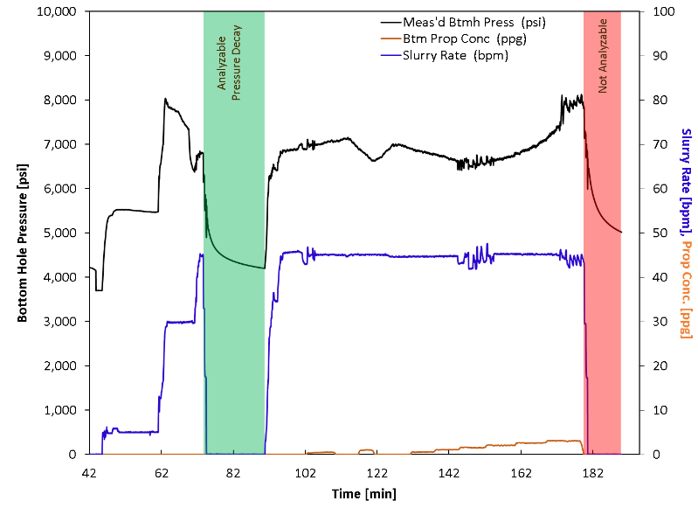
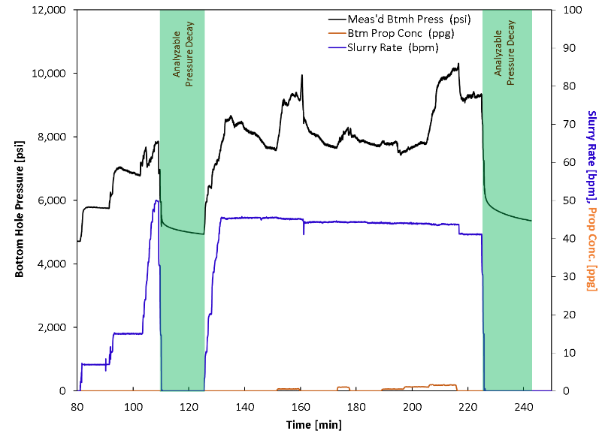
Characterization of HF using Post-Stage-Pressure-Decay Data Acquisition and Processing
Falloff after pumping of the pad
Short falloff period
Analyzable falloff period
fracture dimensions
fracture dimensions
fracture conductivity and skin
fracture conductivity and skin
UNCONVENTIONAL RESERVOIR ENGINEERING PROJECT
5
Advisory Board Meeting, November 8, 2019, Golden, Colorado
Notes:
Stage-by-stage basis

Slide 6
Characterization of HF using Post-Stage-Pressure-Decay Pressure Diagnostics
Taking advantage of Bourdet plot
Derivative of $∆p$with respect to logarithm of superposition time $\left(\frac{t_{p}+∆t}{∆t}\right)$
Matching Multi-Frac Horizontal Well (MFHW) analytical model
Constraints
Maximum → final stage ISIP
Minimum → P_{i} (minifrac)
Matching by varying
fracture half-length
fracture height
skin
fracture conductivity
UNCONVENTIONAL RESERVOIR ENGINEERING PROJECT
6
Advisory Board Meeting, November 8, 2019, Golden, Colorado

Slide 7
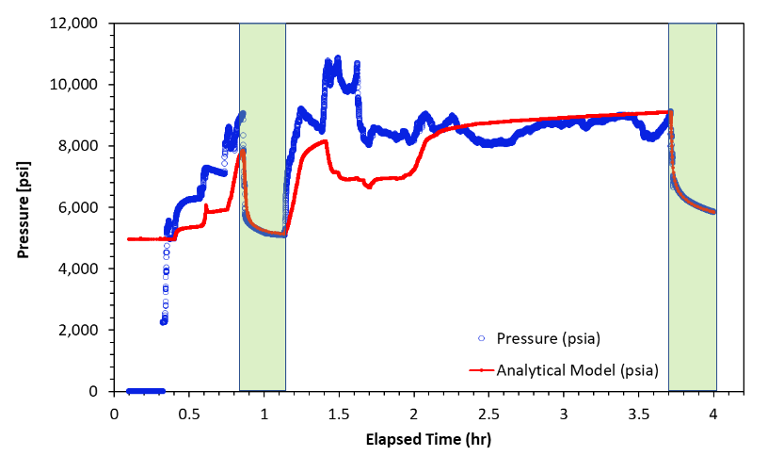
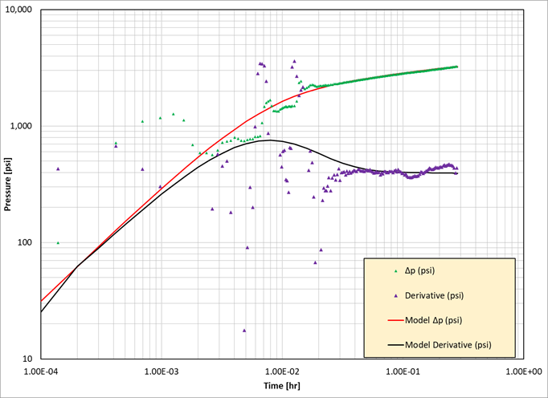
Characterization of HF using Post-Stage-Pressure-Decay Field Case 1
Post-Stage-Pressure-Decay is recorded for 18 minutes
Log-log diagnostic plot of pressure derivative and MFHW analytical model solution
Fracture half-length (ft.) | 50
Total stage fracture half-length (ft.) | 250
Fracture height (ft.) | 57
Fracture conductivity ($k_{f}w_{f}$) (mD.ft) | 141
SSRA (Acres) | 1.3
Skin | -1.69
Stage stimulated reservoir area
$$SSRA=4×n_{c}×x_{f}×h_{f}$$
Stage Analytical Model Solution Parameters
UNCONVENTIONAL RESERVOIR ENGINEERING PROJECT
7
Advisory Board Meeting, November 8, 2019, Golden, Colorado
7

Slide 8
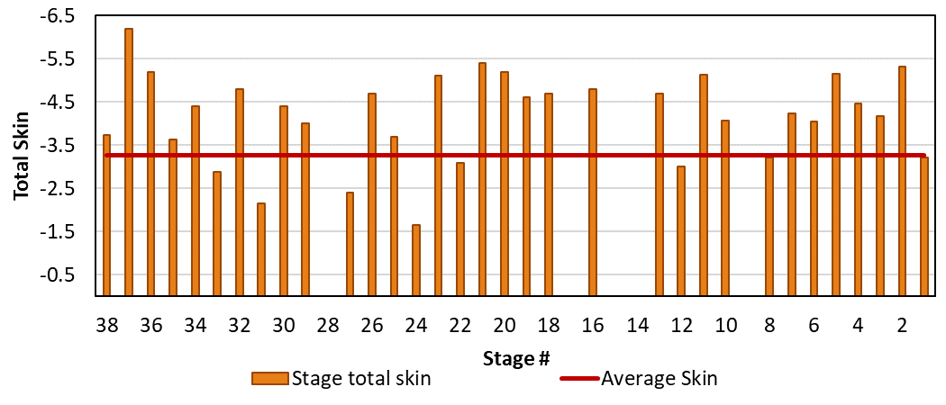
Characterization of HF using Post-Stage-Pressure-Decay Field Case 1
Calculated Skin
Average skin -3.5
UNCONVENTIONAL RESERVOIR ENGINEERING PROJECT
8
Advisory Board Meeting, November 8, 2019, Golden, Colorado

Slide 9
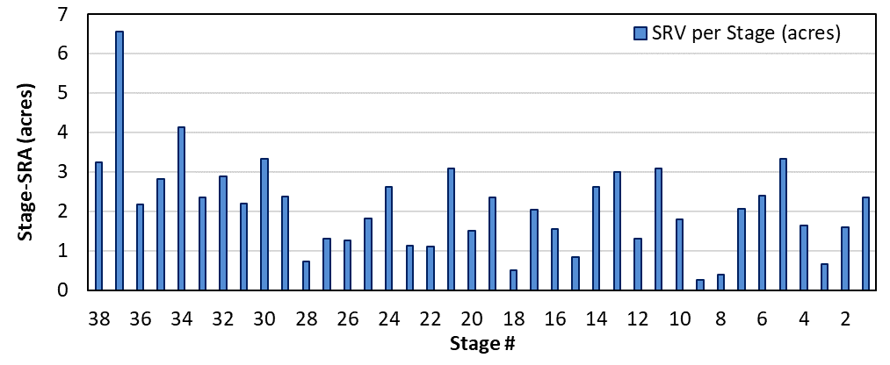
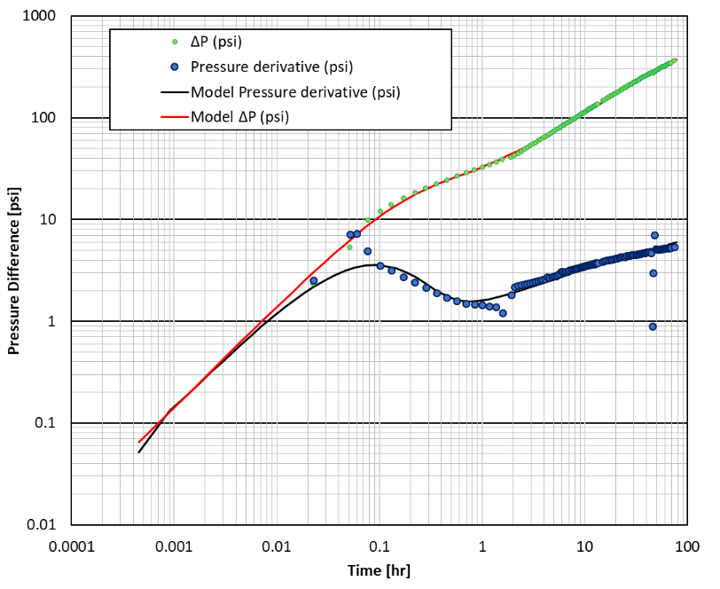
Characterization of HF using Post-Stage-Pressure-Decay Field Case 1
The total SRA = $\sum{SSRA}$ is estimated to be around 81 acres
Total stimulated reservoir area (SRA) = 61 acres
Approximately 25% shrinkage of SRA after roughly 3 weeks of production.
Pressure Build up Verification
SRA_{(Stage x Stage)} > SRA_{(Buildup)}
The SRA permeability = 0.001 md
Average hydraulic fracture half-length =288 ft.
UNCONVENTIONAL RESERVOIR ENGINEERING PROJECT
9
Advisory Board Meeting, November 8, 2019, Golden, Colorado
Notes:
Pressure Build up Verification
Bilinear and linear flow regimes are both detected,
Hydraulic fracture half-length = 288 ft.
SRA permeability = 0.001 md
Total stimulated reservoir area (SRA)
$SRA=4×n_{f}×x_{f}×h_{f}$ = 61 acres
Approximately 25% shrinkage of SRA after 3 weeks of production.
The fluid pressure in hydraulic fractures declines; consequently, the increased effective stress decreases the width of created hydraulic fractures held open with proppant, and the productivity of the well decreases as well.

Slide 10
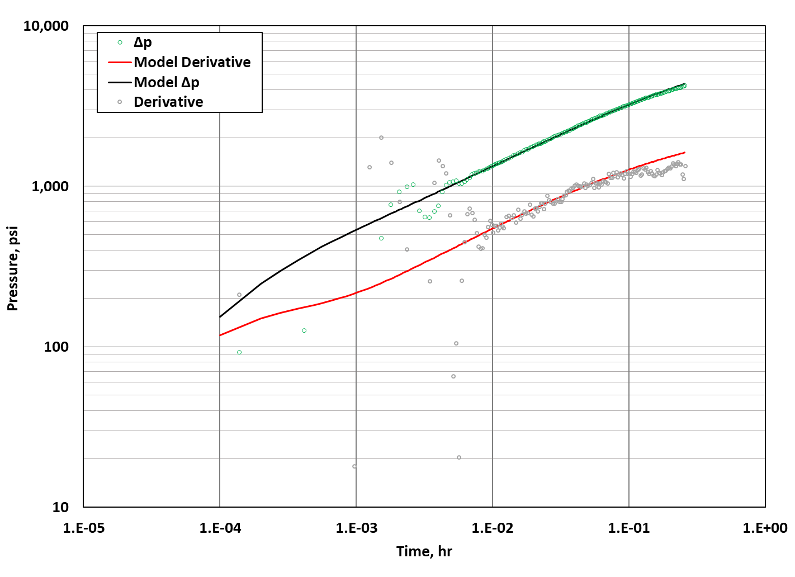
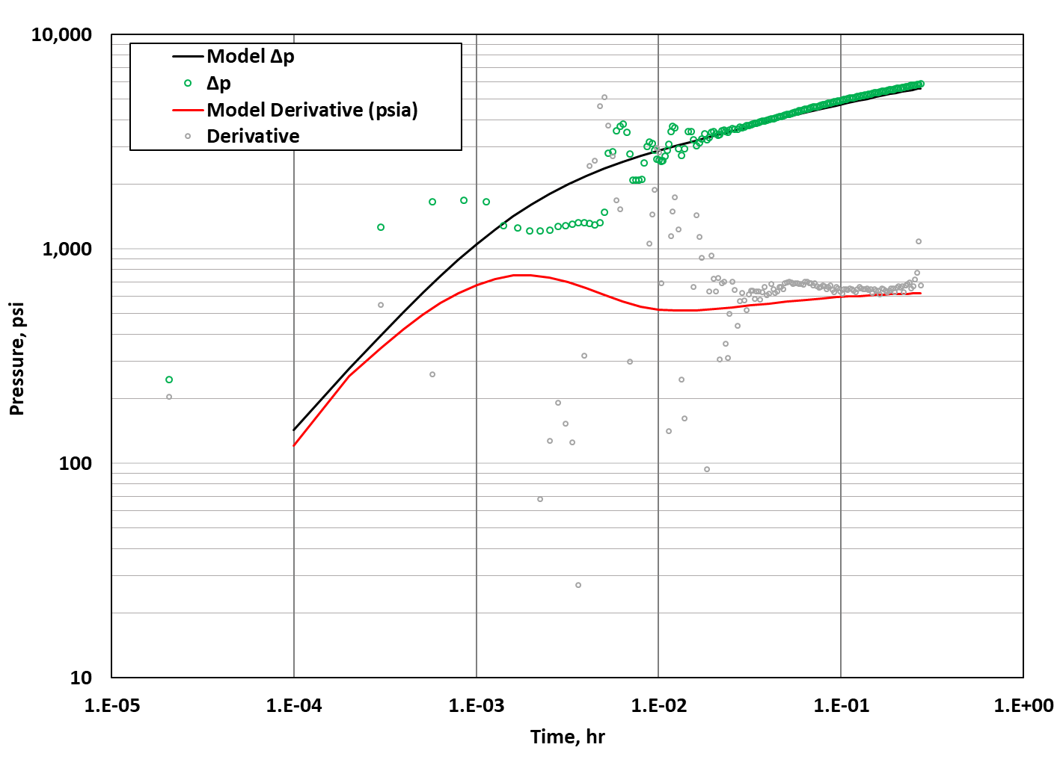
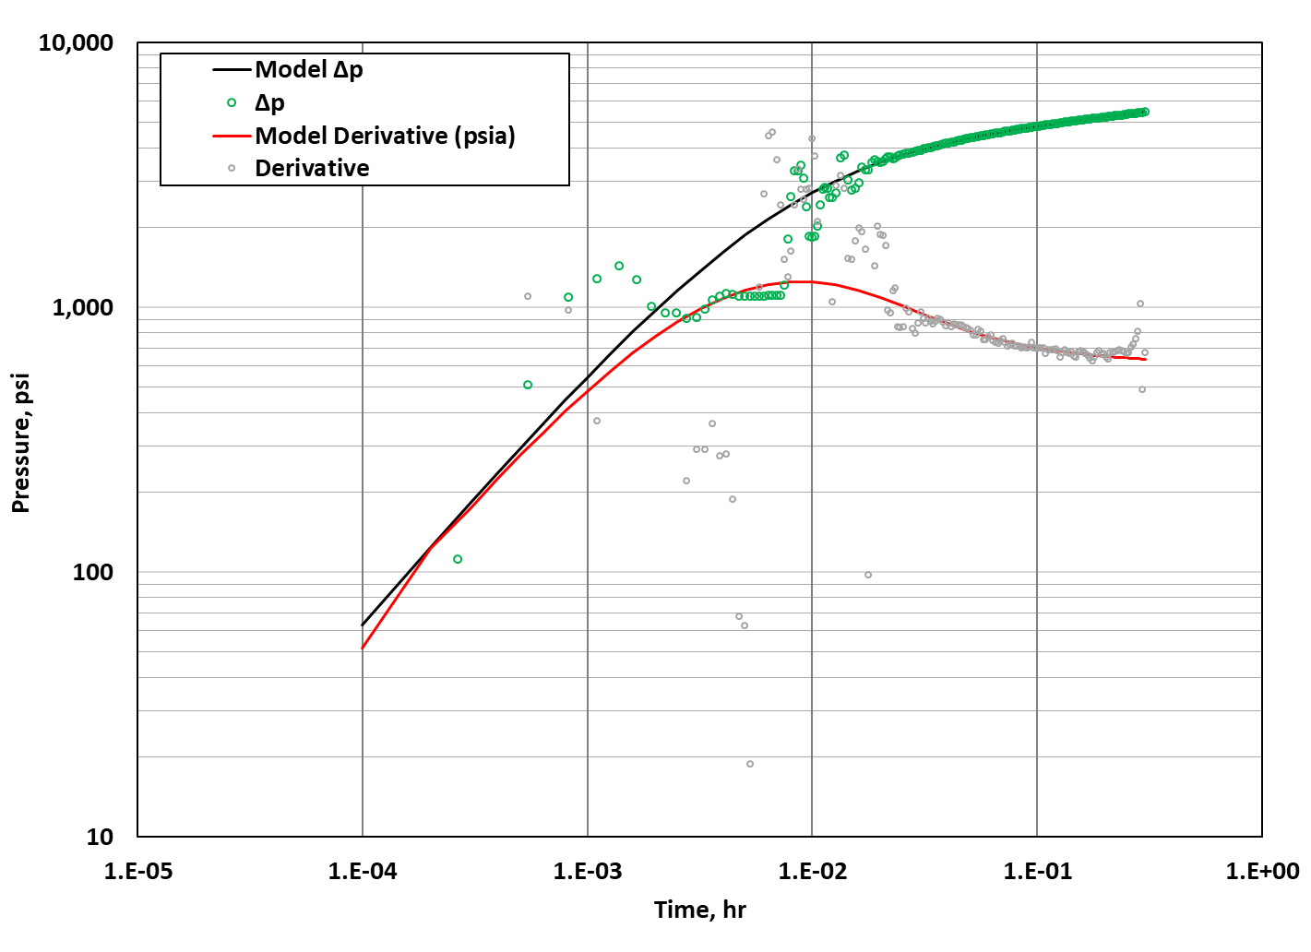
Characterization of HF using Post-Stage-Pressure-Decay Field Case 2
Log-log diagnostic plot of pressure derivative and MFHW analytical model solution
Log-log diagnostic plot of pressure derivative and MFHW analytical model solution
Fracture half-length (ft.) | 40
Number of Clusters $\left(n_{c}\right)$ | 3
Total stage fracture half-length (ft.) | 120
Fracture height $(h_{f})$ (ft.) | 150
Fracture conductivity ($k_{f}w_{f}$) (md.ft) | 5000
SRA (Acres) | 1.5
Skin | 0.02
Stage Analytical Model Solution Parameters
Stage Analytical Model Solution Parameterse
UNCONVENTIONAL RESERVOIR ENGINEERING PROJECT
10
Advisory Board Meeting, November 8, 2019, Golden, Colorado
10

Slide 11
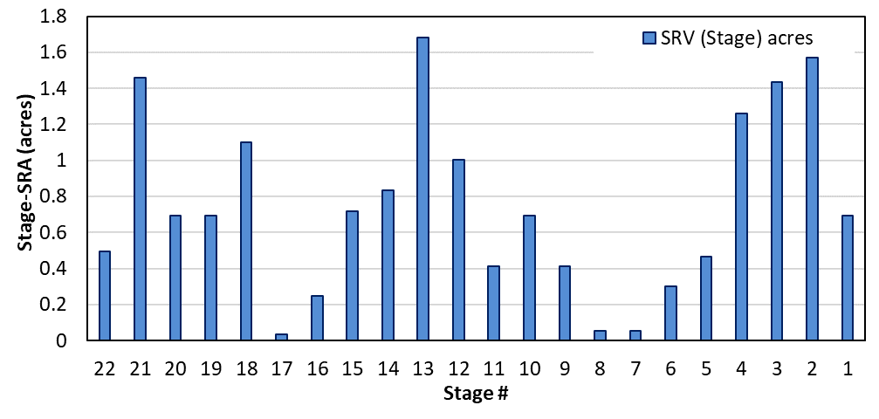
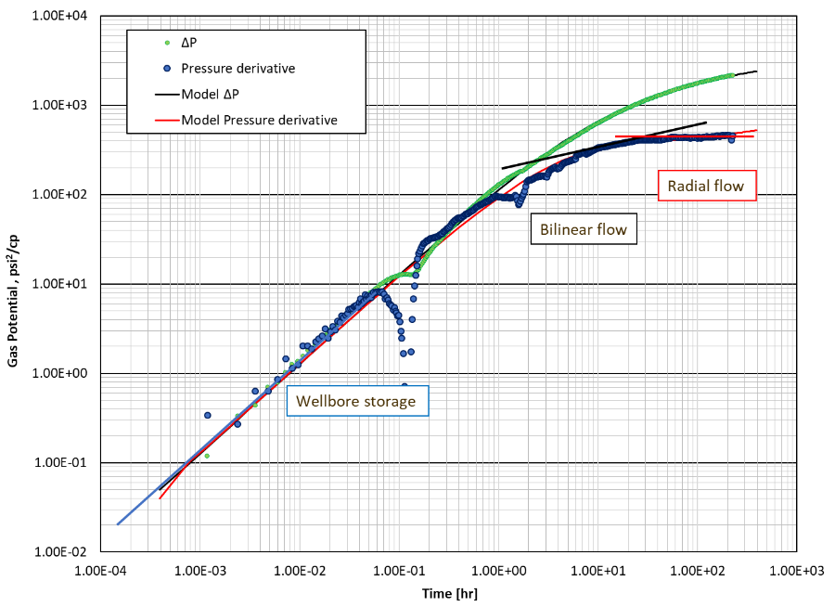
Characterization of HF using Post-Stage-Pressure-Decay Field Case 2
The total SRA = $\sum{SSRA}$ is estimated to be around 6.7 acres
Total stimulated reservoir area (SRA) = 5.4 acres
Approximately 20% shrinkage of SRA after roughly 3 weeks of production.
SRA_{(Stage x Stage)} > SRA_{(Buildup)}
UNCONVENTIONAL RESERVOIR ENGINEERING PROJECT
11
Advisory Board Meeting, November 8, 2019, Golden, Colorado

Slide 12
Conclusions
Post-Stage-Pressure-Decay was used to characterize hydraulically created fractures through automated workflow to allow operators to review, revise, and implement fracture design changes in near real-time.
Post-Stage-Pressure-Decay was used to characterize created fractures
$x_{f}$
Fracture conductivity
Skin
SRA obtained from buildup analysis provides a reasonably good match with SSRA calculated from PSPD.
A shrinkage of 20-25% of SRA is observed after a period of production
Indicates hydraulic fracture closures, possibly due to proppant crush or embedment.
UNCONVENTIONAL RESERVOIR ENGINEERING PROJECT
12
Advisory Board Meeting, November 8, 2019, Golden, Colorado
12
Notes:
Knowing an approximate $t_{c}$after pumping is crucial to minimize the delay in completions operations and for better planning

